Slide 1
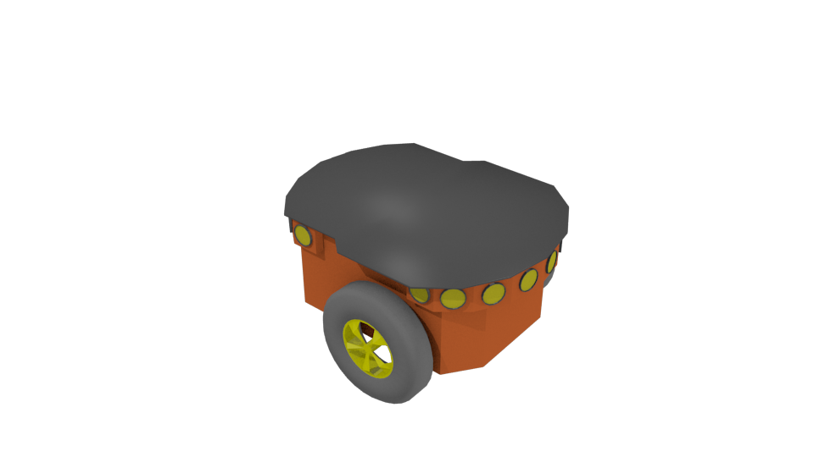
Communication Link
Target Estimation

