Slide 1
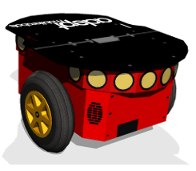
9.90m
6.37m

Slide 2
9.90m
6.37m

Slide 3
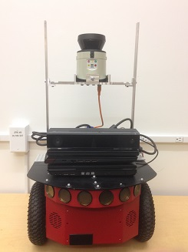
Lidar
DRGB camera
Sonar

Slide 4
Lidar
DRGB camera
9.09m
Sonar
6.37m

