Slide 1
STAT S460F Final Project
S12317290
CHIU Man Tsun

Slide 2
Introduction
Hong Kong always make an impression on high cost of living
Cost of Living Index by City 2020 --- NUMBEO
The largest cost of living database of the world
It compares the cost of basic necessities between 440 cities
Hong Kong is ranked 44th out of 440 cities in the world

Slide 3
Problem description
5 indexes of the basic necessities that relative to New York City(100)
Cost of Living Index(CLI)
Rent Index(RI)
Groceries Index(GI)
Restaurant Price Index(RPI)
Local Purchasing Power Index(LPPI)
Same city may contain a large gap between different index levels
What is the most related variable that correlated to a high cost of living?
Rank | City | CLI | RI | GI | RPI | LPPI
44 | Hong Kong | 77.22 | 79.57 | 75.94 | 54.36 | 65.32

Slide 4
Aims and Objectives
Choosing the best regression model:
Ridge regression
Lasso regression
Classification by using Support Vector Machines
Accuracy

Slide 5
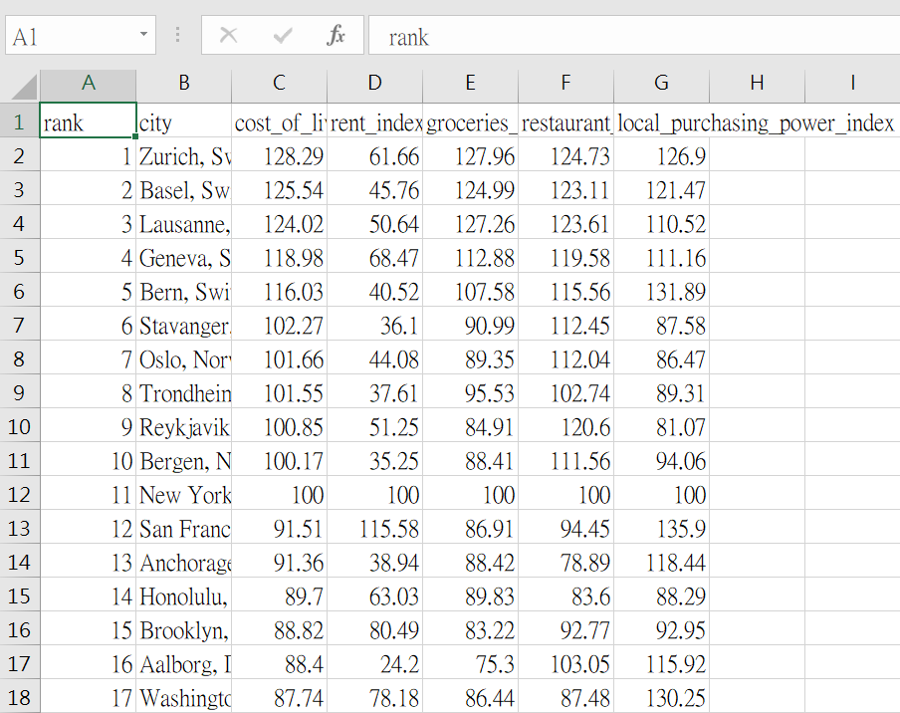
Data Description
440 observations
220 training data(50%)
220 testing data(50%)
Dependent Variable(Y):
Cost of Living Index
Independent Variables(X):
Rent Index[1]
Groceries Index[2]
Restaurant Price Index[3]
Local Purchasing Power Index[4]

Slide 6
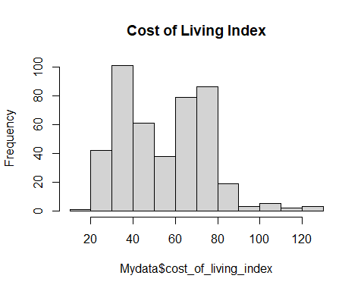
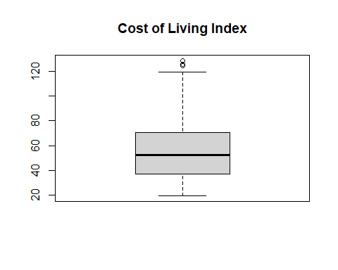
Cost of Living Index(Y)
summary(Mydata$cost_of_living_index)
## Min. 1st Qu. Median Mean 3rd Qu. Max. ## 19.77 37.09 52.45 54.82 70.67 128.29
hist(Mydata$cost_of_living_index, main="Cost of Living Index")
boxplot(Mydata$cost_of_living_index, main="Cost of Living Index")

Slide 7
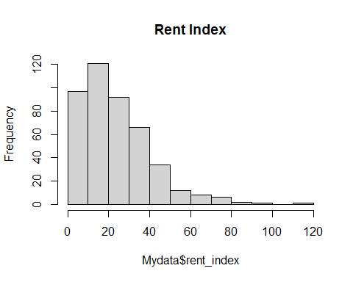
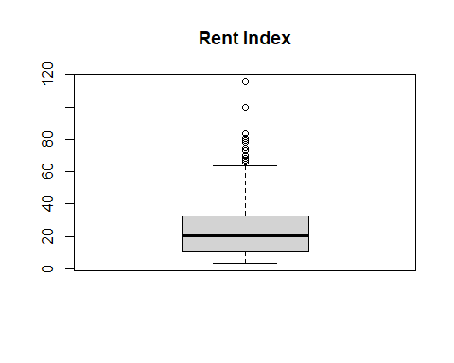
Rent Index(X1)
summary(Mydata$rent_index)
## Min. 1st Qu. Median Mean 3rd Qu. Max. ## 3.46 10.62 20.17 23.75 32.50 115.58
hist(Mydata$rent_index, main="Rent Index")
boxplot(Mydata$rent_index, main="Rent Index")

Slide 8
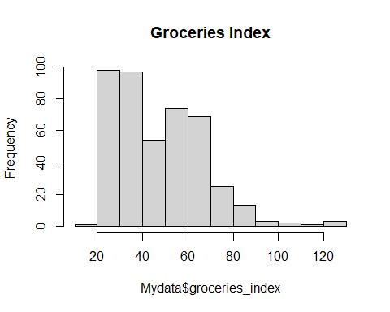
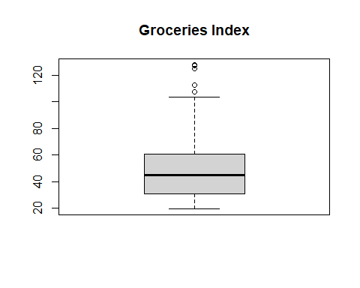
Groceries Index(X2)
summary(Mydata$groceries_index)
## Min. 1st Qu. Median Mean 3rd Qu. Max. ## 19.66 30.82 44.77 47.50 61.03 127.96
hist(Mydata$groceries_index, main="Groceries Index")
boxplot (Mydata$groceries_index, main="Groceries Index")

Slide 9
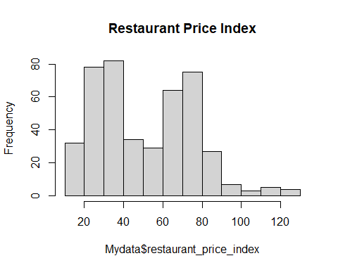
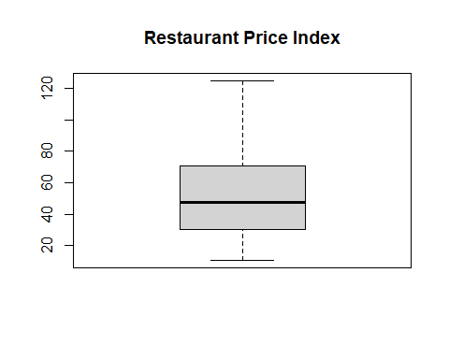
Restaurant Price Index(X3)
summary(Mydata$restaurant_price_index)
## Min. 1st Qu. Median Mean 3rd Qu. Max. ## 10.66 30.21 47.55 51.21 70.83 124.73
hist(Mydata$restaurant_price_index, main="Restaurant Price Index")
boxplot(Mydata$restaurant_price_index, main="Restaurant Price Index")

Slide 10
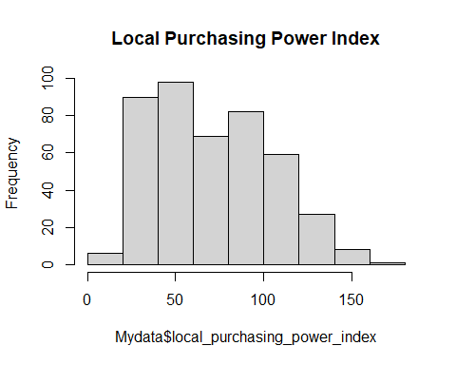
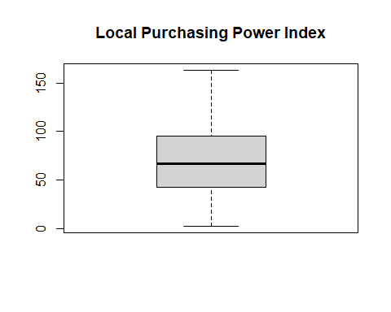
Local Purchasing Power Index(X4)
summary(Mydata$local_purchasing_power_index)
## Min. 1st Qu. Median Mean 3rd Qu. Max. ## 2.36 42.27 66.64 70.80 95.52 163.27
hist(Mydata$local_purchasing_power_index, main="Local Purchasing Power Index")
boxplot(Mydata$local_purchasing_power_index, main="Local Purchasing Power Index")

Slide 11
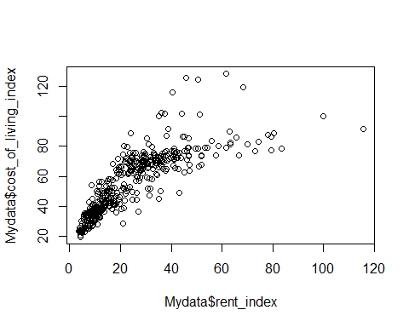
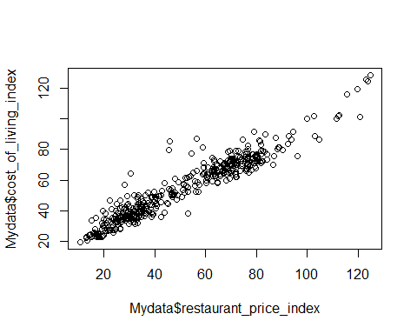
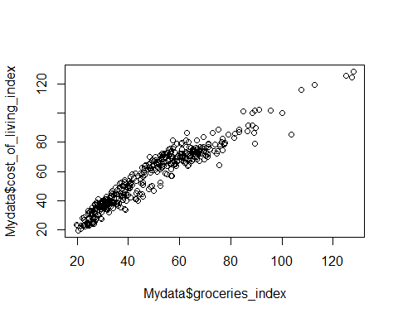
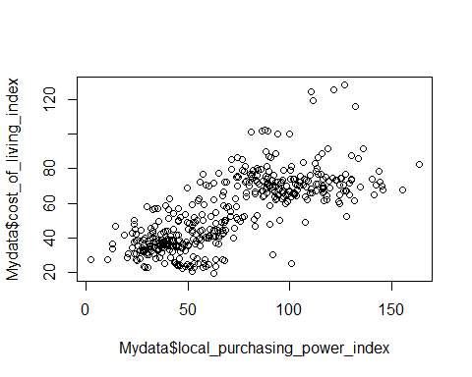
Correlation Plots
plot(Mydata$rent_index, Mydata$cost_of_living_index)
plot(Mydata$groceries_index, Mydata$cost_of_living_index)
plot(Mydata$restaurant_price_index, Mydata$cost_of_living_index)
plot(Mydata$local_purchasing_power_index, Mydata$cost_of_living_index)
cor(Mydata, Mydata$cost_of_living_index)
## [,1] ## cost_of_living_index 1.0000000 ## rent_index 0.8197904 ## groceries_index 0.9580292 ## restaurant_price_index 0.9560048 ## local_purchasing_power_index 0.7470956

Slide 12
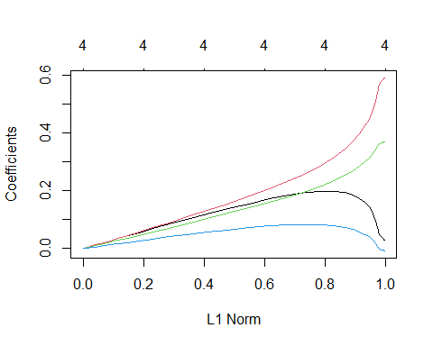
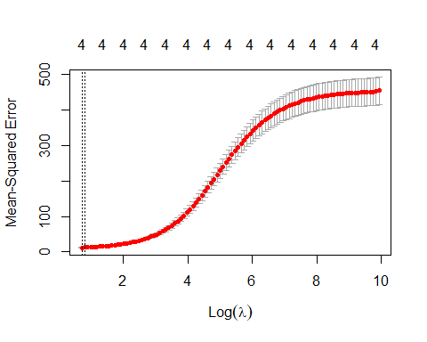
Ridge regression
cv.out = cv.glmnet(x_train, y_train, alpha = 0) bestlam = cv.out$lambda.min bestlam #Lambda
## [1] 2.054318
ridge_pred = predict(ridge_mod, s = bestlam, newx = x_test) mean((ridge_pred - y_test)^2) #Mean Square Error
## [1] 10.20564
out = glmnet(x, y, alpha = 0) predict(out, type = "coefficients", s = bestlam)[1:5,] #Coefficients
## (Intercept) rent_index ## 10.45411301 0.11222359 ## groceries_index restaurant_price_index ## 0.45631725 0.35561506 ## local_purchasing_power_index ## 0.02563671

Slide 13
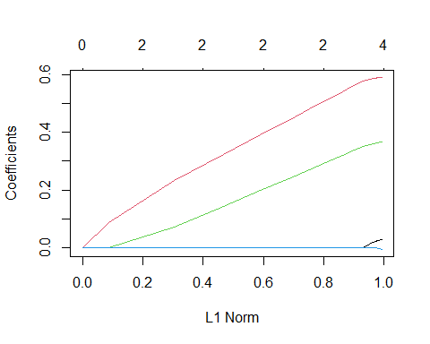
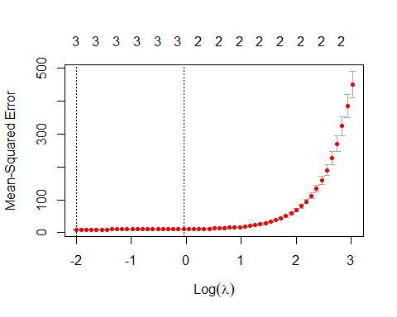
Lasso regression
cv.out = cv.glmnet(x_train, y_train, alpha = 1) bestlam = cv.out$lambda.min bestlam #Lambda
## [1] 0.1351604
lasso_pred = predict(lasso_mod, s = bestlam, newx = x_test) mean((lasso_pred - y_test)^2) #Mean Square Error
## [1] 8.659229
out = glmnet(x, y, alpha = 1, lambda = grid) predict(out, type = "coefficients", s = bestlam)[1:5,] #Coefficients
## (Intercept) rent_index ## 8.02422234 0.01370848 ## groceries_index restaurant_price_index ## 0.53571452 0.41054321 ## local_purchasing_power_index ## 0.00000000

Slide 14
Model Comparison
Ridge regression
λ = 2.054318
MSE = 10.20564
0 dimension is reduced
Lasso regression
λ = 0.1351604
MSE = 8.659229
1 dimension is reduced
The MSE of Lasso regression is lower than Ridge regression.
Lasso regression will obtain a better performance.

Slide 15
Support Vector Machines
Pick X2 and X3 as the as the variables for SVM
The range of Cost-of-Living-Index:
19.77 <-> 128.29
Split the range in 3 equal size by 56 and 92
Low: below 56
Medium: above or equal to 56 and below 92
High: above or equal to 92
Rank | City | CLI
1 | Zurich, Switzerland | 128.29
… | … | …
440 | Thiruvananthapuram, India | 19.77

Slide 16
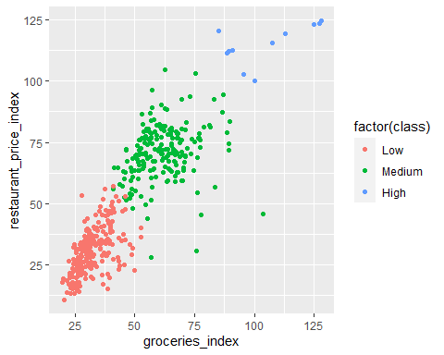
Dataset of SVM
groceries_index = data$groceries_index restaurant_price_index = data$restaurant_price_index class = cut(data$cost_of_living_index, c(0, 56, 92, Inf), labels = c("Low","Medium","High")) Newdata = data.frame(+groceries_index, +restaurant_price_index) ggplot(data.frame(data), aes(groceries_index, restaurant_price_index, colour = factor(class)))+ geom_point()

Slide 17
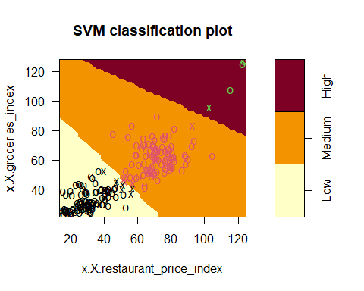
Ten-fold Cross Validation
set.seed(1) tune_out = tune(svm, class~., data=train_newdata, kernel="linear", ranges=list(cost=c(0.1, 1, 5, 10, 100))) summary(tune_out)
## ## Parameter tuning of 'svm': ## ## - sampling method: 10-fold cross validation ## ## - best parameters: ## cost ## 5 ## ## - best performance: 0.009090909 ## ## - Detailed performance results: ## cost error dispersion ## 1 0.1 0.013636364 0.03067948 ## 2 1.0 0.013636364 0.02195663 ## 3 5.0 0.009090909 0.01916532 ## 4 10.0 0.009090909 0.01916532 ## 5 100.0 0.013636364 0.02195663

Slide 18
Prediction
class_pred = predict(bestmod, test_newdata) table = table(predicted=class_pred, true=test_newdata$class) accuracy = (((table[1,1]+ table[2,2]+ table[3,3]))/ count(test_newdata)) table
## true ## predicted Low Medium High ## Low 117 1 0 ## Medium 1 95 0 ## High 0 0 6
accuracy #Accuracy
## n ## 1 0.9909091

Slide 19
Conclusions
Lasso regression is more suitable than Ridge regression for this dataset.
Y = 8.02422234 + 0.01370848(X1) + 0.53571452(X2) + 0.41054321(X3)
SVM can provide a high accuracy classification of Cost-of-Living-Index by using Restaurant-Price-Index and Groceries-Index.
Accuracy = 99.09%

Slide 20
Limitations
The dataset does not cover all cities in the world
Only 4 variables may not represent all costs of basic necessities
The indexes may only shows an approximate result

Slide 21
Recommendations
The price of groceries and restaurant should be control in order to reduce the cost of citizens living in that city.

Slide 22
References
Cost of Living Index by City 2020 (2020). Numbeo. Retrieved from https://www.numbeo.com/cost-of-living/rankings.jsp?title=2020

Slide 23
The End

