Slide 1
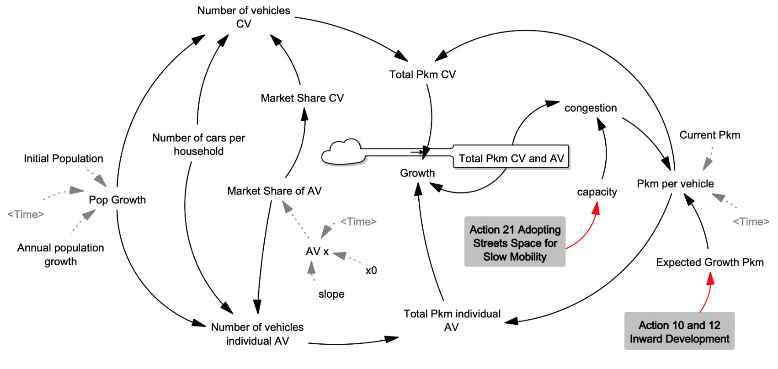
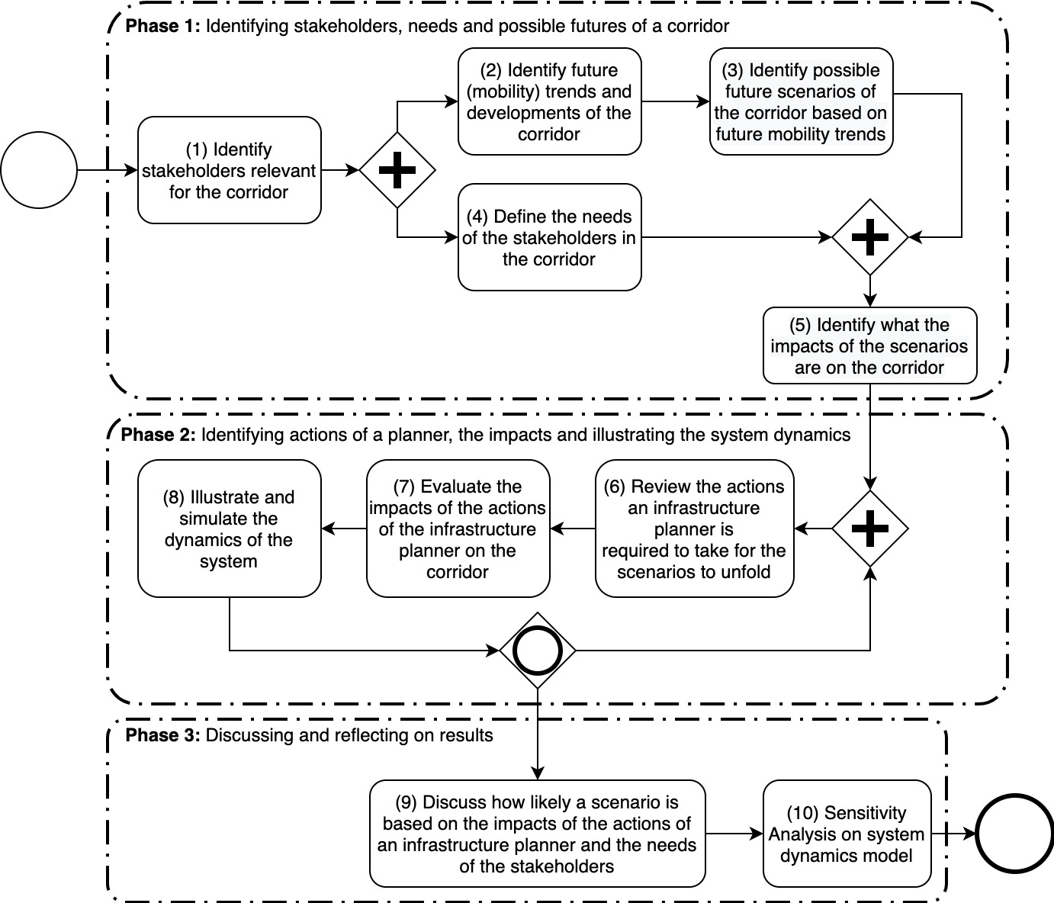


Master Thesis
Title title title title: Subtitle subtitle
  Author: Firstname Lastname
  Supervision: Prof. Dr. Firstname Lastname, Dr. Firstname Lastname
  Date:
1 Motivation
3 Case Study
Remember to have your font small enough to fit everything but big enough so that people can still read your poster.
Add images that allow a reader to get a quick overview of your methods and/or results.
Avoid a wall of text.
Less is more.
Figure 2: System dynamics model of the corridor illustrated in Vensim®.
2 Method Overview
4 Results
Corridor planning guidelines are often used to guide planners. However, current guidelines in practice do not provide sufficient knowledge on how to answer these research questions for a corridor. Hence the following tool (methodology) is proposed.
The actions.
5 References
References
Fig. 1: Illustration of the methodology proposed using business process modelling notation.

