Slide 1


The Olympics
By Jeffrey Parsons and Daisy McClellan

Slide 2
Project Overview
For this project we chose a dataset of different athletes that competed in the past Olympic games, as well as information about them. The information included things such as the athlete’s team, sex, age, height, weight, and the event they competed in. Of course, it also included whether the athlete won a medal or not.
The basis of our data warehouse hinged on being able to use these metrics to compare each athlete, and the event they competed in, with others to see if there were any trends that could provide any insight to how an athlete would perform.
The dimensions we settled on were events, athlete, games, medals, and teams. Based off these dimensions each unique value or combination was assigned an ID. These ids were then used to replace the original data for each row to create the fact table.

Slide 3
The Data Set
The data set we chose is titled “120 Years of Olympic History: Athletes and Results”.
It can be found at: https://www.kaggle.com/heesoo37/120-years-of-olympic-history-athletes-and-results
The original author states that the dataset is a “historical dataset on the modern Olympic Games, including all Games from Athens 1896 to Rio 2016” (Rgriffin, 2018).

Slide 4
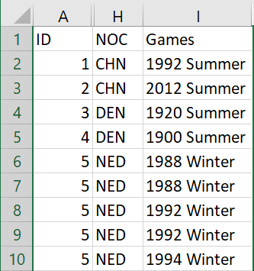
Data Cleansing
The first step in the data cleansing process was to remove any of the columns in the original dataset that were not required for our analysis.
These columns included the id, NOC, and Games columns. The Games column held information that was already in the other columns.
Due to this we felt that it was redundant to include it in our cleansed data.

Slide 5
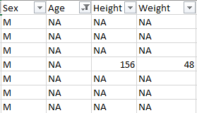
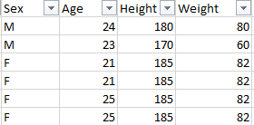
Data Cleansing
After this, we ran into a few issues with null, or NA, values in the Age, Height, and Weight columns.
Since this would ruin our analysis based on these points, we removed any records where these values were null.
Before Cleansing
After Cleansing

Slide 6
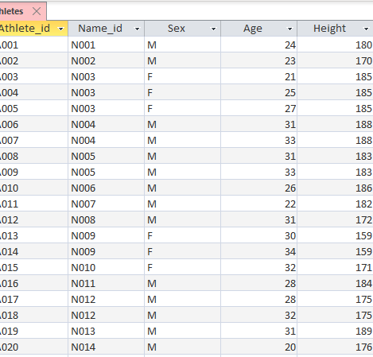
Athlete Dimension
Attributes:
Athlete_id (pk)
Name_id (fk)
Sex
Age
Height
Weight

Slide 7
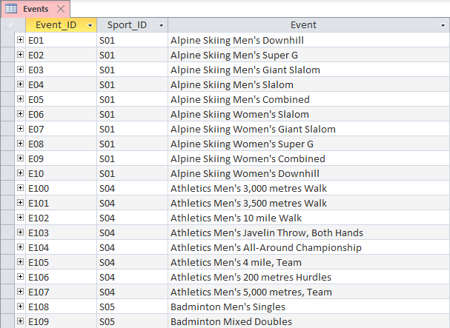
Event Dimension
Attributes:
Event_ID (pk)
Sport_ID (fk)
Event

Slide 8
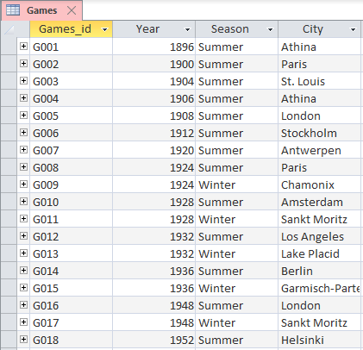
Games Dimension
Attributes:
Games_id (pk)
Year
Season
City

Slide 9
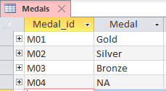
Medals Dimension
Attributes:
Medal_Id (pk)
Medal

Slide 10
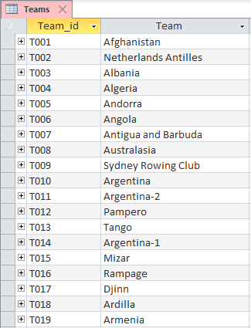
Teams Dimension
Attributes:
Team_id (pk)
Team

Slide 11
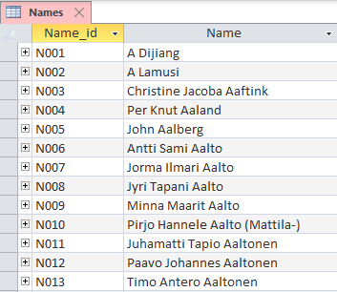
Names Table
Attributes:
Name_id (pk)
Name

Slide 12
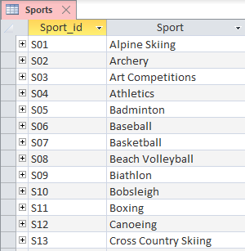
Sports Table
Attributes:
Sport_id (pk)
Sport

Slide 13
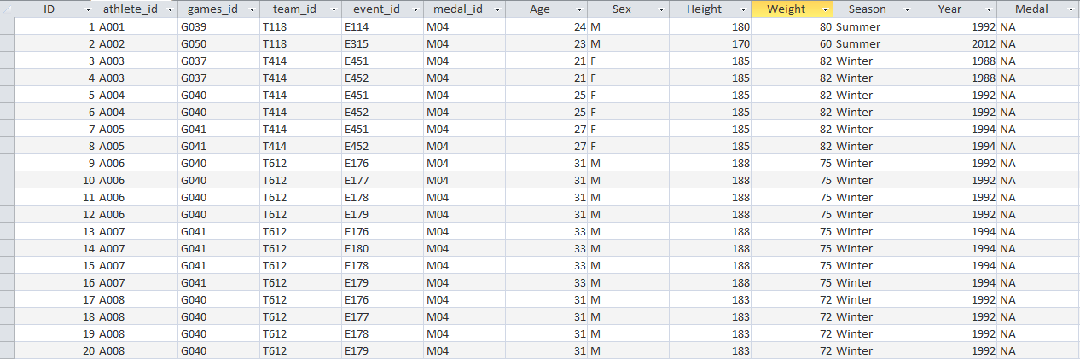
Fact Table
Attributes:
ID (pk)
Athlete_id (fk)
Team_id (fk)
Games_id (fk)
Event_id (fk)
Medal_id (fk)
Age (fact)
Sex (fact)
Height (fact)
Weight (fact)
Season (fact)
Year (fact)
Medal (fact)

Slide 14
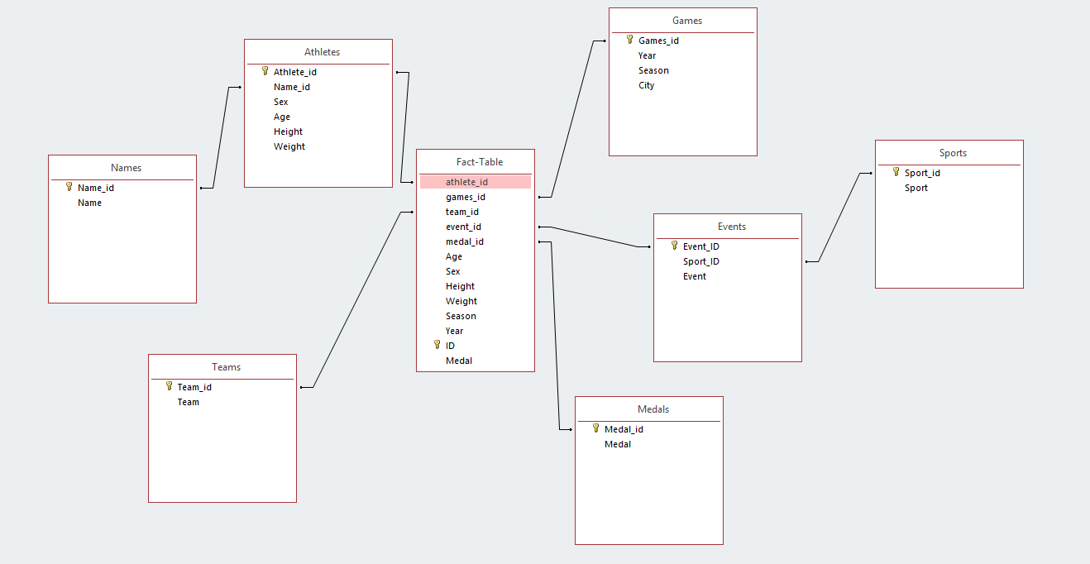
ERD

Slide 15
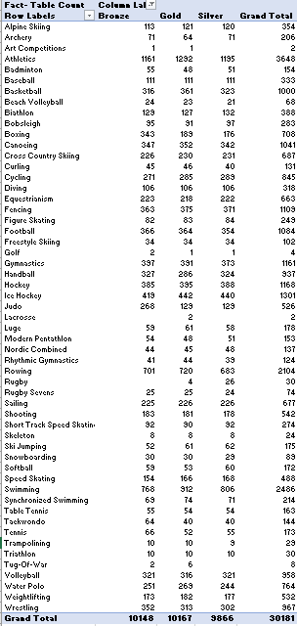
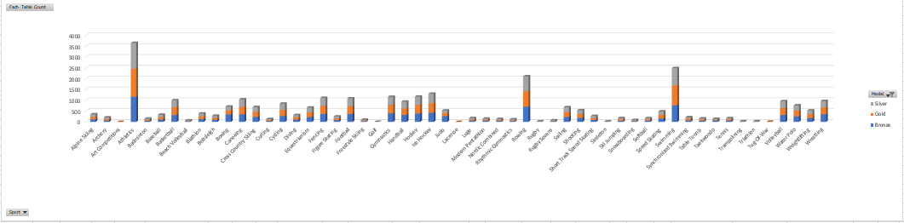
Medals Won by Event
This report views the number of Gold, Silver and Bronze medals award by Event over the life of the Olympic Games

Slide 16
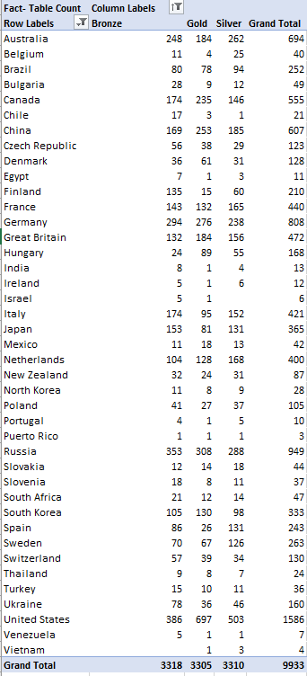
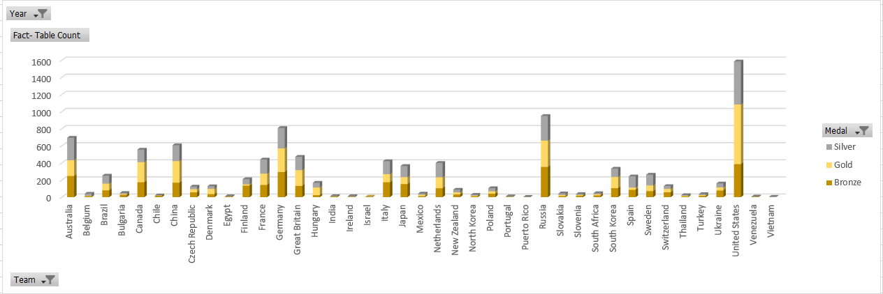
Medals Won by Country
This report shows the number of Gold, Silver and bronze medals awarded to certain countries over the life of the Olympic Games

Slide 17
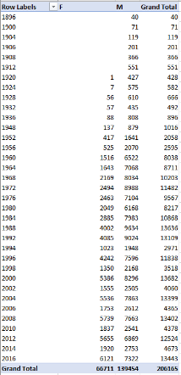
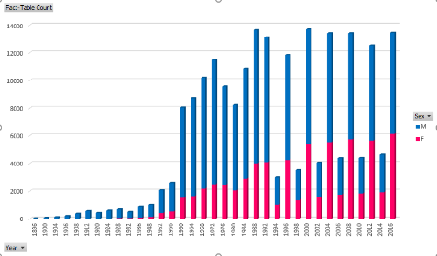
Medals Won by Gender
This report shows the distribution of medals awarded by gender through the life of the Olympic Games

Slide 18
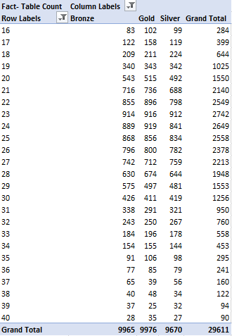
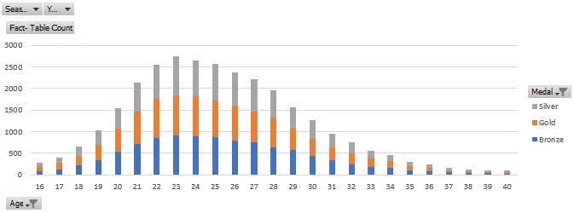
Medals Won by Age
This report shows the number of Gold, Silver and Bronze medals won by athletes from ages 16 to 40.

Slide 19
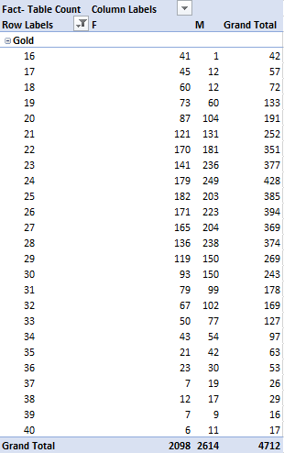
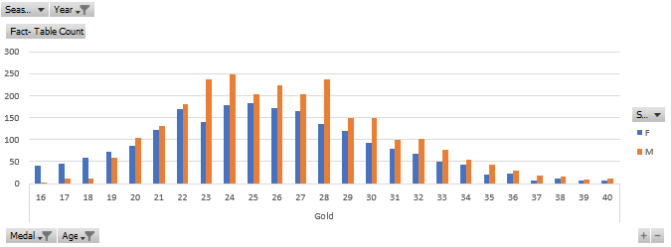
Gold Medals by Age and Gender
This report looks at the number of gold medals awarded based on gender and age. The timetable for this graph is for Olympic Games that took place on or after 1994.

Slide 20
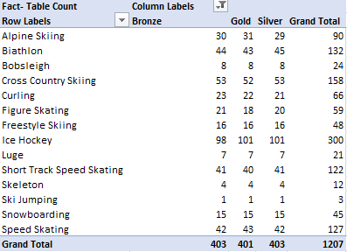
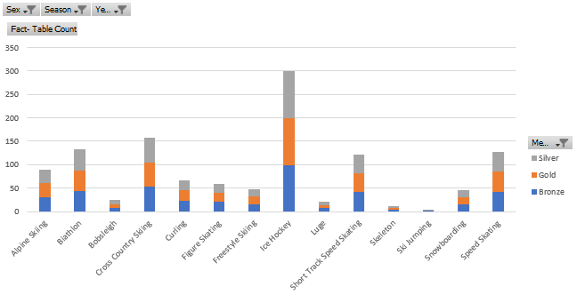
Medals won by Women in the Winter Olympics
This report shows which events women earn the most medals in during the Winter Olympics

Slide 21
Conclusion
We learned that women didn’t start to compete in the Olympics until 1920. It also appears that there are significantly less athletes that compete in the Winter Olympics when compared to the Summer Olympics.
When looking at the medal distribution across different sports we saw that the sports that have been in the Olympics since the beginning, such as Athletics and team-based events, have the highest medals earned.
We also learned that the United States is the winningest team in the Olympics when looking at total medal count.
The data shows that the ideal age for winning a medal of any kind was anywhere from 22 – 25 years old, with 23 being the age with the most medals won. When looking at just gold medal winners’ ages by gender, we found that the results were slightly different, but still very similar. The age with the most gold medals for males was 24, and 25 years old for females.

Slide 22
References

