Slide 1

STORE SALES Time series forecasting
Case Study: Favorita Stores, Ecuador

Slide 2
Outline
Introduction
Execution Process
Exploratory Data Analysis
Data Cleaning & Visualizations
Feature Engineering
Algorithm Selection
Hyperparameter Tuning
Evaluation Metric
Conclusion

Slide 3
Introduction
Time Series measures how things change over time
Building Machine Learning (ML) Models with time series data is often time consuming and complex
Build Time Series Forecasting Model to predict product sales for Favorita Stores in Ecuador

Slide 4
Execution Process
Exploratory Data Analysis
Data Cleaning and Visualization
Algorithm Selection & Hyperparameter Tuning
Evaluation Metrics
Feature Engineering

Slide 5

Exploratory Data Analysis Understanding the data
There are 54 stores located in 16 states of Ecuador
Favorita stores sell products from within 33 product families
The Highest sales are made in December, and on Sundays

Slide 6

Cleaning the Data
Check for missing values, duplicates and outliers in the dataset
43 Missing values in oils data.
Linear Intrapolation
Missing values are imputed with linear intrapolation

Slide 7
Feature Engineering
There is a significant positive correlation between the sales and transaction data
Ecuador is an oil-dependent country hence a higher oil price reduces the sales at Favorita

Slide 8
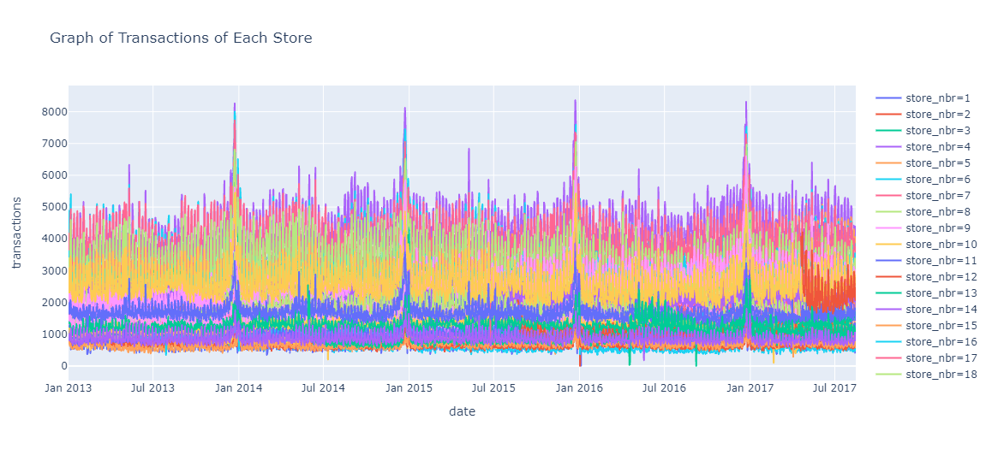
Data Visualization​

Slide 9
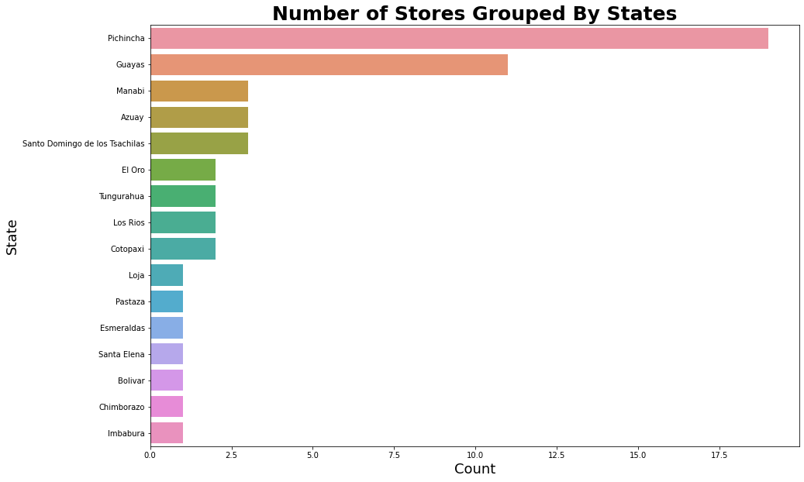
Data Visualization​

Slide 10
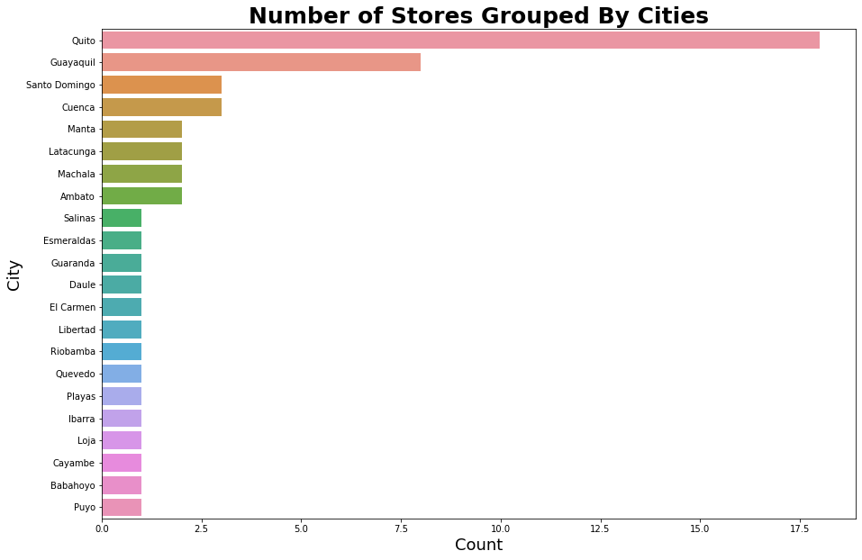

Slide 11
Further Analysis
To accurately improve the model, the holidays and events data can be split logically, although an arduous task, to create new features.
A better quality Oil Dataset can also be used to better improve the model, as research shows the status of the Ecuador economy depends on oil prices

Slide 12

Thank You

