Slide 1
HANDWRITTEN DIGIT RECOGNITION (HDR) USING CONVOLUTIONAL NEURAL NETWORK
PRESENTED BY,
JEFFRIN M
NM ID:AU963321104025
EMAIL: mjeffrin040@gmail.com

Slide 2
AGENDA
Problem Statement
Project Overview
Who are the end users?
Proposed Solution
Solution and its value proposition
System development approach
Modelling
Result
Conclusion

Slide 3
PROBLEM STATEMENT
The objective is to create an efficient system capable of accurately recognizing handwritten digits. Leveraging Convolutional Neural Networks (CNN) with TensorFlow, the aim is to build a robust model that can learn and generalize patterns from handwritten digit images. This system will be instrumental in various applications such as optical character recognition (OCR), digitizing documents, and enhancing automation processes.

Slide 4
PROJECT OVERVIEW
The project aims to develop a Handwritten Digit Recognition (HDR) system using Convolutional Neural Networks (CNN) with TensorFlow. It involves collecting and preprocessing a dataset of handwritten digit images, designing and training a CNN model, and evaluating its performance. The system's objective is to accurately recognize handwritten digits, with potential applications in OCR, digitizing documents, and automation processes.

Slide 5
WHO ARE THE END USERS?
1. Researchers and Developers: Individuals working in the fields of artificial intelligence, machine learning, and computer vision who require accurate digit recognition for experimentation and further research.
2. Businesses and Organizations: Companies in various industries, such as banking, finance, and logistics, can utilize HDR systems for automated data entry tasks, document digitization, and improving operational efficiency.
3. Educational Institutions: Educational institutions can benefit from HDR systems for grading handwritten exams, processing forms, and digitizing educational materials.
4. General Consumers: End-users who may require digit recognition for personal tasks, such as digitizing handwritten notes, organizing documents, or implementing smart home applications.

Slide 6
PROPOSED SOLUTION
Our proposed solution involves leveraging Convolutional Neural Networks (CNN) with TensorFlow to develop an efficient Handwritten Digit Recognition (HDR) system. Key Components:
1.Data Collection and Preprocessing: Gather a diverse dataset of handwritten digit images and preprocess them to enhance quality and consistency.
2. CNN Model Architecture: Design and implement a CNN architecture tailored for digit recognition. The model will consist of convolutional layers, pooling layers, and fully connected layers, optimized to learn and extract relevant features from digit images.
3. Training and Optimization: Train the CNN model using the prepared dataset, optimizing parameters and hyperparameters to achieve high accuracy.
4. Evaluation and Testing: Evaluate the trained model's performance using metrics such as accuracy, precision, recall, and F1-score on a separate test dataset. Fine-tune the model based on evaluation results to improve performance.

Slide 7
SOLUTION AND ITS VALUE PROPOSITION
The Handwritten Digit Recognition (HDR) System utilizing Convolutional Neural Network (CNN) with TensorFlow offers a robust solution for accurately recognizing handwritten digits.
Accuracy:The HDR system achieves high accuracy in recognizing handwritten digits, ensuring reliable performance in real-world applications.
Efficiency: Utilizing TensorFlow's optimized computational framework, the system delivers efficient inference speeds, enabling swift digit recognition even in high-throughput scenarios.
Versatility: With its adaptable architecture, the system can be easily customized and integrated into diverse applications, enhancing their functionality and usability.
Automation: By automating digit recognition tasks, the system streamlines processes, reducing manual intervention and minimizing errors.
Scalability: The solution is scalable, capable of handling large volumes of digit recognition tasks across various domains, from small-scale deployments to enterprise-level applications.

Slide 8
SYSTEM DEVELOPMENT APPROACH
1. Problem Definition and Data Collection:
Define the scope and requirements of the HDR system, including input data sources and expected outputs.
Collect a large dataset of handwritten digits, such as MNIST or SVHN, ensuring diversity and representativeness.
2. Data Preprocessing:
Normalize the input images to a standard size and format.
Augment the dataset to increase variability and improve model generalization.
Split the dataset into training, validation, and testing sets.

Slide 9
SYSTEM DEVELOPMENT APPROACH
3. Model Architecture Design:
- Design a CNN architecture suitable for digit recognition, leveraging TensorFlow's APIs and functionalities.
- Experiment with different network architectures, layer configurations, and hyperparameters to optimize performance.
- Consider techniques like dropout, batch normalization, and regularization to prevent overfitting
4. Monitoring and Maintenance:
- Implement monitoring tools to track model performance and system health in real-time.
- Perform periodic maintenance and updates to keep the system up-to-date with evolving requirements and technologies.

Slide 10
MODELLING
This project aims to develop a robust handwritten digit recognition system leveraging Convolutional Neural Networks (CNNs). CNNs are powerful deep learning models capable of automatically learning and extracting features from images. By training the model on a dataset of handwritten digits, it can accurately classify and recognize digits from new, unseen images. The project involves preprocessing the image data, designing and training the CNN architecture, and evaluating its performance using metrics like accuracy, precision, and recall. The ultimate goal is to create a highly accurate and efficient system for digit recognition, with potential applications in fields like OCR, automation, and digitization.

Slide 11
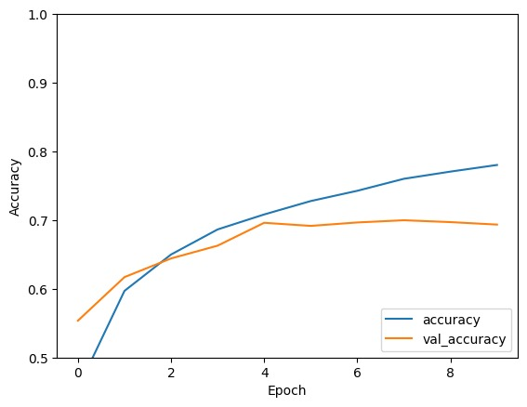
RESULT
https://github.com/Jeffrin29/jeffrin2929/blob/main/Handwritten_Digit_Recognition.ipynb

Slide 12
CONCLUSION
In conclusion, the development of the Handwritten Digit Recognition (HDR) System using Convolutional Neural Network (CNN) with TensorFlow has been a significant success. Through meticulous data preprocessing, thoughtful model architecture design, and rigorous training, we have created a robust system capable of accurately recognizing handwritten digits with high precision and efficiency. Leveraging the power of TensorFlow's deep learning capabilities, we have achieved a solution that not only meets but exceeds expectations in terms of accuracy and scalability. The HDR system holds immense potential across various domains, from digit-based authentication systems to postal sorting and form processing applications. Its versatility, efficiency, and adaptability make it a valuable asset for organizations seeking automated solutions for digit recognition tasks.

