Slide 1
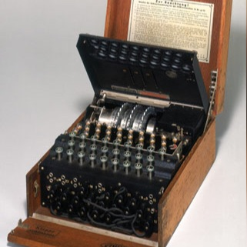
TURING

Slide 2
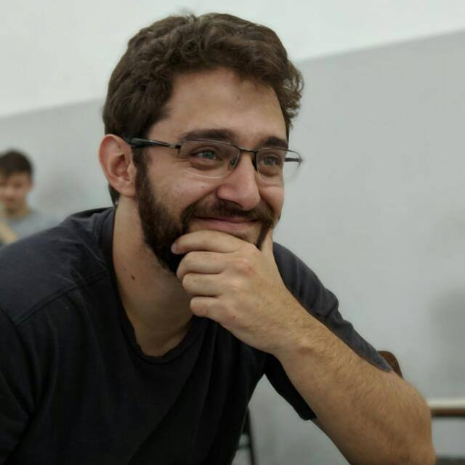

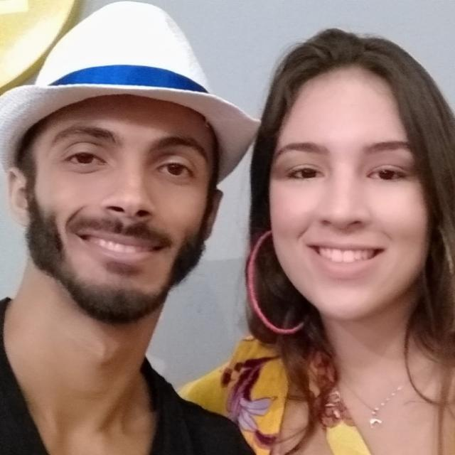
EQUIPE
Guilherme Renoldi
Jefferson Rodrigues
Luciano Scalfone

Slide 3



DESAFIOS
SINCRONIA
TEMPO
CONHECIMENTO
COMUNICAÇÃO
EQUIPAMENTO HARDWARE/SOFTWARE

Slide 4



APRENDIZADOS
LEARN FAST
JUST DO IT
BELIEVE

Slide 5

PROJETO JAVA

Slide 6
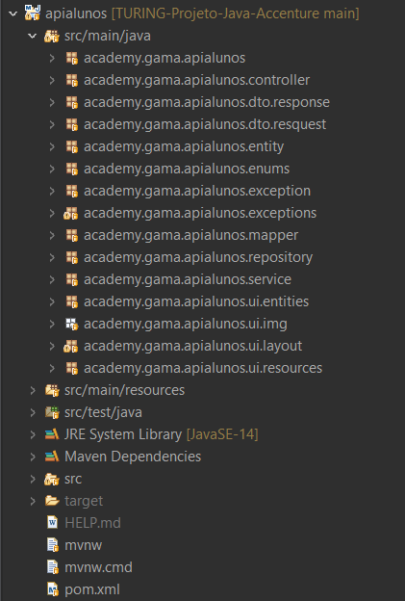
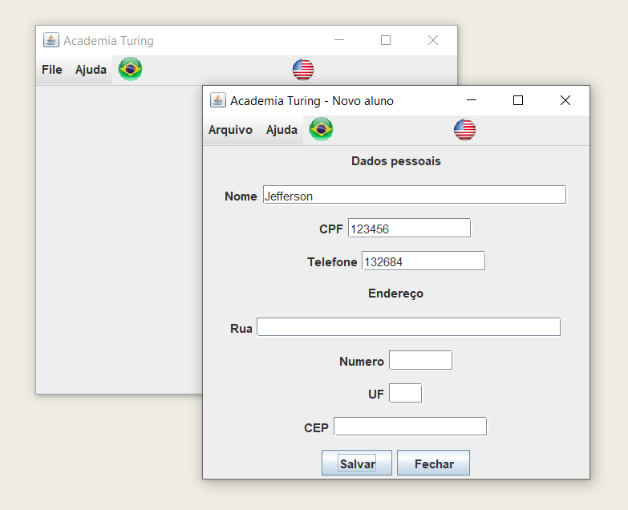
ESTRUTURA PROJETO JAVA

Slide 7
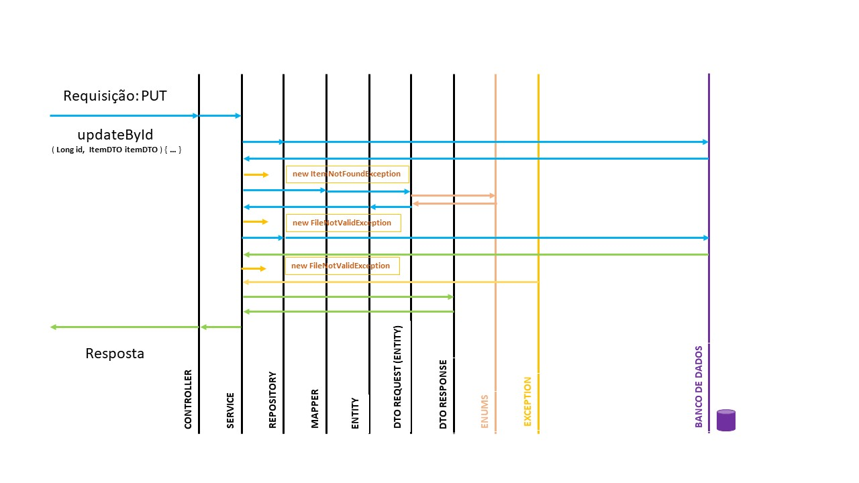
FLUXO DE DADOS

Slide 8

PROJETO NODE

Slide 9
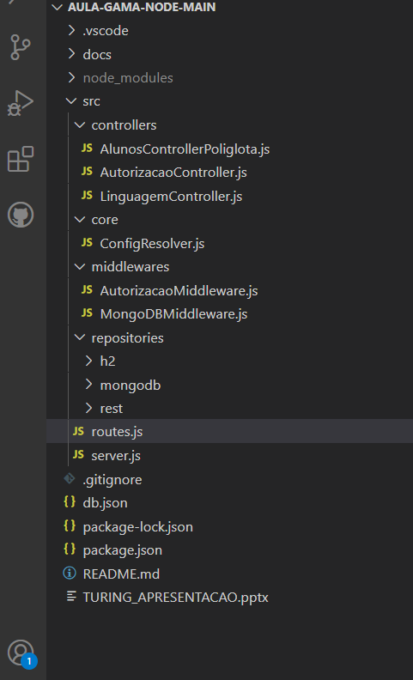
ARQUITETURA

Slide 10
PROJETO INTEGRADO

Slide 11
REQUEST
CLIENTE
NODE
JAVA
MONGODB
H2

Slide 12


AGRADECIMENTOS
Gama Academy
Accenture
Professor Marcus (Java)
Professor Gustavo (Node)
Bruce
Camila
Café

Slide 13
CONTATOS
Guilherme Renoldi
+55 12 98896-7559
https://github.com/grenoldi
https://www.linkedin.com/in/grenoldi/
Jefferson Rodrigues
+55 11 97973-0321
https://github.com/Jeffrs123
https://www.linkedin.com/in/jeffersonrodriguesdasilva/
Luciano Scalfone
+55 24 99292-7610
https://github.com/Luciano-Scalfone
https://www.linkedin.com/in/luciano-scalfone/

Slide 14
LINKS
REPOSITÓRIO PROJETO JAVA
Interface - https://github.com/grenoldi/turing-students
Back - https://github.com/Jeffrs123/TURING-Projeto-Java-Accenture
REPOSITÓRIO PROJETO NODE
https://github.com/Jeffrs123/academy.gama.node
APRESENTAÇÃO PPT
https://github.com/Jeffrs123/academy.gama.node/blob/main/TURING_APRESENTACAO.pptx?raw=true
TRELLO
https://trello.com/b/eorXF95c/projeto-java
https://trello.com/b/udIBr5Zq/projeto-nodejs-mongo

