Slide 1

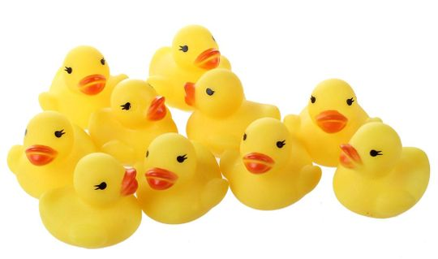
SPCN 2020 Case: Signs recognition
Command: LETI__FRT
Serdiukov Ivan
Nikitin Andrei
Rybakov Erop
Kondratyeva Irina
Shvarkunov Nikolai

Slide 2
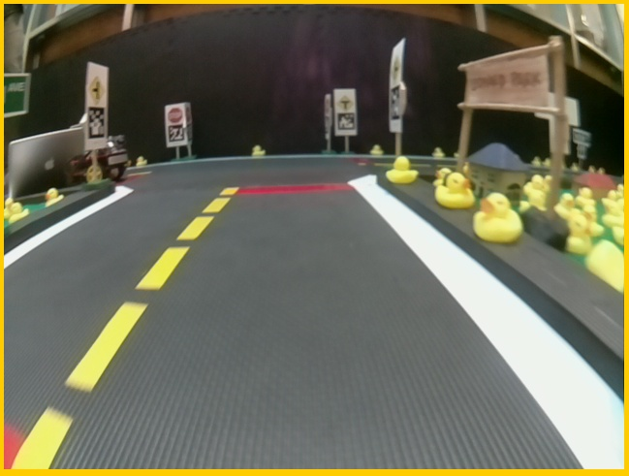
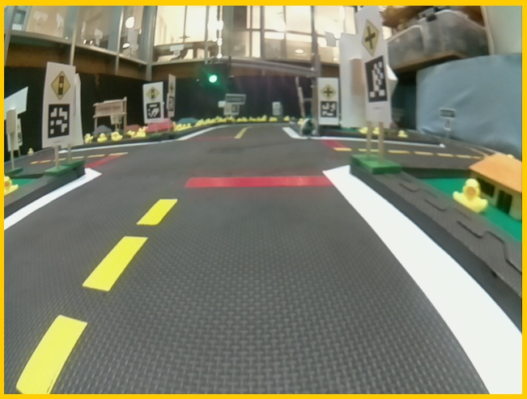
Input data: cameras recordings of real unmanned robots of the Duckietown project. Task: Development of a neural network for recognizing images of signs in an image from an unmanned vehicle camera.
2

Slide 3
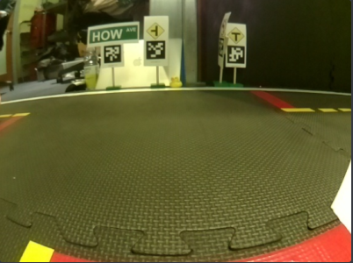




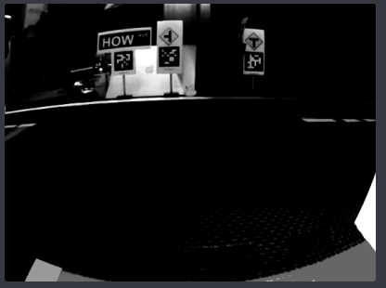
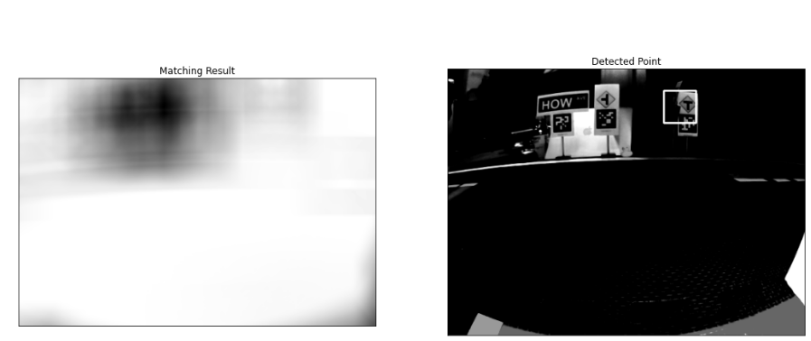
METHODS
Traffic signs base
Cameras recordings
Binarization
Splitting video into thumbnails
Using a sliding window to select a fragment
Converting color thumbnails to B&W;
Increasing contrast
found object
Object search by correlation methods
Image output
3

Slide 4
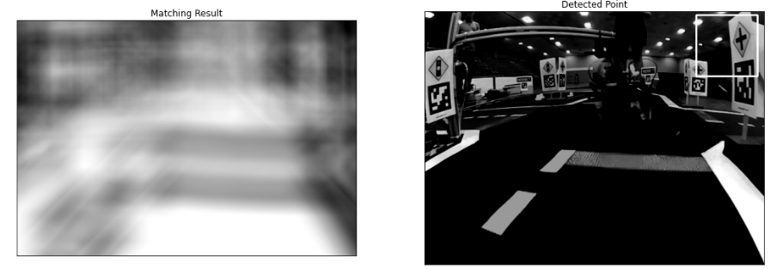
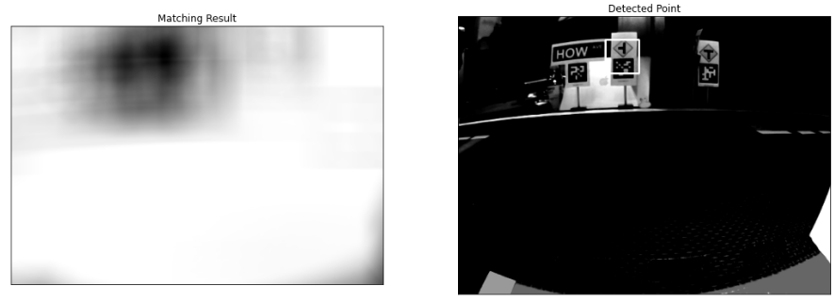
RESULTS
4

Slide 5
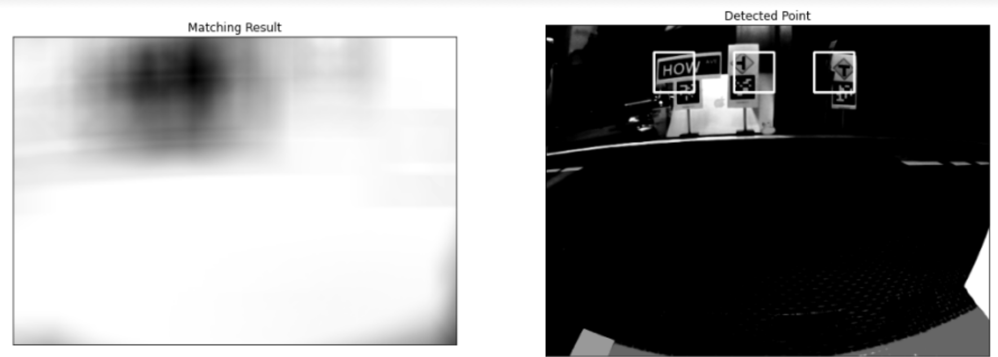
RESULTS
The result of using a cycle with checking all signs of the base
The iteration order is connected with the traffic sign and
thus identifies the found object

Slide 6
Done
Not done
Developed an algorithm for finding traffic signs in camera recording thumbnails(Python)
Neural network wasn’t developed due to extremely limited time for this task
5

Slide 7
THANK YOU FOR ATTENTION!

