Slide 1
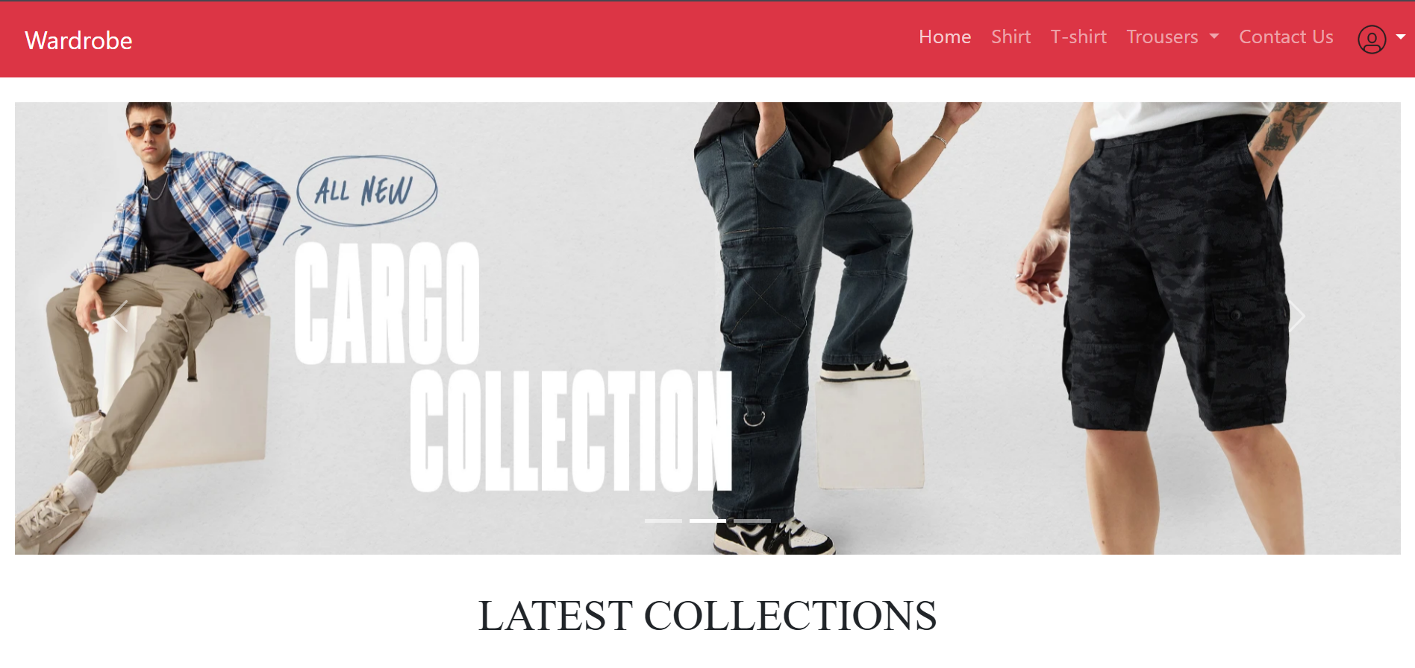
Wardrobe

Slide 2
Abstract
Wardrobe is a full-stack online clothing store prototype that demonstrates a practical e-commerce flow with modular backend APIs and Angular frontend.
The backend is built with Node.js, Express and MongoDB (Mongoose), providing routes for authentication, product (cloth) management, cart operations, and order processing.
Security and user management are supported with authentication and password hashing.

Slide 3
The frontend is an Angular application offering a responsive shopping UI with category pages (shirts, t-shirts, formal & casual trousers, jeans), product detail / buy pages, a persistent cart, and order history.
Core client services abstract API calls for products, users, cart and orders, enabling clean separation of concerns.

Slide 4
Proposed System
Frontend:
Authentication : The frontend pushes user’s request to log-in or register via Angular’s built-in http client. A preliminary input check is done through Angular forms.
Cart Operations : When user selects a product to cart, the uId along with product Id is sent to middleware where the user identity is verified and the data is pushed to backend.
Order Processing : After placing the order, the form data is stored in backend and is retrieved whenever user requests through order history

Slide 5
Proposed System
Purpose and objectives :
Provide a user-friendly online storefront for browsing and purchasing clothing items (shirts, t-shirts, formal & casual trousers, jeans).
Enable secure user authentication, product management, cart operations, and order lifecycle (place, view history, cancel).

Slide 6
User flow
A user registers with a unique Id and password .
User navigates to login page and user provides correct data for login.
After success login user navigates through the products listed.
User selects multiple product for add to cart.
User removes some products from cart.
User proceeds to place an order
User enters the required data before placing the order.
User navigates to order history tab where they can view their purchases and can cancel them.

Slide 7
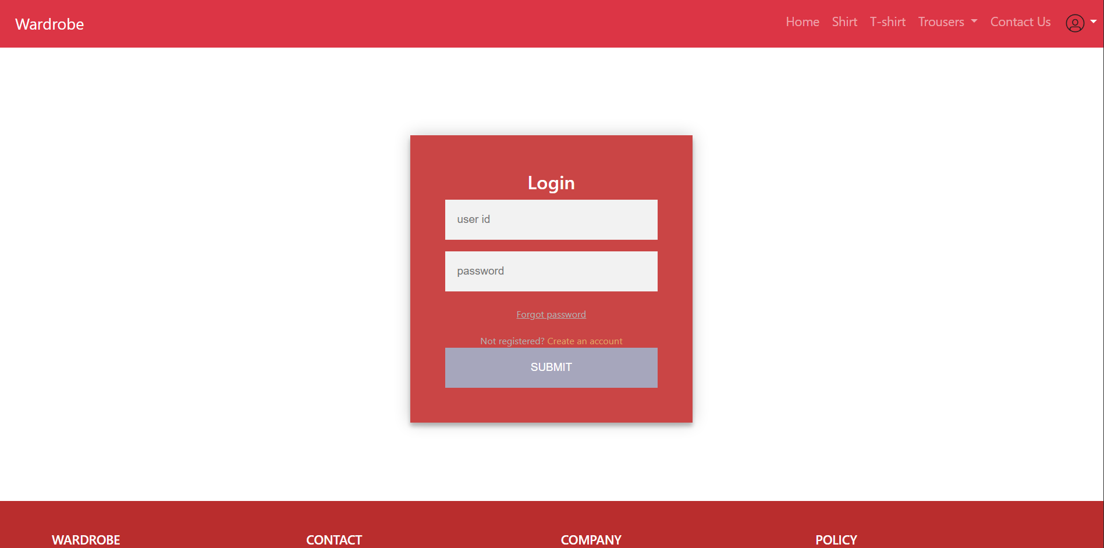
Login Page

Slide 8
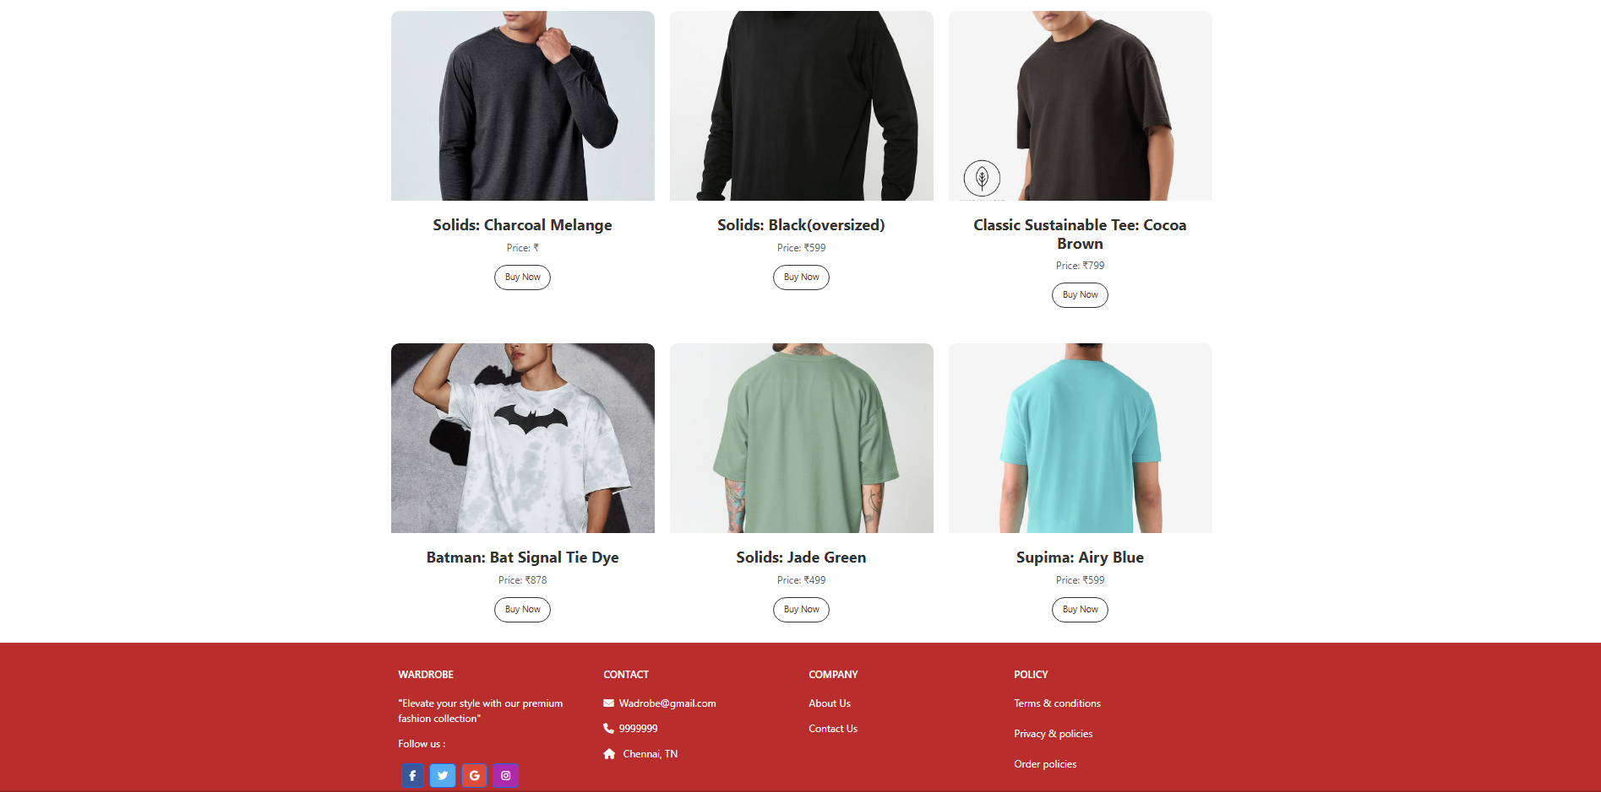
Screenshot of Shop Options

Slide 9
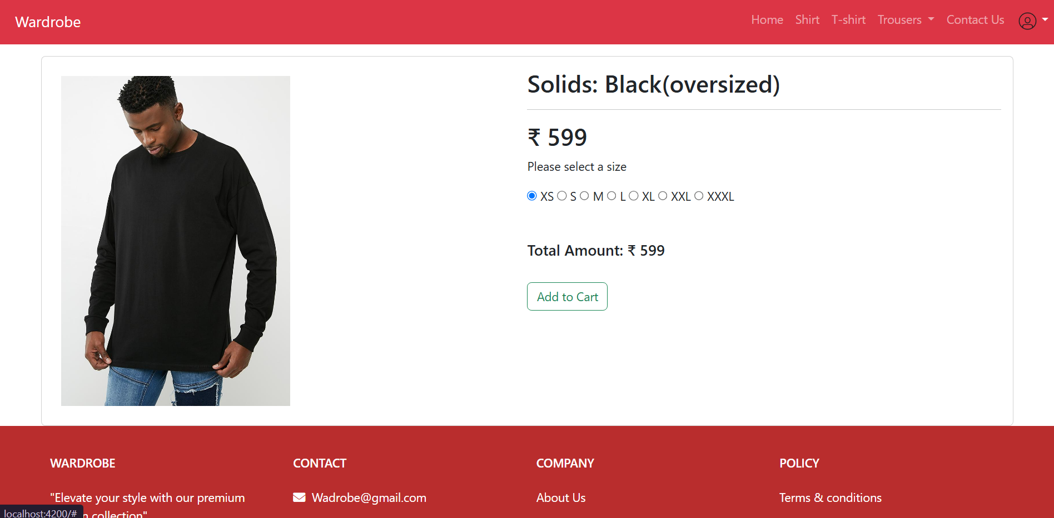
Add to Cart Page

Slide 10
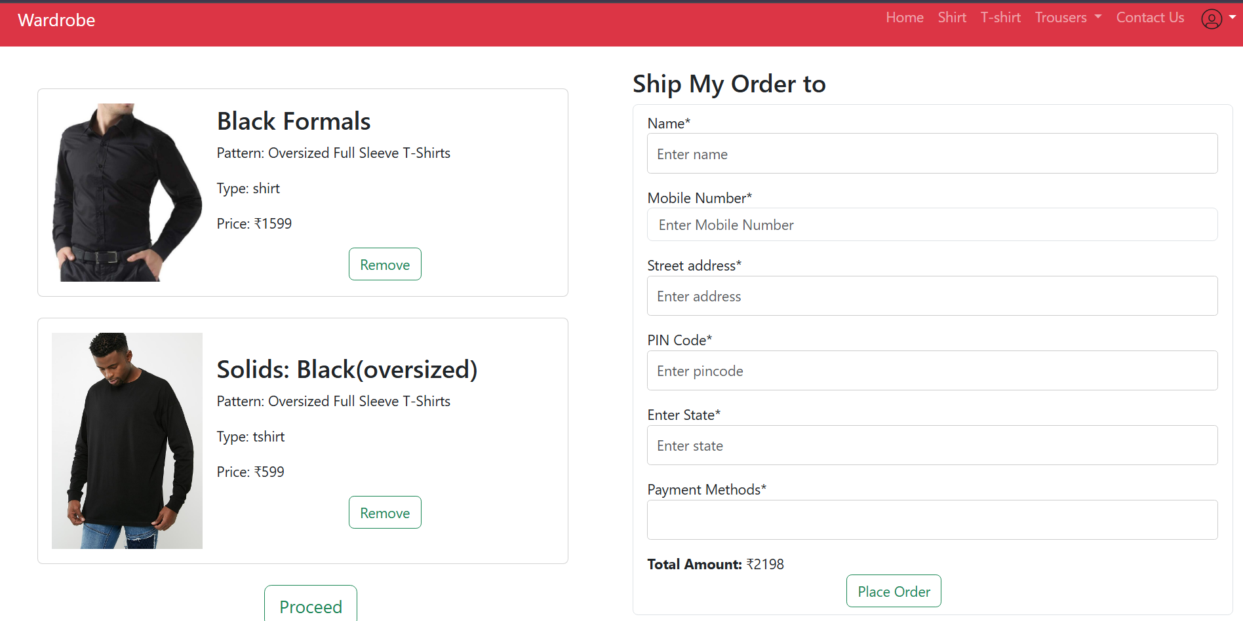
Order Processing

Slide 11
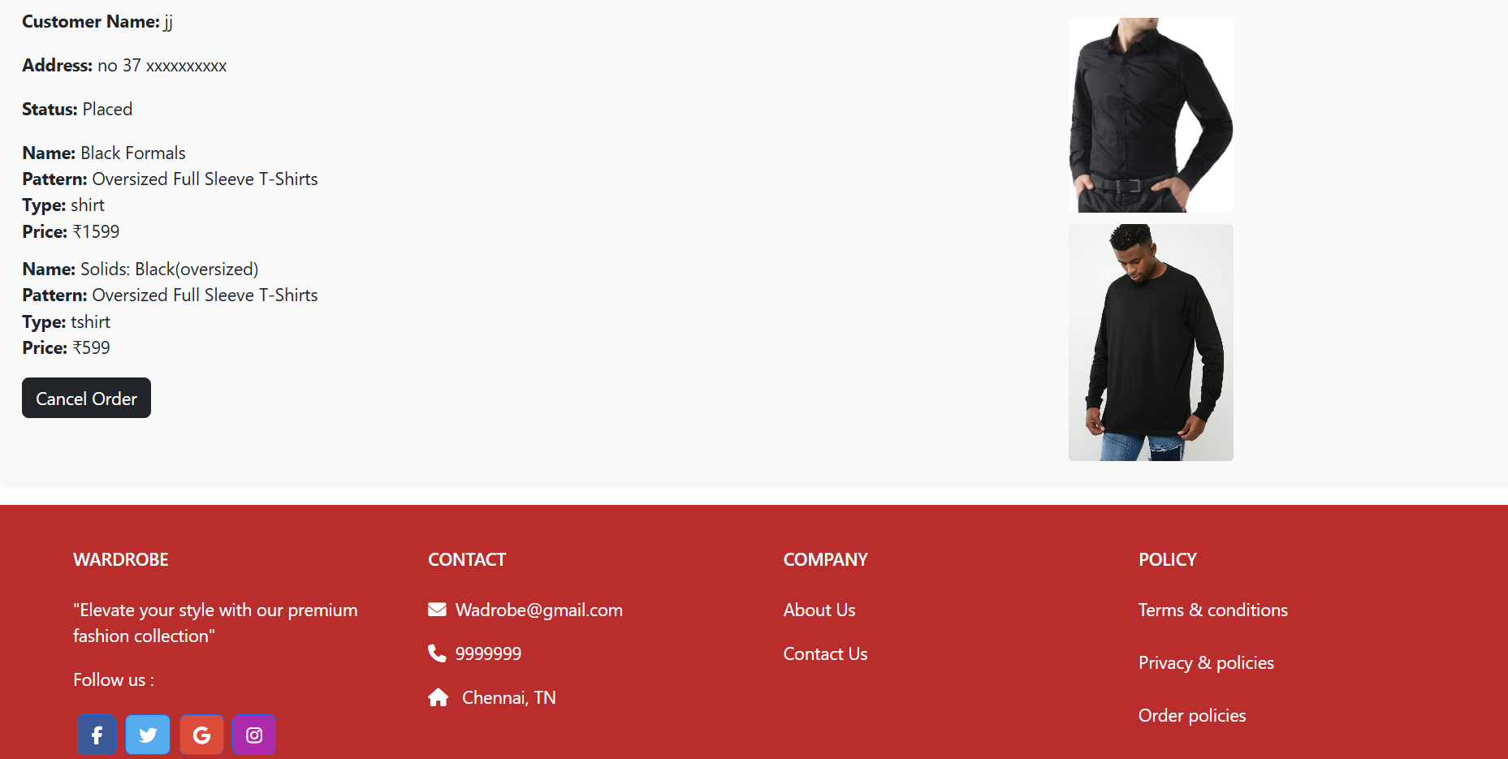
Order placed

Slide 12
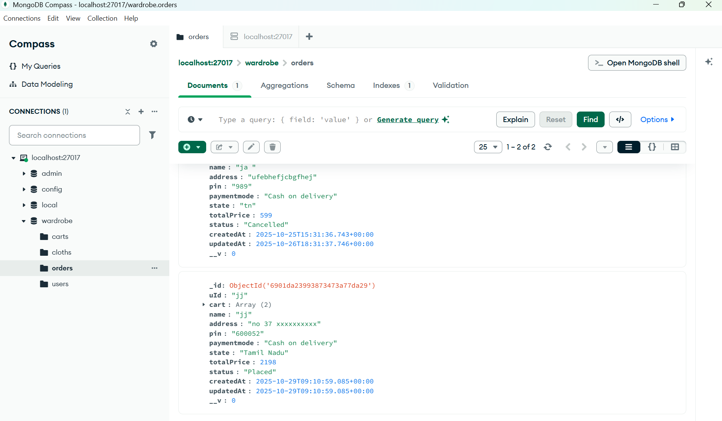
Order Details stored in MongoDB

Slide 13
Angular in Wardrobe Project
Core Angular Features Used
Components & Service
Root: app.component.ts/html - Main shell with:
Product Components: shirt, t-shirt, jeans, formal-trousers, casual-trousers components for category views
User Flow Components:
login, signup for authentication
cart for shopping cart management
order for order history and status
Info Components:
about us, contact us for static/form pages

Slide 14
Express.js in the Wardrobe Project
Express.js is a lightweight and flexible Node.js web application framework that provides a robust set of features for building web and mobile applications. In the Wardrobe project, Express serves as the backend server, handling HTTP requests, routing, middleware, and API endpoint management.
MongoDB & Mongoose in the Wardrobe Project
MongoDB is a NoSQL, document-oriented database that stores data in flexible, JSON-like documents. Mongoose is an Object Data Modeling (ODM) library for MongoDB and Node.js, providing schema-based solutions to model application data.

