Slide 1
数据结构与算法
Data Structures and Algorithms
主讲教师： 许 可
E-mail: xu_ke@bupt.edu.cn

Slide 2
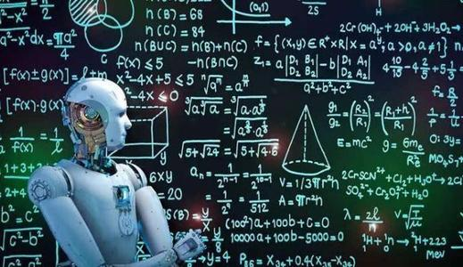
CHAPTER 1
INTRODUCTION
Data structure and algorithm
What is Algorithm?
1/26
Notes:
algorithm 算法 [ˈælgərɪðəm]

Slide 3

What is Algorithm?

Slide 4
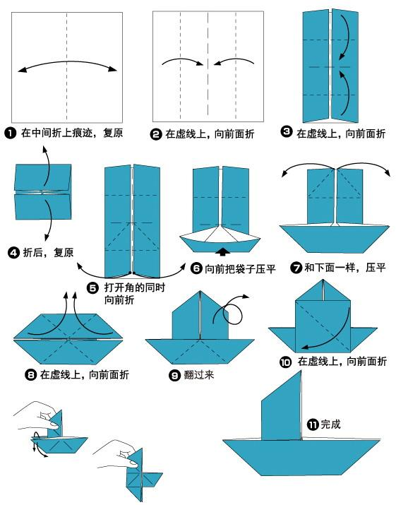
What is Algorithm?

Slide 5
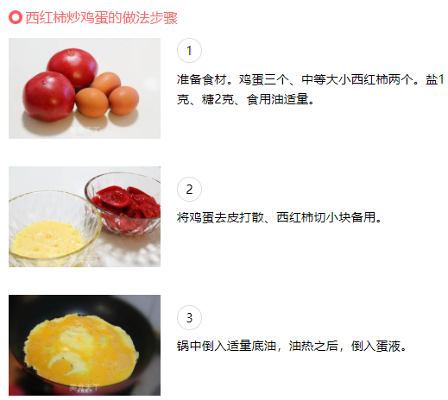
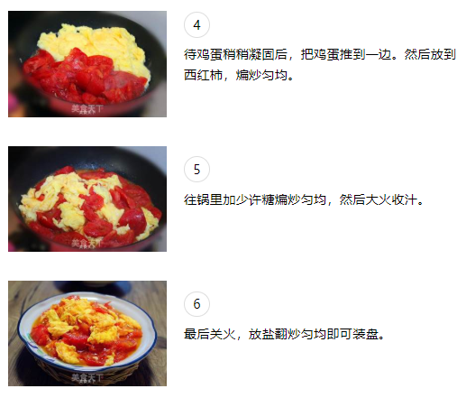
What is Algorithm?

Slide 6
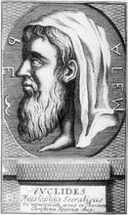
CHAPTER 1
INTRODUCTION
Data structure and algorithm
What is Algorithm?
Euclid’s Algorithm: computing the greatest common divisor
Give you two different integer number a, b a>b
Let a/b, get the remainder r
If r is not zero, let a=b, b=r, goto step 2
If r is zero, b is the common divisor
1/26
Notes:
algorithm 算法 [ˈælgərɪðəm]

Slide 7
You are a COMPUTER in the cases
计算师，计算者
COMPUTER?
计算机（20世纪40年代以后）
Designer→ Algorithm→ Operator (Computer)
意义：设计和执行相分离

Slide 8
CHAPTER 1
INTRODUCTION
Data structure and algorithm
What is Data structure?
1/26
Notes:
algorithm 算法 [ˈælgərɪðəm]

Slide 9
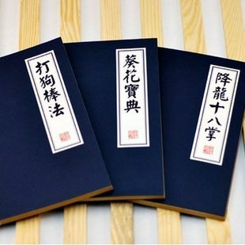


CHAPTER 1
INTRODUCTION
Data structure and algorithm
Program = Algorithm + Data structure
=
+
1/26
Notes:
algorithm 算法 [ˈælgərɪðəm]

Slide 10
CHAPTER 1
INTRODUCTION
Relationship of Data structure and Algorithm
Program = Algorithm + Data structure
Array
Link
Tree
Table
Heap
Queue
Stack
Graph
…
Sort
Search
=
+
1/26

Slide 11
CHAPTER 1
INTRODUCTION
Aims
Learning how to organize data.
Learning how to represent problems in a computer.
Manipulating data structures with basic operations.
Learning how to select efficient data structures and algorithms for a specific program.
Designing and writing algorithms with efficient data structures.
Understanding and designing data abstraction and interfaces.
Getting experienced in C programming.

Slide 12
CHAPTER 1
INTRODUCTION
Learning outcomes
Understand time complexities and the methods to analyze an algorithm.
Understand the implementations and operations on linked list, stack and queue. Understand string and pattern match algorithm.
Understand the definitions, implementations and operations of tree, binary tree and forest. Understand tree traversal and Huffman tree.
Understand the terminologies, implementations and operations of graph. Be familiar with the common algorithms.
Understand the ideas and know how to implement the searching algorithms and sorting algorithms.

Slide 13
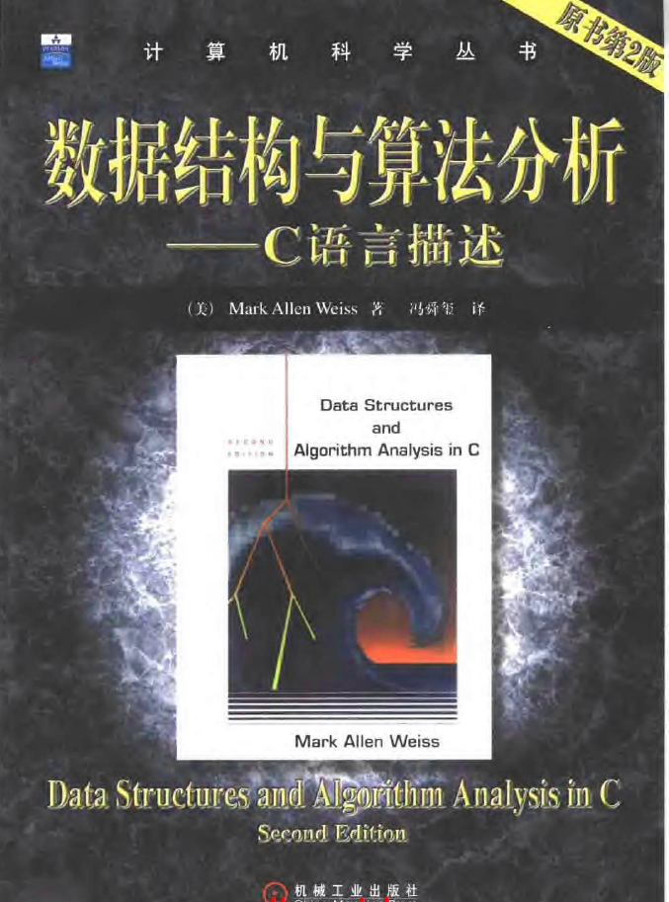
CHAPTER 1
INTRODUCTION
Books
M. A. Weiss, Data Structures and Algorithm Analysis in C, Second Edition，Pearson Education, Inc.

Slide 14
CHAPTER 1
INTRODUCTION
Examination
平时-作业（实验作业+纸质作业）
期中-上机实验考试
期末60%-笔试
（以上参考比例可能会略有调整）

Slide 15
CHAPTER 2
ALGORITHM ANALYSIS
How to evaluate a program?
Time? or Space?

Slide 16
CHAPTER 2
ALGORITHM ANALYSIS
【Definition】An algorithm is a finite set of instructions that, if followed, accomplishes a particular task. In addition, all algorithms must satisfy the following criteria:
(1) Input There are zero or more quantities that are externally supplied.
(2) Output At least one quantity is produced.
(3) Definiteness Each instruction is clear and unambiguous.
(4) Finiteness If we trace out the instructions of an algorithm, then for all cases, the algorithm terminates after finite number of steps.
(5) Effectiveness Every instruction must be basic enough to be carried out, in principle, by a person using only pencil and paper. It is not enough that each operation be definite as in(3); it also must be feasible.
1/26
Notes:
Definiteness 确定性
Finiteness有限性 ['faɪnaɪtˌnɪs]
Effectiveness有效性
feasible可行的

Slide 17
Note: A program is written in some programming language, and does not have to be finite (e.g. an operation system).
An algorithm can be described by human languages, flow charts, some programming languages, or pseudo-code.
〖Example〗 Selection Sort: Sort a set of n ≥ 1 integers in increasing order.
From those integers that are currently unsorted, find the smallest and place it next in the sorted list.
Where and how
are they stored?
for ( i = 0; i < n; i++) {
Examine list[i] to list[n−1] and suppose that the smallest integer is at list[min];
Interchange list[i] and list[min];
}
Where?
Algorithm in
pseudo-code
Sort = Find the smallest integer + Interchange it with list[i].
2/26
Notes:
finite 有限的
integers 整数 ['ɪntɪdʒəz]
pseudocode伪代码 ['sju:dəʊˌkəʊd]

Slide 18
§1 What to Analyze
➢ Machine & compiler-dependent run times.
➢ Time & space complexities : machine & compiler-independent.
Assumptions:
① instructions are executed sequentially
② each instruction is simple, and takes exactly one time unit
③ integer size is fixed and we have infinite memory
Typically the following two functions are analyzed:
T_{avg}(N) & T_{worst}(N) -- the average and worst case time complexities, respectively, as functions of input size N.
If there is more than one input, these functions may have more than one argument.
3/26
Notes:
Assumptions 假设 [ə'sʌmpʃnz]

Slide 19
§1 What to Analyze
〖Example〗 Matrix addition
void add ( int a[ ][ MAX_SIZE ],
int b[ ][ MAX_SIZE ],
int c[ ][ MAX_SIZE ],
int rows, int cols )
{
int i, j ;
for ( i = 0; i < rows; i++ )
for ( j = 0; j < cols; j++ )
c[ i ][ j ] = a[ i ][ j ] + b[ i ][ j ];
}
Q: What shall we do
if rows >> cols?
A: Exchange
rows and cols.
/* rows + 1 */
/* rows(cols+1) */
/* rows ⋅ cols */
T(rows, cols ) = 2 rows ⋅ cols + 2rows + 1
4/ 26
Notes:
一次加法和一次赋值

Slide 20
§1 What to Analyze
float sum ( float list[ ], int n )
{ /* add a list of numbers */
float tempsum = 0;
int i ;
for ( i = 0; i < n; i++ )
tempsum += list [ i ] ;
return tempsum;
}
〖Example〗Iterative function for summing a list of numbers
/* count = 1 */
/* count ++ */
/* count ++ */
T_{sum} ( n ) = 2n + 3
/* count ++ for last execution of for */
/* count ++ */
〖Example〗Recursive function for summing a list of numbers
float rsum ( float list[ ], int n )
{ /* add a list of numbers */
if ( n )
return rsum(list, n−1) + list[n − 1];
return 0;
}
/* count ++ */
T_{rsum} ( n ) = 2n + 2
But it takes more time to compute each step.
/* count ++ */
/* count ++ */
5/ 26

Slide 21

§1 What to Analyze
Take the iterative and
recursive programs for summing
a list for example --- if you think 2n+2 is
less than 2n+3, try a large n and
you’ll be surprised !
So it’s too complicated sometimes.
But does it worth the effort?
Is it really necessary
to count the exact
number of steps ?
Uhhh ...
I don’t think so.
Because
it drives me crazy!
Why?
6/ 26

Slide 22

§2 Asymptotic Notation ( Ο, Ω, Θ, o )
The point of counting the steps is to predict the growth in run time as the N change, and thereby compare the time complexities of two programs. So what we really want to know is the asymptotic behavior of T_{p}.
Suppose T_{p1} ( N ) = c₁N² + c₂N and T_{p2} ( N ) = c₃N. Which one is faster?
No matter what c₁, c₂, and c₃ are, there will be an n₀ such that T_{p1} ( N ) > T_{p2} ( N ) for all N > n₀.
I see! So as long as I know that
T_{p1} is about N² and T_{p2} is about N, then for
sufficiently large N, P2 will be faster!
7/ 26
Notes:
Asymptotic 渐近线的，渐近的 [æsɪmp'tɒtɪk]
Notation记号，标记法

Slide 23
§2 Asymptotic Notation
【Definition】 T (N) = O( f (N) ) if there are positive constants c and n₀ such that T (N) ≤ c ⋅ f (N) for all N ≥ n₀.
【Definition】 T (N) = Ω( g(N) ) if there are positive constants c and n₀ such that T (N) ≥ c ⋅ g(N) for all N ≥ n₀.
【Definition】 T (N) = Θ( h(N) ) if and only if T (N) = O( h(N) ) and T (N) = Ω( h(N) ) .
【Definition】 T (N) = o( p(N) ) if T (N) = O( p(N) ) and T (N) ≠ Θ( p(N) ) .
Note:
➢ 2N + 3 = O( N ) = O( N^{k≥1} ) = O( 2^{N} ) = ⋅⋅⋅ We shall always take the smallest f (N).
➢ 2^{N} + N² = Ω( 2^{N} ) = Ω( N² ) = Ω( N ) = Ω( 1 ) = ⋅⋅⋅ We shall always take the largest g(N).
8/ 26
Notes:
增长率小于O，O增长率的上界
增长率大于Ω，Ω增长率的下界

Slide 24


§2 Asymptotic Notation
Rules of Asymptotic Notation
☞ If T₁ (N) = O( f (N) ) and T₂ (N) = O( g(N) ), then
(a) T₁ (N) + T₂ (N) = max( O( f (N)), O( g(N)) ),
(b) T₁ (N) * T₂ (N) = O( f (N) * g(N) ).
☞ If T (N) is a polynomial of degree k, then T (N) = Θ( N ^{k} ).
☞ log^{k} N = O(N) for any constant k. This tells us that logarithms grow very slowly.
Note: When compare the complexities of two programs asymptotically, make sure that N is sufficiently large.
For example, suppose that T_{p1} ( N ) = 10⁶N and T_{p2} ( N ) = N². Although it seems that Θ( N² ) grows faster than Θ( N ), but if N < 10⁶, P2 is still faster than P1.
9/ 26

Slide 25

§2 Asymptotic Notation
10/ 26

Slide 26

§2 Asymptotic Notation
2^{n}
n²
n log n
f
n
Log n
n
11/ 26

Slide 27

§2 Asymptotic Notation
n
μs = microsecond = 10⁻⁶ seconds
ms = millisecond = 10⁻³ seconds
sec = seconds
min = minutes yr = years
hr = hours
d = days
12/ 26

Slide 28
§2 Asymptotic Notation
〖Example〗 Matrix addition
void add ( int a[ ][ MAX_SIZE ],
int b[ ][ MAX_SIZE ],
int c[ ][ MAX_SIZE ],
int rows, int cols )
{
int i, j ;
for ( i = 0; i < rows; i++ )
for ( j = 0; j < cols; j++ )
c[ i ][ j ] = a[ i ][ j ] + b[ i ][ j ];
}
/* Θ (rows) */
/* Θ (rows ⋅ cols ) */
/* Θ (rows ⋅ cols ) */
T(rows, cols ) = Θ (rows ⋅ cols )
13/ 26

Slide 29
§2 Asymptotic Notation
General Rules
☞ FOR LOOPS: The running time of a for loop is at most the running time of the statements inside the for loop (including tests) times the number of iterations.
☞ NESTED FOR LOOPS: The total running time of a statement inside a group of nested loops is the running time of the statements multiplied by the product of the sizes of all the for loops.
☞ CONSECUTIVE STATEMENTS: These just add (which means that the maximum is the one that counts).
☞ IF / ELSE: For the fragment
if ( Condition ) S1;
else S2;
the running time is never more than the running time of the test plus the larger of the running time of S1 and S2.
14/ 26
Notes:
FOR LOOPS for循环
NESTED 嵌套
CONSECUTIVE STATEMENTS 顺序语句

Slide 30

§2 Asymptotic Notation
☞ RECURSIONS:
〖Example〗 Fibonacci number:
Fib(0) = Fib(1) = 1, Fib(n) = Fib(n−1) + Fib(n−2)
long int Fib ( int N )
{
if ( N <= 1 )
return 1;
else
return Fib( N − 1 ) + Fib( N − 2 );
}
/* T ( N ) */
Q: Why is it
so bad?
/* O( 1 ) */
/* O( 1 ) */
/*O(1)*/
/*T(N −1)*/
/*T(N −2)*/
T(N) = T(N −1) + T(N −2) + 2
≥ Fib(N)
Proof by induction
T(N) grows exponentially
15/ 26
Notes:
Fibonacci斐波纳契

Slide 31


§3 Compare the Algorithms
〖Example〗 Given (possibly negative) integers A₁, A₂, …, A_{N}, find the maximum value of
Algorithm 1
Max sum is 0 if all the integers are negative.
int MaxSubsequenceSum ( const int A[ ], int N )
{
int ThisSum, MaxSum, i, j, k;
/* 1*/ MaxSum = 0; /* initialize the maximum sum */
/* 2*/ for( i = 0; i < N; i++ ) /* start from A[ i ] */
/* 3*/ for( j = i; j < N; j++ ) { /* end at A[ j ] */
/* 4*/ ThisSum = 0;
/* 5*/ for( k = i; k <= j; k++ )
/* 6*/ ThisSum += A[ k ]; /* sum from A[ i ] to A[ j ] */
/* 7*/ if ( ThisSum > MaxSum )
/* 8*/ MaxSum = ThisSum; /* update max sum */
} /* end for-j and for-i */
/* 9*/ return MaxSum;
}
Detailed analysis is given on p.18-19.
T( N ) = O( N³ )
16/ 26

Slide 32
§3 Compare the Algorithms
Algorithm 2
int MaxSubsequenceSum ( const int A[ ], int N )
{
int ThisSum, MaxSum, i, j;
/* 1*/ MaxSum = 0; /* initialize the maximum sum */
/* 2*/ for( i = 0; i < N; i++ ) { /* start from A[ i ] */
/* 3*/ ThisSum = 0;
/* 4*/ for( j = i; j < N; j++ ) { /* end at A[ j ] */
/* 5*/ ThisSum += A[ j ]; /* sum from A[ i ] to A[ j ] */
/* 6*/ if ( ThisSum > MaxSum )
/* 7*/ MaxSum = ThisSum; /* update max sum */
} /* end for-j */
} /* end for-i */
/* 8*/ return MaxSum;
}
T( N ) = O( N² )
17/ 26

Slide 33
§3 Compare the Algorithms
Algorithm 3
Divide and Conquer
conquer
divide
4
−3
5
−2
−1
2
6
−2
4
5
2
6
6
8
11
T ( N/2 )
O( N )
T ( N/2 )
T ( N ) = 2 T( N/2 ) + c N , T(1) = O(1)
The program can be found on p.21.
= 2 [2 T( N/2² ) + c N/2] + c N
Also true for N ≠ 2^{k}
= 2^{k} O(1) + c k N where N/2^{k} = 1
= N O(1)+c N log N
= O( N log N )
18/ 26
Notes:
Conquer

Slide 34
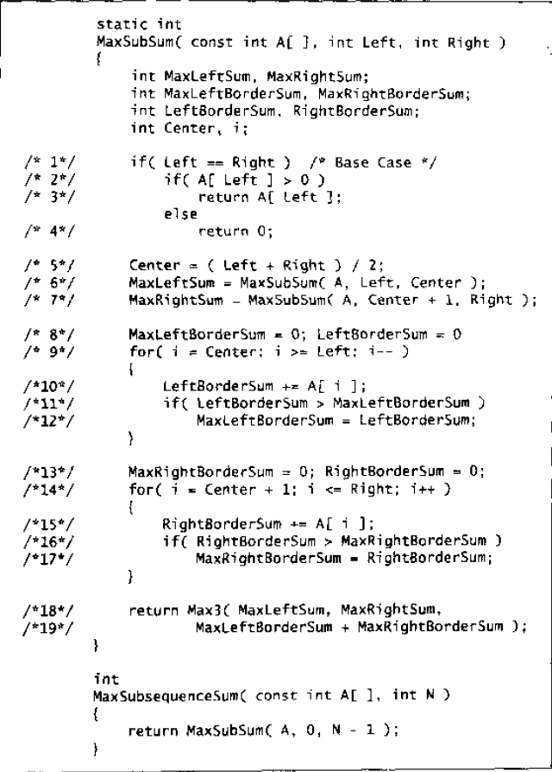

Slide 35
§3 Compare the Algorithms
Algorithm 4
On-line Algorithm
int MaxSubsequenceSum( const int A[ ], int N )
{
int ThisSum, MaxSum, j;
/* 1*/ ThisSum = MaxSum = 0;
/* 2*/ for ( j = 0; j < N; j++ ) {
/* 3*/ ThisSum += A[ j ];
/* 4*/ if ( ThisSum > MaxSum )
/* 5*/ MaxSum = ThisSum;
/* 6*/ else if ( ThisSum < 0 )
/* 7*/ ThisSum = 0;
} /* end for-j */
/* 8*/ return MaxSum;
}
−1
−1
3
3 −2 4 −6
−2
4
−6
1
6
−1
At any point in time, the algorithm can correctly give an answer to the subsequence problem for the data it has already read.
T( N ) = O( N )
A[ ] is scanned once only.
19/ 26

Slide 36

§3 Compare the Algorithms
Running times of several algorithms for maximum subsequence sum (in seconds)
Algorithm
1
2
3
4
Time
O( N³ )
O( N² )
O(N log N)
O( N )
Input Size
N =10
N =100
N =1,000
N =10,000
N =100,000
0.00103
0.47015
448.77
NA
NA
0.00045
0.01112
1.1233
111.13
NA
0.00066
0.00486
0.05843
0.68631
8.0113
0.00034
0.00063
0.00333
0.03042
0.29832
Note: The time required to read the input is not included.
20/ 26

Slide 37
§4 Logarithms in the Running Time
〖Example〗 Binary Search:
Given: A [0] ≤ A [1] ≤ …… ≤ A [N − 1] ; X
Task: Find X
Output: i if X = = A [ i ]
−1 if X is not found
low
mid
high
X ~ A [mid]
<
==
>
low
high = mid − 1
low= mid + 1
high
mid
21/ 26
Notes:
如果一个算法用常数时间O(1)将问题的大小消减为其一部分（通常是1/2），那么该算法就是O(logN)。如果使用常数时间只是把问题减少一个常数，那么它就是O(N)

Slide 38
§4 Logarithms in the Running Time
int BinarySearch ( const ElementType A[ ],
ElementType X, int N )
{
int Low, Mid, High;
/* 1*/ Low = 0; High = N - 1;
/* 2*/ while ( Low <= High ) {
/* 3*/ Mid = ( Low + High ) / 2;
/* 4*/ if ( A[ Mid ] < X )
/* 5*/ Low = Mid + 1;
else
/* 6*/ if ( A[ Mid ] > X )
/* 7*/ High = Mid - 1;
else
/* 8*/ return Mid; /* Found */
} /* end while */
/* 9*/ return NotFound; /* NotFound is defined as -1 */
}
T(N) = ?
Very useful in case the data are static and is in sorted order (e.g. find words from a dictionary).
T_{worst}( N ) = O( log N )
22/ 26

Slide 39
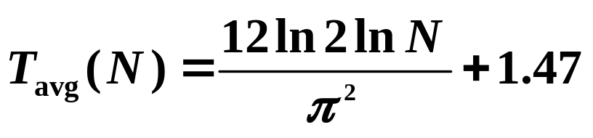
§4 Logarithms in the Running Time
〖Example〗 Euclid’s Algorithm: computing the greatest common divisor (Gcd).
unsigned int Gcd ( unsigned int M, unsigned int N )
{
unsigned int Rem;
/* 1*/ while ( N > 0 ) {
/* 2*/ Rem = M % N;
/* 3*/ M = N;
/* 4*/ N = Rem;
} /* end while */
/* 5*/ return M;
}
T(N) = ?
T(N) < 1 + T ( M/2 )
< 2 + T ( N/2 )
… …
< k + T ( N/2^{k} )
【Theorem】 If M > N, then ( M mod N ) < M / 2.
T( N ) = O( log N )
23/ 26
Notes:
Euclid欧几里得（约公元前3世纪的古希腊数学家） [ˈju:klid]

Slide 40
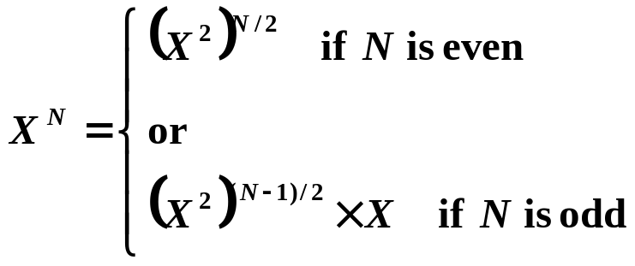

§4 Logarithms in the Running Time
〖Example〗 Exponentiation: computing X ^{N}.
long int Pow ( long int X, unsigned int N )
{
long int P = 1;
while ( N -- ) P *= X;
return P;
}
T( N ) = O( N )
long int Pow ( long int X, unsigned int N )
{
/* 1*/ if ( N == 0 )
/* 2*/ return 1;
/* 3*/ if ( N == 1 )
/* 4*/ return X;
/* 5*/ if ( IsEven( N ) )
/* 6*/ return Pow( X * X, N / 2 );
else
/* 7*/ return Pow( X * X, N / 2 ) * X;
}
return Pow( Pow(X, N / 2), 2); ？
Recursion dead loop…
return Pow( Pow(X, 2), N / 2 ); ？
Recursion dead loop…
return Pow(X, N / 2) * Pow(X, N / 2);
Call double times of pow…
Is it necessary ?
no
T( N ) = O( log N )
24/ 26
Notes:
Exponentiation 幂 [ˌekspəʊˌnenʃɪ'eɪʃən]
Pow 指数

Slide 41
algorithm 算法 [ˈælgərɪðəm]
definiteness 确定性 [de'fɪnətnes]
finiteness有限性 ['faɪnaɪtˌnɪs]
effectiveness有效性
finite 有限的
pseudocode伪代码 ['sju:dəʊˌkəʊd]
assumptions 假设 [ə'sʌmpʃnz]
asymptotic 渐近线的，渐近的 [æsɪmp'tɒtɪk]
notation记号，标记法
for loops for循环
nested 嵌套
consecutive statements 顺序语句
Fibonacci斐波纳契
Euclid欧几里得（前3世纪的古希腊数学家） [ˈju:klid]
exponentiation 幂 [ˌekspəʊˌnenʃɪ'eɪʃən]
Pow 指数

Slide 42

QQ群：2020北邮国院数据结构 480796715
群须知：
1、申请入群注明班级姓名
2、群内签名使用实名：
姓名学号，张三12345
3、不得讨论课程无关内容

Slide 43
Home work 1:
2.1 2.6 2.13

Slide 44
Home work 2:
Output intermediate result of Algorithm 1-4
Input sequence: 4, -3, 5, -2, -1, 2, 6, -2
For different algorithms, out the following variables:
Al-1: The first 10 runs ‘ (ThisSum, MaxSum) .
as (0,0)(4,4)(1,4）
Al-2: The same as above
Al-3: In each call of recursion : MaxLeftSum, MaxRightSum, MaxLeftBorderSum, MaxRightBorderSum.
(you may output the last call in first line)
Al-4: (ThisSum, MaxSum) from all runs
compare and analyze why different algorithms give different run time?
Give example of steps witch are in Algorithm i but not in i+1
Notes:
输出例子算法的中间结果，不同的算法输出的变量要求如下
算法1）写出前10个ThisSum，以及同时对应的MaxSum，(ThisSum, MaxSum) 例如：(0,0)(4,4)(1,4）
算法2）同上
算法3）写出每次递归调用时4个变量的值（MaxLeftSum, MaxRightSum, MaxLeftBorderSum, MaxRightBorderSum），按照实际执行顺序，需要先输出最后一层递归调用，每一层的调用写在同一行，用分号分隔。例如第一行可能是这样 (4,-3,1,1);(5,-2,3,3);…..逐层递归返回
算法4）写出每次循环运行的变量值 (ThisSum, MaxSum)
思考不同的算法为什么运行时间不同，给出你的想法和分析。举例说明每个算法中，哪个计算步骤在第i个算法中有，而第i+1个算法中没有。（如第2个中有而第3个中没有的）

