Slide 1
CHAPTER 3
Lists, Stacks, and Queues
§1 Abstract Data Type (ADT)
【Definition】Data Type = { Objects } ∪ { Operations }
〖Example〗 int = { 0, ±1, ±2, ⋅ ⋅ ⋅, INT_MAX, INT_MIN }
∪ { +, −, ×, ÷, %, ⋅ ⋅ ⋅ }
【Definition】An Abstract Data Type (ADT) is a data type that is organized in such a way that the specification on the objects and specification of the operations on the objects are separated from the representation of the objects and the implementation on the operations.
1/18

Slide 2
§2 The List ADT
❖ ADT:
Objects: ( item₀, item₁, ⋅⋅⋅ , item_{N−1} )
Operations:
☞ Finding the length, N, of a list.
☞ Printing all the items in a list.
☞ Making an empty list.
☞ Finding the k-th item from a list, 0 ≤ k < N.
☞ Inserting a new item after the k-th item of a list, 0 ≤ k < N.
☞ Deleting an item from a list.
☞ Finding next of the current item from a list.
☞ Finding previous of the current item from a list.
Why after?
2/18

Slide 3

1. Simple Array implementation of Lists
§2 The List ADT
array[ i ] = item_{i}
Address
Content
……
……
Sequential mapping
array+i
item_{i}
array+i+1
item_{i+1}
……
……
 MaxSize has to be estimated.
 Find_Kth takes O(1) time.
 Insertion and Deletion not only take O(N) time, but also involve a lot of data movements which takes time.
3/18

Slide 4
2. Linked Lists
§2 The List ADT
ptr
Address
Data
Pointer
ZHAO
QIAN
0010
0011
0110
1011
SUN
QIAN
ZHAO
LI
1011
0010
0011
NULL
SUN
LI
NULL
To link ‘ZHAO’ and ‘QIAN’:
list_ptr N1, N2 ;
N1 = (list_ptr)malloc(sizeof(struct list_node));
N2 = (list_ptr)malloc(sizeof(struct list_node));
N1->data = ‘ZHAO’ ;
N2->data = ‘QIAN’ ;
N1->next = N2 ;
N2->next = NULL ;
ptr = N1 ;
Head pointer ptr = 0110
Locations of the nodes may
change on different runs.
Initialization:
typedef struct list_node *list_ptr;
typedef struct list_node {
char data [ 4 ] ;
list_ptr next ;
} ;
list_ptr ptr ;
ptr
ZHAO
QIAN
NULL
4/18

Slide 5

 takes O(1) time.
§2 The List ADT
Insertion
node
ptr
...
...
a₁
a_{i}
a_{i+1}
a_{n}
NULL
① temp->next =
node->next
② node->next = temp
b
temp
Question: What will happen
if the order of the two steps is reversed?
Question: How can we insert a new first item?
5/18

Slide 6
 takes O(1) time.
§2 The List ADT
Deletion
pre
ptr
...
...
a₁
a_{i}
a_{i+1}
a_{n}
NULL
① pre->next =
node->next
② free ( node )
b
b
Question: How can we
delete the first node from a list?
node
node
Answer: We can add a dummy
head node to a list.
Read programs in Figures 3.6-3.15
for detailed implementations of operations.
6/18

Slide 7


Doubly Linked Circular Lists
§2 The List ADT
typedef struct node *node_ptr ;
typedef struct node {
node_ptr llink;
element item;
node_ptr rlink;
} ;
llink
rlink
•
item
•
Uhhh ... Then I’ll have to
go from the 1st node again.
But hey, why do I wantta
find the previous node?
Don’t we have
enough headache already?
Why do we need
the doubly linked lists?
ptr = ptr->llink->rlink
= ptr->rlink->llink
I’ll go from the 1st node
to the m-th node.
Suppose you have a list
1->2->3->…->m.
Now how would you
get the m-th node?
Why do you ask me? :-)
Maybe you wantta delete
the m-th node?
A doubly linked circular list with head node:
Then you are asked to find
its previous node m − 1?
H
•
•
•
item1
•
•
item2
•
•
item3
•
An empty list :
H
•
•
7/18

Slide 8
Two Applications
§2 The List ADT
✵ The Polynomial ADT
Objects : P ( x ) = a₁ x ^{e1} + ⋅⋅⋅ + a_{n} x ^{en} ; a set of ordered pairs of < e_{i} , a_{i} > where a_{i} is the coefficient and e_{i} is the exponent. e_{i} are nonnegative integers.
Operations:
☞ Finding degree, max { e_{i} }, of a polynomial.
☞ Addition of two polynomials.
☞ Subtraction between two polynomials.
☞ Multiplication of two polynomials.
☞ Differentiation of a polynomial.
8/18
Notes:
Polynomial

Slide 9


【Representation 1】
typedef struct {
int CoeffArray [ MaxDegree + 1 ] ;
int HighPower;
} *Polynomial ;
§2 The List ADT
Try to apply MultPolynomial (p.53)
On P₁(x) = 10x¹⁰⁰⁰+5x¹⁴+1 and
P₂(x) = 3x¹⁹⁹⁰−2x¹⁴⁹²+11x+5
-- now do you see my point?
I like it! It’s easy to
implement most of the operations,
such as Add and Multiplication.
Really? What is the time complexity
for finding the product of two polynomials
of degree N₁ and N₂?
O( N₁*N₂ )
What’s wrong with that?
9/18

Slide 10

【Representation 2】
§2 The List ADT
Given:
We represent each term as a node
Coefficient
Exponent
Next •
Home work:
3.6
Add two polynomials
Declaration:
typedef struct poly_node *poly_ptr;
struct poly_node {
int Coefficient ; /* assume coefficients are integers */
int Exponent;
poly_ptr Next ;
} ;
typedef poly_ptr a ; /* nodes sorted by exponent */
a
a_{m−1}
e_{m−1}
•
……
a₀
e₀
NULL
10/18

Slide 11


✵ Multilists
§2 The List ADT
〖Example〗 Suppose that we have 40,000 students and 2,500 courses. Print the students’ name list for each courses, and print the registered classes’ list for each student.
【Representation 1】
int Array[40000][2500];
11/18

Slide 12
【Representation 2】
§2 The List ADT
S1
S2
S3
S4
S5
C1
C2
C3
C4
12/18

Slide 13

§2 The List ADT
3. Cursor Implementation of Linked Lists (no pointer)
☞ Features that a linked list must have:
The data are stored in a collection of structures. Each structure contains data and a pointer to the next structure.
A new structure can be obtained from the system’s global memory by a call to malloc and released by a call to free.
0
1
2
… …
S-1
Cursor
Space
Element
Next
1
2
3
S-1
0
Note: The interface for the cursor implementation (given in Figure 3.28) is identical to the pointer implementation (given in Figure 3.6).
13/18

Slide 14
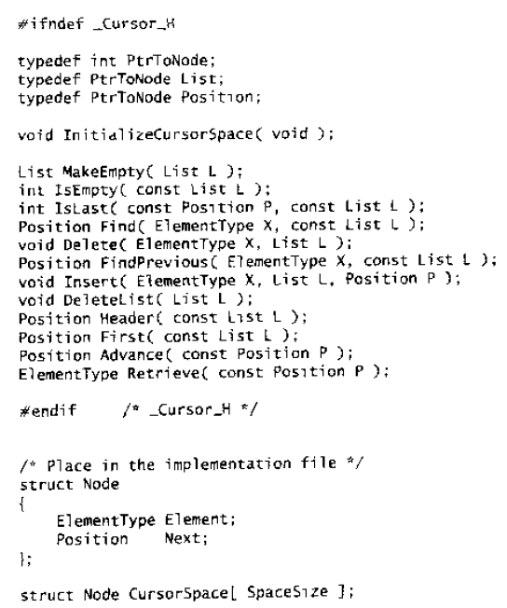

Slide 15
§2 The List ADT
0
1
2
… …
S-1
Element
Next
2
x
5
S-2
0
p
Home work:
3.12
Reverse a singly linked list
malloc:
p = CursorSpace[ 0 ].Next ;
CursorSpace[ 0 ].Next = CursorSpace[ p ].Next ;
0
1
2
… …
S-1
Element
Next
2
5
S-2
0
p
2
p
free(p):
CursorSpace[ p ].Next = CursorSpace[ 0 ].Next ;
CursorSpace[ 0 ].Next = p ;
Read operation implementations given in Figures 3.31-3.35
Note: The cursor implementation is usually significantly faster because of the lack of memory management routines.
14/18

Slide 16
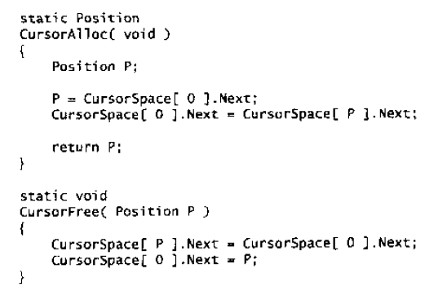
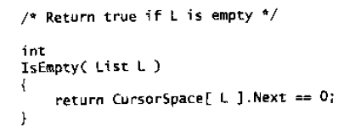
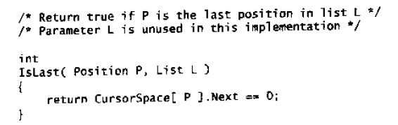

Slide 17
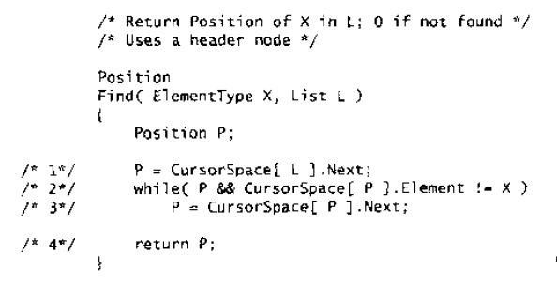
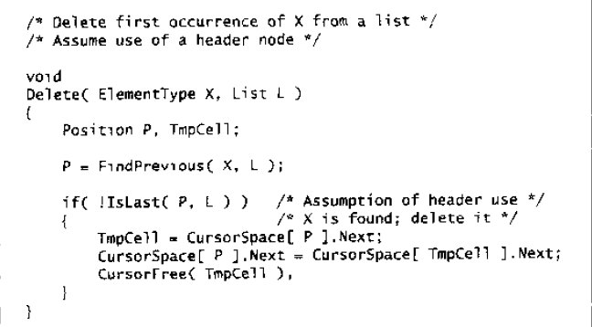

Slide 18
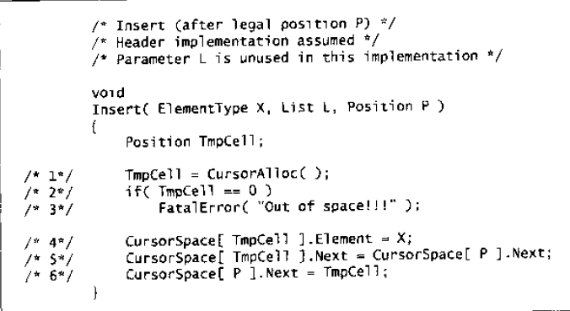

Slide 19


§3 The Stack ADT
6
5
1. ADT
A stack is a Last-In-First-Out (LIFO) list, that is, an ordered list in which insertions and deletions are made at the top only.
6
5
4
Objects: A finite ordered list with zero or more elements.
3
5
2
Operations:
☞ Int IsEmpty( Stack S );
☞ Stack CreateStack( );
☞ DisposeStack( Stack S );
☞ MakeEmpty( Stack S );
☞ Push( ElementType X, Stack S );
☞ ElementType Top( Stack S );
☞ Pop( Stack S );
6
1
Note: A Pop (or Top) on an empty stack is an error in the stack ADT.
Push on a full stack is an implementation error but not an ADT error.
15/18
Notes:
Stack 栈

Slide 20
2. Implementations
§3 The Stack ADT
➢ Linked List Implementation (with a header node)
 Push:
① TmpCell->Next = S->Next
② S->Next = TmpCell
Element
☞ Top:
return S->Next->Element
Element
TmpCell
FirstCell
•
•
S
 Pop:
① FirstCell = S->Next
② S->Next = S->Next->Next
Element
S
•
•
S
•
③ free ( FirstCell )
Easy! Simply keep
another stack as
a recycle bin.
Element
But, the calls to
malloc and free
are expensive.
•
Element
NULL
16/18

Slide 21
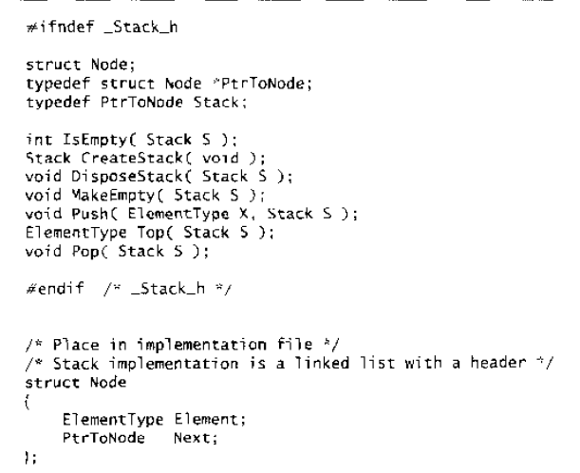
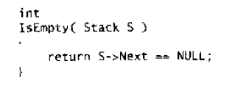
➢ Linked List Implementation (with a header node)

Slide 22
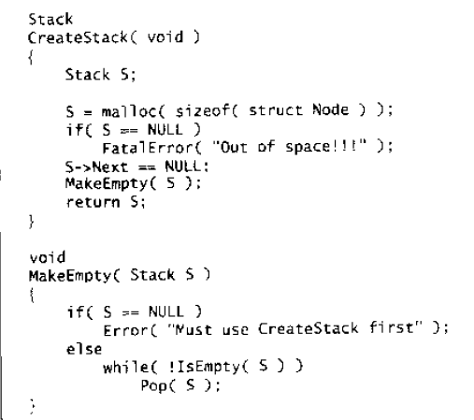
➢ Linked List Implementation (with a header node)

Slide 23
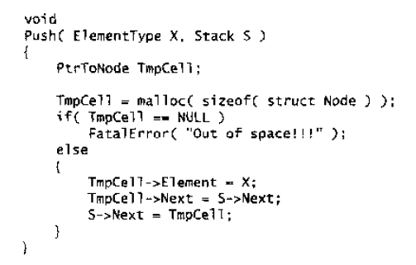
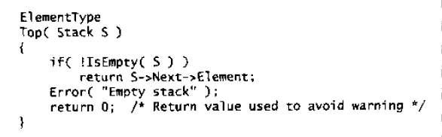
➢ Linked List Implementation (with a header node)

Slide 24
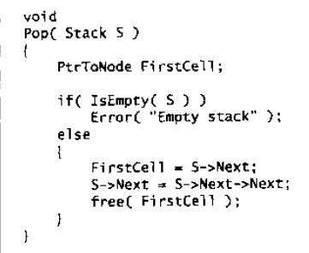
➢ Linked List Implementation (with a header node)

Slide 25
➢ Array Implementation
§3 The Stack ADT
struct StackRecord {
int Capacity ; /* size of stack */
int TopOfStack; /* the top pointer */
/* ++ for push, -- for pop, -1 for empty stack */
ElementType *Array; /* array for stack elements */
} ;
Note: ① The stack model must be well encapsulated. That is, no part of your code, except for the stack routines, can attempt to access the Array or TopOfStack variable.
② Error check must be done before Push or Pop (Top).
Read Figures 3.38-3.52 for detailed implementations of stack operations.
17/18

Slide 26
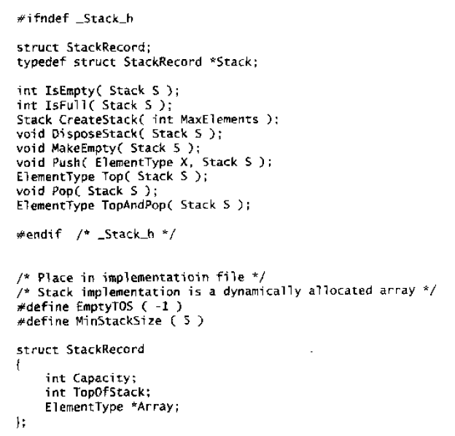
➢ Array Implementation

Slide 27
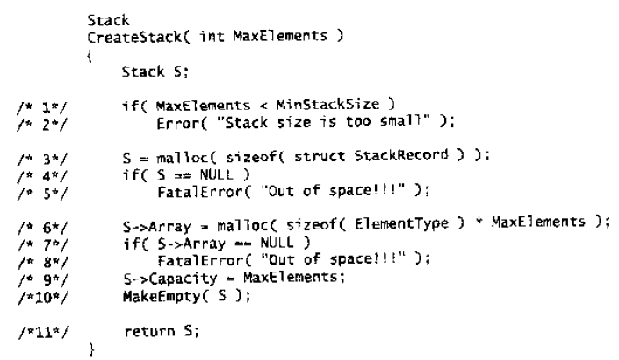
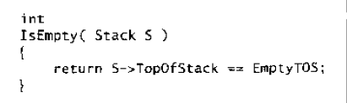
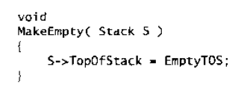
➢ Array Implementation

Slide 28
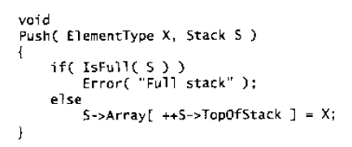
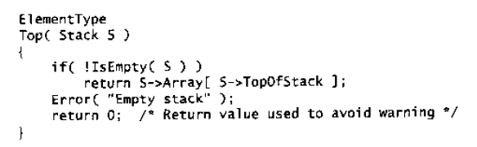
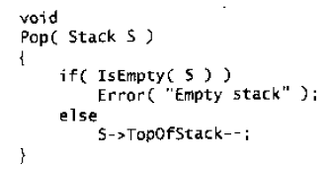
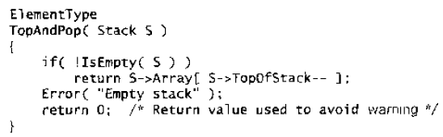
➢ Array Implementation

