Slide 1

3. Applications
§3 The Stack ADT
✵ Balancing Symbols
Check if parenthesis ( ), brackets [ ], and braces { } are balanced.
Algorithm {
Make an empty stack S;
while (read in a character c) {
if (c is an opening symbol)
Push(c, S);
else if (c is a closing symbol) {
if (S is empty) { ERROR; exit; }
else { /* stack is okay */
if (Top(S) doesn’t match c) { ERROR, exit; }
else Pop(S);
} /* end else-stack is okay */
} /* end else-if-closing symbol */
} /* end while-loop */
if (S is not empty) ERROR;
}
T( N ) = O ( N )
where N is the length
of the expression.
This is an
on-line algorithm.

Slide 2

✵ Postfix Evaluation
§3 The Stack ADT
〖Example〗An infix expression: a + b ∗ c − d / e
A prefix expression: − + a ∗ b c / d e
A postfix expression: a b c ∗ + d e / −
operator with
the highest precedence
Reverse Polish notation
operand
operator
〖Example〗 6 2 / 3 − 4 2 ∗ + = ?
8
Get token: 6 ( operand )
Get token: 2 ( operand )
Get token: / ( operator )
Get token: 3 ( operand )
2
top
Get token: − ( operator )
Get token: 4 ( operand )
top
top
top
2
top
3
4
8
top
Get token: 2 ( operand )
Get token: ∗ ( operator )
6
/
2
= 3
top
top
top
top
top
top
6
top
3
0
8
top
Get token: + ( operator )
3
−
3
= 0
Pop: 8
top
top
top
= 8
top
+
top
4
∗
2
= 8
0
8
T( N ) = O ( N ). No need to know precedence rules.
1/9
Notes:
postfix 后缀
prefix 前缀
infix 中缀
Reverse polish notation 逆波兰记法

Slide 3

✵ Infix to Postfix Conversion
§3 The Stack ADT
〖Example〗 a + b ∗ c − d = ?
a b c ∗ + d −
Note:
➢ The order of operands is the same in infix and postfix.
➢ Operators with higher precedence appear before those with lower precedence.
Isn’t that
simple?
Output:
Wait till
you see the next
example...
a
b
c
∗
+
d
−
Get token: a (operand)
Get token: + (plus)
Get token: b (operand)
Get token: ∗ (times)
Get token: c (operand)
Get token: − (minus)
+ ≥ ∗ ?
∗
top
Get token: d (operand)
∗ ≥ − ?
+ ≥ − ?
top
top
+
top
−
top
top
top
2/9

Slide 4

§3 The Stack ADT
〖Example〗 a ∗ ( b + c ) / d = ?
a b c + ∗ d /
Output:
a
b
c
+
∗
d
/
Get token: a (operand)
Get token: ∗ (times)
Get token: ( (lparen)
Get token: b (operand)
+
top
Get token: + (plus)
Get token: c (operand)
top
∗ ≥ ( ?
(
top
Get token: ) (rparen)
Get token: / (divide)
( ≥ + ?
∗
top
/
top
top
Get token: d (operand)
∗ ≥ / ?
top
top
top
NO?!
T( N ) = O ( N )
3/9

Slide 5


§3 The Stack ADT
Solutions:
① Never pop a ( from the stack except when processing a ) .
② Observe that when ( is not in the stack, its precedence is the highest; but when it is in the stack, its precedence is the lowest. Define in-stack precedence and incoming precedence for symbols, and each time use the corresponding precedence for comparison.
Note: a – b – c will be converted to a b – c –. However, 2^2^3 ( ) must be converted to 2 2 3 ^ ^, not 2 2 ^ 3 ^ since exponentiation associates right to left.
4/9

Slide 6

✵ Function Calls
§3 The Stack ADT
-- System Stack
Recursion can always be completely removed.
Non recursive programs are generally faster than
equivalent recursive programs.
However, recursive programs are in general
much simpler and easier to understand.
f p
Old Frame Pointer
Well, if 1 million elements
are not enough to crash
your program,
try a larger one.
s p
Return Address
What will happen
if L contains 1 million
elements?
s p
Local Variables
What’s wrong
with it?
s p
Home work:
3.21
Implement Two Stacks
tail recursion
f p
f p
Stack Frame
s p
s p
Return Address
void PrintList ( List L )
{
if ( L != NULL ) {
PrintElement ( L->Element );
PrintList( L->next );
}
} /* a bad use of recursion */
void PrintList ( List L )
{
top: if ( L != NULL ) {
PrintElement ( L->Element );
L = L->next;
goto top; /* do NOT do this */
}
} /* compiler removes recursion */
6/9

Slide 7

§4 The Queue ADT
1. ADT
4
A queue is a First-In-First-Out (FIFO) list, that is, an ordered list in which insertions take place at one end and deletions take place at the opposite end.
3
2
Objects: A finite ordered list with zero or more elements.
1
Operations:
☞ int IsEmpty( Queue Q );
☞ Queue CreateQueue( );
☞ DisposeQueue( Queue Q );
☞ MakeEmpty( Queue Q );
☞ Enqueue( ElementType X, Queue Q );
☞ ElementType Front( Queue Q );
☞ Dequeue( Queue Q );
2
1
2
1
7/9

Slide 8

2. Array Implementation of Queues
(Linked list implementation is trivial)
§4 The Queue ADT
struct QueueRecord {
int Capacity ; /* max size of queue */
int Front; /* the front pointer */
int Rear; /* the rear pointer */
int Size; /* Optional - the current size of queue */
ElementType *Array; /* array for queue elements */
} ;
〖Example〗 Job Scheduling in an Operating System
0
1
2
3
4
5
6
Job 1
Job 2
Job 3
Job 4
Job 5
Job 6
Job 7
Front
Rear
Rear
Rear
Rear
Rear
Rear
Front
Front
Rear
Rear
Enqueue Job 1
Enqueue Job 2
Enqueue Job 3
Dequeue Job 1
Enqueue Job 4
Enqueue Job 5
Enqueue Job 6
Dequeue Job 2
Enqueue Job 7
Enqueue Job 8
8/9

Slide 9
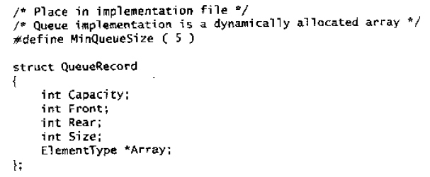
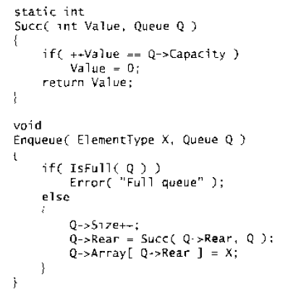
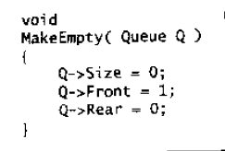

Slide 10
Circular Queue:
§4 The Queue ADT
[ 5 ]
[ 0 ]
Rear
Question:
Why is the queue
announced full
while there is
still a free
space left?
Rear
Enqueue Job 1
Do you have
a better idea?
Rear
Rear
Job
5
Job
6
Are you kidding?
Of course I do!
Enqueue Job 2
Home work:
3.26
Implement deque
Front
Front
Enqueue Job 3
Job
4
Job
1
[ 4 ]
[ 1 ]
Dequeue Job 1
Enqueue Job 4
Rear
Job
3
Job
2
Enqueue Job 5
The queue
is full
Rear
Enqueue Job 6
[ 3 ]
[ 2 ]
Front
Enqueue Job 7
Rear
Note: Adding a Size field can avoid wasting one empty space to distinguish “full” from “empty”. Do you have any other ideas?
9/9

