Slide 1


Automated Robots Design
Design of the circuit and implementation of the functions
Team members：
Tangxun Wu
Boyang He
Guanyi Lin
Donngze Sun
Weiping Kong
GROUP 16

Slide 2
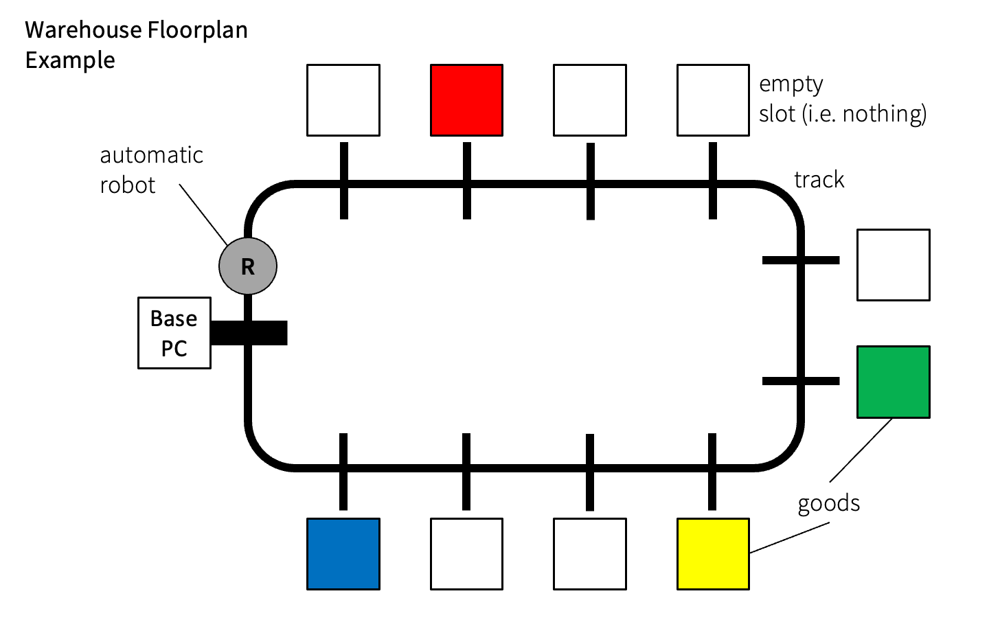
Mission Requirements
Automated Robots Design
Basic requirements:
1. follows black line tracks on the floor;
2. stops at marked positions and records the position of the
goods of four possible colours (red, blue, yellow and
green) along the track;
3. stops when it is back to the base PC;
4. offloads the recorded positions to the hardware-database
interface software
• Possible advanced functions:
– connect to the host PC wirelessly and transmit the positions
of the goods in real time.
– self-designed other functions.
Effective marketing
Innovative
design
Careful planning
Comprehensive documentation
Excellent teamwork
GROUP 16

Slide 3
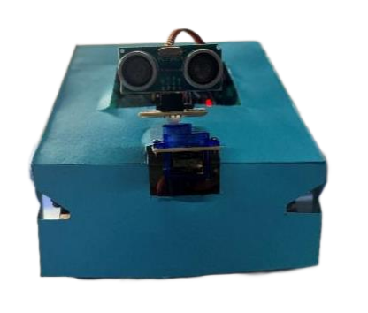
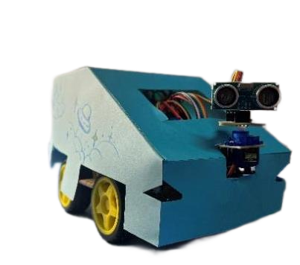
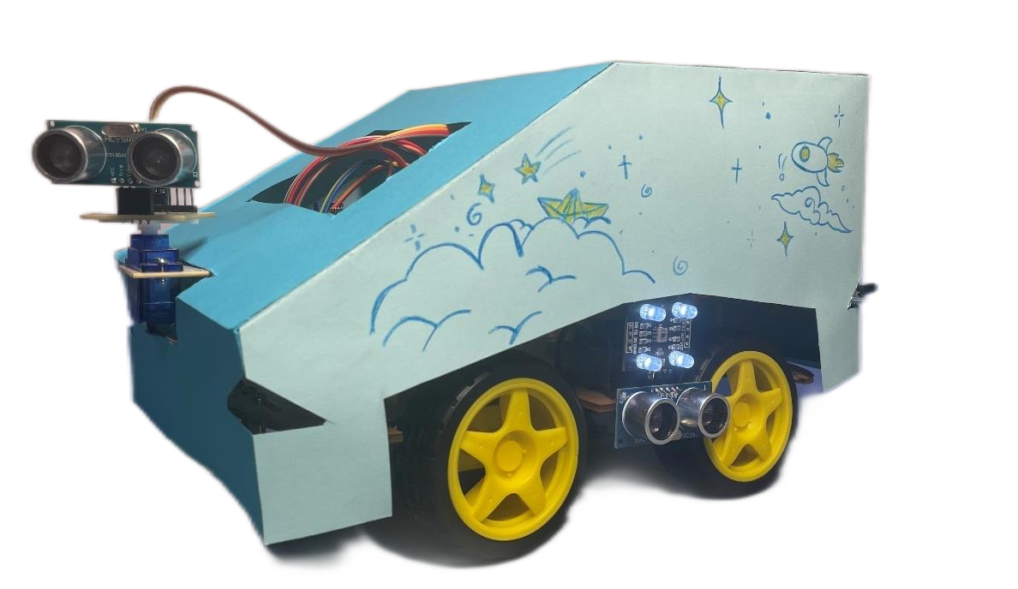
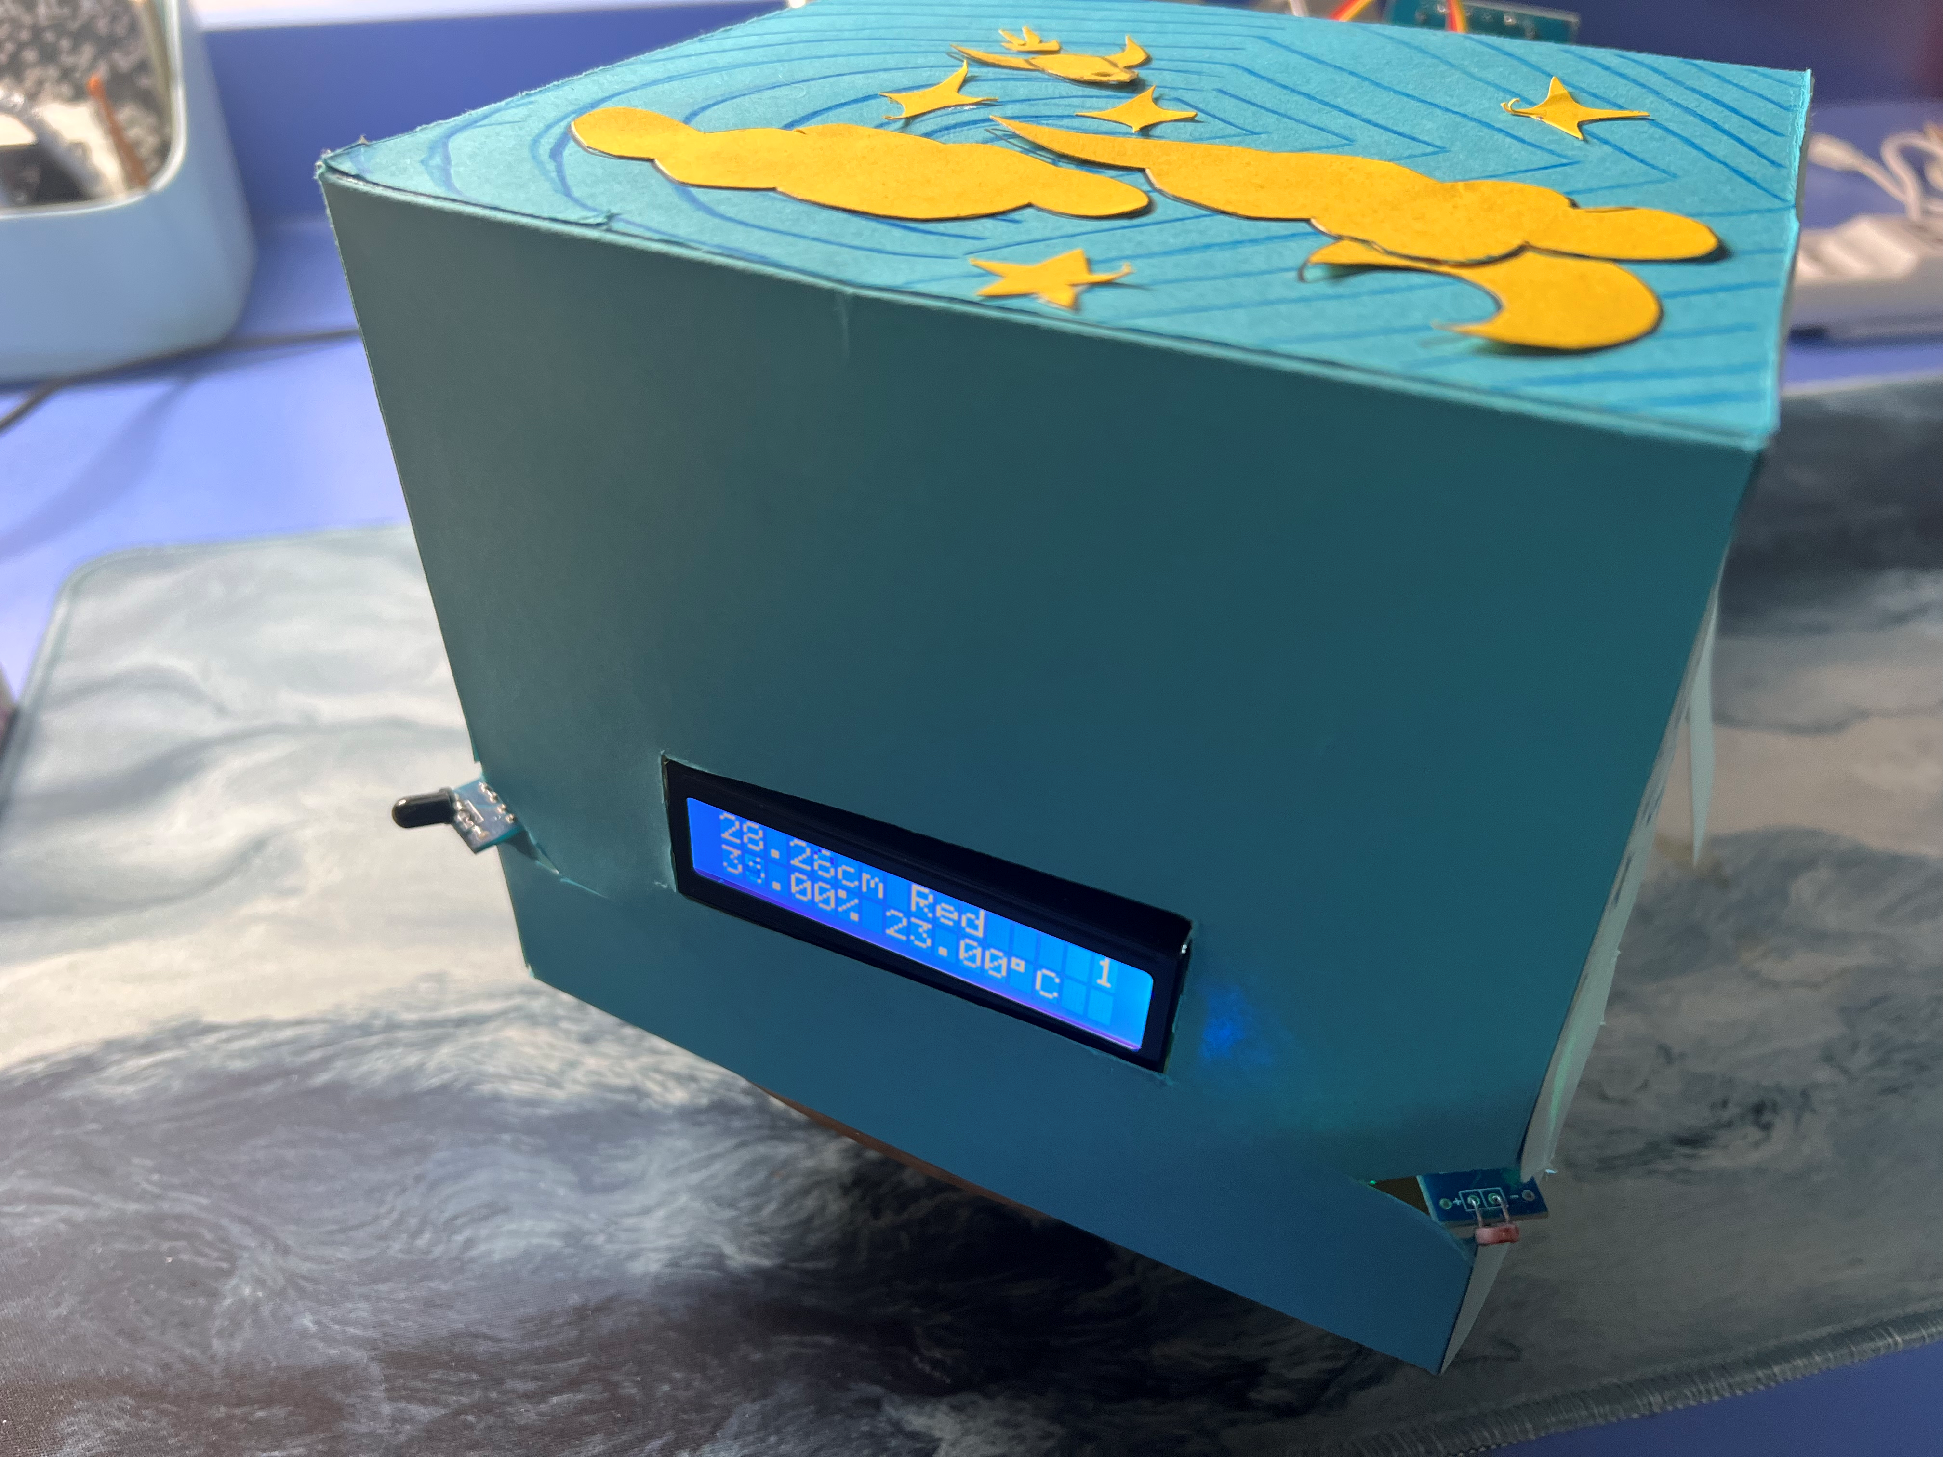
Appearance
GROUP 16

Slide 4

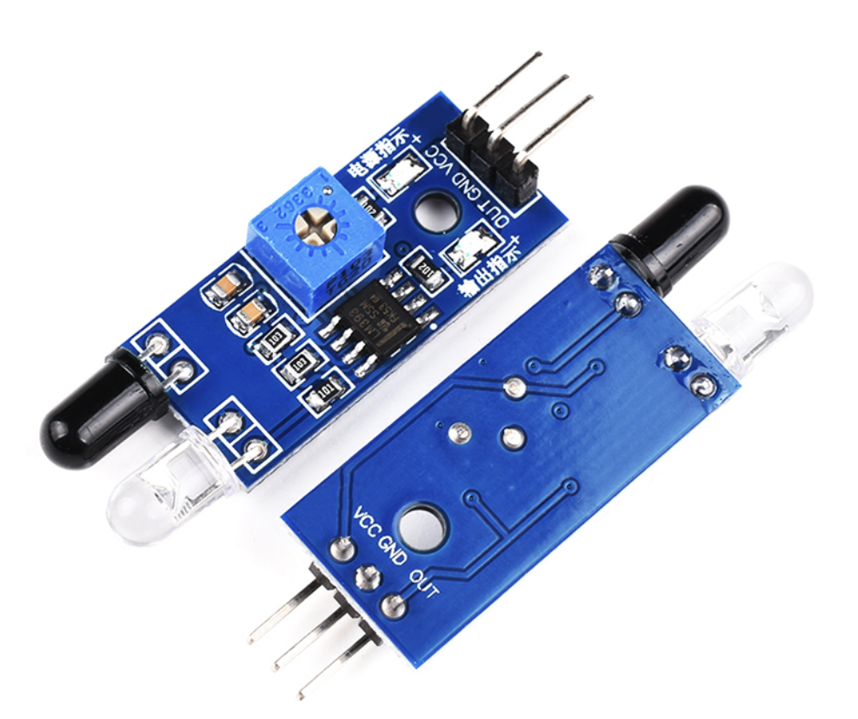
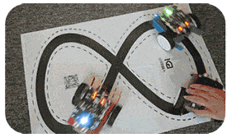
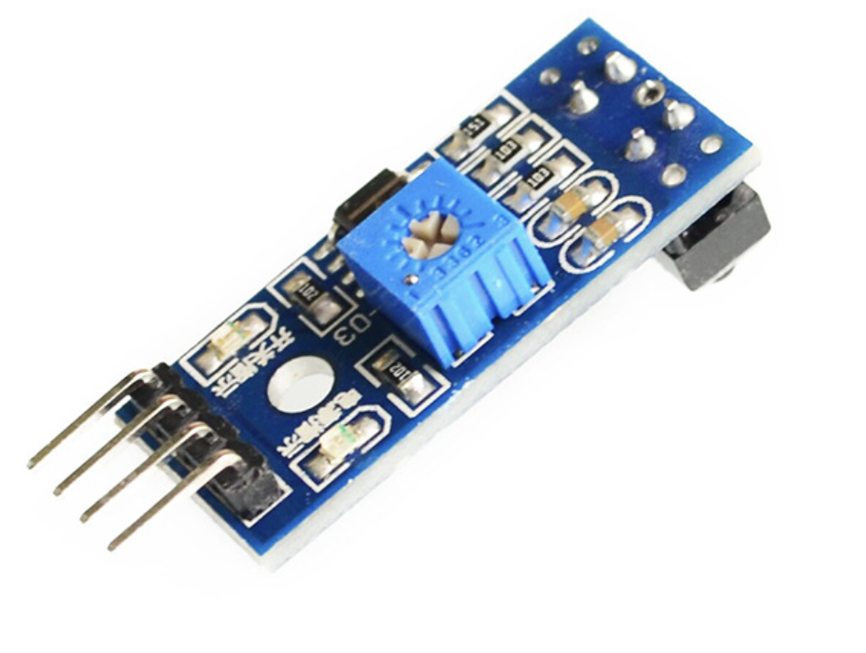
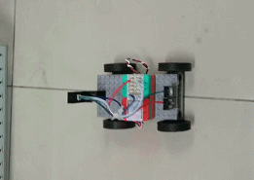
Basic Functions
Do infrared tracking
Obstacle avoidance
Useful for normal running!
Sensor for
Infrared Obstacle
Avoidance
Sensor for
Color Identification
GROUP 16

Slide 5

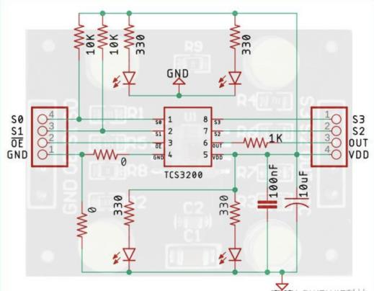
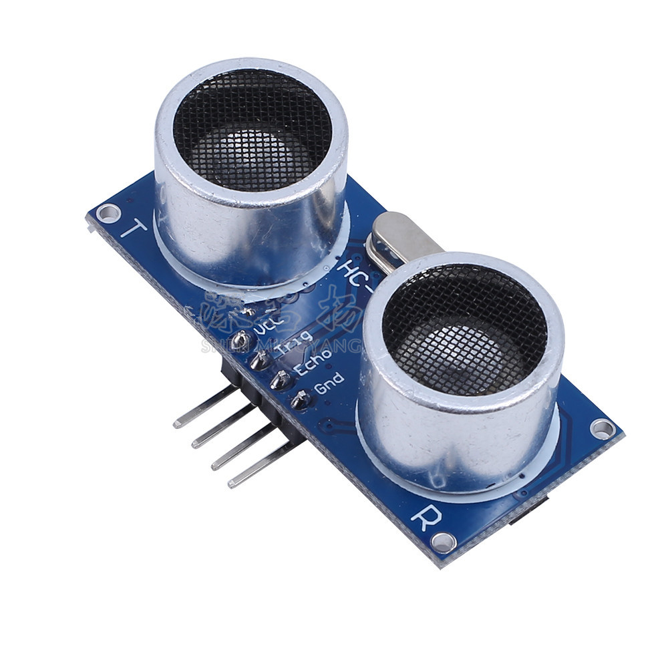
Basic Functions
3. Identify the cargos via color
4. Warehouse location counting
Optimized algorithm for accuracy!
Sensor for
Infrared Tracking
Ultrasonic Ranging
& Warehouse Counting
Transform RGB into HSV for identifying color.
Apply distance to do if-else judgement for
better warehouse counting.
GROUP 16

Slide 6
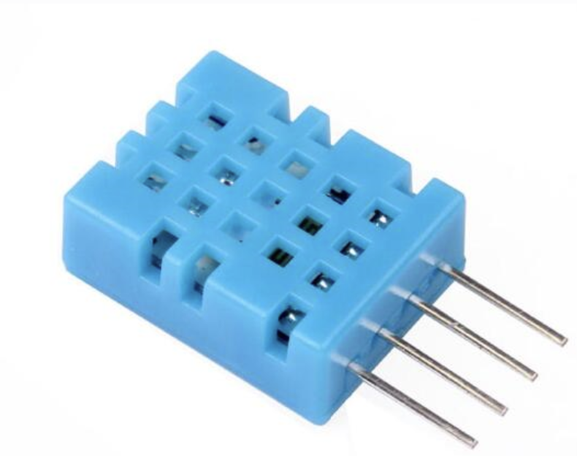
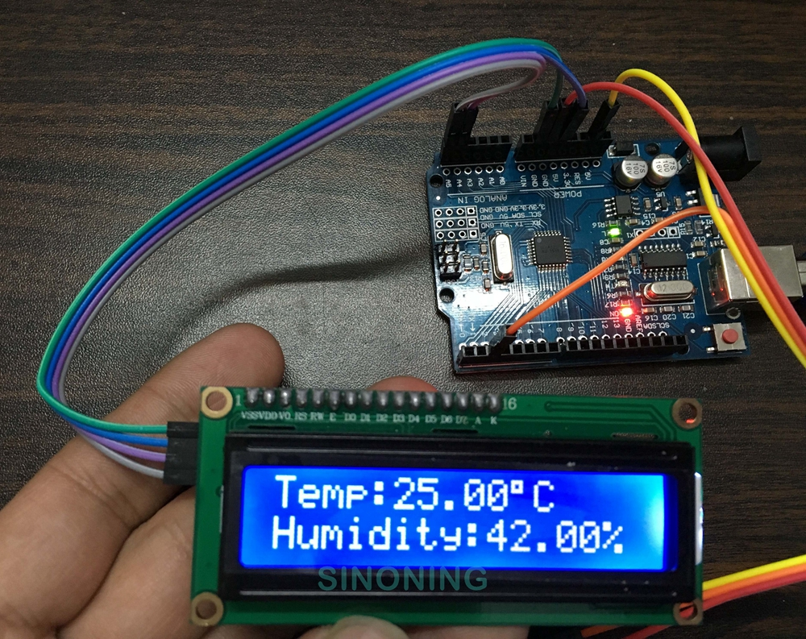
Innovation 1: Environmental monitoring
Detect indoor humidity
Measure the temperature
For better cargo storage!
Environmental
Parameter
Acquisition sensor
GROUP 16

Slide 7
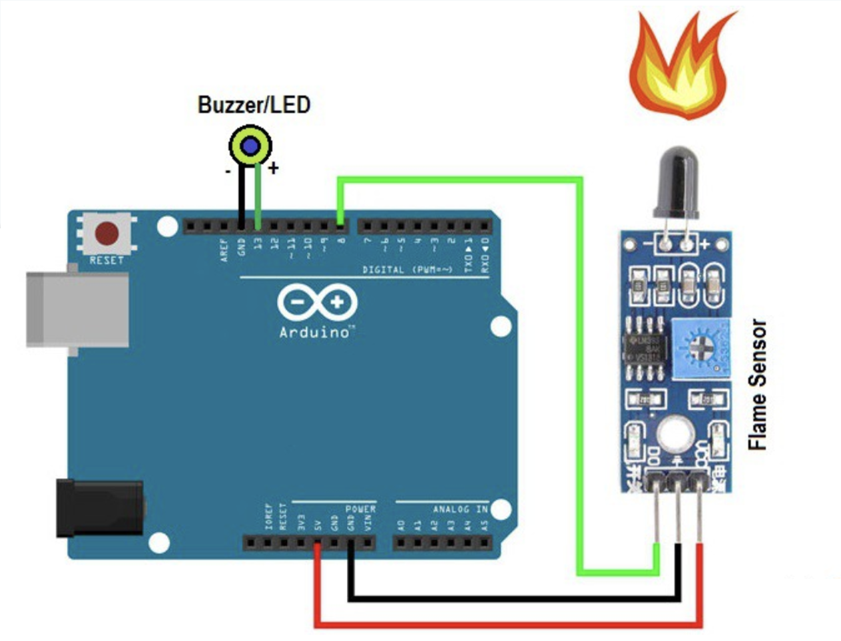
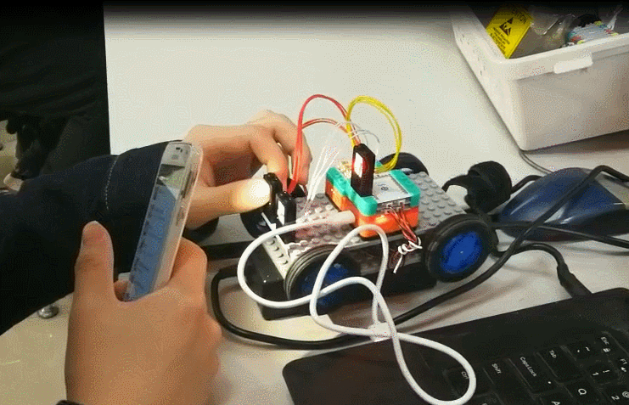
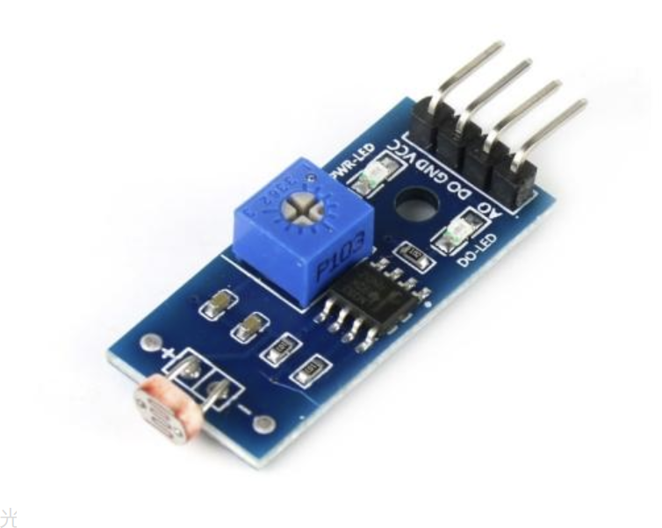
Innovation 2: Emergency control
Detect flame and give warning
Avoid robbers by checking strong light
Fire/flame
Alarm
Photosensitive/light Alarm
GROUP 16

Slide 8
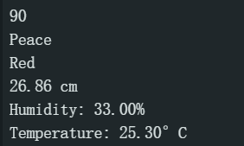
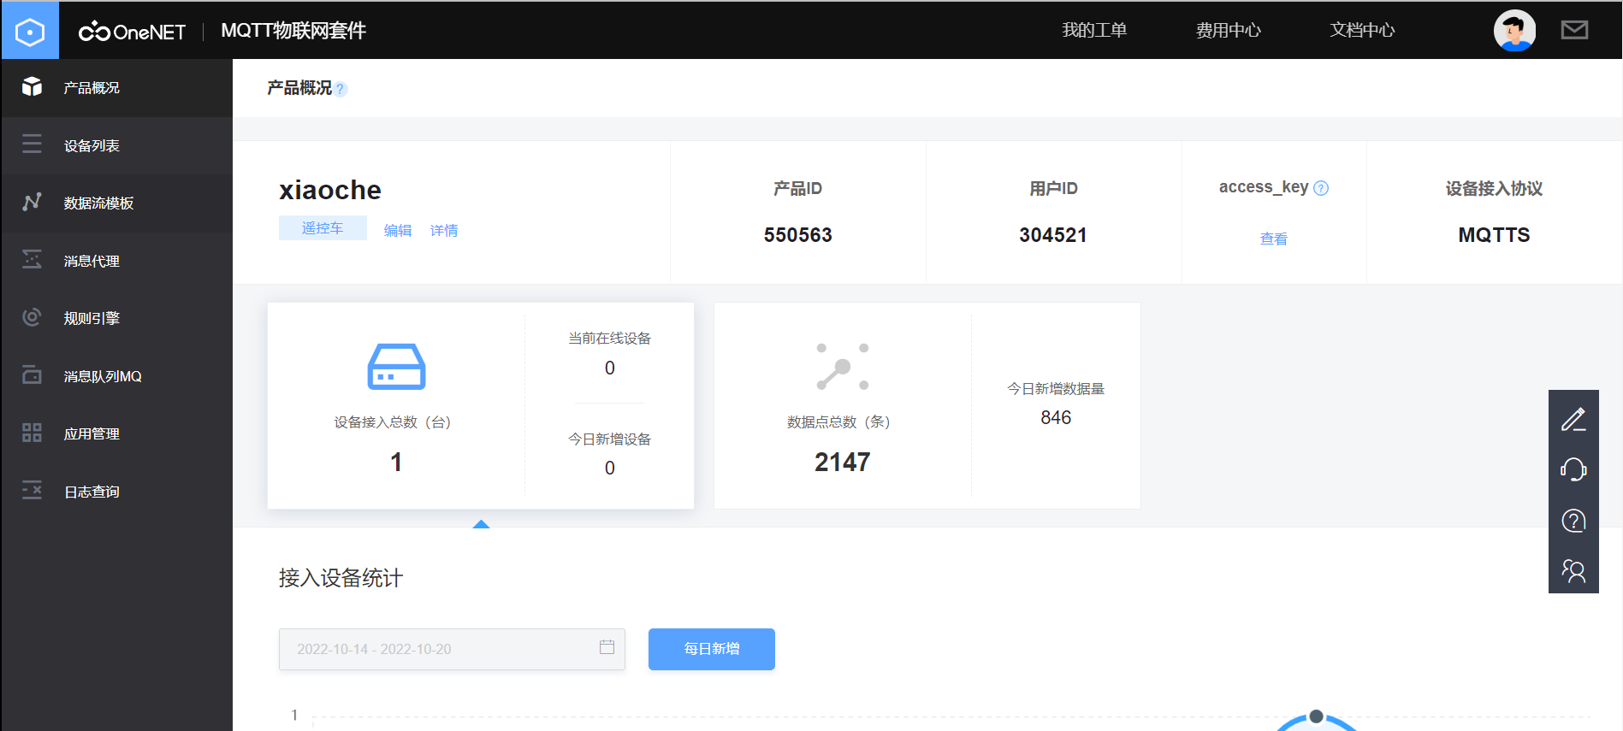
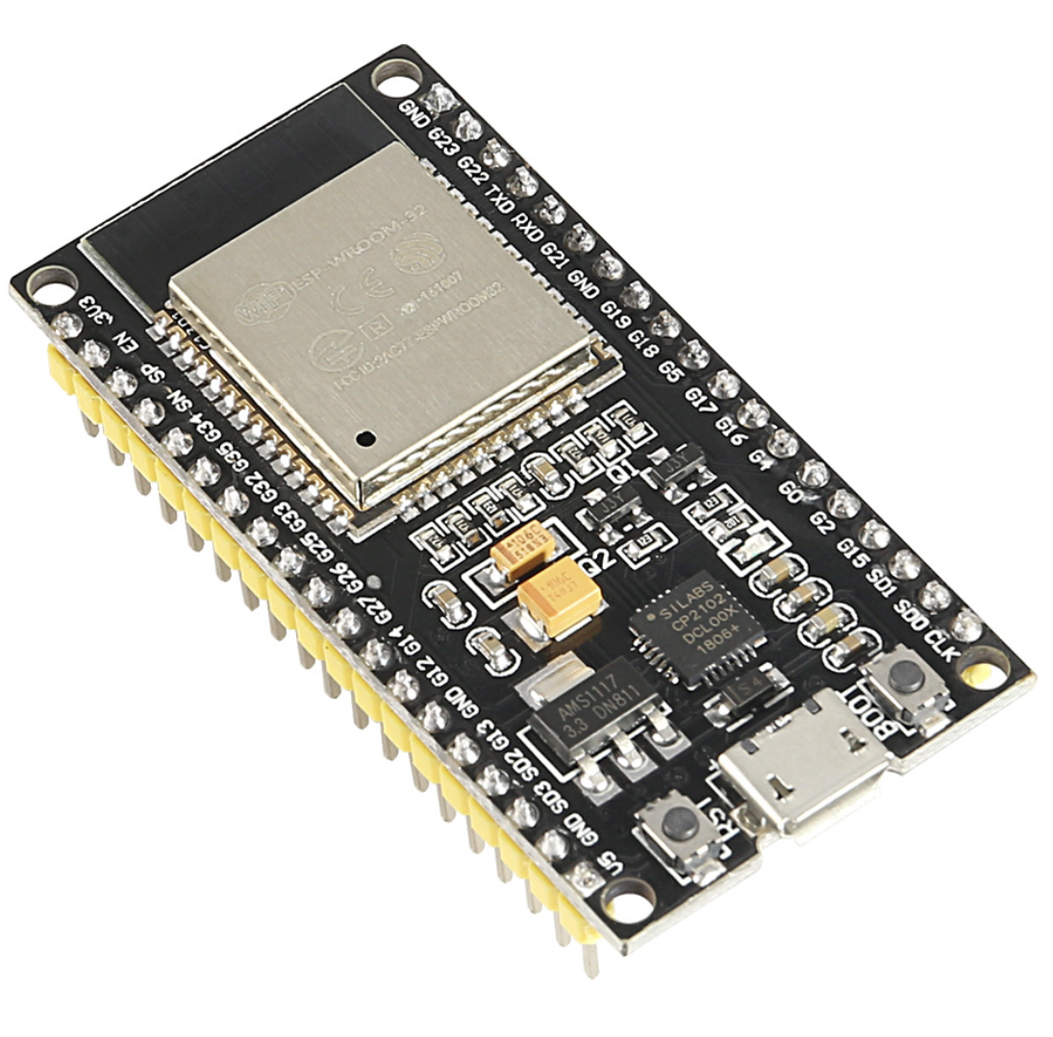
Innovation 3: Wi-Fi wireless transmission
Wi-Fi connection
upload
sensor ESP32
Step 1. Sensors read data from the environment
and transmit them to the main board.
Step 2. The main board exchanges data to esp32.
Step 3. Esp32 establishes a transmission protocol with the OneNET platform and uploads data into the platform.
Step 4. IoT students download the data stream and form an excel sheet.
GROUP 16

Slide 9
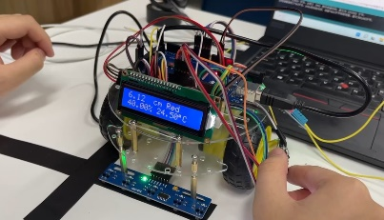
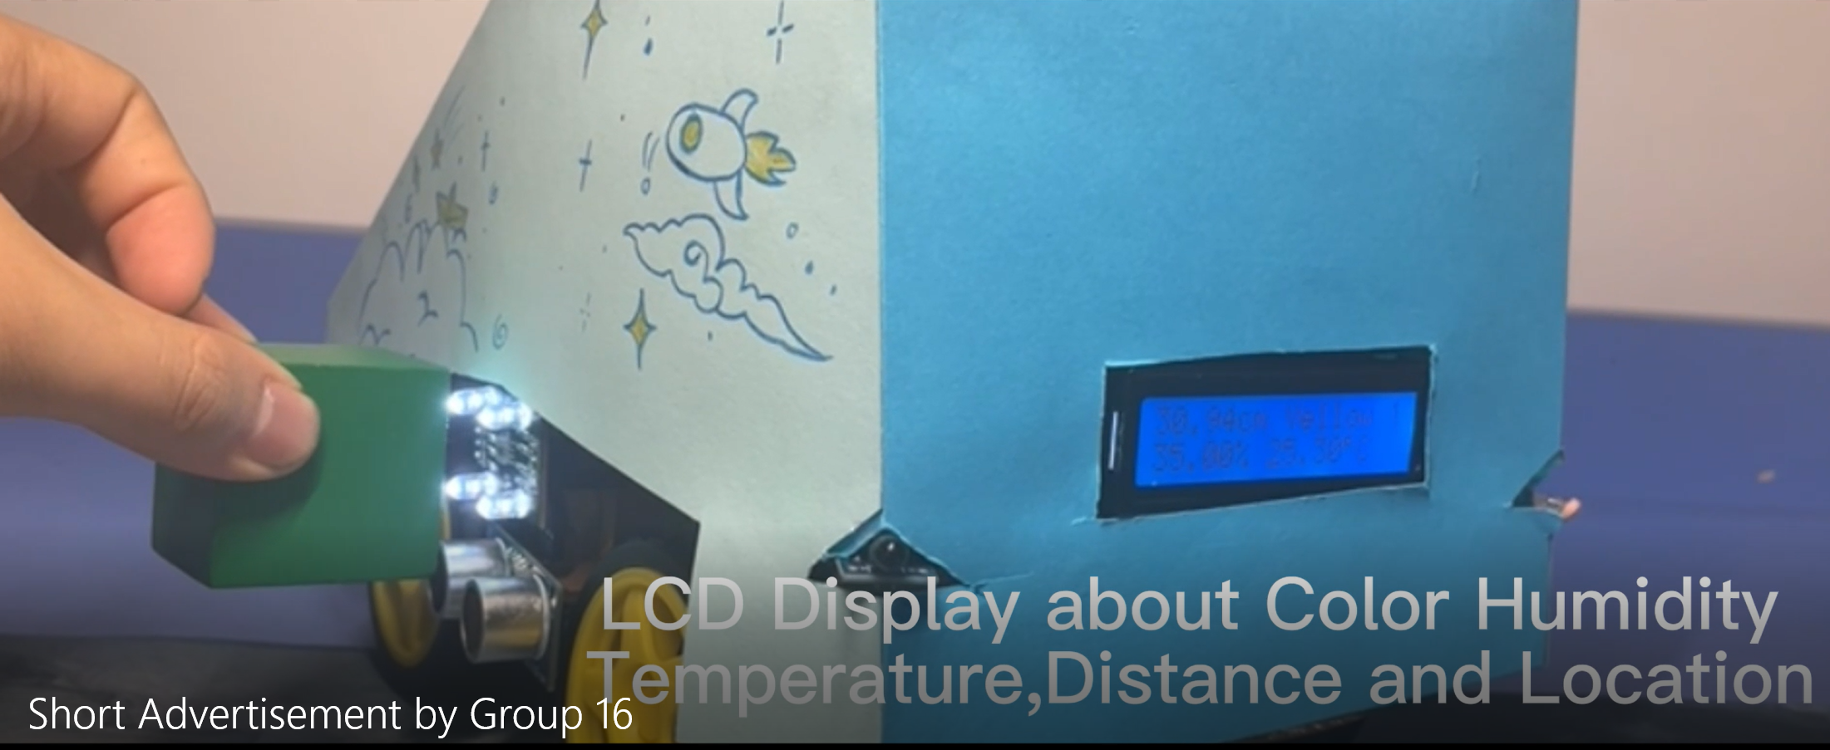
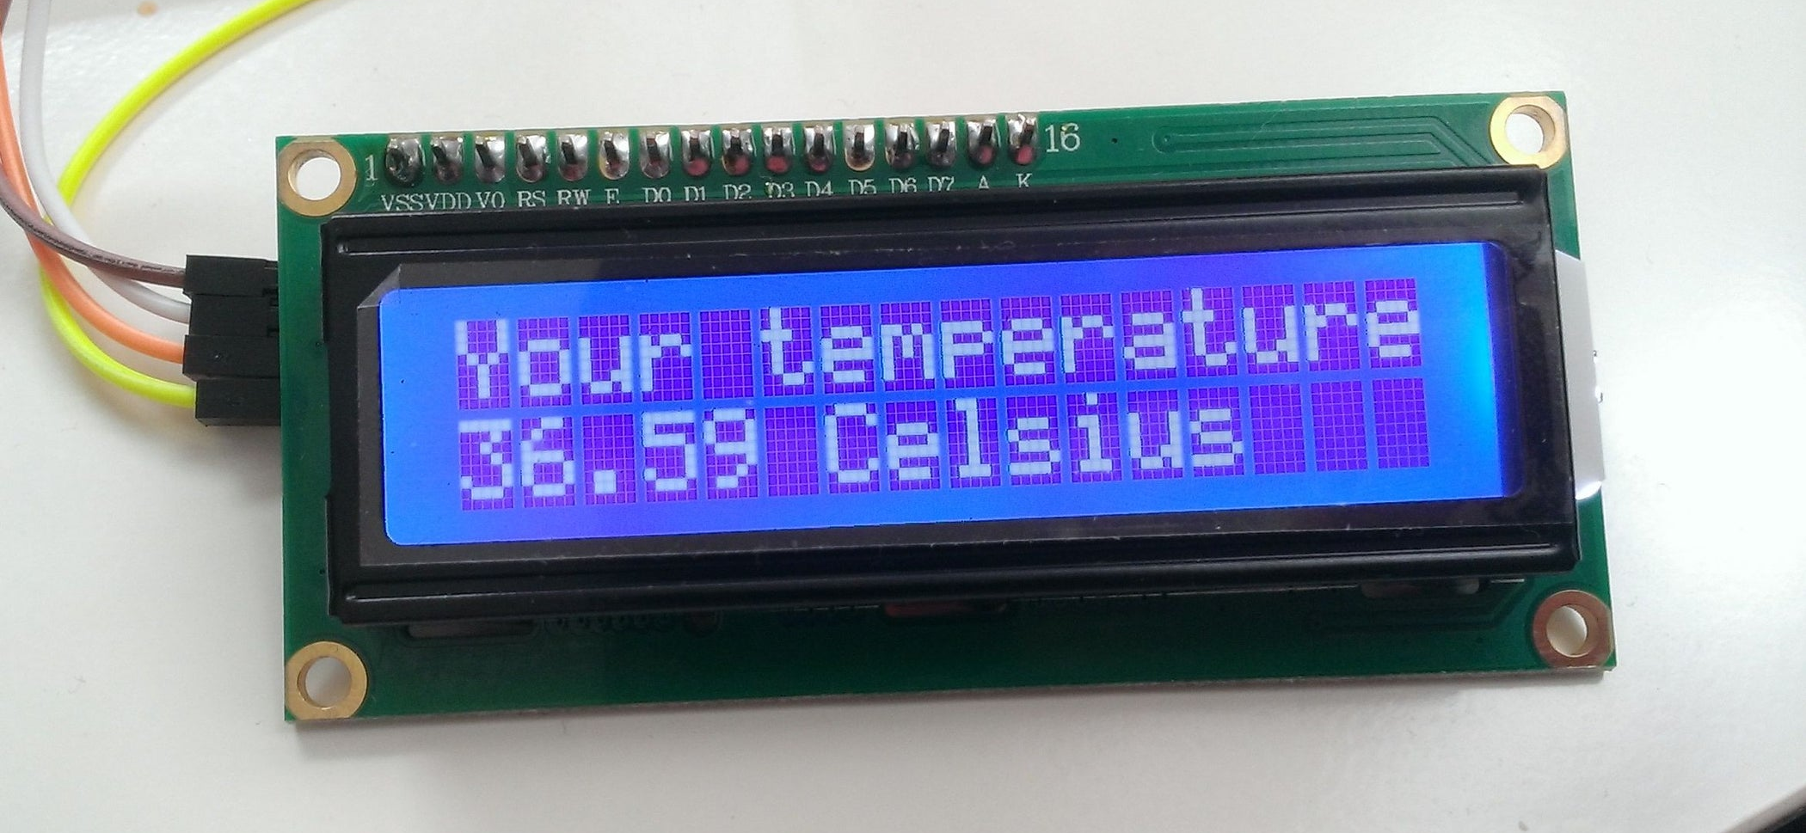

Innovation 4: LCD screen for displaying data
Distance, color, temperature, humidity, warehouse number are all displayed there!
LCD 1602
GROUP 16

Slide 10
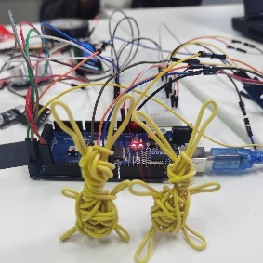
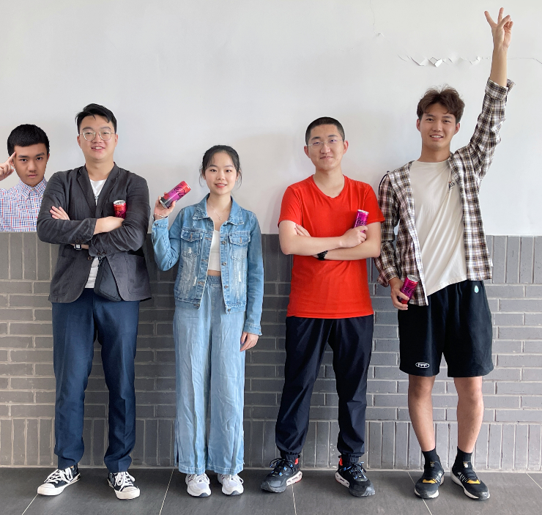
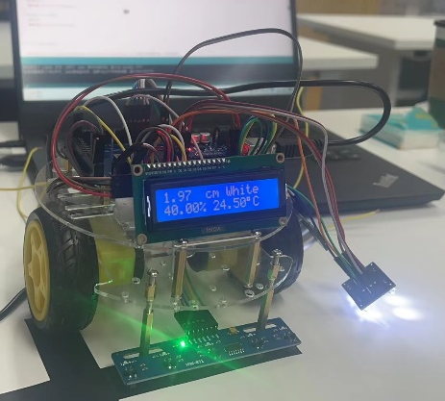

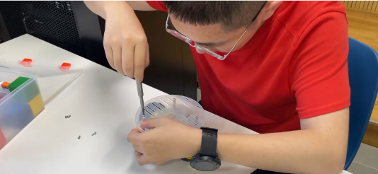
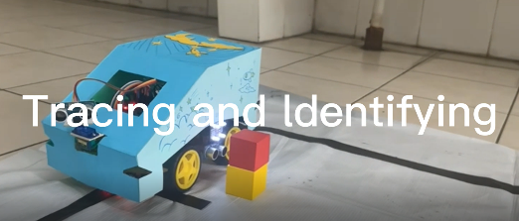
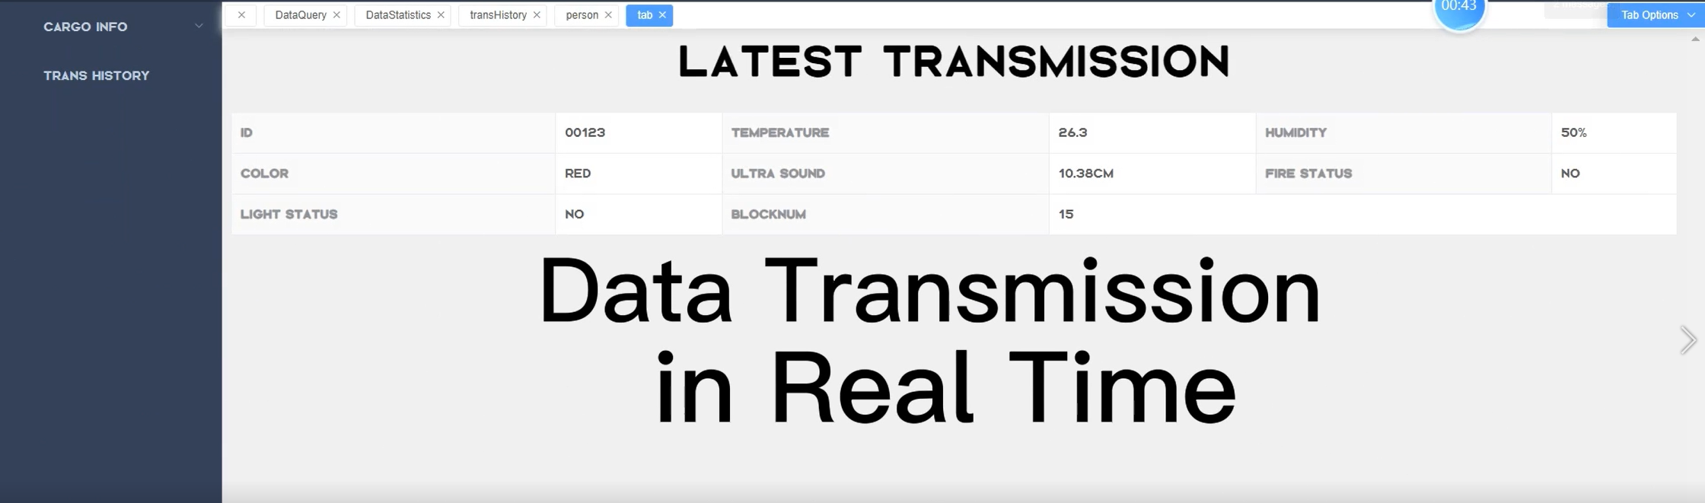
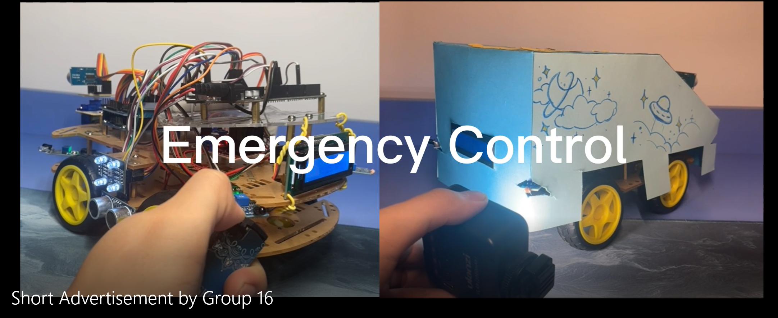
Summary
Good-looking appearance
Multiple comprehensive functions
Good data collection and update
Lower cost
Better commercial use
Perfect smart car from group 16!
GROUP 16

Slide 11

Thanks
For
Watching
Design of the circuit and implementation of the functions
Team members：
Tangxun Wu
Boyang He
Guanyi Lin
Donngze Sun
Weiping Kong
GROUP 16

