Slide 1


Automated Robots Design
Design of the circuit and implementation of the functions
Team members：
Tangxun Wu
Boyang He
Guanyi Lin
Donngze Sun
Weiping Kong
GROUP 16

Slide 2
Automated Robots Design
Mission Requirements
01
02
Appearance
CONTENTS
CONTENTS
03
Functions
04
Summary
GROUP 16

Slide 3
Mission Requirements
01
PART ONE
The First Unit
GROUP 16

Slide 4
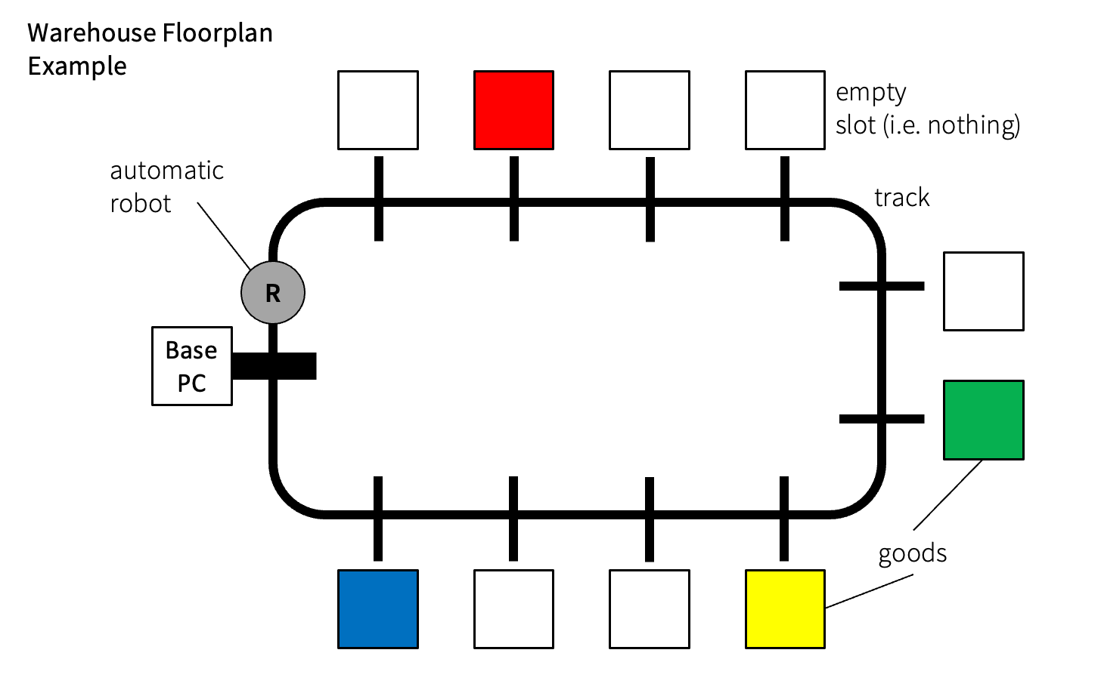
Mission Requirements
Automated Robots Design
Basic requirements:
1. follows black line tracks on the floor;
2. stops at marked positions and records the position of the
goods of four possible colours (red, blue, yellow and
green) along the track;
3. stops when it is back to the base PC;
4. offloads the recorded positions to the hardware-database
interface software
• Possible advanced functions:
– connect to the host PC wirelessly and transmit the positions
of the goods in real time.
– self-designed other functions.
Effective marketing
Innovative
design
Careful planning
Comprehensive documentation
Excellent teamwork
GROUP 16

Slide 5
02
Appearance
PART TWO
The Second Unit
GROUP 16

Slide 6
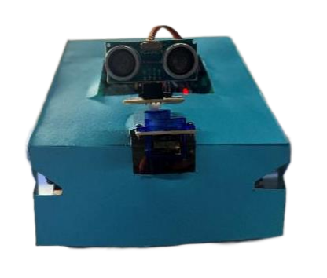
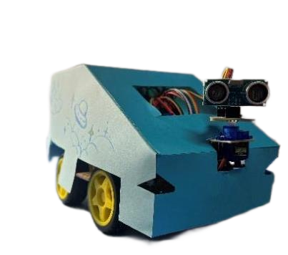
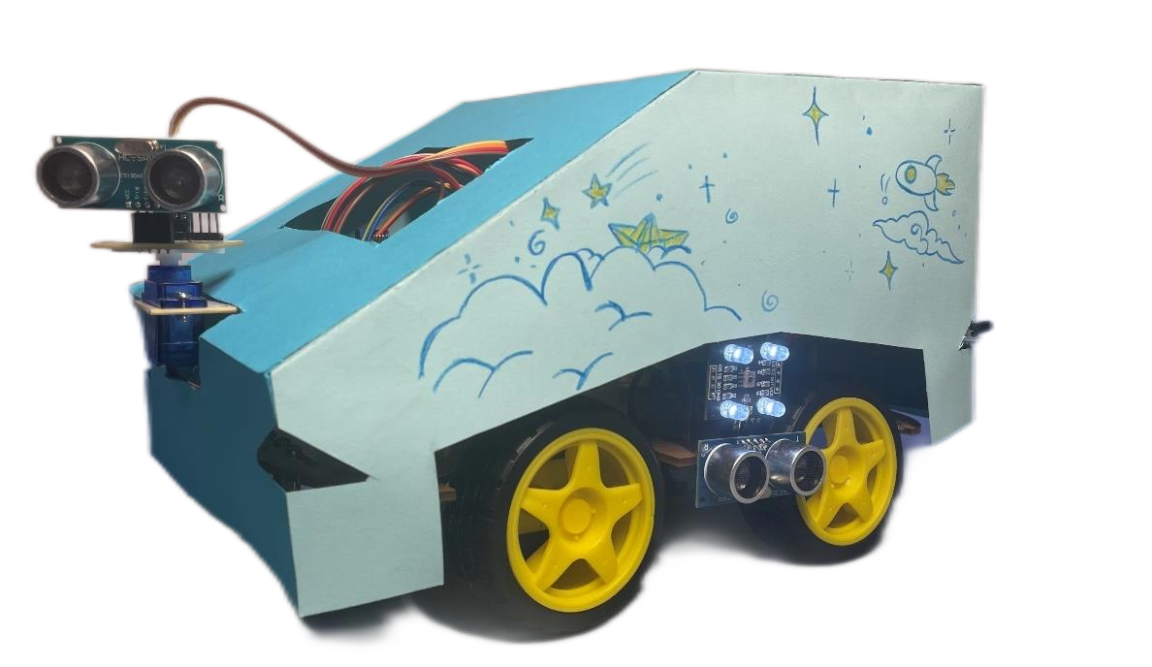
Appearance
GROUP 16

Slide 7
03
Functions
PART THREE
The Third Unit
GROUP 16

Slide 8
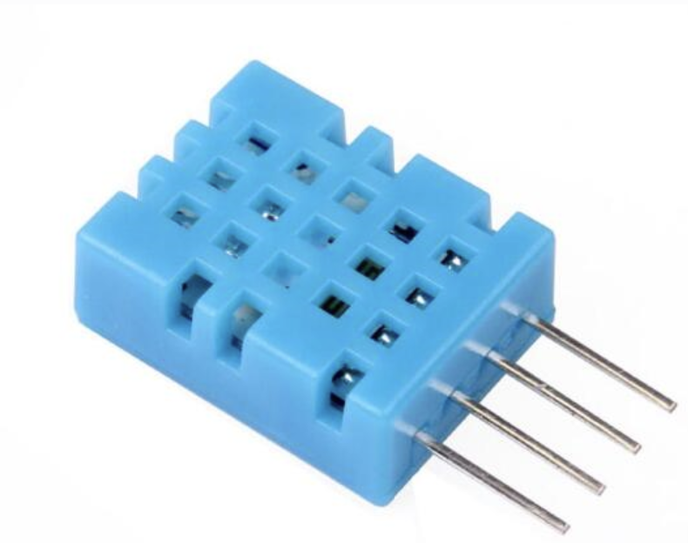
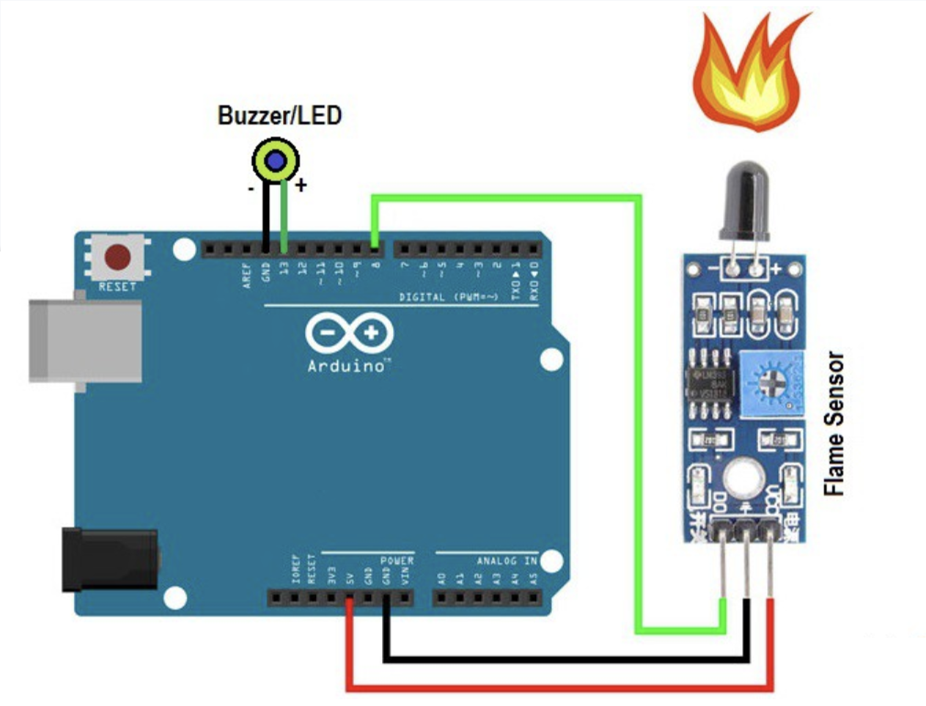
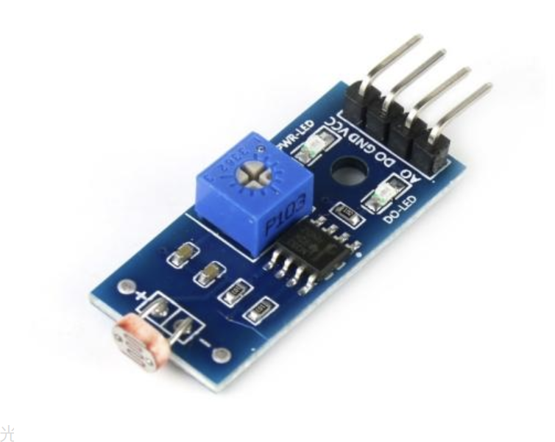
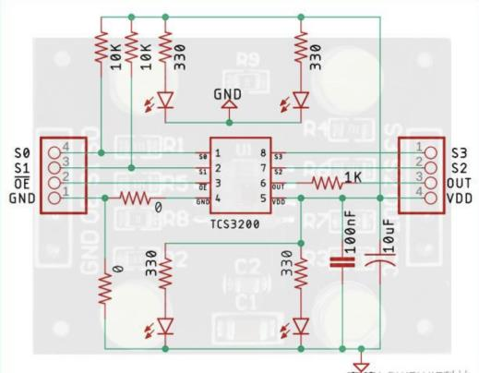
Functions
Environmental
parameter
acquisition
Fire
Alarm
Photosensitive Alarm
Cargo Identification
GROUP 16

Slide 9
Functions
Environmental
parameter
acquisition
Fire
Alarm
Photosensitive Alarm
Cargo Identification
GROUP 16

Slide 10
Functions
Environmental
parameter
acquisition
Fire
Alarm
Photosensitive Alarm
Cargo Identification
GROUP 16

Slide 11
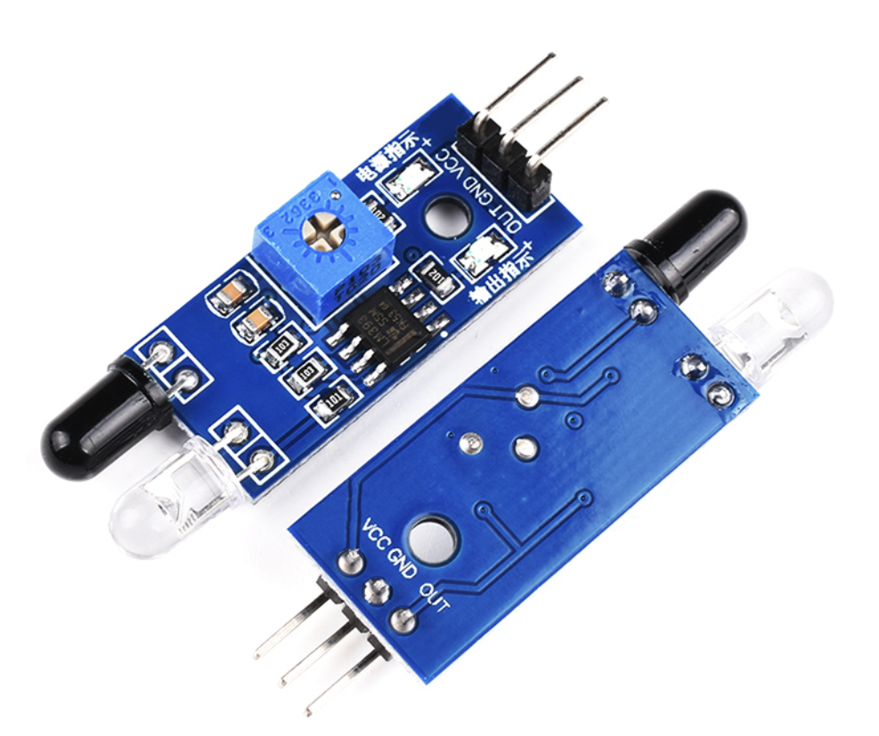
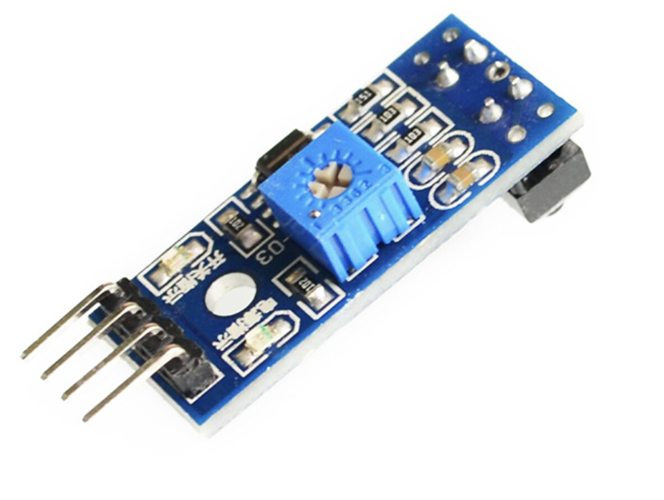
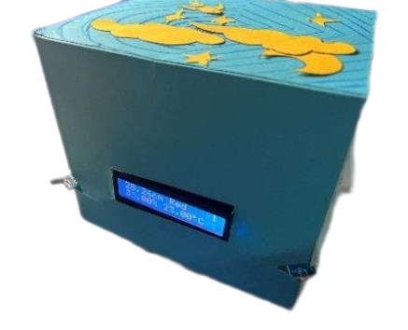
Functions
Infrared
Obstacle
Avoidance
Ultrasonic Ranging
& Warehouse Counting
Infrared
Tracking
LCD Visualization
GROUP 16

Slide 12
Functions
Infrared
Obstacle
Avoidance
Ultrasonic Ranging
& Warehouse Counting
Infrared
Tracking
LCD Visualization
GROUP 16

Slide 13
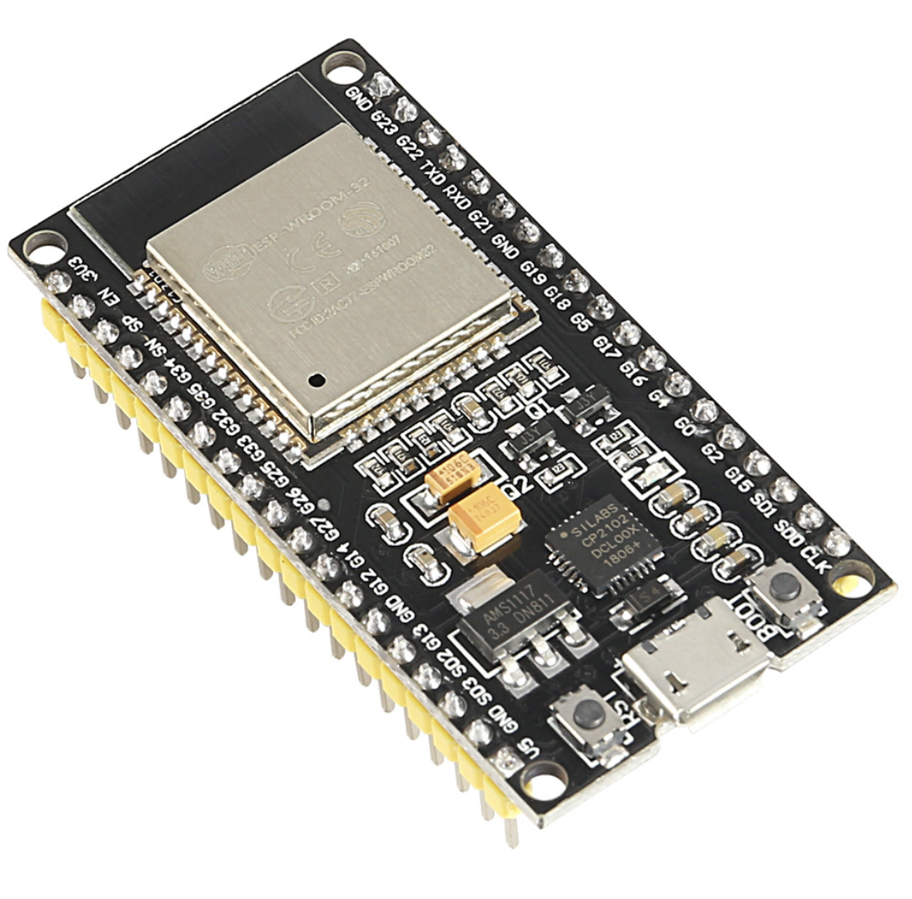
Functions
Wi-Fi
Connection upload
GROUP 16

Slide 14
04
Summary
PART FOUR
The First Unit
GROUP 16

Slide 15
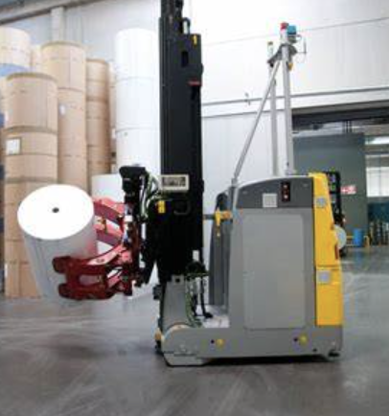
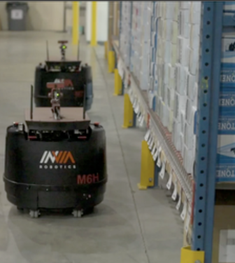
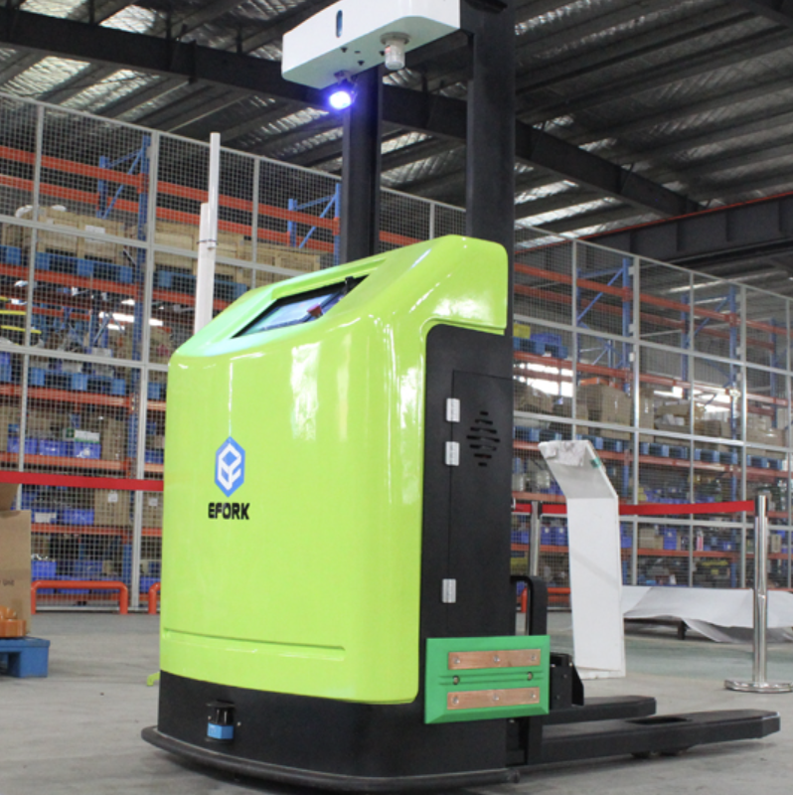
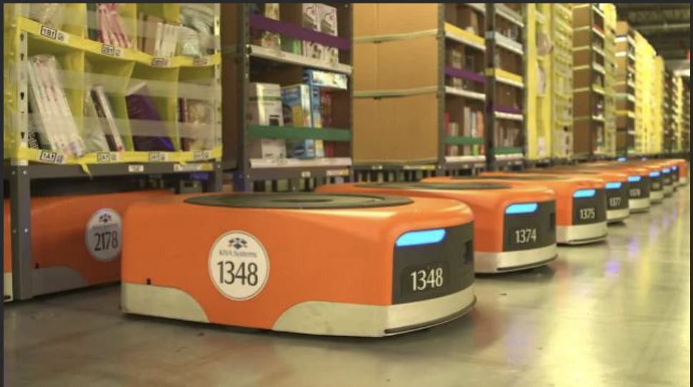

Summary
GROUP 16

Slide 16

Thanks
For
Watching
Design of the circuit and implementation of the functions
Team members：
Tangxun Wu
Boyang He
Guanyi Lin
Donngze Sun
Weiping Kong
GROUP 16

