Slide 1
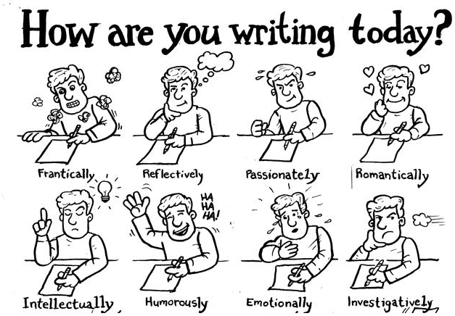

Slide 2

Writing is nothing easy.
Essay writing is difficult, but following concrete guides will improve your writing skills and make it easier to create an original, coherent essay.

Slide 3
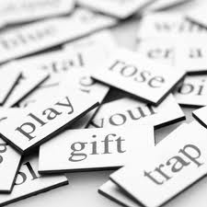

What composes a good essay?
Structure
Training
Revision
Creativity
Inspiration
Aspiration

Slide 4
Priority: 规范格式-标题
Title: Capitalize the important words
Adjectives (tiny, large, etc.)
Adverbs
Nouns
Pronouns
Subordinating conjunctions
Verbs
Attention: avoid over-capitalization; no need to use punctuation marks except for ?
An Introdution to Writing
The Persecution and Assassination of Jean-Paul Marat as Performed by the Inmates of the Asylum of Charenton Under the Direction of the Marquis de Sade

Slide 5
Priority: 规范格式-标点
Comma and colon
I bought bananas, peanut butter, peas, two cans of soda, a beef steak, and an orange juice.
Mandy asked, “Are you working now?”
I could choose from among three options: to become an engineer, to start my own band, or to study abroad for a year.

Slide 6

Sentence Structure Problems
这次写作问题-典型错误
There are four types of common problems:
(1) Sentence Fragments 残缺句
(2) Run-on Sentences 粘连句
(3) Misplaced Modifiers 误置修饰语
(4) Dangling Modifiers 悬垂修饰语

Slide 7

(1) Sentence Fragments
Having no money and being lonely in the big city.
Corrected： Having no money and being lonely in the big city, the old woman committed suicide.

Slide 8
(2) Run-On Sentences
粘连句 （接排句）就是两个或更多的句子或谓语混合叠加在一起，没有正确的标点或连接词标明关系的句子。
I called for a reservation at a famous restaurant in town, all the tables
were taken before the Dragon Boat Festival.
这种句子可以使用四种方式来修正：
1. a period 2. a semicolon
3. a coordinating conjunction 4. a subordinating conjunction

Slide 9
Practice
Revise the following run-on sentence
Women no longer need to move into the traditionally male professions they have already opened the doors to most career paths.

Slide 10
(3) Misplaced Modifiers
误置修饰语，亦称“修饰语错位”，在修饰语和其所修饰的中心词之间不恰当地夹进了其他成分。
He sold the old car to the man with leather seats.
The robber was described as a six-foot-tall man with a mustache weighing 150 pounds.
Corrected: He sold the old car with leather seats to the man.
Corrected: The robber was described as a 150-pound, six-foot-tall man with a mustache.

Slide 11
(4) Dangling Modifiers
To write the proposal, research must be done.
Corrected: To write the proposal, the professor must first do some research.
非限定性动词短语作状语时，易形成悬垂性修饰语。

Slide 12
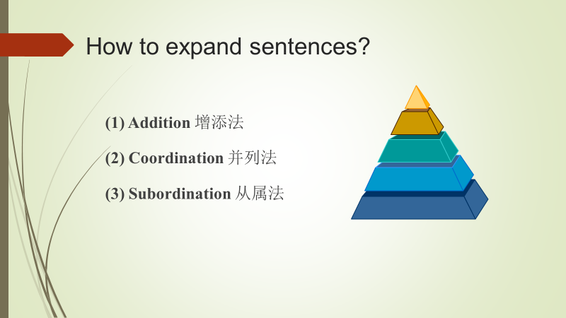
Is writing tortuous?
The truth is:
Writing a great essay doesn’t happen in one sitting, you must commit yourself to a process.
Where to begin? Sentence.

Slide 13
请大家第二次写作前花点时间看完后面的内容：
基本句式和标点符号

Slide 14
SV
Things change.
There exist a variety of different opinions on this question.
“There + be” 是倒装结构，谓语还可以是appear， come， enter， exist， happen， lie， live， occur， remain， rise， seem， stand等。

Slide 15
SVCs
Hard work and honesty are the keys to success.
Without suitable preservation, food goes bad easily.
系动词还有appear， become， grow， prove，remain，run， seem， feel， look， smell， sound， taste等。

Slide 16
SVO
Students often recite useful phrases to be used in their compositions.
He hoped to major in law while taking part-time jobs.
以动名词作宾语的动词包括avoid, admit, deny, enjoy, finish, keep, mind, postpone, recommend, prefer, require, resume, risk, quit, practice 等。
及物动词可接不定式作宾语，如, agree, ask, decide, determine, hope, learn, order, pretend, promise, try, want 等。

Slide 17
SVO
及物动词可以接动名词或不定式作宾语，其意义基本相同。较常见的这类动词有：begin, continue, intend, like, prefer, start 等。例如，
Young people like to wear/wearing stylish clothes.
有些动词, 如：forget, need, remember, stop, try等，之后接动名词或不定式作宾语时含义不同。试比较：
● I remember locking the door before leaving the room.
● I remember to lock the door before leaving the room.

Slide 18
SVOiOd
A friend brought me a textbook of internal medicine.
OR: A friend brought a textbook of internal medicine to me.
一位朋友给我带来一本内科学教科书。
此句型的动词有accord, allow, bring, buy, fetch, get, give, lend, offer, save, sell, send, show, take, wish等。

Slide 19
SVOCo
Today, we call Einstein a genius.
They believe it important to make an early diagnosis of cancer.
主谓宾补结构的常见动词有believe, call, consider, cut, elect, find, have, keep, leave, let, like, make, name, see, think, want, wish等。

Slide 20

Punctuation
(1) Colon
(2) Semicolon
(3) Comma
(4) Quotation marks

Slide 21
(1) colon
Do you know the functions of colon in these sentences?
Most students use two dictionaries: a bilingual dictionary and an English dictionary.
There are several reasons to throw the emphasis forward: to list, to explain, and to illustrate a long quotation.
Southwest Stories: Tales from the Desert
8:30 a.m.
a ratio of 3:5
(To list）
(To Explain)
(To separate titles and subtitles)
(To express time)
(To express ratios)

Slide 22
(2) Semicolon
When shall semicolon be used?
No one is born with knowledge; knowledge must be taught and learned.
We are planning a trip to Disney World next summer; therefore, even the children are saving their pennies.
Quincy Market is a popular tourist attraction in Boston; the White House, in Washington, D.C.; and the Statue of Liberty, in New York City.
(并列句之间)
(连接副词之前)
(逗号表达不清之处)

Slide 23
(3) Comma
When shall comma be used?
As the examination approaches, some students cram for it.
Tom, who is my close friend, will visit me tomorrow.
For a small sum of money, you can be a shareholder of this company.
School life is often unforgettable, and it brings many sweet memories.
（状语从句在主句之前）
（非限定性定语从句）
（介词短语在句首）
（并列连接词之前）

Slide 24
Vitamin K is found in spinach, lettuce, kale, cabbage, cauliflower, liver, and egg yolk.
The story is narrated objectively at first, subjectively toward the end.
The first version of our book published on June 7, 2003.
123,456,789
Dear Sam, Sincerely yours
（词或短语之间）
（对比）
（日和年份之间）
（数字）
（信函的开头与结束）

Slide 25
(4) Quotation Marks
When shall quotation marks be used?
Ben Franklin once wrote, “To lengthen thy life, lessen thy meals.”
They are discussing the article “ The Problem of Acid Rain”.
引语中的引语用单引号
“What do you mean by ‘language acquisition device’? ” one of the students asked.
(标引某讲话人)
(短篇作品的名称)

