Slide 1
POLICE BRUTALITY: A COMPARISON BETWEEN ETHNICITY
Jefta Adriel Heryadi – 2106638671

Slide 2
TABLE OF CONTENTS
01
02
BACKGROUND
STATUS QUO
03
04
DATA
VISUALIZATION
How it started, why is it important, and questions
Development of the case in 2023
What kind of data that is necessary
Showing police brutality counts for each ethnicity

Slide 3
DISCLAIMER
This is just an assignment for a class and not a scientific project, do your own research as well.

Slide 4
01
BACKGROUND

Slide 5
HOW IT STARTED
2001-2013
2015
‘Stop & Frisk’ Policy => targetted lots of Black people.
Sandra Bland is found dead after being arrested during a traffic stop
2007
2020
NYPD releases data showing racial disparities in its policing
Death of George Floyd reignite worldwide protests and popularize Black Lives Matter (BLM)

Slide 6
WHY IS IT IMPORTANT
LACK OF CREDIBILITY
BIAS
LIES USING STATISTICS
Lots of people and social media spreading the narration without providing any credible data
The narration of Police Brutality most of the time only highlights the case on Black people without providing additional information on other ethnics and races
People can lied using the counts of cases only, but not the proportion of cases per ethnicity

Slide 7
QUESTIONS
Is there a higher prevalence of police brutality cases involving Black individuals compared to other racial groups?

Slide 8
02
STATUS QUO

Slide 9
A GROWING TREND!
Up until 2023, the case of police brutality in USA still happens, and the total number of people that were killed per year from 2020 – 2022 shows a growing trend.
Up until 2023, the case of police brutality in USA still happens, and the total number of people that were killed per year from 2020 – 2022 shows a growing trend.
Year | Number of People Killed
2020 | 1150
2021 | 1173
2022 | 1247

Slide 10
03
DATA

Slide 11
DATASET
A good dataset for verifying this information:
Contains information about the dates when the police brutality happens, the states and cities where it happens, the race and ethnicity of the victim
It’s better if it also contains additional information such as gender, whether the victim armed or nor, whether the victim tries to flee or not, whether the victim shows signs of mental illness, etc.
Dataset that has demographic population data for each cities in each state for each race and ethnicity

Slide 12
04
VISUALIZATION

Slide 13
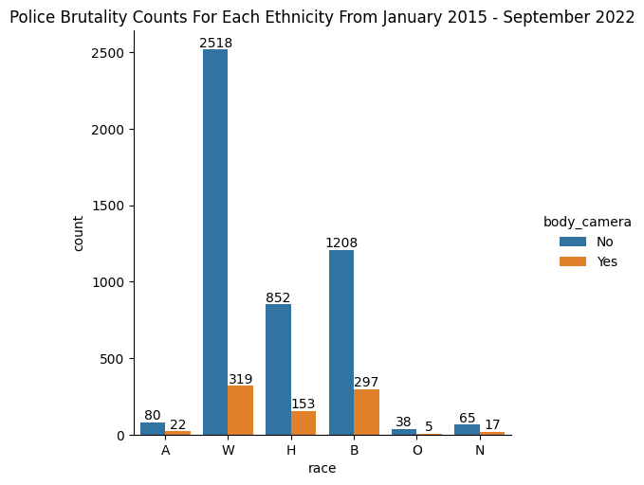
Only seeing from the count plot, one can argue that it is untrue that police brutality targets Black people more than other races.
From the plot, White people were the one who were killed the most by police brutality cases, followed by Black people, Hispanic people, Asian people, Native people, and Other people.
From the plot, there are more cases with no body camera on the police compared to cases with body camera on the police.
A = Asian
W = White
H = Hispanic
B = Black
O = Other
N = Native

Slide 14
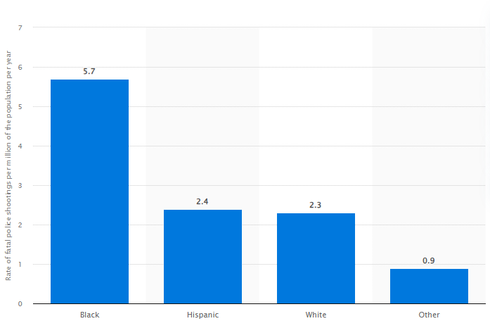
Rate of fatal police shootings in the United States from 2015 to July 2023, by ethnicity (per million of the population per year)
The demographic data for USA is 40 million Black Americans, 62 million Hispanic Americans, 192 million White Americans, 38 million Americans listed as "other“
From the demographic data, it is understandable if White people have more cases counts because they have more number compared to Black people
From the plot, we can see that by proportion, police brutality (shootings) targets Black people more than other races.
Source: https://www.statista.com/statistics/1123070/police-shootings-rate-ethnicity-us/

Slide 15
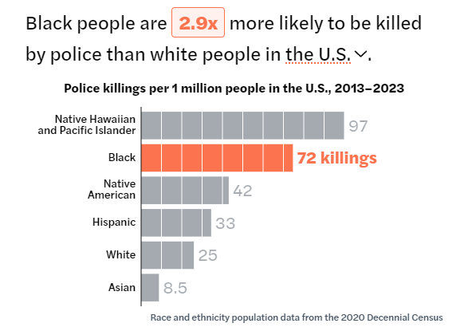
Source: https://mappingpoliceviolence.org/

Slide 16
QUESTION
Is there a higher prevalence of police brutality cases involving Black individuals compared to other racial groups?
ANSWER
According to the data collected from 2020 to 2022, and supplemented by other sources for 2023, it appears that when adjusted for population size, Black individuals are indeed more frequently involved in police brutality cases. However, in terms of absolute numbers, this is not the case.

Slide 17
REFERENCE
[1] Jas, R. (n.d.). 👮‍♂️🔫US Police Shootings from 2015- Sep 2022. Kaggle.com. Retrieved September 10, 2023, from https://www.kaggle.com/datasets/ramjasmaurya/us-police-shootings-from-20152022
[2] Statista (2023, August 10). Number of people shot to death by the police in the United States from 2017 to 2023, by race. Statista.com. Retrieved September 10, 2023, from https://www.statista.com/statistics/585152/people-shot-to-death-by-us-police-by-race/
[3] Statista (2023, August 10). Rate of fatal police shootings in the United States from 2015 to July 2023, by ethnicity (per million of the population per year). Statista.com. Retrieved September 10, 2023, from https://www.statista.com/statistics/1123070/police-shootings-rate-ethnicity-us/
[4] Mapping Police Violence (2023, July 31). Mapping Police Violence. Retrieved September 10, 2023, from https://mappingpoliceviolence.org/
[5] Neal, E. (2022, April 29). A history of police violence in America. Stacker.com. Retrieved September 10, 2023, from https://stacker.com/history/history-police-violence-america
The Python code used to preprocess and visualize the [1] Dataset can be accessed on:
https://github.com/JeftaAdriel/Softskill-DS/blob/main/TugasIndividu1/CodePython_TugasIndividu1_JeftaAdrielHeryadi_2106638671.ipynb

Slide 18
THANKS!

