Slide 1




Security Platform for Mobile OS
Project ID :- 19-001

Slide 2
Authors
Supervisor : Mr. Amila Nuwan Senarathne
Co Supervisor : Mr. Kavinga Yapa Abeywardena
Student ID | Name
IT16009400 | Brayan Benett A.S
IT16026544 | Vinushanth K
IT16034396 | Sam Abisherk R
IT16073399 | Ranjitha L

Slide 3
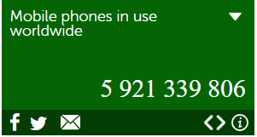
Introduction
What are the information that matters?
Importance of Mobile phones in day today life.
Kaspersky Labs Statistics.
Why android?

Slide 4
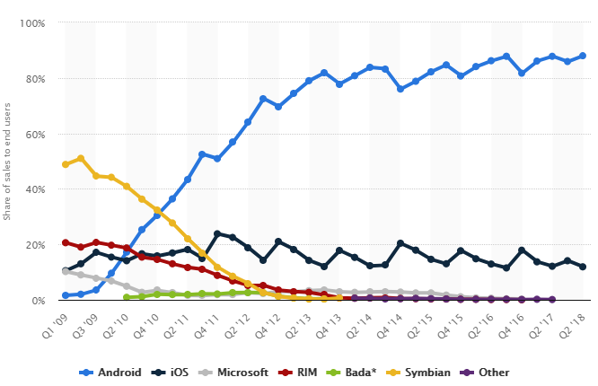
Global mobile OS market share in sales to end users from 1st quarter 2009 to 2nd quarter 2018 by www.statista.com

Slide 5
Research Components.
Accidental Data Leakage Prevention
Rogue Access point Detector
Secure Bluetooth
Secure Wi-Fi Direct

Slide 6
Accidental Data Leakage Prevention.

Slide 7
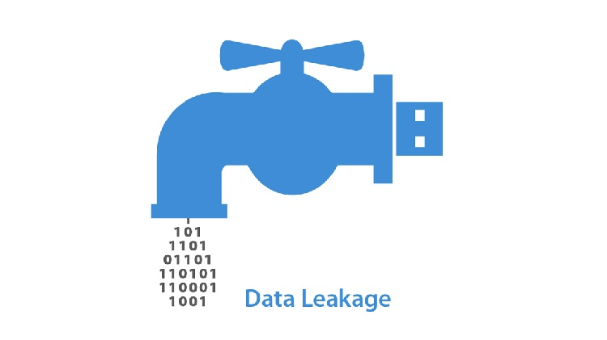
What is a data leakage?
How does it affects an Organization?
How does it affects an Individual?
What is an accidental Data leakage?

Slide 8
Existing Security Measures
Detecting Data semantic: A data leakage prevention approach.
Term Frequency-Inverse Document Frequency (TF-IDF) for text mining.
Separate details into predefined topics.
Secrecy Level.
Automatic detection of sensitive attribute .
Suppress the data by data mining.
Query analysis.
Sensitive data leakage detection in pre-installed applications of custom Android firmware.
APK extractor
APK analyzer
Path matcher

Slide 9
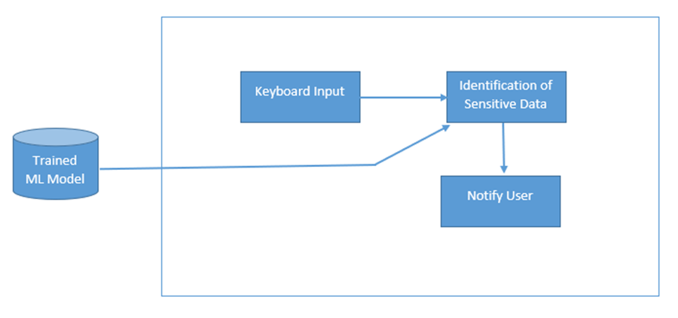
Proposed Solution.
Data Leakage prevention in the Keyboard Level.
Detect sensitive data with the help of Machine Learning.
Alert the user for possible leakage of sensitive data.

Slide 10
Rogue Access Point

Slide 11
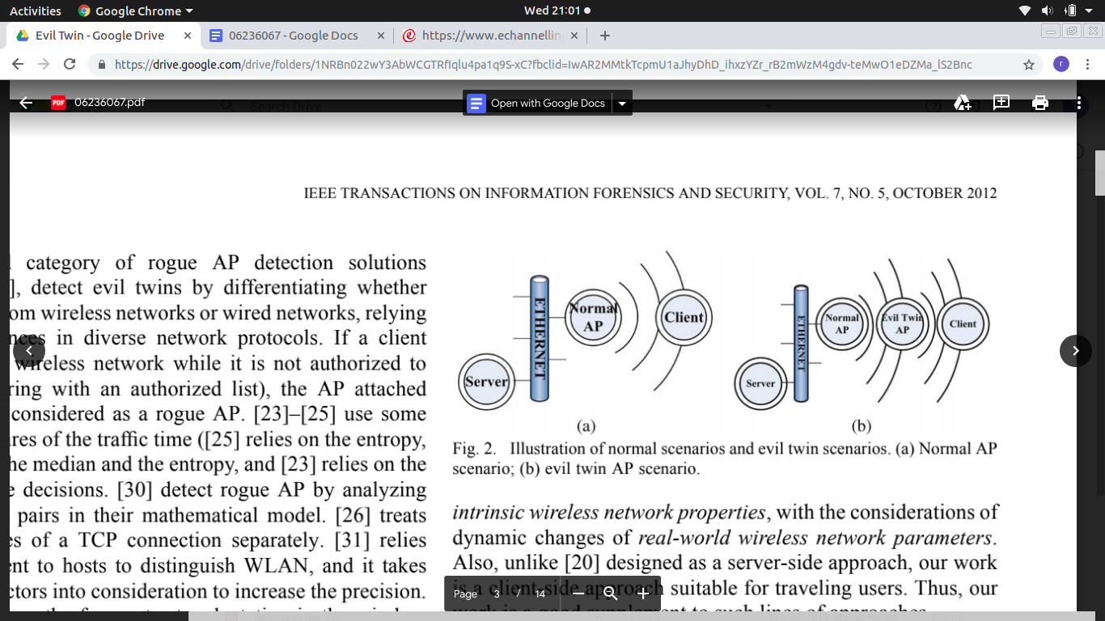
What is a Legitimate/Genuine Access Point?
What is a Rogue Access Point ?
Who Implements a RAP?
What are the threats ?

Slide 12
Existing Security measures.
Hidden Markov Model.
Detection in end hosts.
Training the model
Monitor for Sample packets.
Statistical Techniques.
No authorized access list required.
Best for those who travel most.Uses Trained Mean Matching(TMM) and Hop Differentiating Technique(HDT).
CETAD : Detecting Evil Twin Access Point Attacks in Wireless Hotspots
Client end Evil Twin Access point Detector.
Compares the legitimate and Rogue AP’s
Focuses mainly on data parameters to detect Rogue AP’s

Slide 13
Research Gap
Methods implemented already.
No efficiency.
No Android mobile platform accompanied detection of RAP.

Slide 14
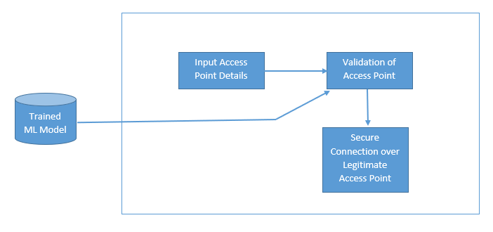
Objectives
Inbuilt RAP detector for mobile phones.
At the point of connection.
Validate details with help of machine learning.

Slide 15
Secure Bluetooth

Slide 16
What is Bluetooth?
Exchange data between fixed and mobile devices over short distances using radio waves.
Bluetooth is a strong, simple and cost-efficient technology
Developed by Bluetooth Special Interest Group (SIG).
Available in mobile phones, laptops, Speakers/Earphones, Personal Digital Assistant.
Bluetooth versions – 1, 1.1, 1.2, 2.0, 2.1, 3.0, 4.0, 4.1, 4.2, and 5
How Bluetooth works?
Using short-range wireless exchange of communication between attached two gadgets together.
Uses Frequency Hopping Spread Spectrum (FHSS)

Slide 17
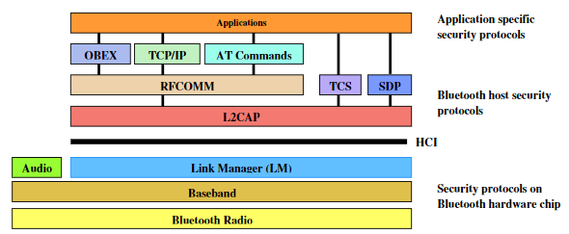
Currently Available Security Measures
OBEX - Object Exchange Protocol
SDP - Service Discovery Protocol
HCI - Host Controller Interface
Protocol stacks defines the connectivity between devices according to the standards.

Slide 18
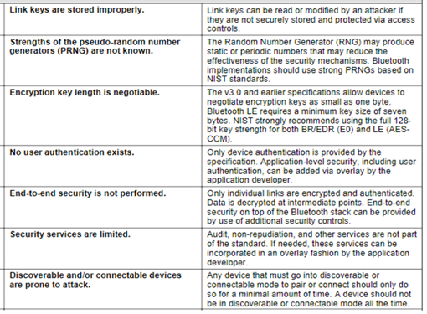
What are the vulnerabilities common to all Bluetooth versions?

Slide 19
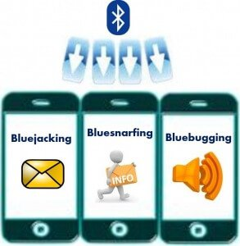
What are the Threats related to Bluetooth?
Threats common to wireless connectivity
Eavesdropping
Denial of service
Impersonation
Man-in-the-middle
Specific threats for Bluetooth connectivity
Bluesnarfing - Any unauthorized access
Bluebugging - Let them listen
Bluejacking - Sends fake messages
Location tracking - Discover the location
Key management - Discovering the unit key

Slide 20
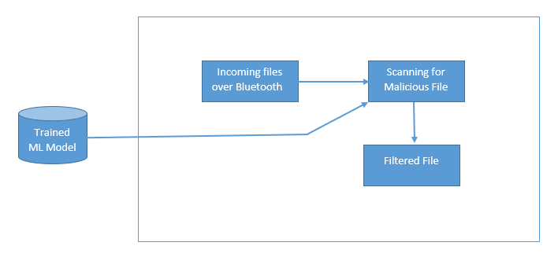
Proposed Mitigation Techniques
Implanting a firewall in Bluetooth
Collect data set about malware files.
Defining machine learning algorithms.

Slide 21

Monitor the incoming traffic for malicious files
Alerting the user for Malicious connections and files.
Securing outgoing files.
Validating Bluetooth Devices.
Defining the Bluetooth Addresses.
Maintaining the logs for all the activities done through Bluetooth channels.

Slide 22
Secure Wi-Fi Direct

Slide 23
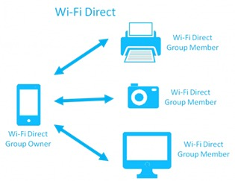
What is Wi-Fi Direct?
Communication between two devices to transfer file.
Works with Peer to Peer technology.
How Wi-Fi direct establish connection with devices?

Slide 24
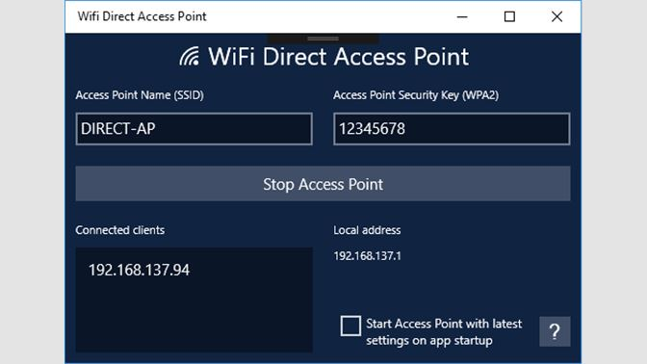
Currently available security measures?
SAS(Short Authentication String)
WPA 2 (Wi-Fi Protected Access)

Slide 25
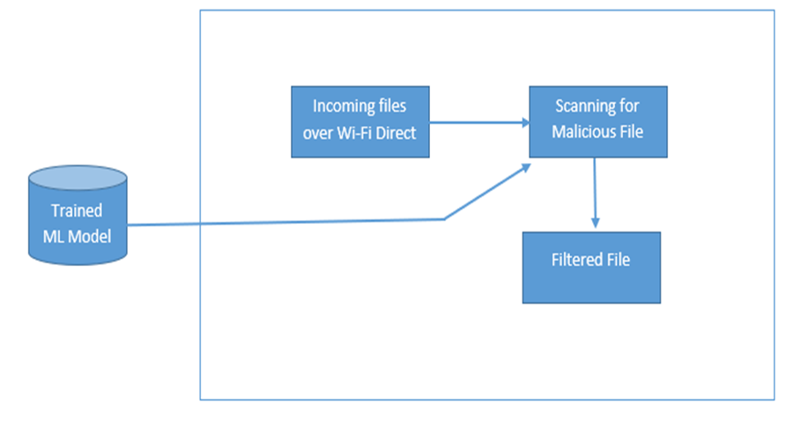
How Wi-Fi direct affects in security of a mobile phone?
Accepts any kinds of files without any verification.
Two way transaction is possible without any restrictions.
What we propose to implement in order to secure wi-fi direct
Implementing firewall. (behavior style ML)
Implement write block.
User accessible logs.

Slide 26
Pre-requirements
Machine with Linux or Mac (64-bit environment): - In order to compile Android
Sandbox: - It needs to be precaution to safeguard the running system from malwares as we have to work with malwares to get data set.
Machine Running Windows 7 or latest: - To run an emulator
Android Emulator: - To check for the capabilities and every build should be checked.
Mobile Phone with Android OS: - To check the customized ROM
Network Simulator: - In order to create fake access points.

Slide 27
Common objectives
Ease of use
System level architecture to improvise user experiance.
Minimal use of available resources.
New implementations must use minimal amount of resources.
Analyzation of data
Use of available malware signature and behaviour for optimal data set.
Knowledge acquisition
Giving the user full knowledge on the end product.
Out of the box experience.
Decrease the requirement of 3rd party apps.

Slide 28
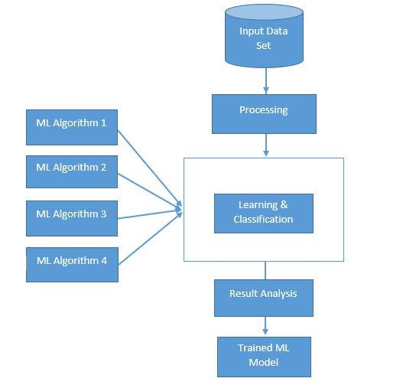
Machine Learning Architecture.
Collect Finalized Data Set.
Preprocess.
Use of multiple ML algorithms.
K-Nearest Neighbors
SVM
Naïve Bayes
Learning vector Quantization
Result analysis.

Slide 29
 | Current Mobiles with Android OS | Secure Mobile OS
Data Leakage Prevention Mechanism |  | ✔
Bluetooth Connectivity | ✔ | ✔
Bluetooth Logs |  | ✔
Bluetooth Firewall |  | ✔
Wireless Connection | ✔ | ✔
Rogue Access point detector |  | ✔
Wi-Fi Direct Logs |  | ✔
Wi-Fi Direct Firewall |  | ✔
Outgoing data manager |  | ✔

Slide 30
Q & A

Slide 31
Thank You

