Slide 1
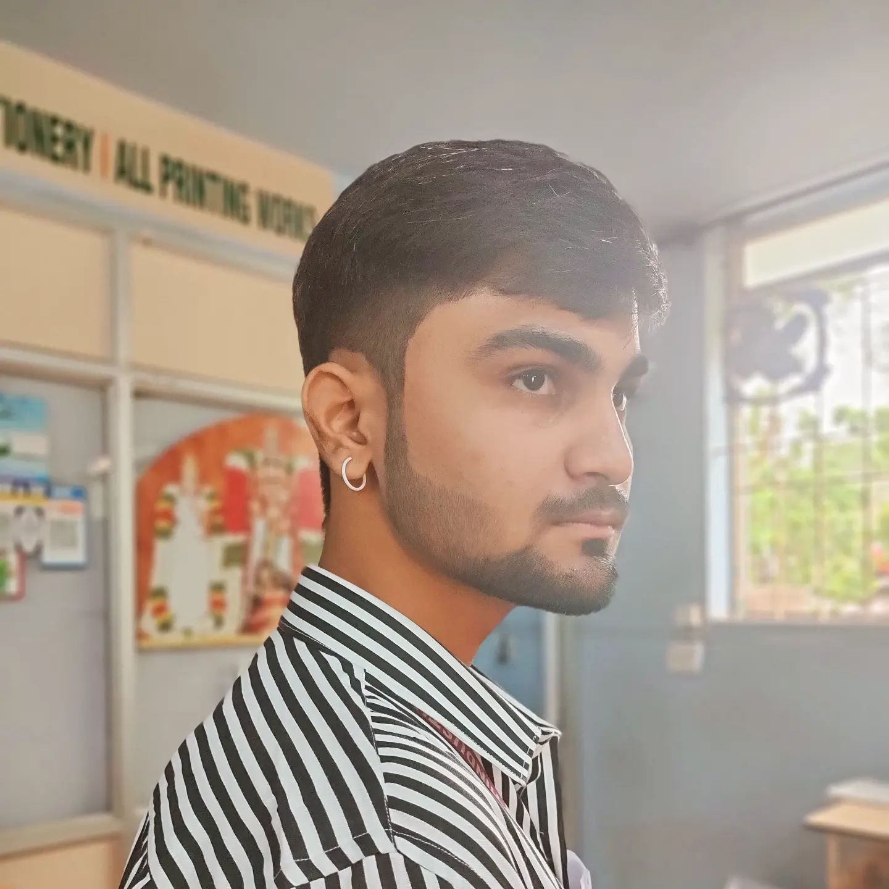
{
}
#myself (Jegan)
Entry level-IT Professional
// Frontend Developer-Programmer
// M: jegankathiravanit@gmail.com
// P: +91-86103-31954
About Me {
Motivated student eagerly seeking entry-level opportunities to apply my skills into real-world experiences with a strong willingness to learn and contribute. Effective communicator with a collaborative mindset, ready to bring fresh perspectives and a strong
work ethic to any team.
}
Education {
B.Tech Information Technology, Hindusthan College of Engineering & Technology
2022-Pursuing
Coimbatore, TN
}
Certifications {
# Cloud Computing, NPTEL
# Introduction to Database Systems, NPTEL
# Tally ERP 9
# C/C++
}
Skills {
”HTML/CSS” ”JavaScript” ”Angular.JS” ”Flask”
”SQL” ”C/C++” ”Python” ”Java”
”VS Code” ”Git” ”GitHub” ”Tally”
}
Dialects {
”English” ”Tamil” ”Kannada” ”Hindi”
}

Slide 2
Additionals {
# Webinars {
“Artificial Intelligence”
“Full Stack Development”
“Internet of Things”
“Blockchain with React.JS”
“Embedded Systems with IOT”
}
# Platforms {
“Linkedin” “Unstop”
“Leetcode” “Hackerrank”
}
}
Interests {
# Tech Savvy Informations
# Problem Solving
# Exploring New Technologies
# Watching Anime
}
Links {
# Linkedin: linkedin.com/in/jegankathiravanit
# GitHub: github.com/Jegan1412
# : github
}

