Slide 1


Engineering Project Management
Certification: 3 courses

Slide 2
3 Courses
Initiating and Planning
01
Scope, Time, and Cost Management
02
Risk, quality, teams, and Procurement
03

Slide 3
Initiating and Planning
Organization of large project structure

Slide 4
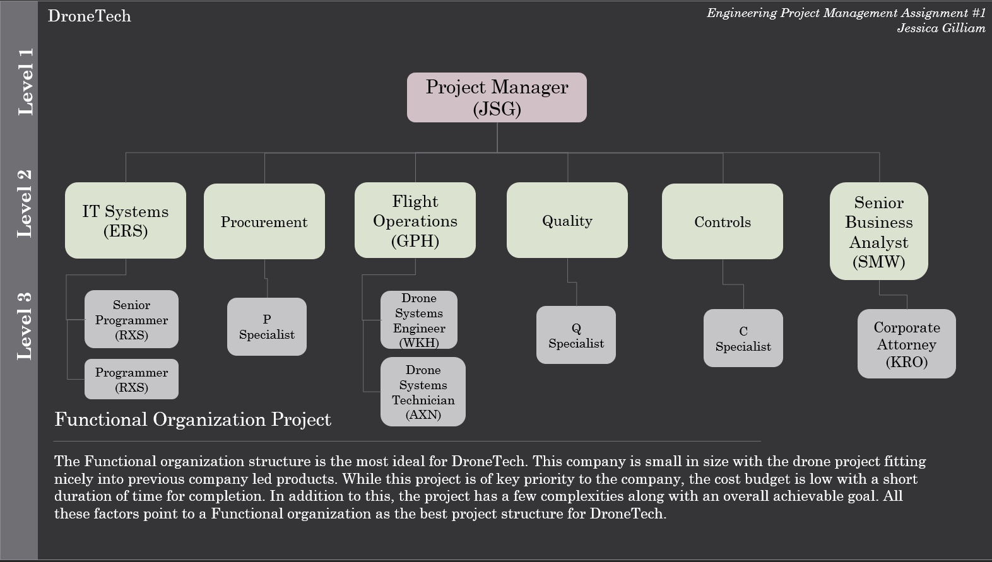

Slide 5
Initiating and Planning
Organization of large project structure
Stakeholder register: Who’s interested? Why are they interested?

Slide 6
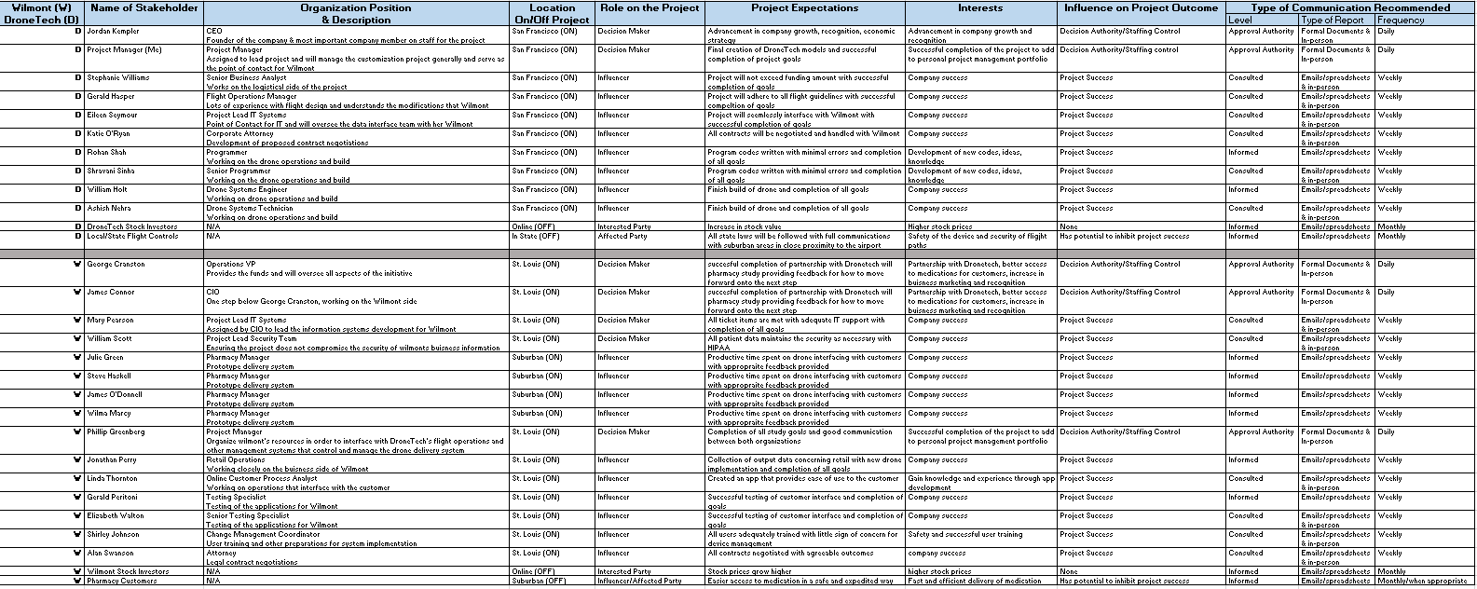

Slide 7
Initiating and Planning
Organization of large project structure
Stakeholder register: Who’s interested? Why are they interested?
Project Charter
Project descriptions
Purpose
Requirements
Deliverables/Objectives

Slide 8
Scope, Time, and Cost Management
Work Breakdown Schedule: Who does what? Why?
Project Schedule: When should things get done?
Project Budget: What are the calculated costs? How can we stay on schedule?

Slide 9
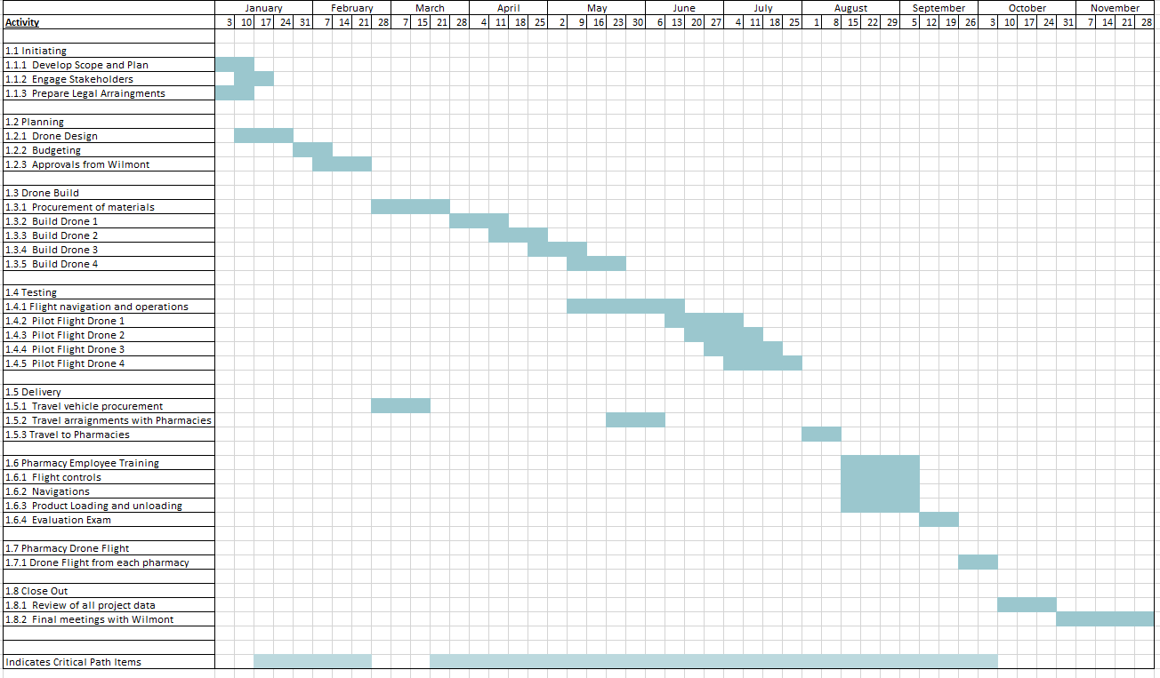

Slide 10
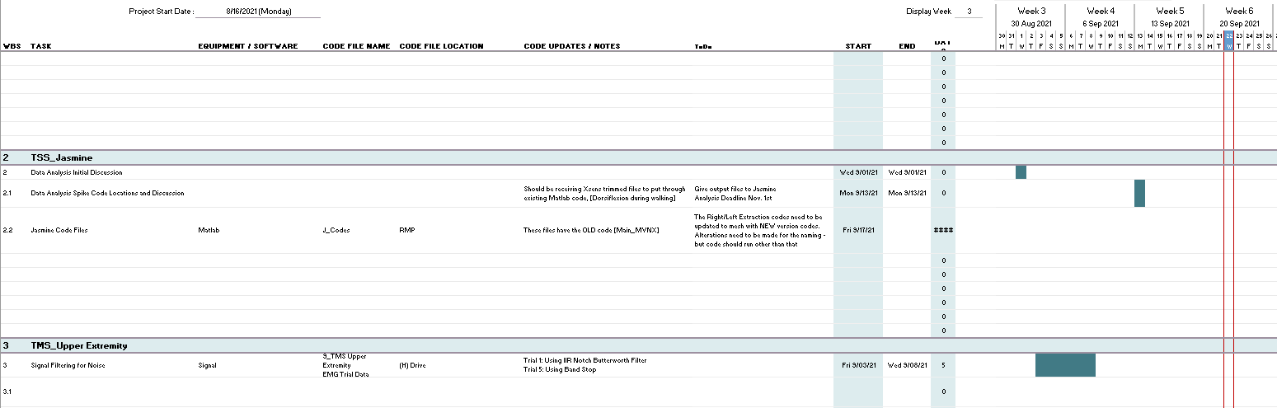

Slide 11
Risk, Quality, Teams
Risk Logs: What could go wrong?
Quality: How do we verify the product created is at the highest quality?
Teams: How does your team operate?

Slide 12
Team Development
Myers Briggs: 16 Personalities
Recommendation: Take personality test every 5-10 years to see potential changes

Slide 13
Myers Briggs: Me
INFJ: Advocate Personality
Rare personality type: 1% - 3 % of US population
Strengths: Creative, Insightful
Weaknesses: Perfectionistic
Workplace Habits: Value cooperation, sensitivity, and independence

