Slide 1
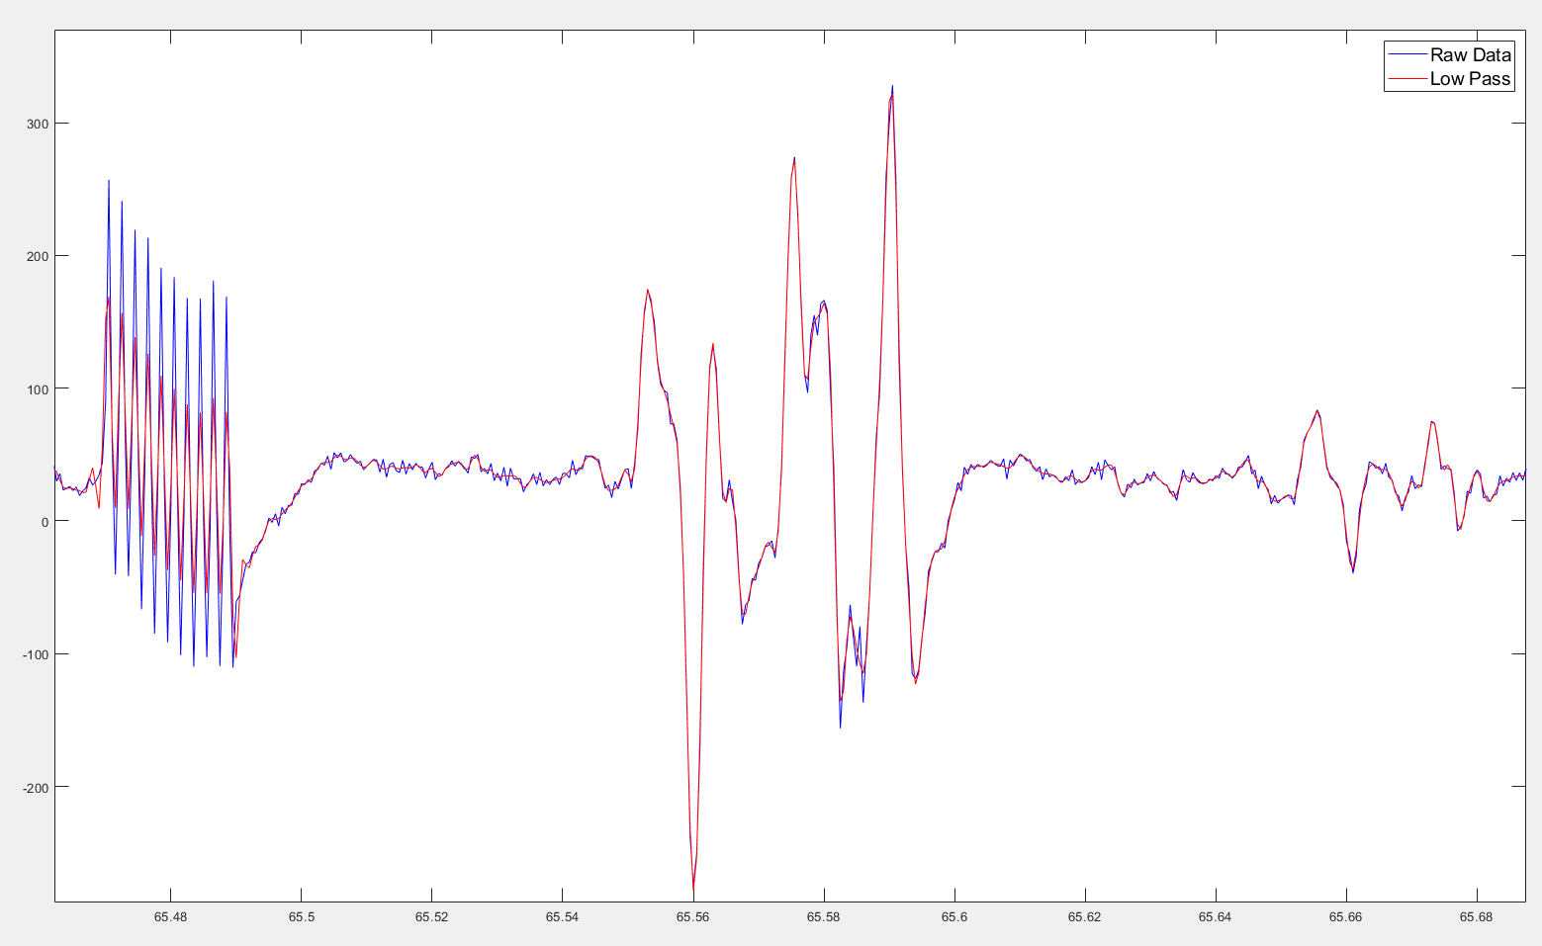
MATLAB Data Filtering
02/09/2022
Protocol:
*4th Order Butterworth
Low pass filter (500Hz)

Slide 2
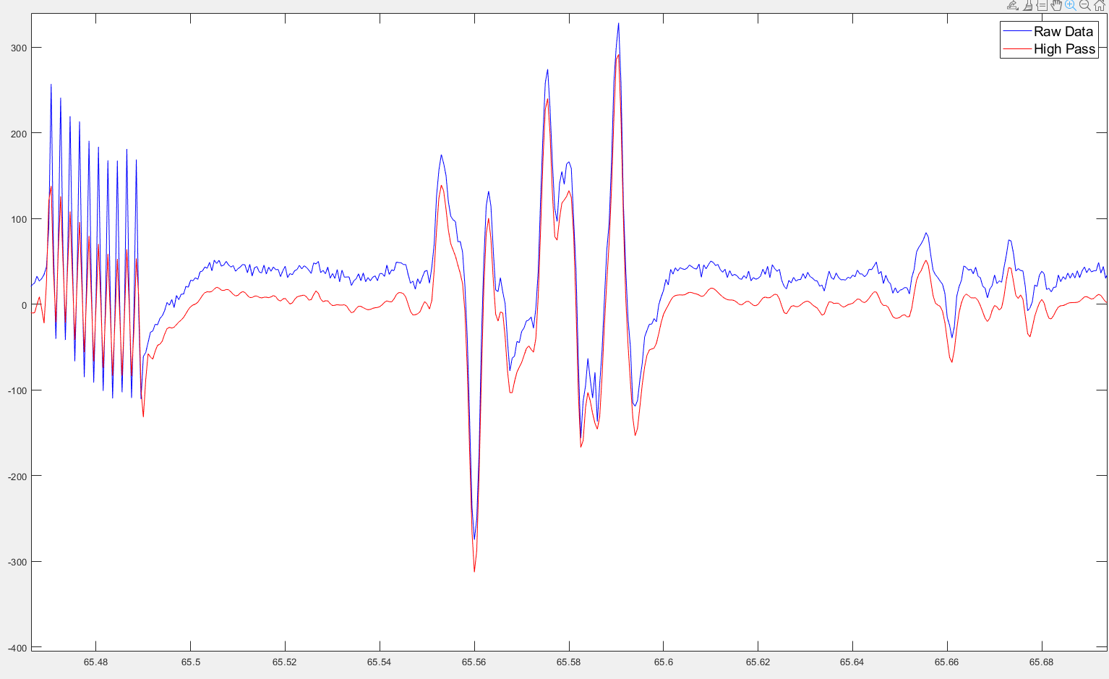
MATLAB Data Filtering
02/09/2022
Protocol:
*4th Order Butterworth
2. High pass filter (10Hz)

Slide 3
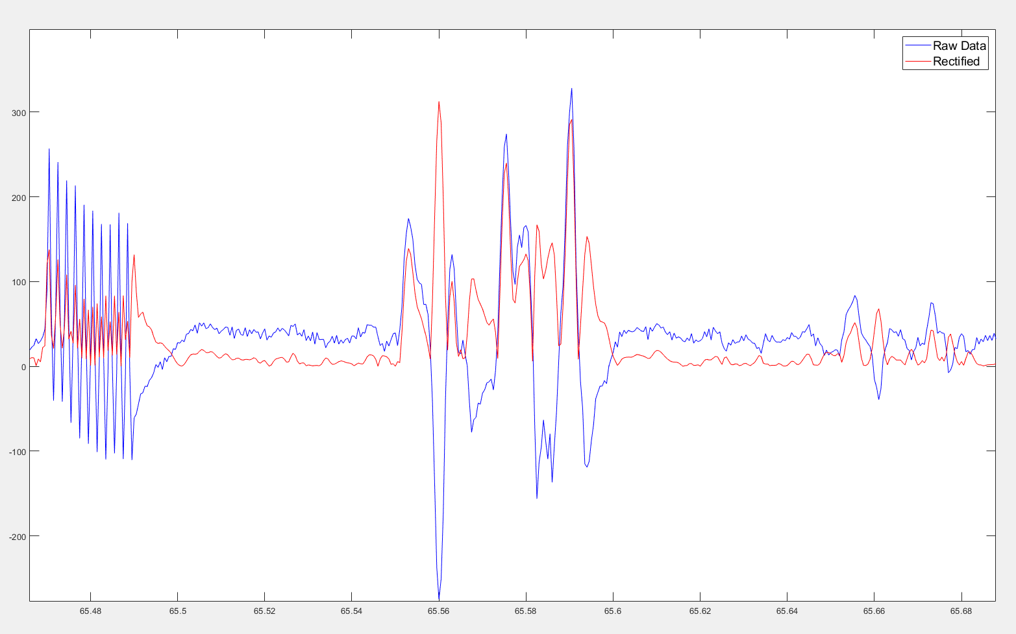
MATLAB Data Filtering
02/09/2022
Protocol:
2. Full Wave Rectification

Slide 4
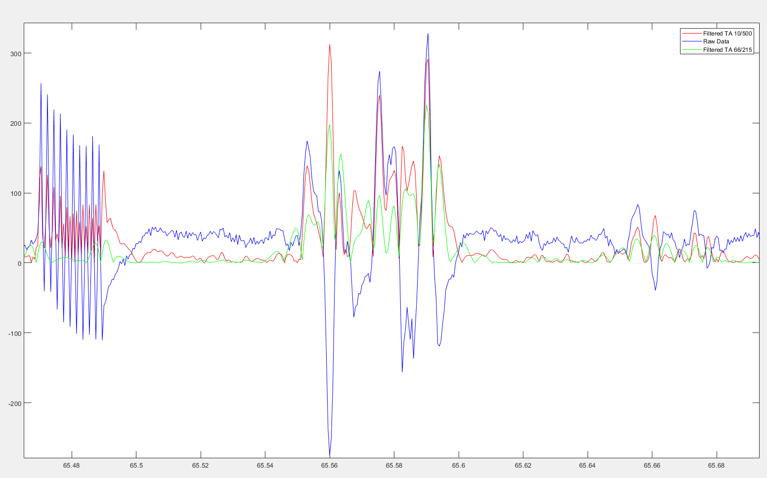
MATLAB Data Filtering
02/09/2022
Filtering Methods
Raw Data – Blue
Filtered 10/500 Red
Filtered 66/215 Green

Slide 5
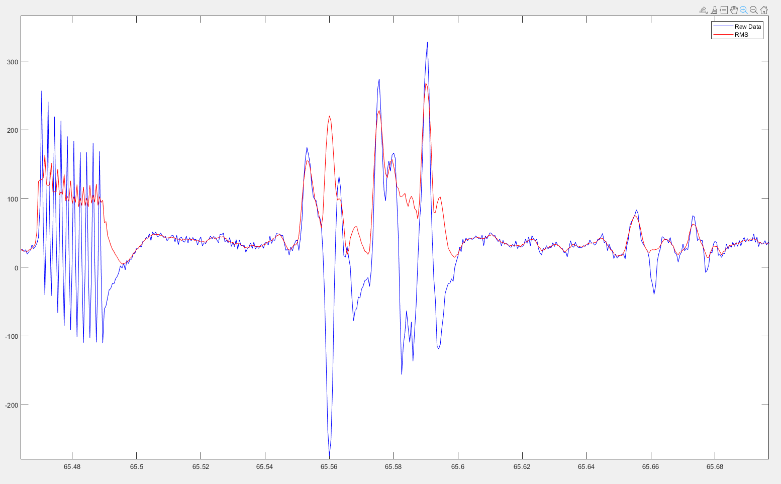
RMS
Moving window of 5 data points

Slide 6
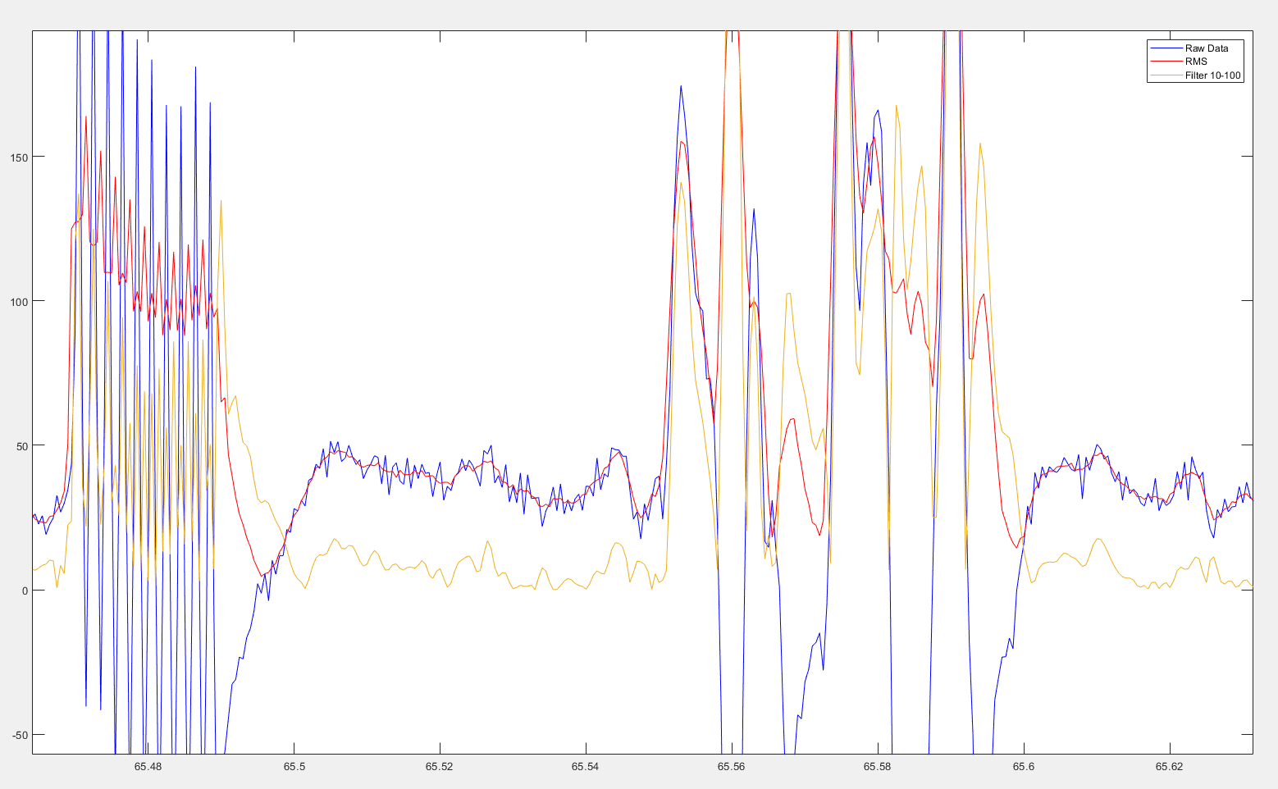

Slide 7
MATLAB Code
Onset (slope (>1st derivative of the data 2.5)
Offset (slope(< avg baseline +(.3 millivolts) 5 points
Duration Between Onset – Offset
Area under the curve
Area under the curve for 5 trials summed

