Slide 1

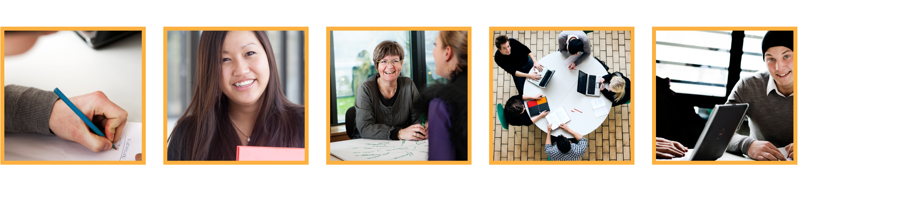
Virtualisation and services
.
Jens Egholm Pedersen
<jeep@cphbusiness.dk>

Slide 2
Agenda
Why virtualisation
Virtualisation techniques
The cloud
  X as a service
Docker
Serverless computing
Notes:
Remembering – Understanding – Applying – Analyzing – Evaluating – Creating

Slide 3
History of computing
Manual computing
Mainframes
Racks
Virtualisation
See also: Evolution of computing at CERN
Notes:
Remembering – Understanding – Applying – Analyzing – Evaluating – Creating

Slide 4
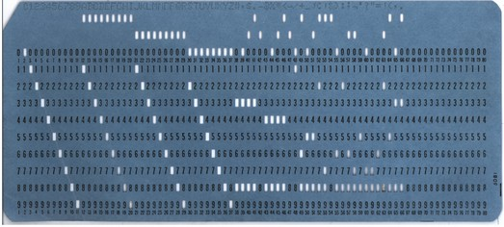
Early mainframes
One huge computer
Humans wrote machine code
  Punchcards and later consoles
Notes:
Remembering – Understanding – Applying – Analyzing – Evaluating – Creating

Slide 5
Racks
Many computers in one place
Stored in a data center
Few jobs distributed to many machines
How to interact with the racks?
Data center
Notes:
Remembering – Understanding – Applying – Analyzing – Evaluating – Creating

Slide 6
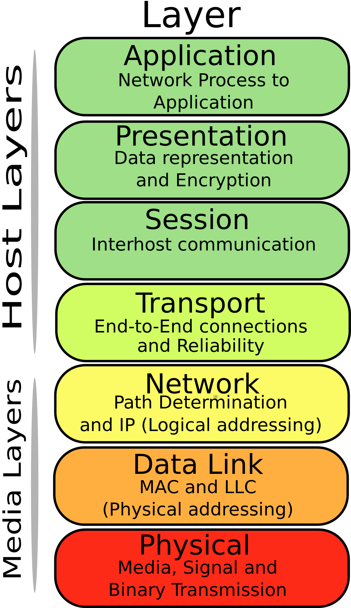
OSI
Layer interacts up and down
We use the application layer
We (rarely) care about others
The application layer has to communicate with the OS
See also: OSI model on Wikipedia
Notes:
Remembering – Understanding – Applying – Analyzing – Evaluating – Creating

Slide 7
Early operating systems
Human inputs machine code
  Punchcards
10010111011110
10101101001101
Notes:
Remembering – Understanding – Applying – Analyzing – Evaluating – Creating

Slide 8
Later operating systems
Multiple resources, cores, users
How to manage them?
Operating system kernel
  User space
  Kernel space
Kernel
10010111011110
10101101001101
10010111011110
10101101001101
Notes:
Remembering – Understanding – Applying – Analyzing – Evaluating – Creating

Slide 9
Virtual machine
Emulated operating systems
Single entrypoint for the user
  Not OS specific
VM
Kernel
Kernel
10010111011110
10101101001101
10010111011110
10101101001101
10010111011110
10101101001101
See also: Virtual machine on Wikipedia
Notes:
Remembering – Understanding – Applying – Analyzing – Evaluating – Creating

Slide 10
Virtual machine benefits
Write once, run everywhere
Share resources
  Exploit economies of scale
Scaling
  Elasticity
  Resources provided on-demand
See also: Docker
Notes:
Remembering – Understanding – Applying – Analyzing – Evaluating – Creating

Slide 11
Virtual machine disadvantages
Less efficient than bare-metal
  All problems in computer science can be solved by another level of indirection
  No performance problem cannot be solved by removing a level of indirection
Centralisation of data = security risk
Putting data in someone else’s computer
Notes:
Remembering – Understanding – Applying – Analyzing – Evaluating – Creating

Slide 12
Virtualisation
Abstraction of resources
Implementation decides how and where
Typically managed by a Hypervisor
  Creates and runs virtual machines
Similar to the OSI model of abstraction
  When you interact with a layer, you don’t care about the implementation
See also: Virtualisation on Wikipedia
Notes:
Remembering – Understanding – Applying – Analyzing – Evaluating – Creating

Slide 13
The ‘cloud’
Huge data centers running virtualised environments
Examples: Amazon Web Services (AWS)
  Distributed across the entire world (fast!)
2011: Netflix migrated to AWS
Remember
  Always someone else’s computer
See also: Cloud computing on Wikipedia
Notes:
Remembering – Understanding – Applying – Analyzing – Evaluating – Creating

Slide 14
X as a Service
Three variants of the cloud:
  Infrastructure
  Platform
  Software
Software
Platform
Infrastructure
Notes:
Remembering – Understanding – Applying – Analyzing – Evaluating – Creating

Slide 15
Infrastructure as a Service
Write software for VM, scale dynamically
Examples
  Digital Ocean, Amazon Web Service
Advantages
  Pay as you go
  Low vendor lock-in
Disadvantages
  Still need to interact with OS / VM
  Critical infrastructure out of your hands
Software
Platform
Infrastructure
Notes:
Remembering – Understanding – Applying – Analyzing – Evaluating – Creating

Slide 16
Platform as a Service
Full development environment
  Typically: Database, web-server, execution environment
Examples
  Openshift, Heroku
Advantages
  Pay as you go
  No need to know the VM environment
  Built-in scalability and availability
Disadvantages
  Medium vendor lock-in
Software
Platform
Infrastructure
Notes:
Remembering – Understanding – Applying – Analyzing – Evaluating – Creating

Slide 17
Software as a Service
Buy access to application or data
Examples
  Gmail, Facebook, Dropbox
Advantages
  Pay as you go
  Easy to use
Disadvantages
  High vendor lock-in
  No control over security
Software
Platform
Infrastructure
Notes:
Remembering – Understanding – Applying – Analyzing – Evaluating – Creating

Slide 18
X as a Service
As Momondo, which X would you choose?
Local | IaaS | PaaS | SaaS
Data | Data | Data | Data
Runtime | Runtime | Runtime | Runtime
Virtualisation | Virtualisation | Virtualisation | Virtualisation
Hardware | Hardware | Hardware | Hardware
Notes:
Remembering – Understanding – Applying – Analyzing – Evaluating – Creating

Slide 19
Private hosting
Running software on local datacenter
Advantages
  Full control over hardware, OS, software and data
  Easier to secure
  Cheap in the long run
Disadvantages
  Expensive in the beginning
  Unused hardware
  Bad scaling
    Slow and expensive
  Worse infrastructure
Notes:
Remembering – Understanding – Applying – Analyzing – Evaluating – Creating

Slide 20
Virtual machine
Emulated operating systems
Single entrypoint for the user
  Not OS specific
…. But it is still an operating system
  “It works on my machine”
VM
Kernel
Kernel
10010111011110
10101101001101
10010111011110
10101101001101
10010111011110
10101101001101
See also: Virtual machine on Wikipedia
Notes:
Remembering – Understanding – Applying – Analyzing – Evaluating – Creating

Slide 21
Virtualised virtual machine
Can we virtualise the VM?
  Yes we can!
One version: Docker
  Basically just translates kernel calls
Container
VM
VM
Kernel
Kernel
Kernel
10010111011110
10101101001101
10010111011110
10101101001101
10010111011110
10101101001101
10010111011110
10101101001101
See also: Operating-system-level virtualisation
Notes:
Remembering – Understanding – Applying – Analyzing – Evaluating – Creating

Slide 22
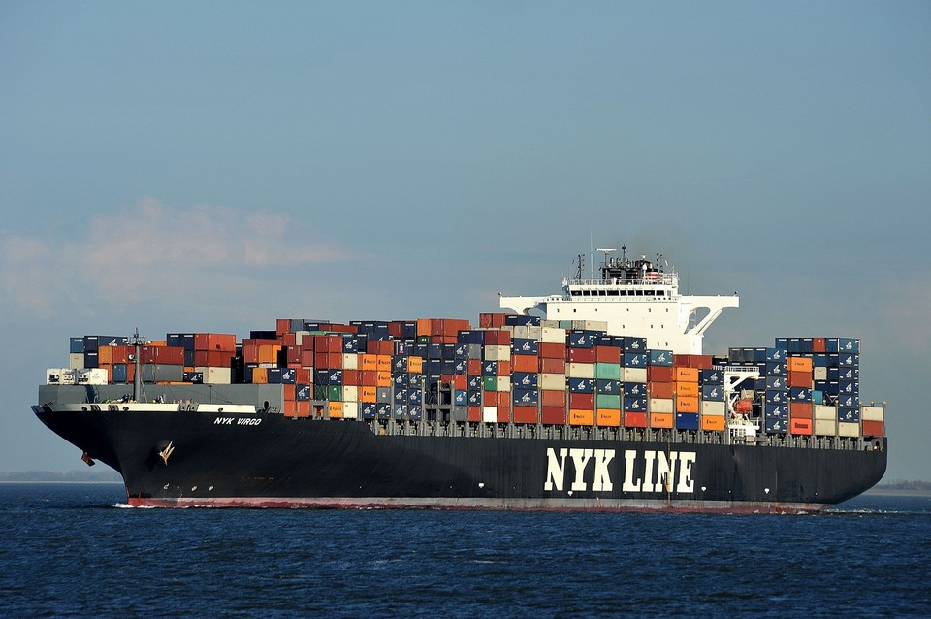
Containerisation
One version: Docker
  Basically just translates kernel calls
Similar to a shipping analogy
See also: Operating-system-level virtualisation
Notes:
Remembering – Understanding – Applying – Analyzing – Evaluating – Creating

Slide 23
Recap
Virtualisation
‘Cloud’ computing (= NSA)
XaaS
Containerisation
  Containers that can run anywhere

Slide 24
Lambda services
We reduced our applications to containers
Why not boil it further down?
  What does an application typically consist of?
  Functions (lambdas): some input and some output
Now we don’t even need the idea of a machine
  We can just provide a single function, that can be executed
Notes:
Remembering – Understanding – Applying – Analyzing – Evaluating – Creating

Slide 25
Serverless cloud computing
A new technology
… Nope!
There is no such thing as no server!
  There is only someone else’s PC
Notes:
Remembering – Understanding – Applying – Analyzing – Evaluating – Creating

