Slide 1
Using Texture Objects
specify textures in texture objects
set texture filter
set texture function
set texture wrap mode
set optional perspective correction hint
bind texture object
enable texturing
supply texture coordinates for vertex
coordinates can also be generated

Slide 2
Texture Parameters
WebGL has a variety of parameters that determine how texture is applied
Wrapping parameters determine what happens if s and t are outside the (0,1) range
Filter modes allow us to use area averaging instead of point samples
Mipmapping allows us to use textures at multiple resolutions
Environment parameters determine how texture mapping interacts with shading

Slide 3
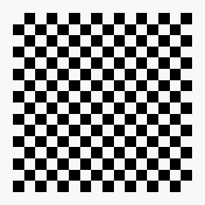
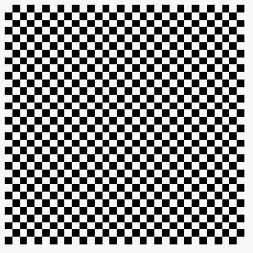

Wrapping Mode
Clamping: if s,t > 1 use 1, if s,t <0 use 0
Wrapping: use s,t modulo 1
gl.texParameteri(gl.TEXTURE_2D, gl.TEXTURE_WRAP_S, gl.CLAMP )
gl.texParameteri( gl.TEXTURE_2D, gl.TEXTURE_WRAP_T, gl.REPEAT )
t
s
gl.REPEAT
wrapping
gl.CLAMP
wrapping
texture

Slide 4
Magnification and Minification
More than one texel can cover a pixel (minification) or
more than one pixel can cover a texel (magnification)
Can use point sampling (nearest texel) or linear filtering
( 2 x 2 filter) to obtain texture values
Texture
Polygon
Texture
Polygon
Magnification
Minification

Slide 5
Filter Modes
Modes determined by
gl.texParameteri( target, type, mode )
gl.texParameteri(gl.TEXTURE_2D, gl.TEXURE_MAG_FILTER,
GL_NEAREST);
gl.texParameteri(gl.TEXTURE_2D, gl.TEXURE_MIN_FILTER,
gl.LINEAR);

Slide 6
Mipmapped Textures
Mipmapping allows for prefiltered texture maps of decreasing resolutions
Lessens interpolation errors for smaller textured objects
Declare mipmap level during texture definition
gl.texImage2D(gl.TEXTURE_*D, level, … )

Slide 7
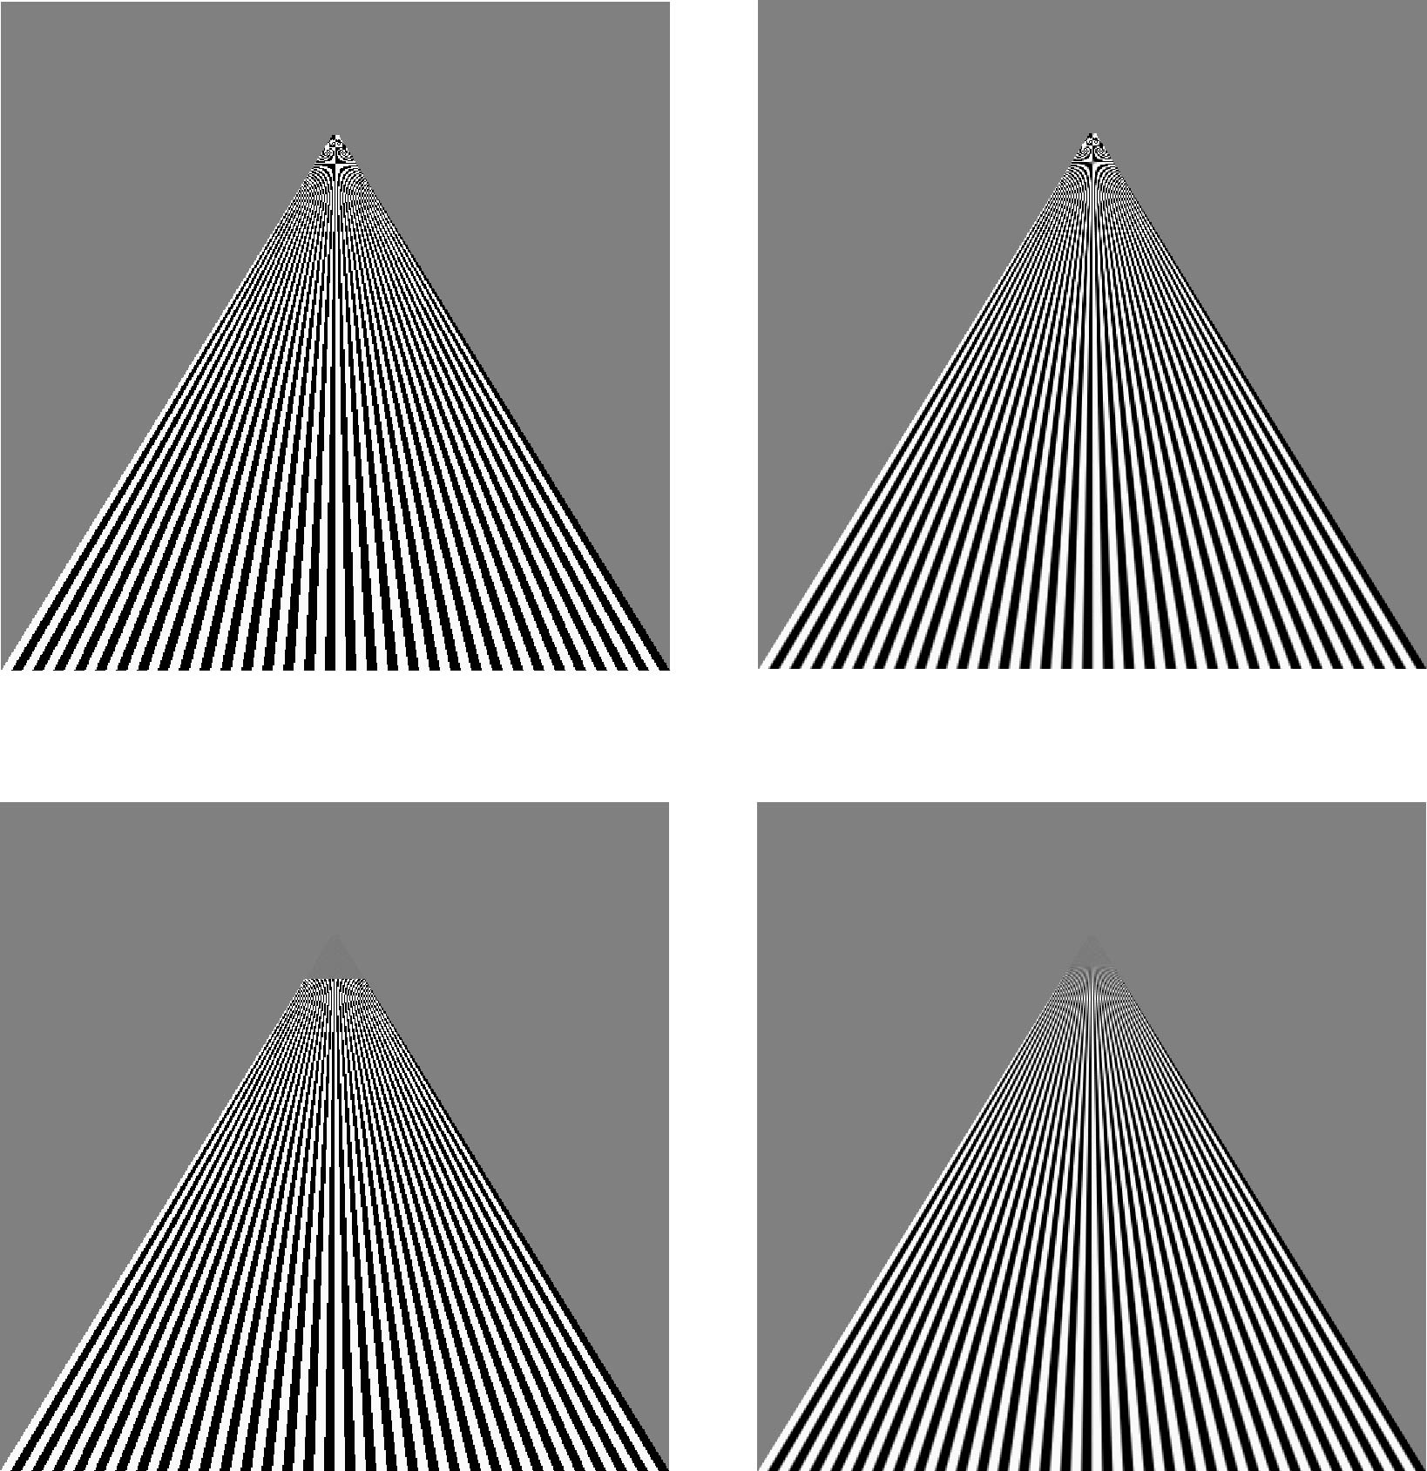
Example
point
sampling
linear
filtering
mipmapped
point
sampling
mipmapped
linear
filtering

Slide 8
Applying Textures
Texture can be applied in many ways
texture fully determines color
modulated with a computed color
blended with and environmental color
Fixed function pipeline has a function glTexEnv to set mode
deprecated
can get all desired functionality via fragment shader
Can also use multiple texture units

Slide 9
Applying Textures
Textures are applied during fragments shading by a sampler
Samplers return a texture color from a texture object
varying vec4 color; //color from rasterizer
varying vec2 texCoord; //texture coordinate from rasterizer
uniform sampler2D texture; //texture object from application
void main() {
gl_FragColor = color * texture2D( texture, texCoord );
}

Slide 10
Vertex Shader
Usually vertex shader will output texture coordinates to be rasterized
Must do all other standard tasks too
Compute vertex position
Compute vertex color if needed
attribute vec4 vPosition; //vertex position in object coordinates
attribute vec4 vColor; //vertex color from application
attribute vec2 vTexCoord; //texture coordinate from application
varying vec4 color; //output color to be interpolated
varying vec2 texCoord; //output tex coordinate to be interpolated

Slide 11
A Checkerboard Image
var image1 = new Uint8Array(4*texSize*texSize);
for ( var i = 0; i < texSize; i++ ) {
for ( var j = 0; j <texSize; j++ ) {
var patchx = Math.floor(i/(texSize/numChecks));
var patchy = Math.floor(j/(texSize/numChecks));
if(patchx%2 ^ patchy%2) c = 255;
else c = 0;
//c = 255*(((i & 0x8) == 0) ^ ((j & 0x8) == 0))
image1[4*i*texSize+4*j] = c;
image1[4*i*texSize+4*j+1] = c;
image1[4*i*texSize+4*j+2] = c;
image1[4*i*texSize+4*j+3] = 255;
}
}

Slide 12
Cube Example
var texCoord = [
vec2(0, 0),
vec2(0, 1),
vec2(1, 1),
vec2(1, 0)
];
function quad(a, b, c, d) {
pointsArray.push(vertices[a]);
colorsArray.push(vertexColors[a]);
texCoordsArray.push(texCoord[0]);
pointsArray.push(vertices[b]);
colorsArray.push(vertexColors[a]);
texCoordsArray.push(texCoord[1]);
// etc

Slide 13
Texture Object
function configureTexture( image ) {
var texture = gl.createTexture();
gl.bindTexture( gl.TEXTURE_2D, texture );
gl.pixelStorei(gl.UNPACK_FLIP_Y_WEBGL, true);
gl.texImage2D( gl.TEXTURE_2D, 0, gl.RGB,
gl.RGB, gl.UNSIGNED_BYTE, image );
gl.generateMipmap( gl.TEXTURE_2D );
gl.texParameteri( gl.TEXTURE_2D, gl.TEXTURE_MIN_FILTER,
gl.NEAREST_MIPMAP_LINEAR );
gl.texParameteri( gl.TEXTURE_2D, gl.TEXTURE_MAG_FILTER,
gl.NEAREST );
gl.activeTexture(gl.TEXTURE0);
gl.uniform1i(gl.getUniformLocation(program, "texture"), 0);
}

Slide 14
Linking with Shaders
var vTexCoord = gl.getAttribLocation( program, "vTexCoord" );
gl.enableVertexAttribArray( vTexCoord );
gl.vertexAttribPointer( vTexCoord, 2, gl.FLOAT, false, 0, 0);
// Set the value of the fragment shader texture sampler variable
// ("texture") to the the appropriate texture unit. In this case,
// zero for GL_TEXTURE0 which was previously set by calling
// gl.activeTexture().
gl.uniform1i( glGetUniformLocation(program, "texture"), 0 );

