Slide 5
What happens when white light hit red surface at an angle of 0?

Slide 8
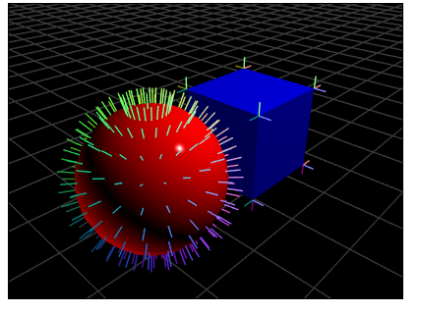

Slide 11
Lights , Normal and Materials

Slide 12
Positional Versus Directional Lights
A light source is called Positional where it location will affect how the scene is lit. A lamp inside the room is a positional light source. The light direction would be different for every vertex. The shader would have to calculate the direction dynamically by subtracting the vertex position from the light position: vec3 lightDir = normalize(u_LightPosition - a_Position);
Directional lights are light the produce the same luminous results regardless of their position. The shader uses a single, constant vector (u_LightDirection) for every single vertex. It assumes the light rays are parallel, hitting every part of the object from the exact same angle

Slide 13
Positional Versus Directional Lights
A position light is modeled by a point in space while a directional light is modeled with a vector that indicates its direction. It is common to use a normalized vector for this purpose, given that this simplifies mathematical operations.

Slide 14
Normals
Normals are vectors that are perpendicular to the surface we want to illuminate.
Normals represent the orientation of the surface and therefore critical to modeling the interaction between light source and the object.
Given that each vertex has an associated normal vector, we can use the cross product to calculate normals.

Slide 17
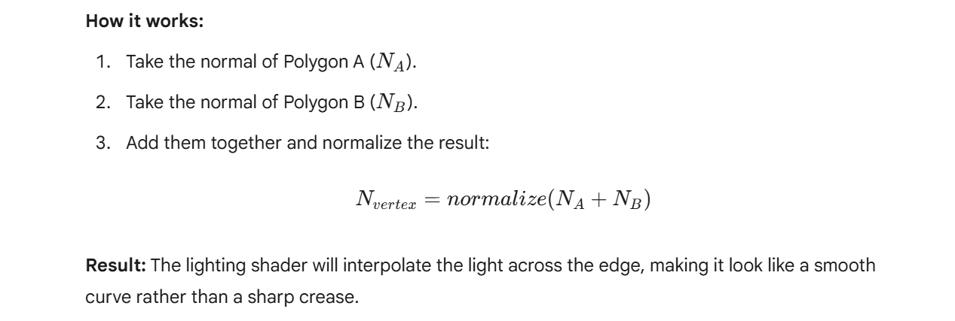
The "Smooth" Look (Averaged Normal)

Slide 18
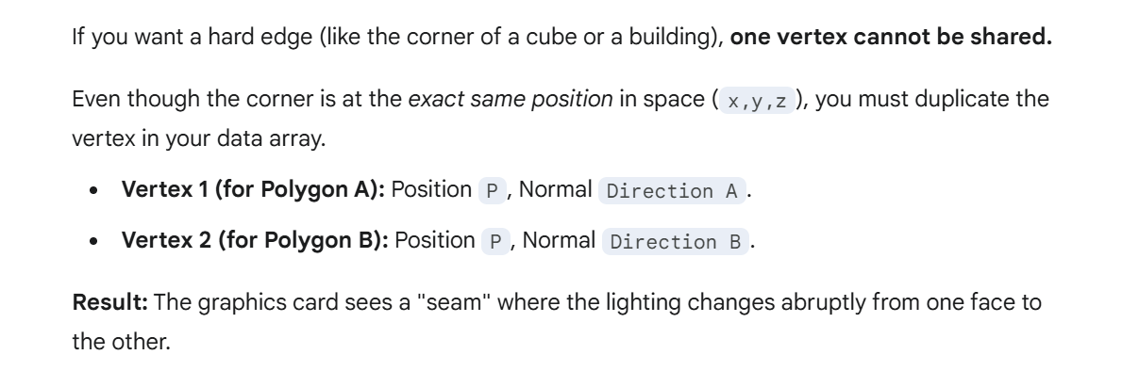
The "Sharp" Look (Split Normals)

Slide 19
Lights, Normals , Materials in the Pipeline

Slide 20
Parallelism & Difference b/w Attributes and Uniforms

Slide 21
Shading Methods & Light-Reflection Models
Shading refers to the type of interpolation that is performed to obtain the final color for every fragment in the scene.
Once the shading model is established, the lighting model determines how the normals, materials and lights need to be combined to produce the final color.
Lighting models in computer graphics are also referred as reflection models.

Slide 22
Shading/ Interpolation Methods
The Goraud interpolation calculates the final color in the Vertex shader. The vertex normals are used to perform calculation.
Then Using Varying variable, the final color for the vertex is passed to the Fragment shader.

Slide 24
Shading/ Interpolation Methods
The Phong interpolation calculates the final color in the Fragment shader.
Each vertex normal is passed from the vertex shader to the fragment shader using a varying variable.
Each Fragment will have its own normal.
Fragment normals are then used to calculate the final color in the Fragment shader.

Slide 25
Light-Reflection Models
Lambertian reflections is a common model for diffuse reflection.
Incident light ray is reflected in many angles instead of just one.

Slide 28
Phong Reflection Model
Surface reflects the light as the sum of three types of reflection
Ambient
Diffuse
Specular

Slide 31
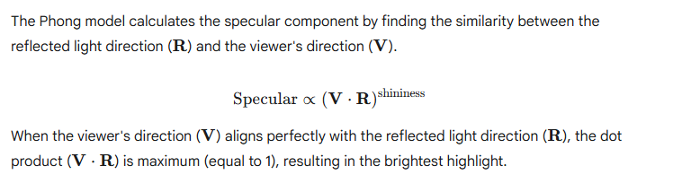

Slide 32
The reflected vector R in the Phong shading model is the direction a perfect mirror reflection of the light travels away from the surface

Slide 34
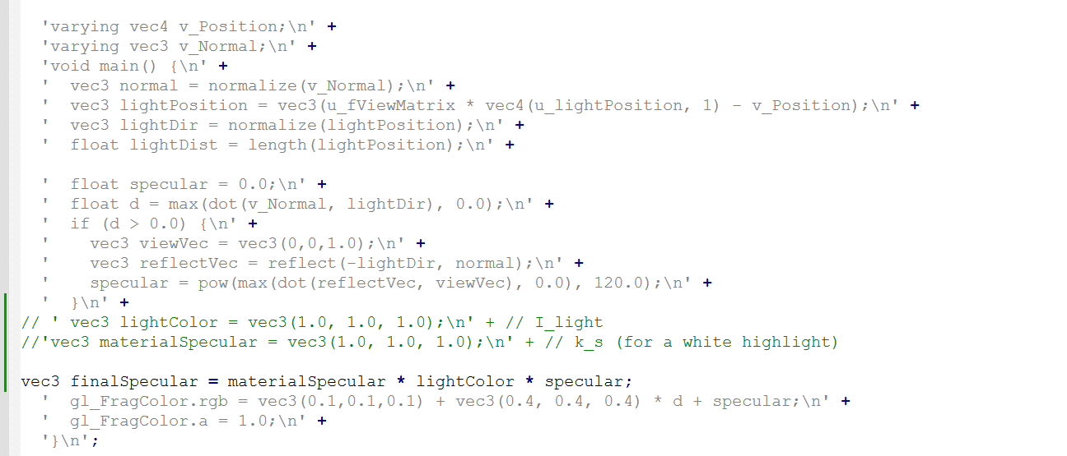

Slide 35
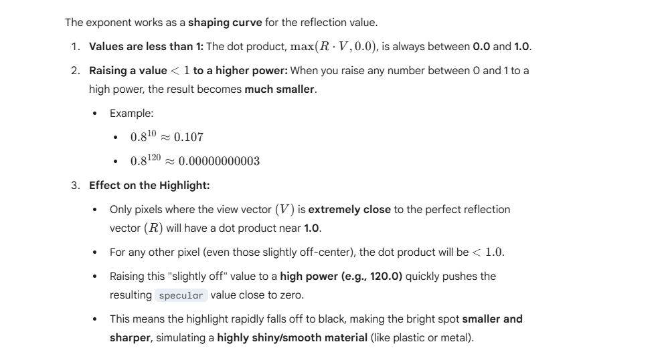

Slide 36
Shading Due to Ambient Light

Slide 38
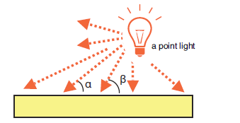
Position Lighting
In contrast to a directional light, the direction of the light from a point light source differs at each position in the 3D scene.
When calculating shading, you need to calculate the light direction at the specific position on the surface where the light hits.

Slide 39
The light direction changes, you need to pass the position of the light source and then calculate the light direction at each vertex position.

Slide 40
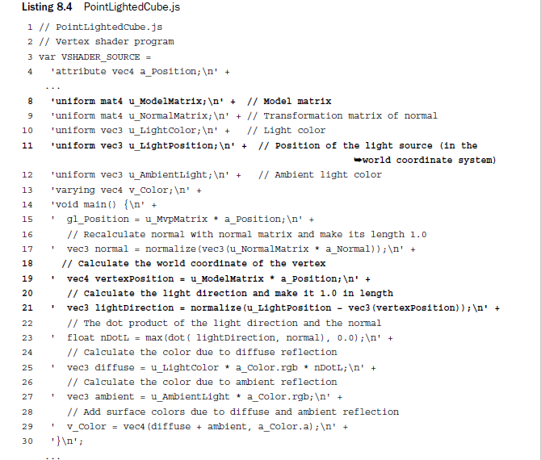

Slide 41
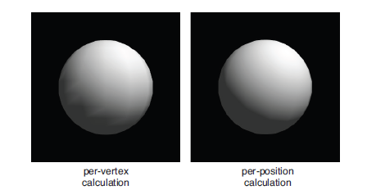
Vertex vs Position Calculation

Slide 42
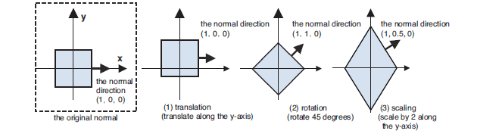

Slide 43
Inverse Transpose Matrix
The matrix that performs a coordinate transformation on an object is called a model matrix.
The normal direction can be calculated by multiplying the normal by the inverse transpose matrix of a model matrix.

Slide 44
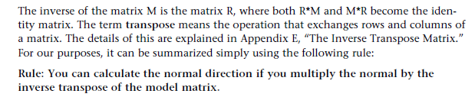
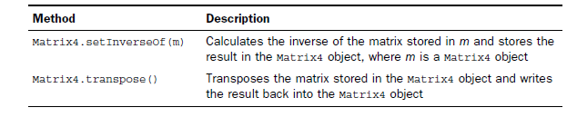

Slide 45
