Slide 1
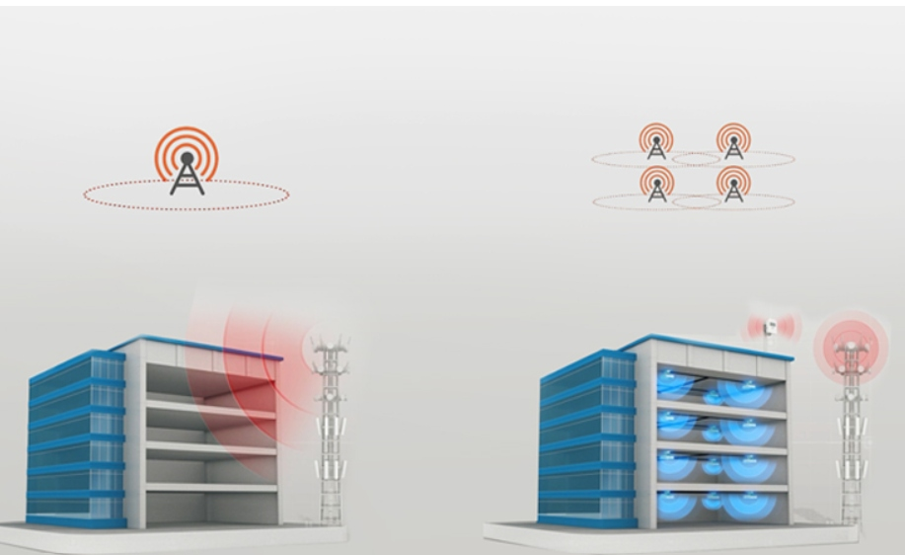
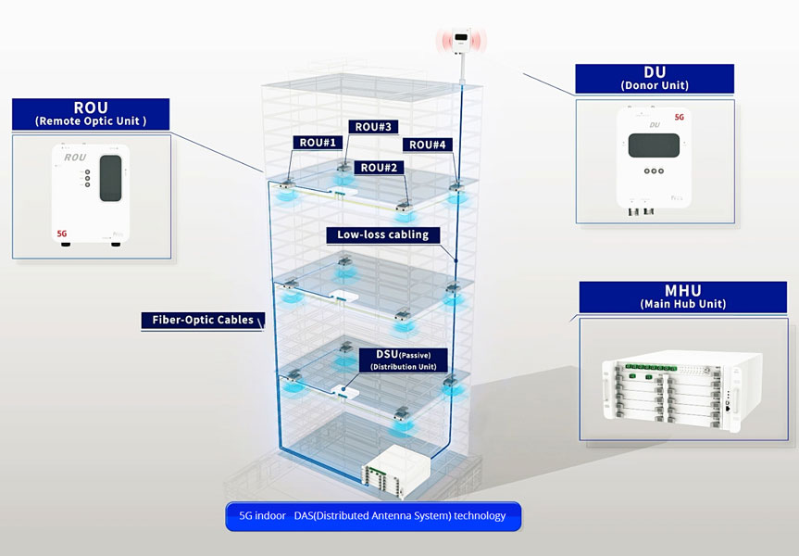
Use 1: In-Building DAS
Problem → solution: walls block the outdoor signal; many low-power antennas inside give uniform coverage.
Chain: Donor Unit → Main Hub (RF → optical) → fiber riser (RoF) → Remote Optic Unit per floor → antennas.
Notes:
Left: outdoor macro signal cannot penetrate the building; with DAS, many low-power antennas inside give uniform coverage. Right: the chain. Donor Unit takes the operator signal, Main Hub Unit converts RF to optical, fiber runs up the riser to Remote Optic Units on each floor, short low-loss coax and passive splitters (DSU) feed the ceiling antennas. The fiber riser is the RoF link from Part 1. Image sources: add the URLs of both images before presenting.

Slide 2
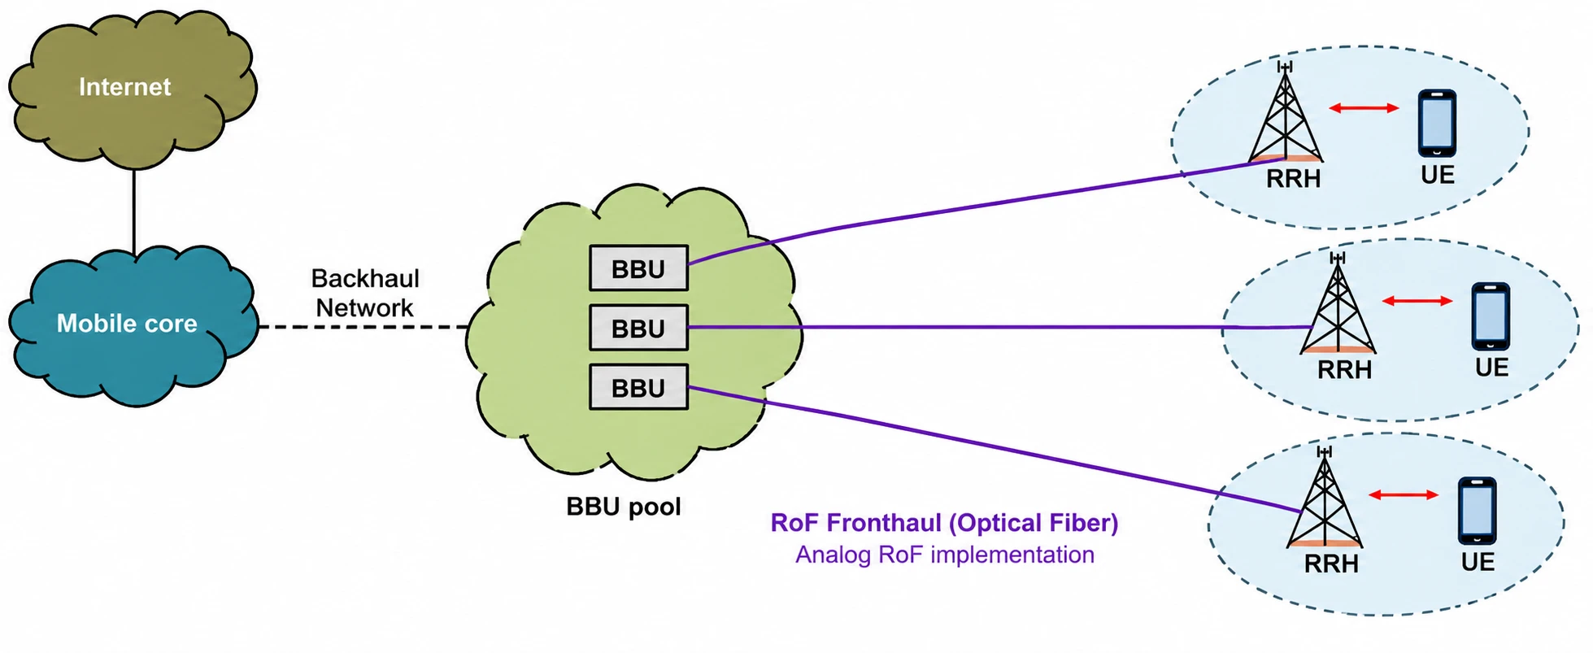
Use 2: C-RAN with RoF Fronthaul
Backhaul (core → BBU pool) is digital; fronthaul (BBU → RRH) is the RoF link.
Trade-off: analog RoF needs up to 40× less fiber bandwidth than CPRI, at lower signal quality (EVM ≈ 8 %).
Notes:
Baseband units are pooled centrally; each remote radio head keeps only the RF part. Backhaul (core to BBU pool) is digital; fronthaul (BBU to RRH) is the RoF link. Digital fronthaul (CPRI) needs 1.23 Gb/s for 20 MHz x 1 antenna and about 315 Gb/s for 100 MHz x 64 antennas; analog RoF needs up to 40x less fiber bandwidth but EVM of about 8 % fails the 3.5 % 256-QAM limit (Li et al., arXiv:2111.13851; 3GPP TS 38.104). Image source: add the URL before presenting.

