Slide 1
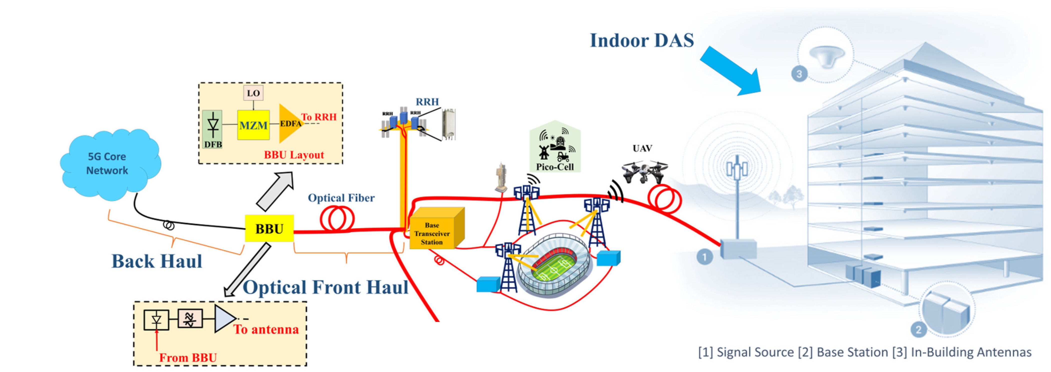
Where Is RoF Used in Practice?
Two uses, one question: where does the fiber carry the radio signal, and what is the trade-off?
Adapted from: Hadi & Murtaza, "Fibre Wireless Distributed Antenna Systems for 5G and 6G Services," Electronics 12(1), 64 (2023), Fig. 1, CC BY 4.0.
Notes:
Goal of Part 2: show where the RoF link from Part 1 is used in practice, and what it costs. Left: C-RAN fronthaul (BBU to RRH over fiber). Right: indoor DAS.

Slide 2
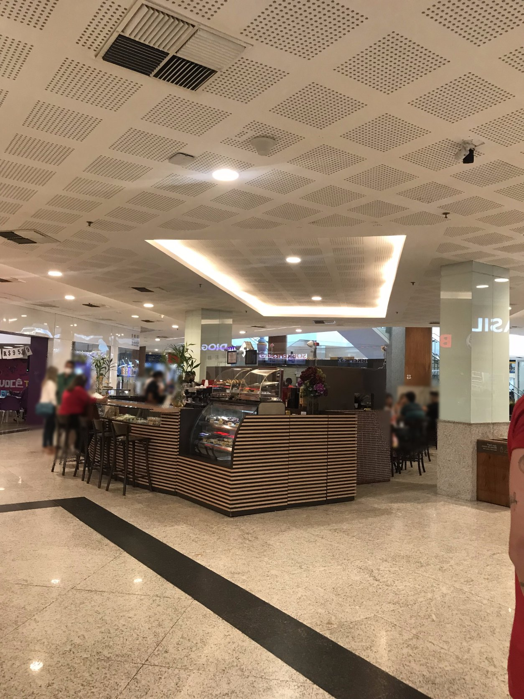
Use 1: In-Building DAS
DAS: one base station, many low-power antennas close to users.
Coax: loss grows with frequency, 26.7 dB/100 m at 3.5 GHz.
Fiber: ≈ 0.025 dB/100 m for every band and operator.
Cost: power at every remote unit; uplink noise rises with more units.
Photo: ceiling DAS antenna, Silva et al., Sensors 23, 4579 (2023). Chart: Times Microwave LMR-400 datasheet formula.
Notes:
Students: one signal source, many low-power antennas close to users (photo: real ceiling DAS antenna). Experts: coax loss rises with frequency, so fiber feeds remote units; cost moves to remote power, and uplink noise rises ~10log10(N) when N units share a port.

Slide 3
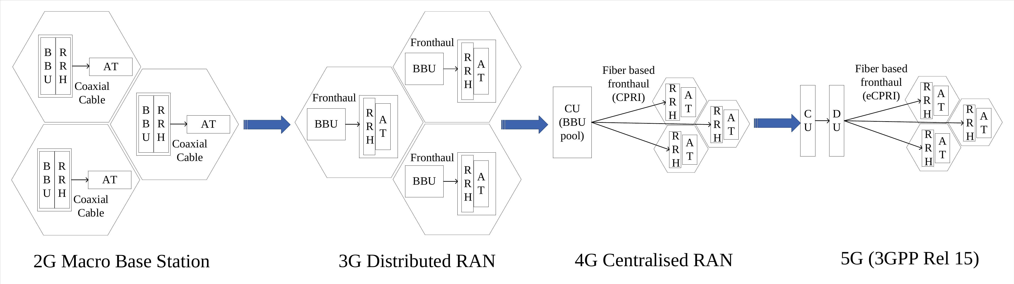
Use 2: C-RAN Fronthaul
C-RAN: baseband pooled centrally; radio heads stay at the antennas.
Gain: shared processing, easier cell coordination, less equipment at each site.
Price: fronthaul. CPRI: 1.23 Gb/s for 20 MHz × 1 antenna; ≈ 315 Gb/s for 100 MHz × 64 antennas.
Source: Li, Xie, El-Hajjar, Hanzo, "Analogue Radio Over Fiber for Next-Generation RAN," arXiv:2111.13851 (2021), Fig. 1. Rates: CPRI Specification V7.0.
Notes:
Baseband moves away from the antenna site and is pooled. The price is fronthaul: CPRI 20 MHz x1 antenna = 1.23 Gb/s; 100 MHz x64 antennas ≈ 315 Gb/s (CPRI V7.0 formula).

Slide 4
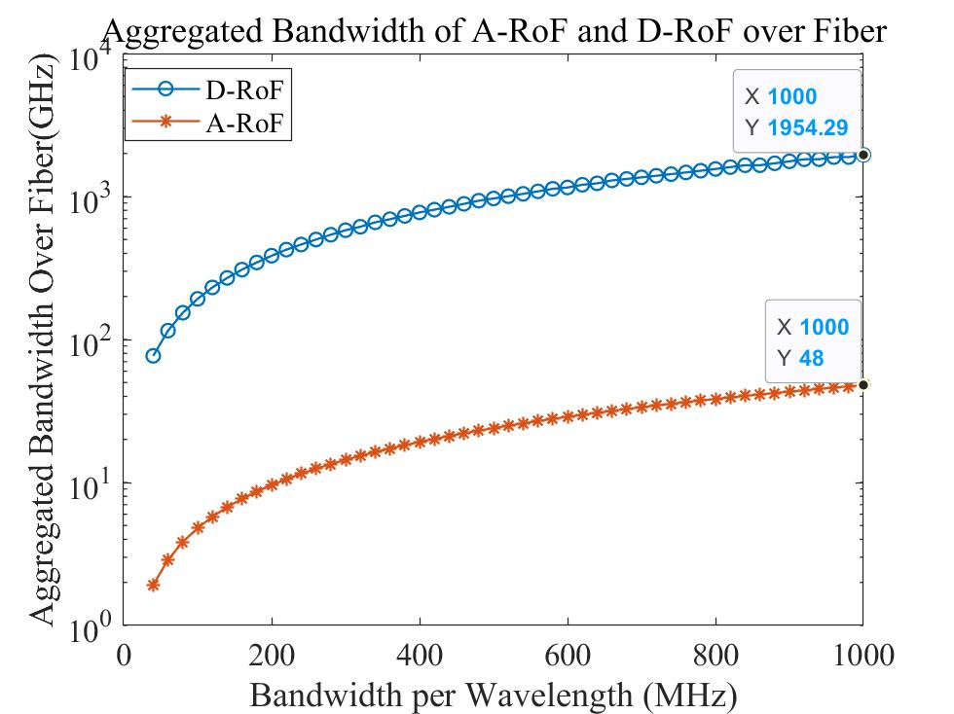
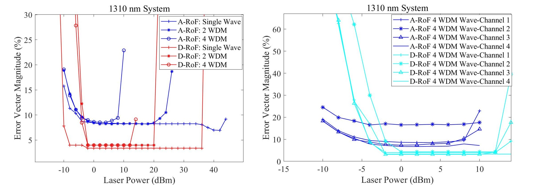
Analog vs. Digital Fronthaul: Bandwidth vs. Quality
Analog RoF: up to 40× less fiber bandwidth, simpler radio head, but EVM ≈ 8 % (fails the 3.5 % limit for 256-QAM).
Digital fronthaul: robust and standardized (CPRI / eCPRI), but bandwidth- and power-hungry.
Source: Li, Xie, El-Hajjar, Hanzo, "Analogue Radio Over Fiber for Next-Generation RAN," arXiv:2111.13851 (2021), Figs. 3 and 5. EVM limit: 3GPP TS 38.104.
Notes:
Left: aggregated fiber bandwidth, A-RoF far lower (up to 40-fold in the modeled case). Right: EVM; A-RoF ~8 % meets 64-QAM but not the 3.5 % 256-QAM limit (3GPP TS 38.104); D-RoF meets it. This is the core trade-off of the talk.

Slide 5
Limitations & Mitigation
Challenge | Impact | Mitigation
Fiber & remote power | CAPEX; every remote unit needs power | Reuse fiber; hybrid fiber–copper cable
Noise & nonlinearity | Limit dynamic range and EVM | Drive-level optimization; predistortion
Chromatic dispersion | RF power fading at high RF, long fiber | 1310 nm; single-sideband; IFoF
Fronthaul rate (C-RAN) | Grows with antennas and bandwidth | Split 7.2x (eCPRI); analog RoF
Interoperability | Analog interfaces are vendor-specific | ITU-T G.9803; eCPRI / O-RAN
Notes:
Five rows only; details on request.

Slide 6
Conclusions
• RoF carries the analog radio waveform over fiber: low, band-independent loss.
• In buildings (DAS): fiber replaces lossy coax and feeds many antennas from one source.
• In C-RAN: analog RoF cuts fronthaul bandwidth sharply but loses signal quality.
• The choice depends on fiber availability, bands, required EVM and remote power.
• RoF moves the antenna closer to users; it does not add spectrum or capacity.
Notes:
Close the talk on the boundary experts will test: RoF moves the antenna, not the spectrum.

Slide 7
References
1. Y. Li, Q. Xie, M. El-Hajjar, L. Hanzo, arXiv:2111.13851, 2021.
2. M. U. Hadi, G. Murtaza, Electronics 12(1), 64, 2023. DOI: 10.3390/electronics12010064.
3. J. da L. A. Silva et al., Sensors 23, 4579, 2023.
4. V. Quintuna Rodriguez et al., arXiv:2101.04216, 2021.
5. CPRI V7.0 (2015); eCPRI V2.0 (2019); 3GPP TS 38.104; ITU-T G.9803 (2018) & Amd. 2 (2022).
6. Times Microwave Systems, LMR-400 datasheet.

Slide 8
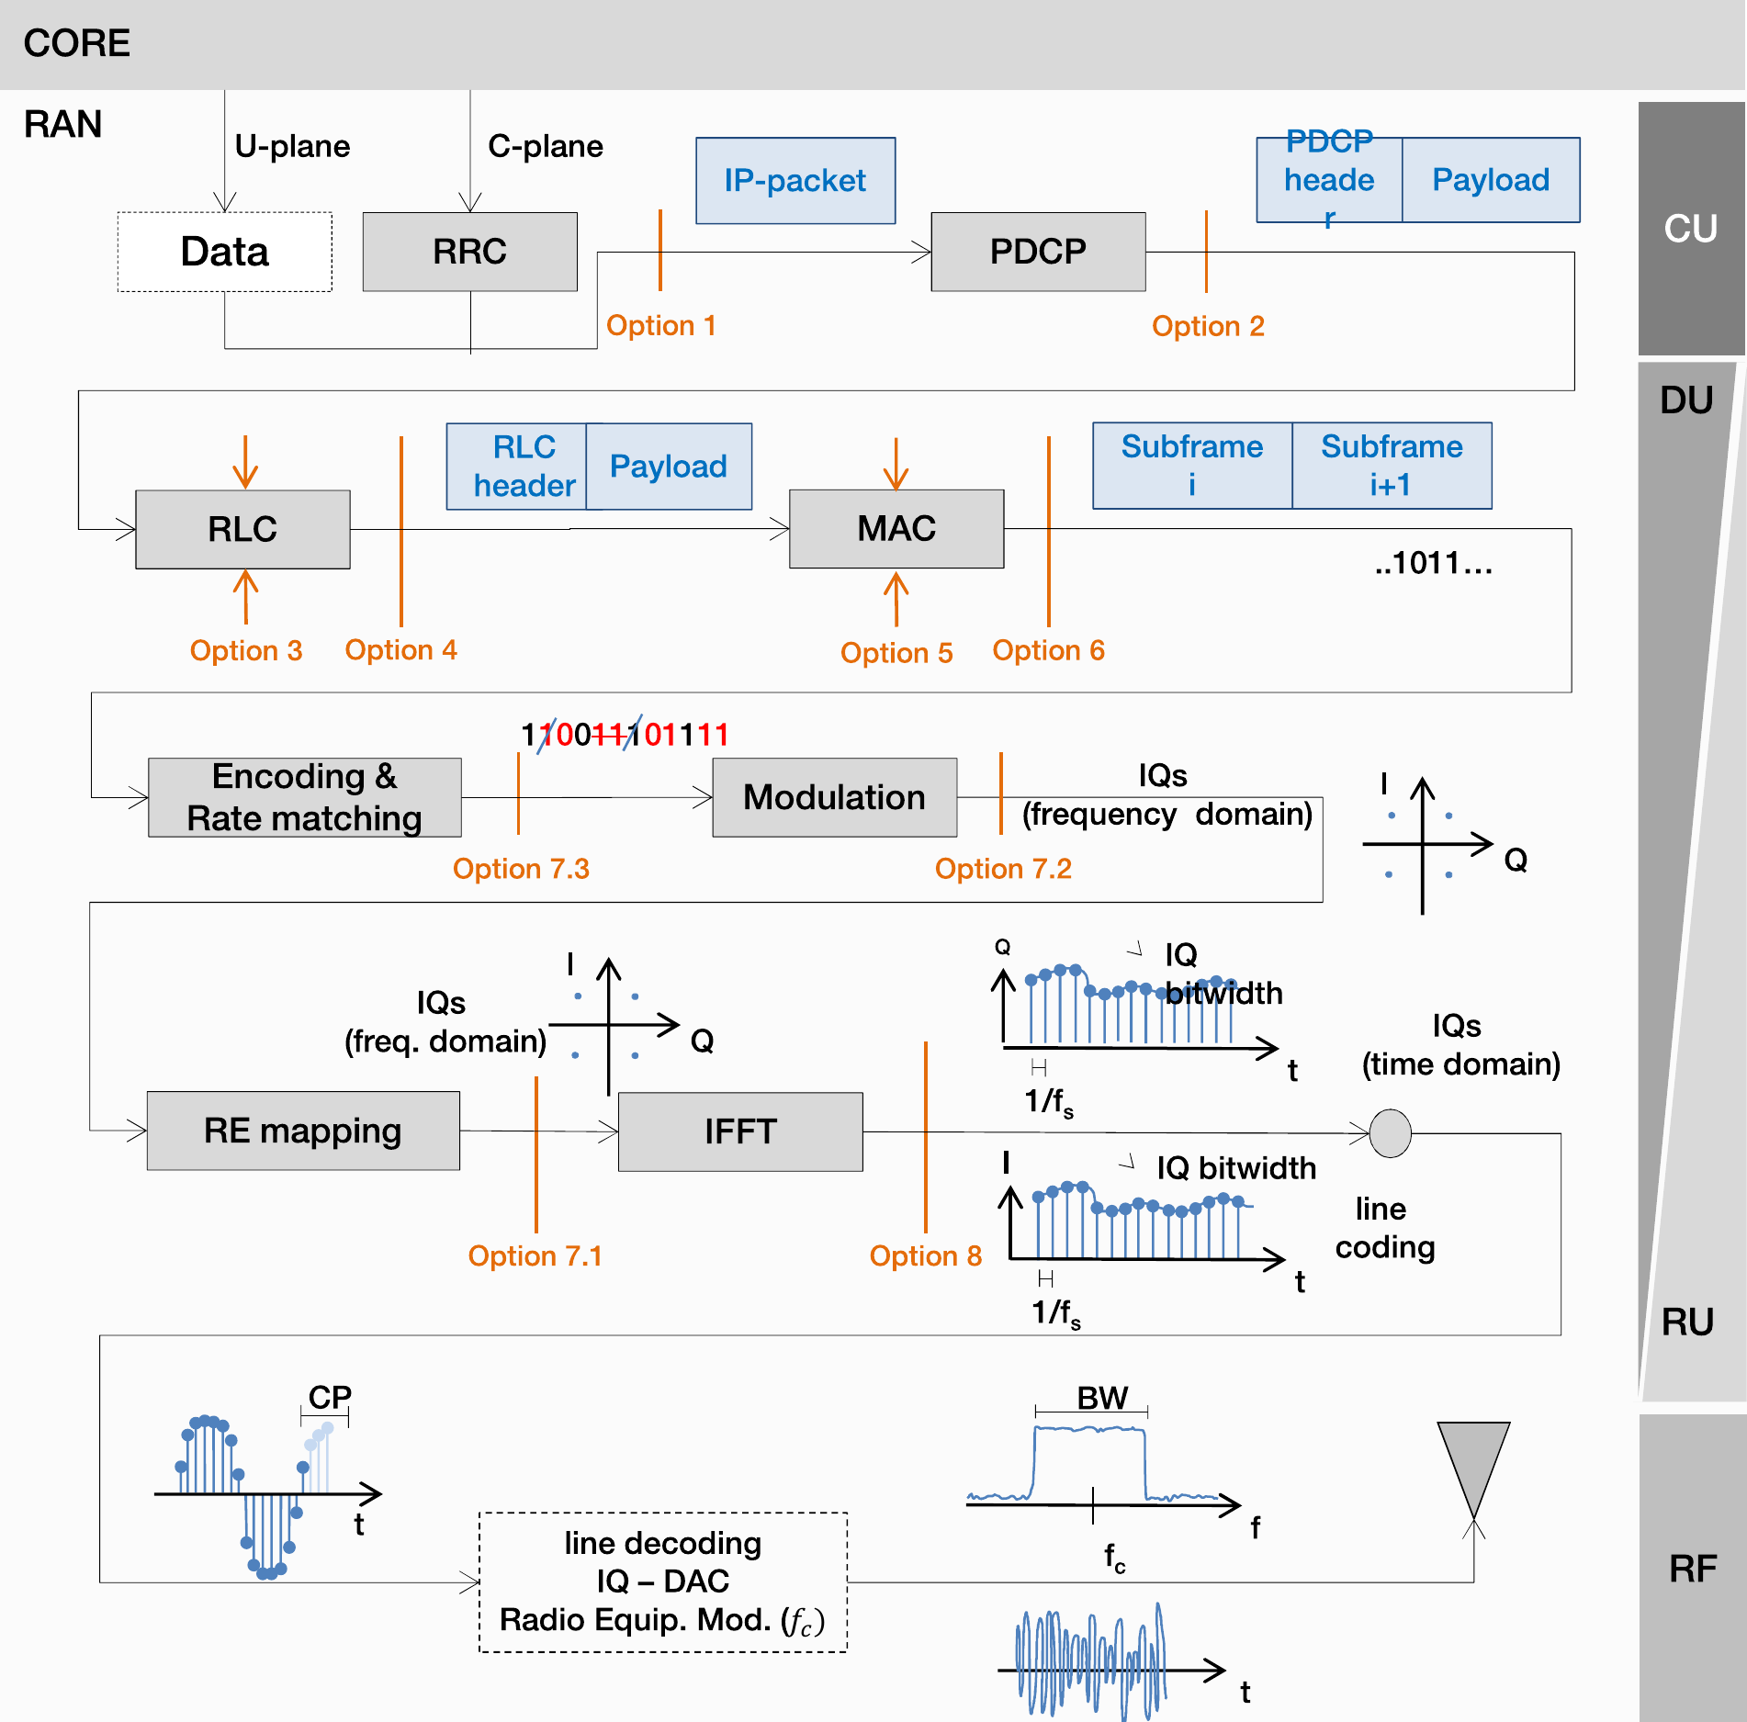
Backup: Functional Splits
Option 8: time-domain I/Q (CPRI), highest rate.
Option 7.2: frequency-domain I/Q (eCPRI, O-RAN).
Option 2: packets; lowest rate.
Analog RoF: the RF waveform itself, below Option 8.
Source: Quintuna Rodriguez et al., "Cloud-RAN functional split for an efficient fronthaul network," arXiv:2101.04216 (2021).
Notes:
For RAN experts: the lower the split, the more is central and the higher the fronthaul rate. Analog RoF sits below Option 8.

