Slide 1
Radio over Fiber (RoF)
Technology, Architecture, Advantages, Applications and Limitations

Slide 2
Agenda
1. What is Radio over Fiber?
2. How it works: architecture and building blocks
3. Analog vs. digital RoF
4. Advantages of RoF
5. RoF in Distributed Antenna Systems (DAS)
6. Application areas
7. Limitations, challenges and outlook

Slide 3
Why Do We Need Radio over Fiber?
How do you bring a clear mobile signal inside a tunnel or a big stadium?
• The problem: walls, distance and crowds weaken radio signals, so one antenna cannot cover a whole building or venue.
• The usual fix: place many small antennas around the area, all fed from one central equipment room.
• Coaxial cable can feed them, but at radio frequencies it loses signal quickly over distance and is heavy and bulky.
• Optical fiber loses very little signal, is thin and light, and does not pick up electromagnetic interference. This is the idea behind RoF.

Slide 4
RoF vs. Coaxial Cable and Microwave Links
Aspect | Coaxial cable | Microwave link | RoF (fiber)
Loss over distance | High at radio frequencies; grows with frequency and length | Free-space path loss; needs a clear line of sight | Very low (about 0.2 dB/km at 1550 nm)
Reach | Short runs | Line-of-sight hops between towers | Many kilometers
Interference | Shielded, but not immune | Affected by weather and radio interference | Fiber span is immune to electromagnetic pickup
Size and weight | Heavy and bulky | Needs antennas, dishes and towers | Thin and light
Bandwidth | Moderate; loss limits useful length | Limited by allocated spectrum | Very large (more with WDM)
Best fit | Short indoor links | Point-to-point links where fiber is not available | Longer links to many remote antennas
Qualitative comparison; actual values depend on cable type, frequency and link design. Fiber loss: ITU-T G.652 family.

Slide 5
Example: Signal Loss over Distance
A 2.4 GHz signal carried over each medium (loss = power lost along the cable):
Distance | Coax (about 22 dB per 100 m at 2.4 GHz) | Fiber (0.2 dB/km at 1550 nm)
100 m | about 22 dB loss (under 1% of the power left) | 0.02 dB loss (about 99.5% left)
1 km | about 220 dB loss | 0.2 dB loss
10 km | about 2,200 dB loss: not usable | 2 dB loss (about 63% left)
Takeaway: over 10 km, fiber loses a few dB while coax loses far more than any amplifier could recover.
In an intensity-modulated link, 1 dB of optical loss reduces the recovered RF power by about 2 dB, so 2 dB of fiber loss is roughly 4 dB of RF loss. Still tiny next to coax.
Illustrative values. Coax: typical datasheet figure for LMR-400-class cable at 2.4 GHz; check your own cable’s datasheet. Fiber: ITU-T G.652 family.

Slide 6
Radio over Fiber: Definition & Principle of Operation
• Core concept: RoF transports an analog RF or IF waveform directly over an optical fiber carrier, rather than baseband digital bits.
• Downlink (E/O → O/E): at the central station, the RF/IF signal modulates a CW laser carrier (direct modulation or an external MZM). At the remote unit, a photodiode recovers the RF/IF signal for filtering, amplification and antenna transmission.
• Uplink: follows the reverse conversion path, from the remote antenna back to the central processing unit.
• Multiplexing: wavelength-division multiplexing (WDM) lets several RF channels share one fiber on different wavelengths (λ1 … λn).
Critical distinction: RoF removes the transport bottleneck, but it does not create extra radio spectrum or wireless air-interface capacity by itself.

Slide 7
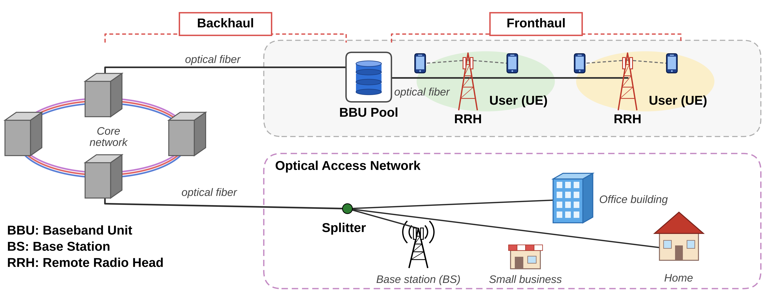
RoF Network Architecture
BBU: Baseband Unit · BS: Base Station · RRH: Remote Radio Head

Slide 8
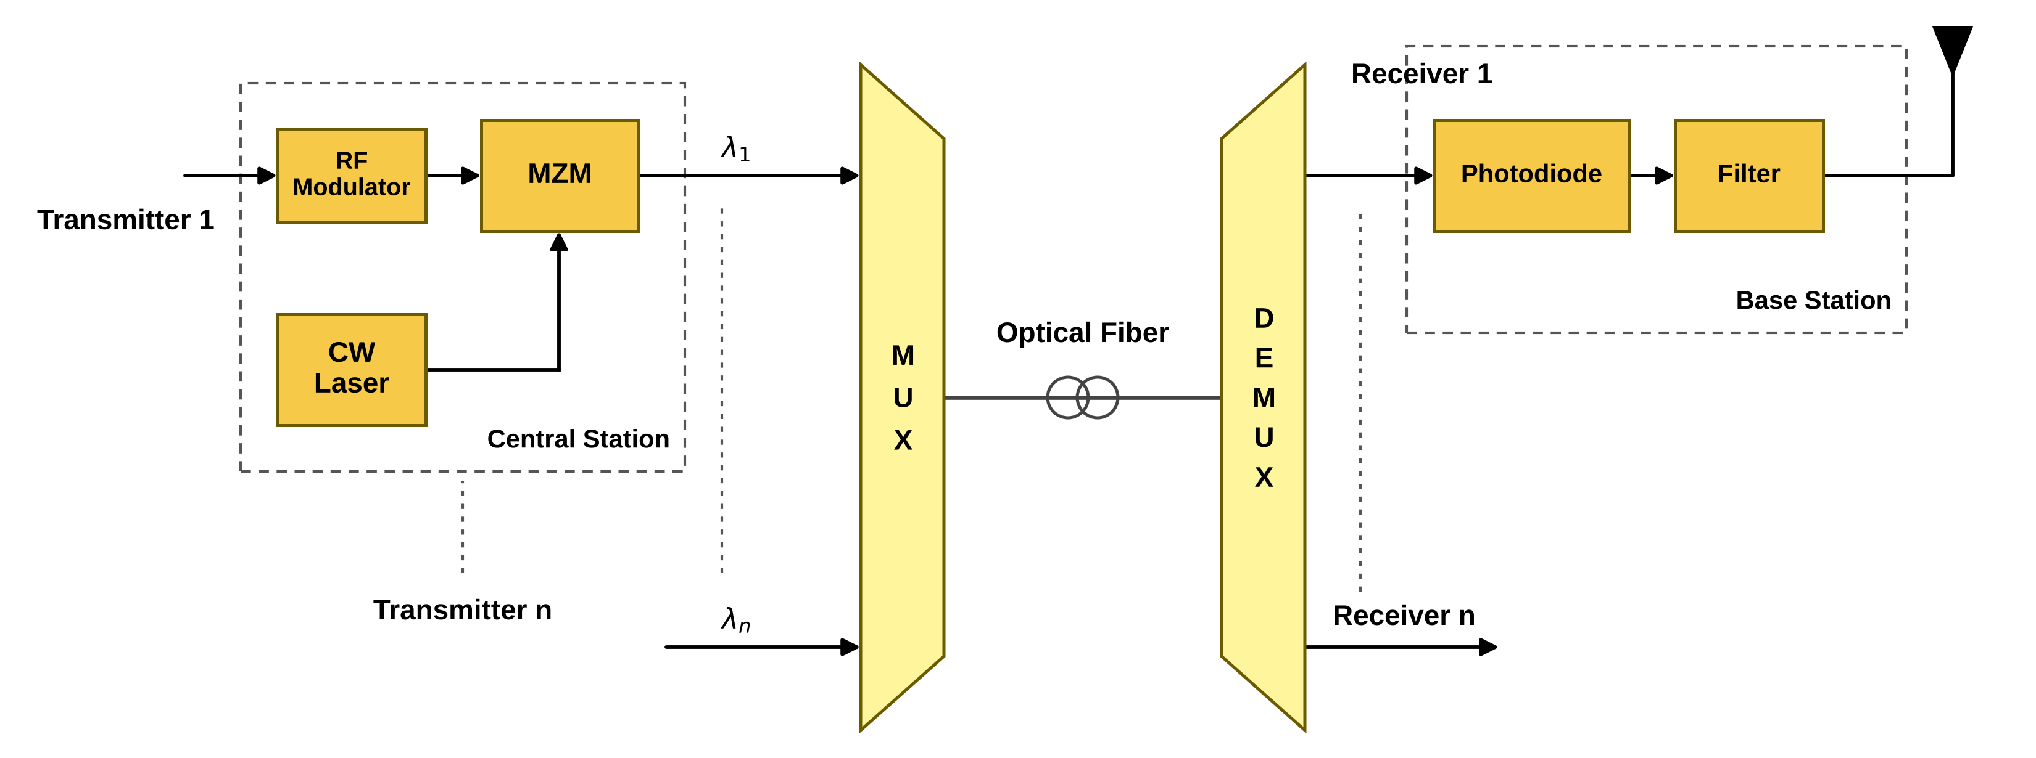
RoF Link Block Diagram
CW laser: continuous-wave source that provides the optical carrier.
MZM: Mach-Zehnder modulator; varies light intensity with the RF signal (alternative: direct laser modulation).
WDM MUX / DEMUX: combine and separate channels λ1 … λn when they share one fiber.
Photodiode: converts light back into the electrical RF signal at the base station (remote antenna site).
Filter and PA: remove out-of-band products and amplify the RF signal before the antenna.
Downlink shown; the uplink follows the reverse conversion path.

Slide 9
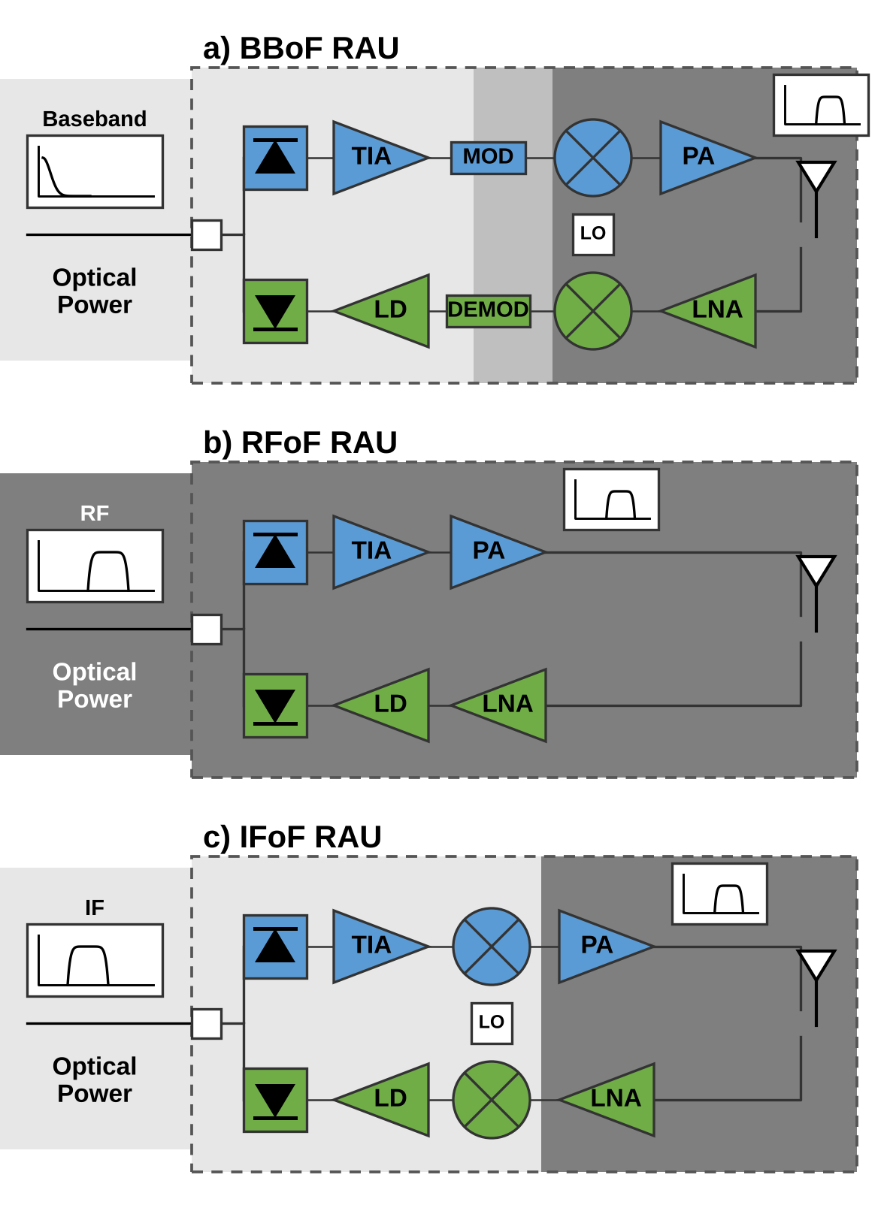
RoF Remote Antenna Unit (RAU) Types
BBoF — baseband over fiber
RAU: modulator + mixer + LO. Converts baseband up to RF.
IFoF — intermediate frequency over fiber
RAU: mixer + LO. Converts IF up to RF.
RFoF — RF over fiber
RAU: photodiode + TIA + PA. No frequency conversion; simplest RAU.
All types
Downlink: photodiode, TIA, PA. Uplink: LNA, laser diode (LD).
TIA: transimpedance amplifier · PA: power amplifier · LNA: low-noise amplifier. Figure adapted from “Radio over Fiber: An Alternative Broadband Network Technology for IoT,” Electronics 9(11), 1785 (2020), Fig. 3.
Notes:
Figure source: “Radio over Fiber: An Alternative Broadband Network Technology for IoT,” Electronics 9(11), 1785 (2020), Figure 3. DOI: https://doi.org/10.3390/electronics9111785.

Slide 10
Analog vs. Digital RoF
Aspect | Analog RoF (A-RoF) | Digital RoF (D-RoF)
Signal on fiber | The RF waveform itself modulates the light | Sampled and quantized digital bits
Remote unit | Very simple: photodiode, filter, amplifier | More complex: needs DAC / ADC
Fiber bandwidth | Efficient | Very high; grows with antennas and bandwidth
Main weakness | Noise, nonlinearity, dispersion | High data rate, remote-unit cost and power
Standards | ITU-T G.9803 defines RoF system requirements, including IMT-2020 fronthaul in Amendment 2 (2022). | CPRI / eCPRI: digital fronthaul interface families.
Sources: Li et al. (2021); ITU-T G.9803 (2018), Amendment 2 (2022).

Slide 11
Key Engineering Advantages of RoF
1. Ultra-low attenuation & extended reach
≈ 0.2 dB/km at 1550 nm (ITU-T G.652 SMF), so one central site can serve a wide coverage area. Reach is bounded by noise, nonlinearity and dispersion.
2. Large transport bandwidth
High fiber capacity, extended with WDM, supports multiple channels and operators on one fiber.
3. EMI immunity
The optical fiber span is immune to electromagnetic interference. Over-the-air RF interference still applies.
4. Centralized processing, low field maintenance
Complex processing stays at the BBU pool. Simpler remote units with fewer active parts reduce remote power and maintenance.
5. Protocol & modulation transparency
A transparent optical link carries multiple radio generations and modulation formats without changing remote hardware.
6. Cost & installation efficiency
Light, flexible cable simplifies installation in tunnels and buildings; existing dark fiber can be reused.
Note: wireless capacity remains governed by radio spectrum, modulation efficiency and the number of radio units, not by fiber bandwidth alone.
Fiber attenuation: typical single-mode fiber at 1550 nm, ITU-T G.652 family.

Slide 12
RoF: Distributed Antenna System (DAS)
• A common RoF deployment model is the Distributed Antenna System (DAS), which connects a central equipment room to remote radio units over fiber.
• DAS can improve indoor or venue coverage in places such as stadiums, airports, shopping malls and campuses. Wireless capacity still depends on radio spectrum and radio design.

