Slide 1
Radio over Fiber (RoF)
Technology, Architecture, Advantages, Applications and Limitations

Slide 2
Agenda
1. What is Radio over Fiber?
2. How it works: architecture and building blocks
3. Analog vs. digital RoF
4. Advantages of RoF
5. RoF in Distributed Antenna Systems (DAS)
6. Application areas
7. Limitations, challenges and outlook

Slide 3
Why Do We Need Radio over Fiber?
How do you bring a clear mobile signal inside a tunnel or a big stadium?
• The problem: walls, distance and crowds weaken radio signals, so one antenna cannot cover a whole building or venue.
• The usual fix: place many small antennas around the area, all fed from one central equipment room.
• Coaxial cable can feed them, but at radio frequencies it loses signal quickly over distance and is heavy and bulky.
• Optical fiber loses very little signal, is thin and light, and does not pick up electromagnetic interference. This is the idea behind RoF.

Slide 4
RoF vs. Coaxial Cable and Microwave Links
Aspect | Coaxial cable | Microwave link | RoF (fiber)
Loss over distance | High at radio frequencies; grows with frequency and length | Free-space path loss; needs a clear line of sight | Very low (about 0.2 dB/km at 1550 nm)
Reach | Short runs | Line-of-sight hops between towers | Many kilometers
Interference | Shielded, but not immune | Affected by weather and radio interference | Fiber span is immune to electromagnetic pickup
Size and weight | Heavy and bulky | Needs antennas, dishes and towers | Thin and light
Bandwidth | Moderate; loss limits useful length | Limited by allocated spectrum | Very large (more with WDM)
Best fit | Short indoor links | Point-to-point links where fiber is not available | Longer links to many remote antennas
Qualitative comparison; actual values depend on cable type, frequency and link design. Fiber loss: ITU-T G.652 family.

Slide 5
Example: Signal Loss over Distance
A 2.4 GHz signal carried over each medium (loss = power lost along the cable):
Distance | Coax (about 22 dB per 100 m at 2.4 GHz) | Fiber (0.2 dB/km at 1550 nm)
100 m | about 22 dB loss (under 1% of the power left) | 0.02 dB loss (about 99.5% left)
1 km | about 220 dB loss | 0.2 dB loss
10 km | about 2,200 dB loss: not usable | 2 dB loss (about 63% left)
Takeaway: over 10 km, fiber loses a few dB while coax loses far more than any amplifier could recover.
In an intensity-modulated link, 1 dB of optical loss reduces the recovered RF power by about 2 dB, so 2 dB of fiber loss is roughly 4 dB of RF loss. Still tiny next to coax.
Illustrative values. Coax: typical datasheet figure for LMR-400-class cable at 2.4 GHz; check your own cable’s datasheet. Fiber: ITU-T G.652 family.

Slide 6
Radio over Fiber: Definition & Principle of Operation
• Core concept: RoF transports an analog RF or IF waveform directly over an optical fiber carrier, rather than baseband digital bits.
• Downlink (E/O → O/E): at the central station, the RF/IF signal modulates a CW laser carrier (direct modulation or an external MZM). At the remote unit, a photodiode recovers the RF/IF signal for filtering, amplification and antenna transmission.
• Uplink: follows the reverse conversion path, from the remote antenna back to the central processing unit.
• Multiplexing: wavelength-division multiplexing (WDM) lets several RF channels share one fiber on different wavelengths (λ1 … λn).
Critical distinction: RoF removes the transport bottleneck, but it does not create extra radio spectrum or wireless air-interface capacity by itself.

Slide 7
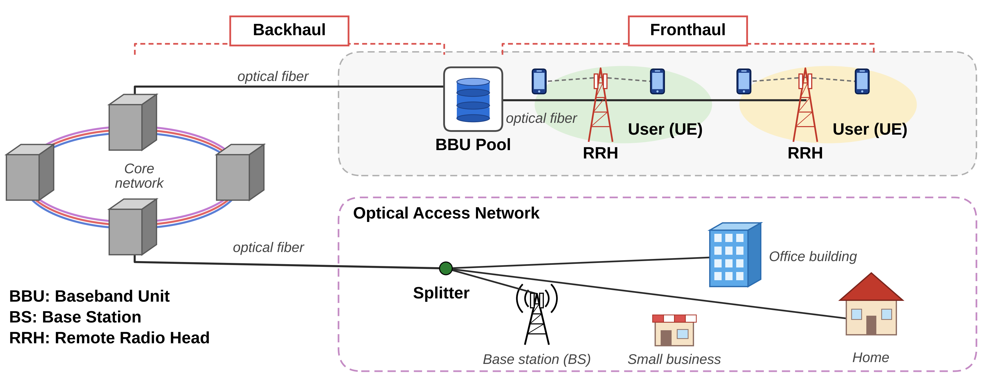
RoF Network Architecture
BBU: Baseband Unit · BS: Base Station · RRH: Remote Radio Head

Slide 8
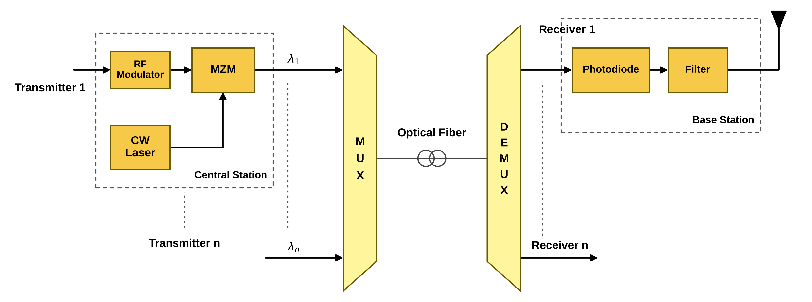
RoF Link Block Diagram
CW laser: continuous-wave source that provides the optical carrier.
MZM: Mach-Zehnder modulator; varies light intensity with the RF signal (alternative: direct laser modulation).
WDM MUX / DEMUX: combine and separate channels λ1 … λn when they share one fiber.
Photodiode: converts light back into the electrical RF signal at the base station (remote antenna site).
Filter and PA: remove out-of-band products and amplify the RF signal before the antenna.
Downlink shown; the uplink follows the reverse conversion path.

Slide 9
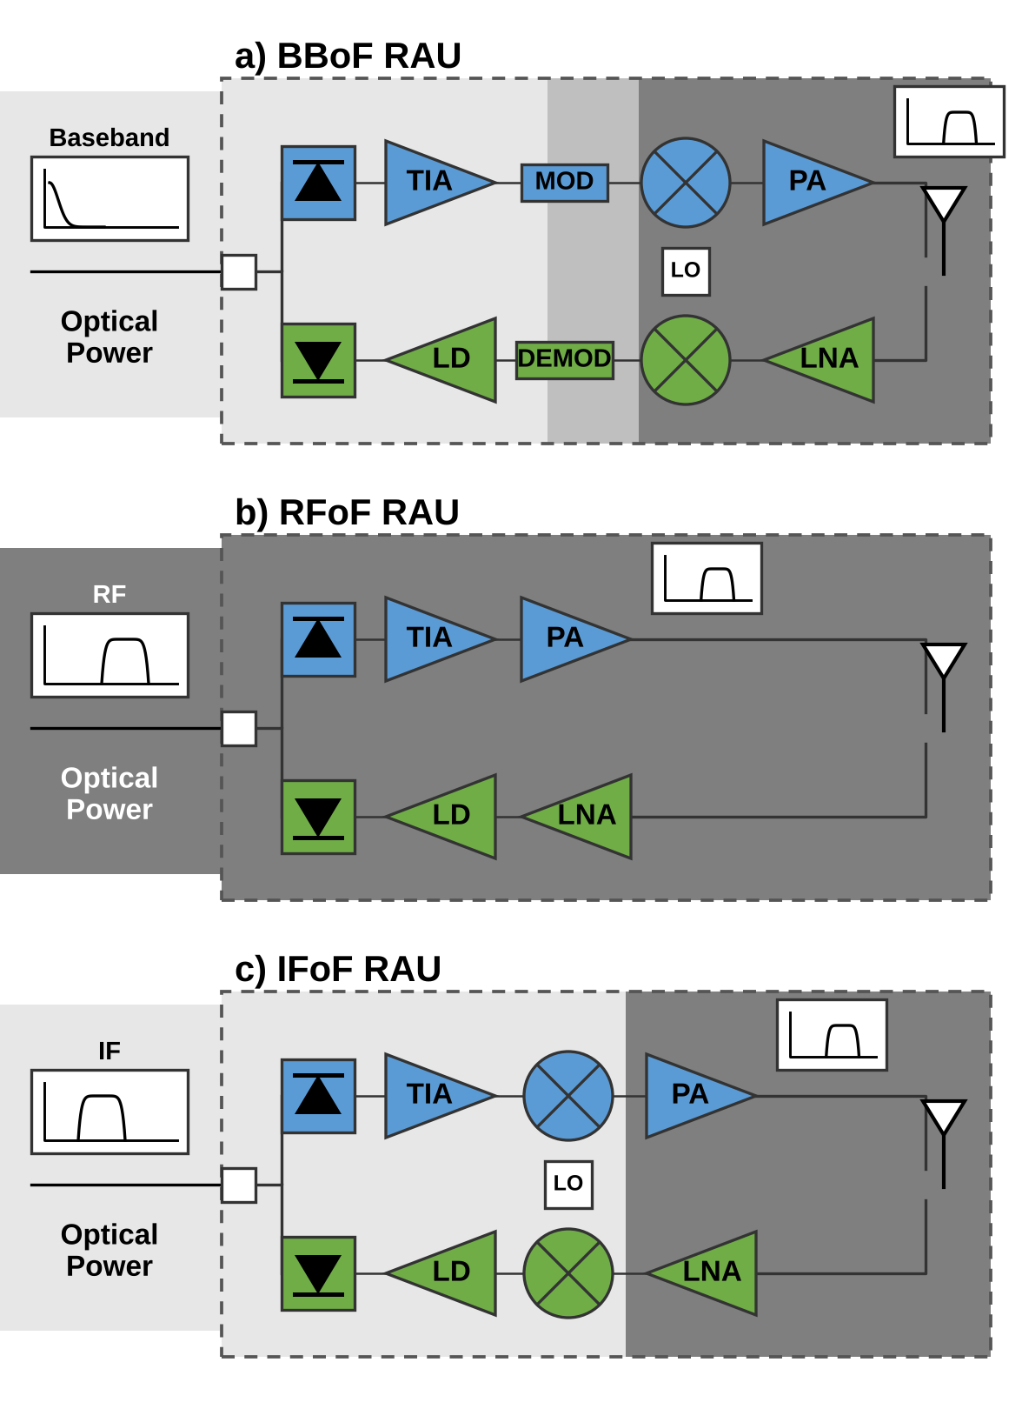
RoF Remote Antenna Unit (RAU) Types
BBoF — baseband over fiber
RAU: modulator + mixer + LO. Converts baseband up to RF.
IFoF — intermediate frequency over fiber
RAU: mixer + LO. Converts IF up to RF.
RFoF — RF over fiber
RAU: photodiode + TIA + PA. No frequency conversion; simplest RAU.
All types
Downlink: photodiode, TIA, PA. Uplink: LNA, laser diode (LD).
TIA: transimpedance amplifier · PA: power amplifier · LNA: low-noise amplifier. Figure adapted from “Radio over Fiber: An Alternative Broadband Network Technology for IoT,” Electronics 9(11), 1785 (2020), Fig. 3.
Notes:
Figure source: “Radio over Fiber: An Alternative Broadband Network Technology for IoT,” Electronics 9(11), 1785 (2020), Figure 3. DOI: https://doi.org/10.3390/electronics9111785.

Slide 10
Analog vs. Digital RoF
Aspect | Analog RoF (A-RoF) | Digital RoF (D-RoF)
Signal on fiber | The RF waveform itself modulates the light | Sampled and quantized digital bits
Remote unit | Very simple: photodiode, filter, amplifier | More complex: needs DAC / ADC
Fiber bandwidth | Efficient | Very high; grows with antennas and bandwidth
Main weakness | Noise, nonlinearity, dispersion | High data rate, remote-unit cost and power
Standards | ITU-T G.9803 defines RoF system requirements, including IMT-2020 fronthaul in Amendment 2 (2022). | CPRI / eCPRI: digital fronthaul interface families.
Sources: Li et al. (2021); ITU-T G.9803 (2018), Amendment 2 (2022).

Slide 11
Key Engineering Advantages of RoF
1. Ultra-low attenuation & extended reach
≈ 0.2 dB/km at 1550 nm (ITU-T G.652 SMF), so one central site can serve a wide coverage area. Reach is bounded by noise, nonlinearity and dispersion.
2. Large transport bandwidth
High fiber capacity, extended with WDM, supports multiple channels and operators on one fiber.
3. EMI immunity
The optical fiber span is immune to electromagnetic interference. Over-the-air RF interference still applies.
4. Centralized processing, low field maintenance
Complex processing stays at the BBU pool. Simpler remote units with fewer active parts reduce remote power and maintenance.
5. Protocol & modulation transparency
A transparent optical link carries multiple radio generations and modulation formats without changing remote hardware.
6. Cost & installation efficiency
Light, flexible cable simplifies installation in tunnels and buildings; existing dark fiber can be reused.
Note: wireless capacity remains governed by radio spectrum, modulation efficiency and the number of radio units, not by fiber bandwidth alone.
Fiber attenuation: typical single-mode fiber at 1550 nm, ITU-T G.652 family.

Slide 12
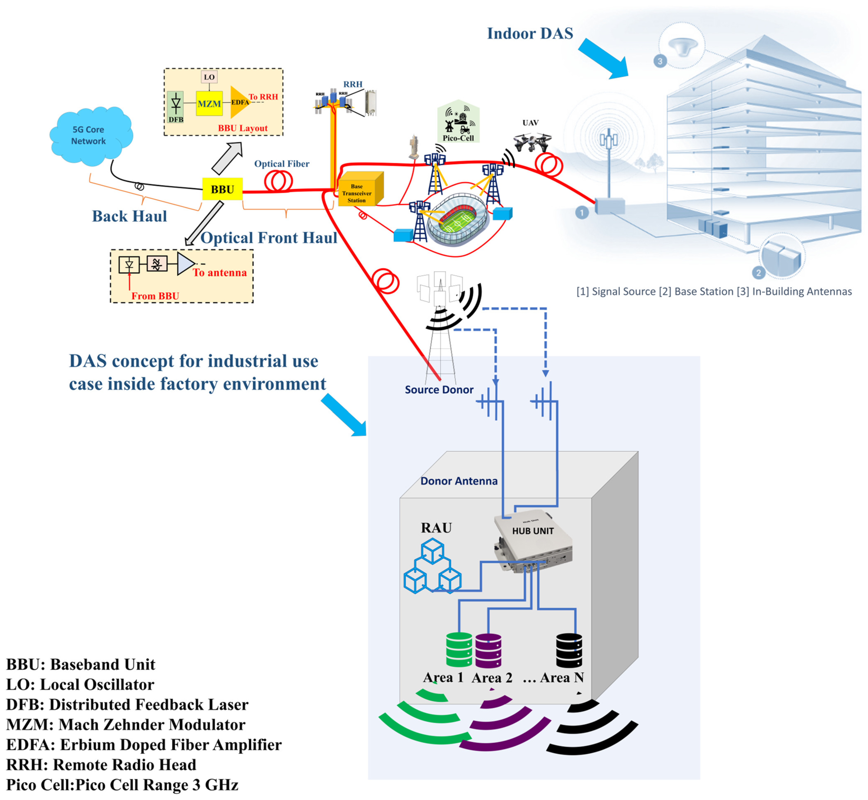
Part 2: Where Is RoF Used? DAS and C-RAN
In buildings (DAS): fiber carries the radio signal from one source to many indoor antennas.
In the mobile network (C-RAN): fiber fronthaul links a central BBU pool to remote radio heads.
Same physics as Part 1: loss, noise, dynamic range and transparency become design decisions.
Source: Hadi & Murtaza, "Fibre Wireless Distributed Antenna Systems for 5G and 6G Services," Electronics 12(1), 64 (2023), CC BY 4.0, Fig. 1.
Notes:
Transition. The figure shows both uses of fiber-wireless transport in one picture: indoor DAS on the right, optical fronthaul from the BBU on the left.

Slide 13
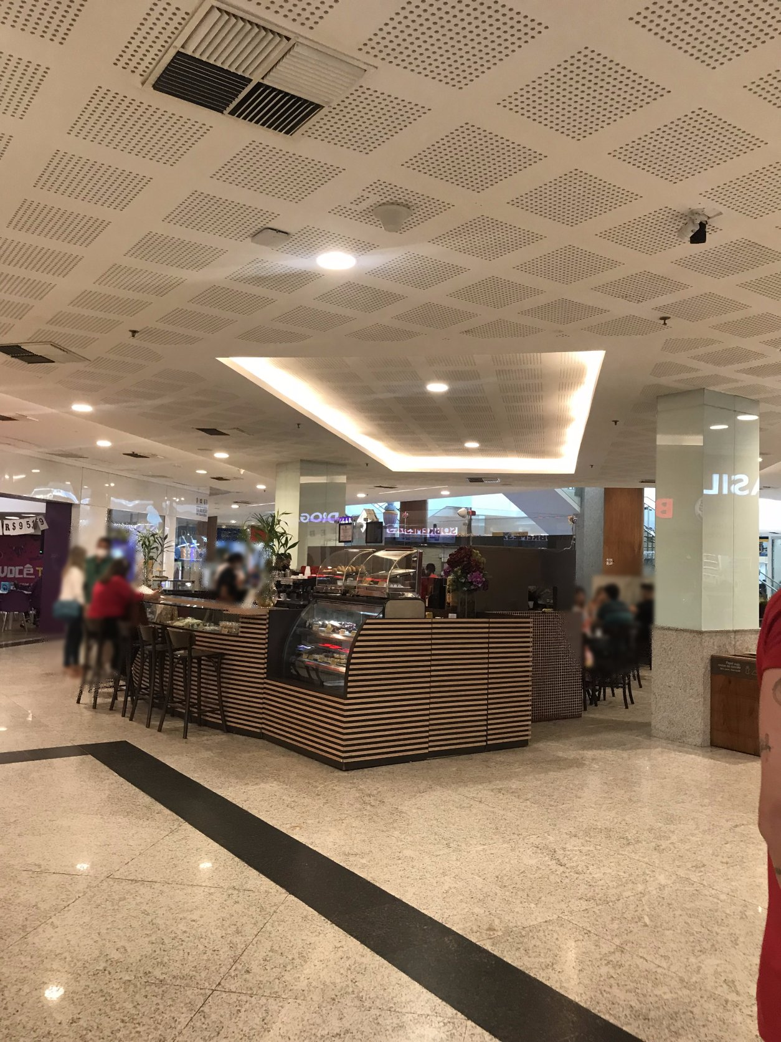
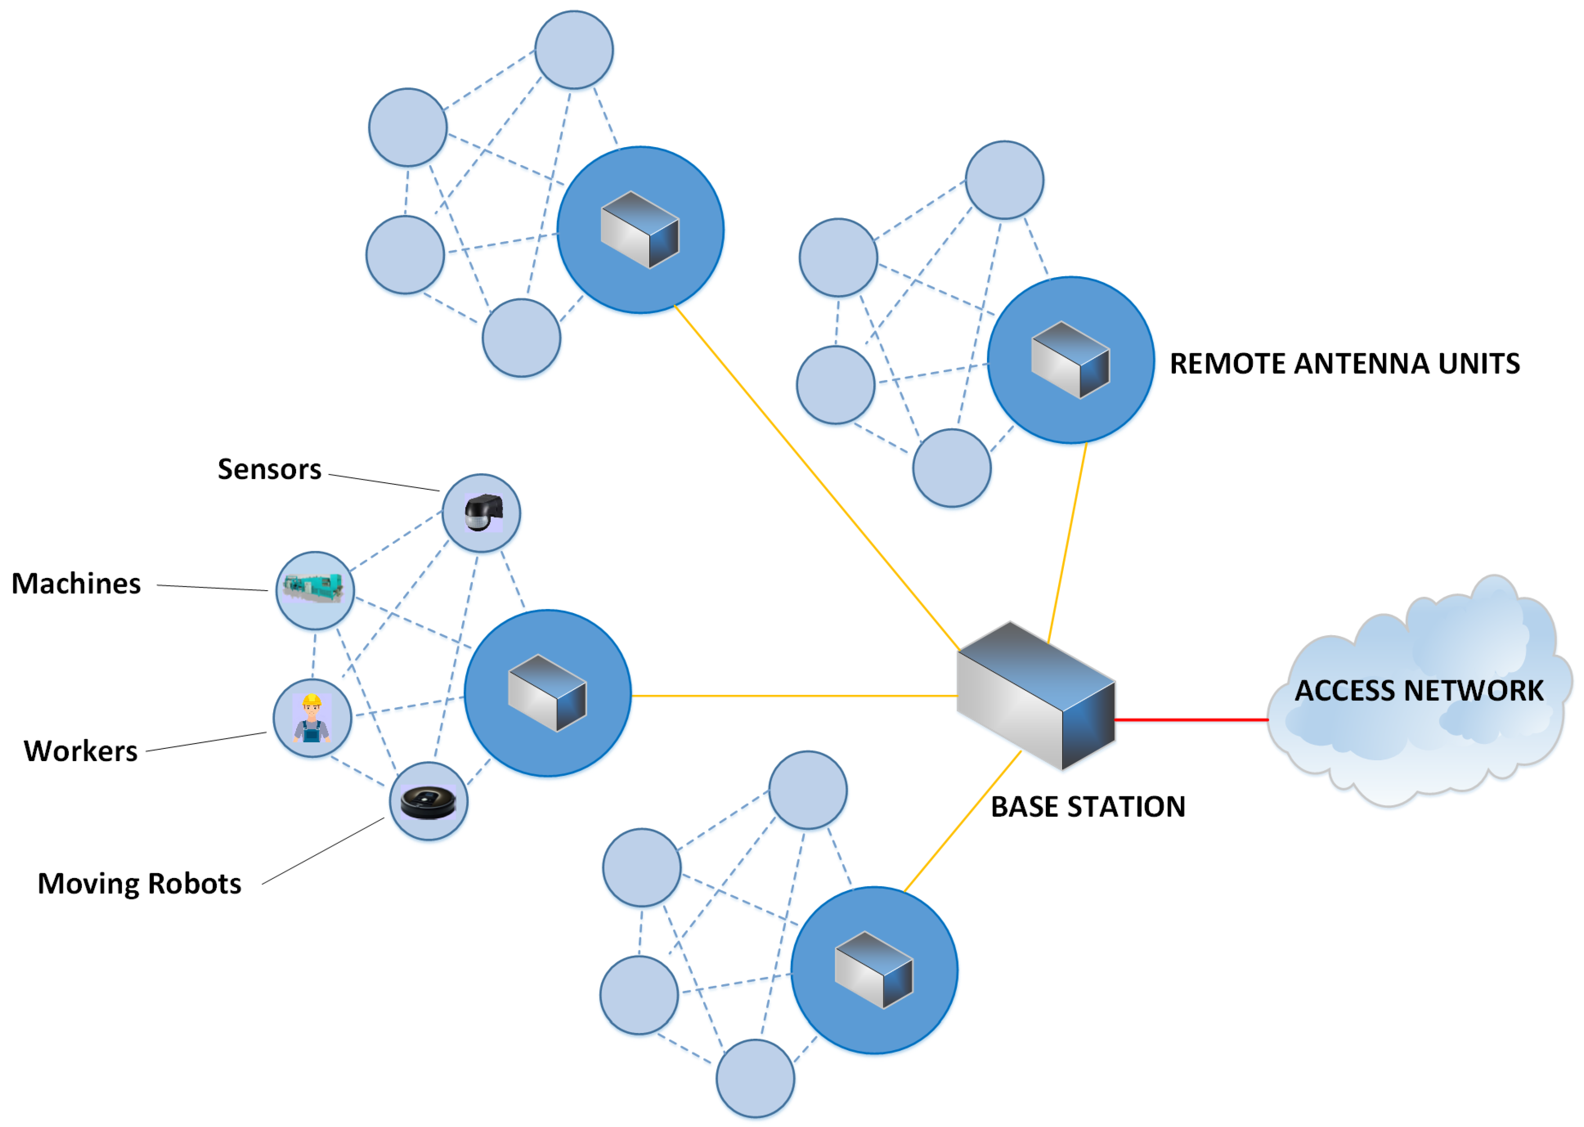
What Is a Distributed Antenna System (DAS)?
1 Signal source
operator base station
2 Distribution
fiber or coax to remote units
3 Antennas
many low-power antennas close to users
Left: ceiling DAS antenna, Silva et al., Sensors 23, 4579 (2023). Right: Paredes-Páliz et al., "Radio over Fiber: An Alternative Broadband Network Technology for IoT," Electronics 9(11), 1785 (2020), Fig. 1, CC BY 4.0.
Notes:
For students: one signal source, many low-power antennas close to users. Left: a real ceiling DAS antenna in a shopping mall. Right: remote antenna units around one base station.

Slide 14
Why Fiber Instead of Coax in a DAS?
Coax: loss rises with frequency; ≈ 2.4× higher at 3.5 GHz than at 700 MHz.
Fiber: ≈ 0.025 dB per 100 m, the same for every band and operator.
Trade-off: remote units need E/O, O/E, amplifiers and power.
Uplink: N remote units on one port raise the noise floor by ≈ 10·log10(N) dB.
Source: Times Microwave LMR-400 datasheet (attenuation formula); G.652.D single-mode fiber, ≈ 0.25 dB/km at 1550 nm.
Notes:
Values computed from the LMR-400 datasheet attenuation formula (dB/100 ft = 0.12229·√f + 0.00026·f). Coax loss grows with frequency; fiber loss does not depend on the RF band.

Slide 15
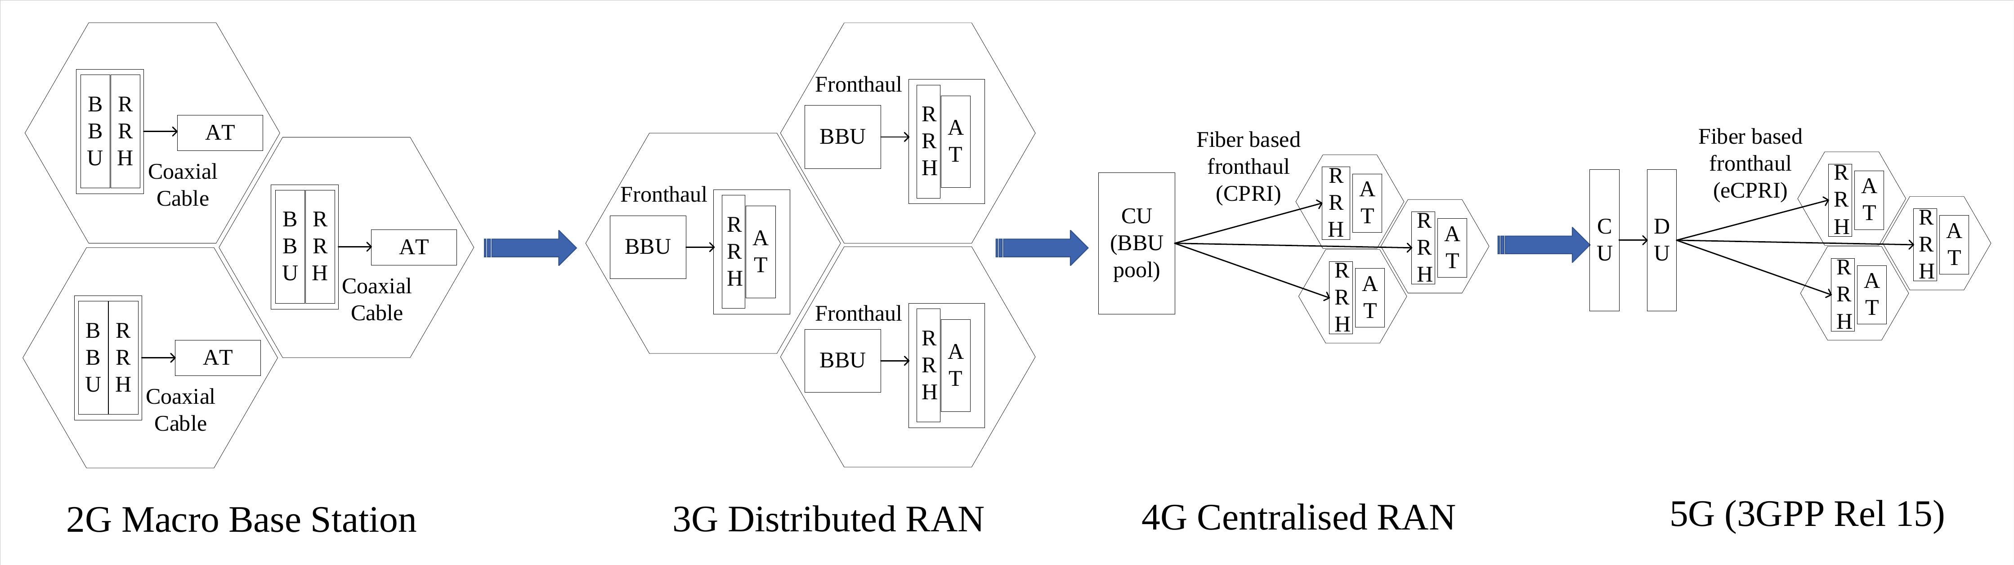
From D-RAN to C-RAN
C-RAN: baseband processing is pooled at a central site; remote radio heads stay at the antennas.
Benefits: shared processing, easier coordination between cells, less equipment and power at each site.
Cost: every remote radio head needs a high-capacity, low-latency fronthaul link.
Source: Li, Xie, El-Hajjar, Hanzo, "Analogue Radio Over Fiber for Next-Generation RAN," arXiv:2111.13851 (2021), Fig. 1.
Notes:
RAN evolution: the baseband unit moves away from the antenna site. 3G separates BBU and RRH; 4G pools BBUs centrally (C-RAN) with fiber fronthaul (CPRI); 5G splits the BBU into CU and DU with eCPRI.

Slide 16
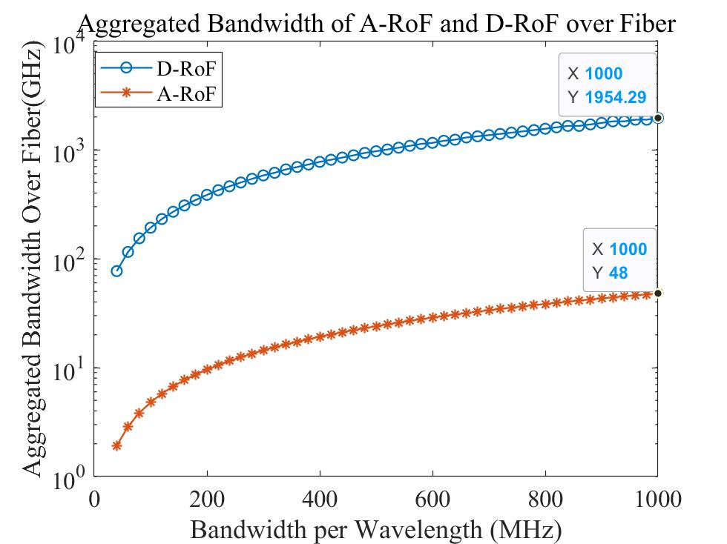
The Fronthaul Bottleneck
Digital fronthaul sends sampled I/Q bits; its rate grows with bandwidth and antenna count.
Example (CPRI): 20 MHz LTE, 1 antenna = 1.23 Gb/s; 100 MHz, 64 antennas ≈ 315 Gb/s.
Analog RoF needs far less fiber bandwidth: up to 40-fold less in the modeled case.
Source: Li, Xie, El-Hajjar, Hanzo, "Analogue Radio Over Fiber for Next-Generation RAN," arXiv:2111.13851 (2021), Fig. 3.
Notes:
The plot from Li et al. compares aggregated fiber bandwidth needed by A-RoF and D-RoF as the bandwidth per wavelength grows. CPRI numbers follow the CPRI V7.0 rate formula (15-bit I/Q, 16/15 control words, 8B/10B).

Slide 17
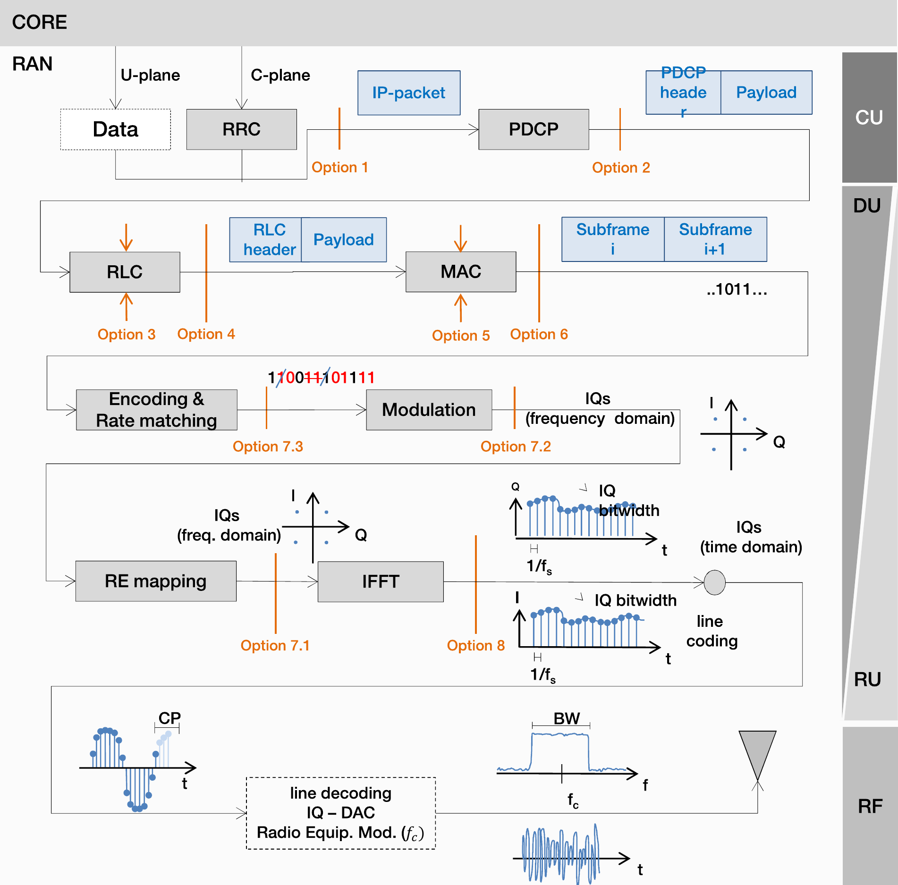
Functional Splits: Where to Cut the Base Station
Option 8: everything central; time-domain I/Q on the fiber (CPRI). Highest rate.
Option 7.2: low-PHY at the radio unit; frequency-domain I/Q (eCPRI, O-RAN). Lower rate.
Option 2: PDCP central; packets on the fiber. Lowest rate, relaxed latency.
Analog RoF: goes beyond Option 8: the RF waveform itself is on the fiber.
Source: Quintuna Rodriguez, Guillemin, Ferrieux, Thomas, "Cloud-RAN functional split for an efficient fronthaul network," arXiv:2101.04216 (2021).
Notes:
The higher the split option number, the more processing stays central and the higher the fronthaul rate and latency requirements.

Slide 18
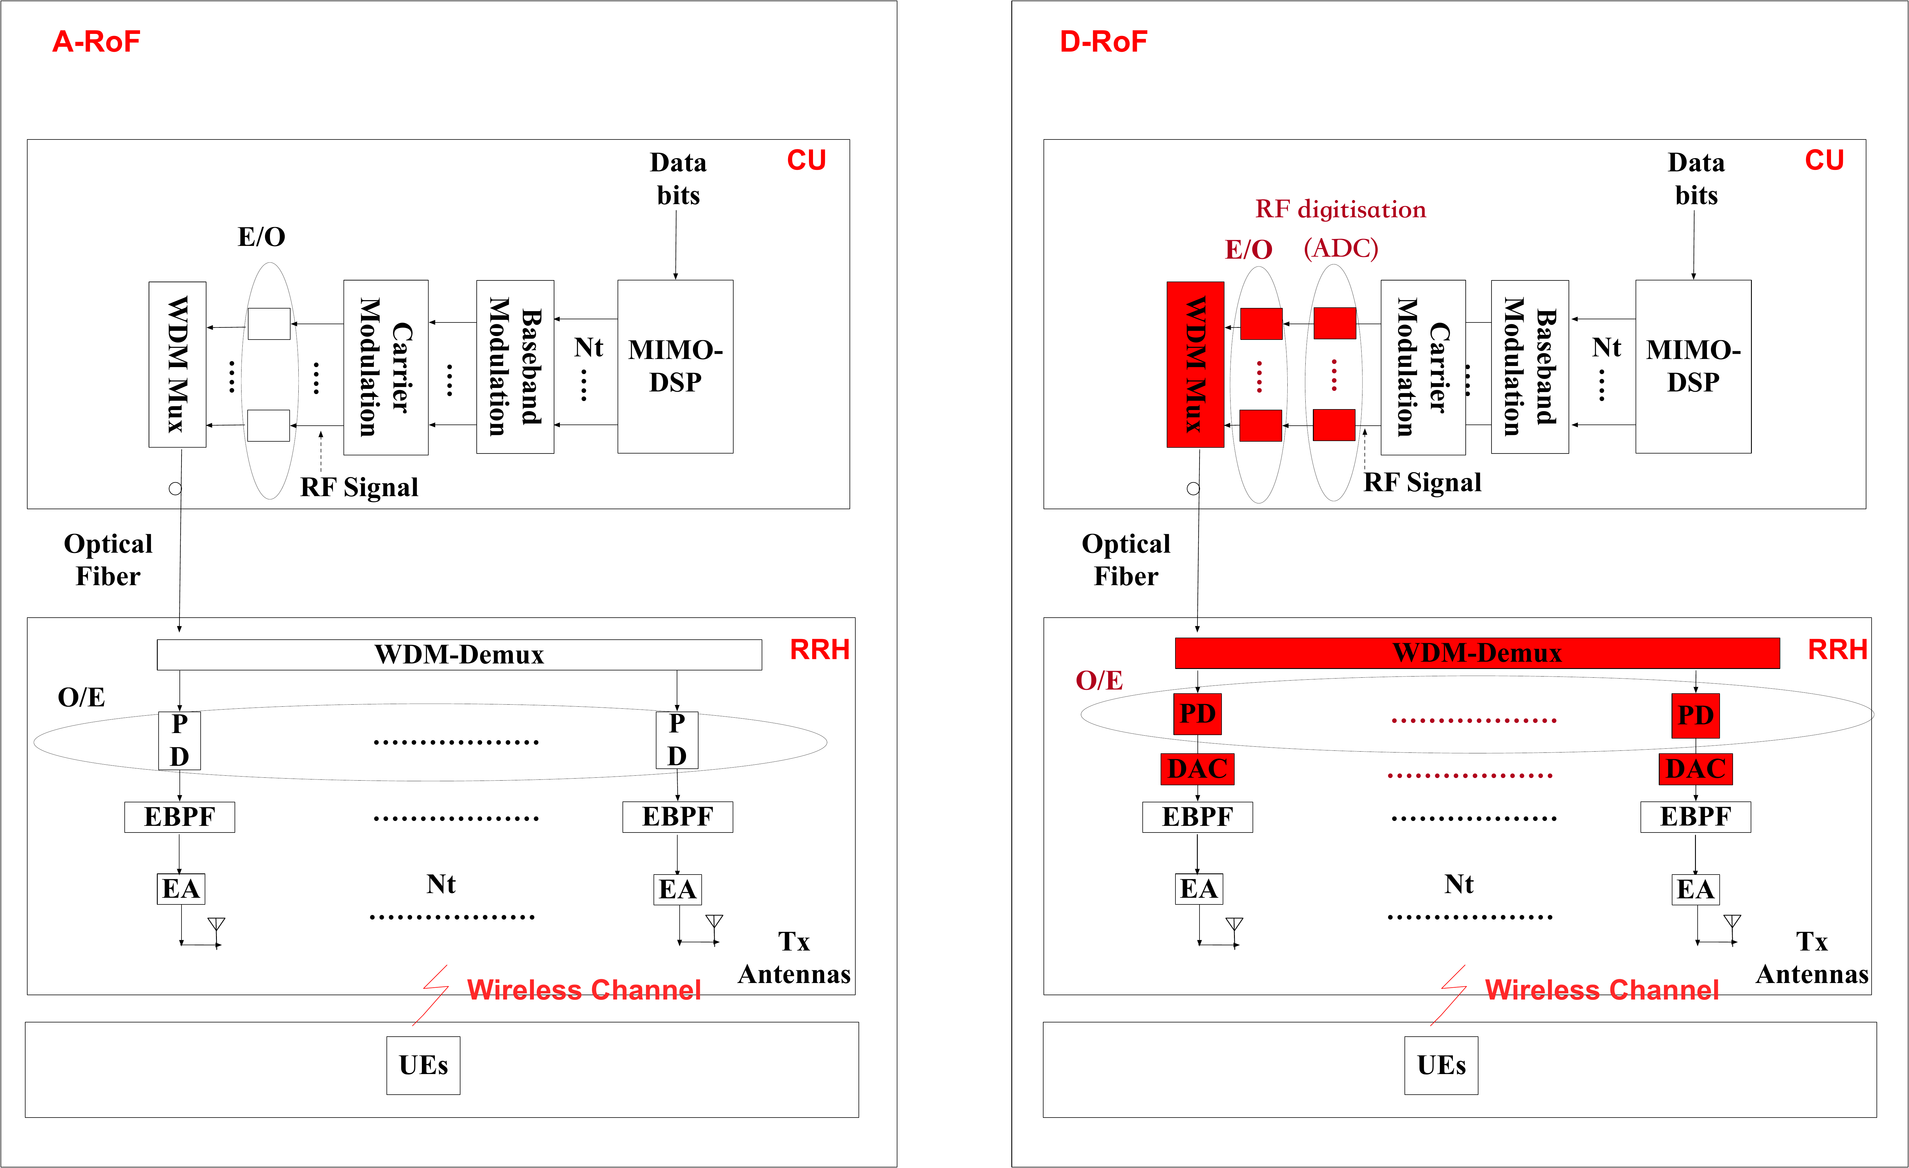
Analog vs. Digital Fronthaul in C-RAN
A-RoF: RF on the fiber; RRH has photodiode, filter, amplifier.
D-RoF: ADC at the CU and DAC at every RRH (red blocks).
Result: A-RoF is simpler and more power-efficient at the RRH; D-RoF is more robust.
Source: Li, Xie, El-Hajjar, Hanzo, "Analogue Radio Over Fiber for Next-Generation RAN," arXiv:2111.13851 (2021), Fig. 2.
Notes:
Left: A-RoF, right: D-RoF. The red blocks are what digital fronthaul adds: data converters and higher-rate optics.

Slide 19
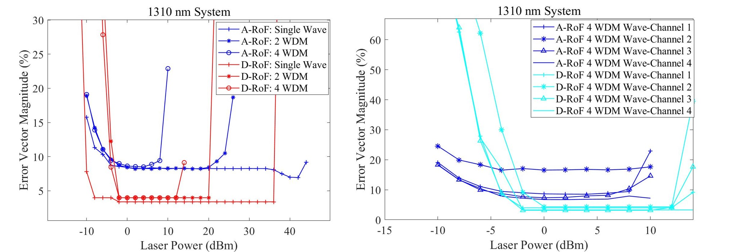
The Trade-off: Signal Quality (EVM)
A-RoF: ≈ 8 % EVM: meets the 64-QAM limit, not the 3.5 % limit for 256-QAM (3GPP TS 38.104).
D-RoF: meets the 256-QAM limit, at the cost of much higher fiber bandwidth and power.
Source: Li, Xie, El-Hajjar, Hanzo, "Analogue Radio Over Fiber for Next-Generation RAN," arXiv:2111.13851 (2021), Fig. 5 (1310 nm system).
Notes:
EVM versus laser power. D-RoF (red / cyan) reaches about 3-4 % EVM; A-RoF (blue) stays near 8 % and degrades with more WDM channels. For 256-QAM the 3GPP limit is 3.5 % (TS 38.104), so in this modeled case A-RoF meets 64-QAM but not 256-QAM.

Slide 20
RoF Application Areas
In-building & venues
Fiber-fed DAS in buildings, stadiums, airports, tunnels and metros.
5G fronthaul (C-RAN)
Commercial fronthaul is mainly digital (CPRI / eCPRI); analog RoF is at research and trial stage.
Public safety
In-building coverage for emergency-responder radio.
Defense & aerospace
Antenna remoting, radar, satellite ground stations.
Research
RF-over-fiber in the SKA-low radio-telescope receiver (Perini et al., 2022).
Sources: ITU-T G.9803 Amd. 2 (2022); Perini et al., J. Astron. Telesc. Instrum. Syst. 8(1), 011016 (2022).
Notes:
One line per area.

Slide 21
Limitations & Technical Challenges
Challenge | Impact | Mitigation
Cost & fiber availability | New fiber and optoelectronics raise CAPEX | Reuse existing fiber; share among operators
Remote power | Every remote unit needs power and backup | Hybrid fiber–copper cable; local UPS
Fronthaul capacity (C-RAN) | Digital fronthaul rate grows with antennas and bandwidth | Split 7.2x (eCPRI); analog RoF
Latency | Fronthaul distance limited by HARQ timing | Keep BBU pool within the latency budget
Nonlinearity & noise | Limit dynamic range and EVM | Optimized drive level; predistortion
Chromatic dispersion | RF power fading at high RF and long fiber | 1310 nm; single-sideband; IFoF
Interoperability | Analog interfaces are vendor-specific | ITU-T G.9803 requirements; eCPRI / O-RAN
Notes:
Practical limits first, then technical limits, each with its mitigation.

Slide 22
Summary
• RoF carries the analog radio waveform over fiber: E/O at one end, O/E at the other.
• Fiber loss is low and band-independent; the link still adds conversion loss, noise and distortion.
• In buildings, a fiber-fed DAS uses RoF to feed many antennas from one signal source.
• In C-RAN, analog RoF cuts fronthaul bandwidth sharply but loses signal quality versus digital fronthaul.
• RoF moves the antenna closer to users; it does not add spectrum or air-interface capacity.
Notes:
Five take-aways in the order of the talk.

Slide 23
References
1. ITU-T G.9803 (2018), Radio over fibre systems; Amendments 1 (2019) and 2 (2022). ITU-T G.Suppl.55 (10/2025). ITU-T G.652.
2. Y. Li, Q. Xie, M. El-Hajjar, L. Hanzo, "Analogue Radio Over Fiber for Next-Generation RAN: Challenges and Opportunities," arXiv:2111.13851, 2021.
3. M. U. Hadi, G. Murtaza, "Fibre Wireless Distributed Antenna Systems for 5G and 6G Services," Electronics 12(1), 64, 2023. DOI: 10.3390/electronics12010064.
4. D. F. Paredes-Páliz et al., "Radio over Fiber: An Alternative Broadband Network Technology for IoT," Electronics 9(11), 1785, 2020. DOI: 10.3390/electronics9111785.
5. V. Quintuna Rodriguez et al., "Cloud-RAN functional split for an efficient fronthaul network," arXiv:2101.04216, 2021.
6. J. da L. A. Silva et al., "Human Exposure to Non-Ionizing Radiation from Indoor DAS: Shopping Mall Measurement Analysis," Sensors 23, 4579, 2023.
7. CPRI Specification V7.0 (2015); eCPRI Specification V2.0 (2019); 3GPP TS 38.104.
8. Times Microwave Systems, LMR-400 coaxial cable datasheet.
9. F. Perini et al., "Radio frequency over fiber technology for SKA-low receiver," JATIS 8(1), 011016, 2022.
10. SolFinder Research, "Radio Over Fiber," video presentation (source of original material).

Slide 24
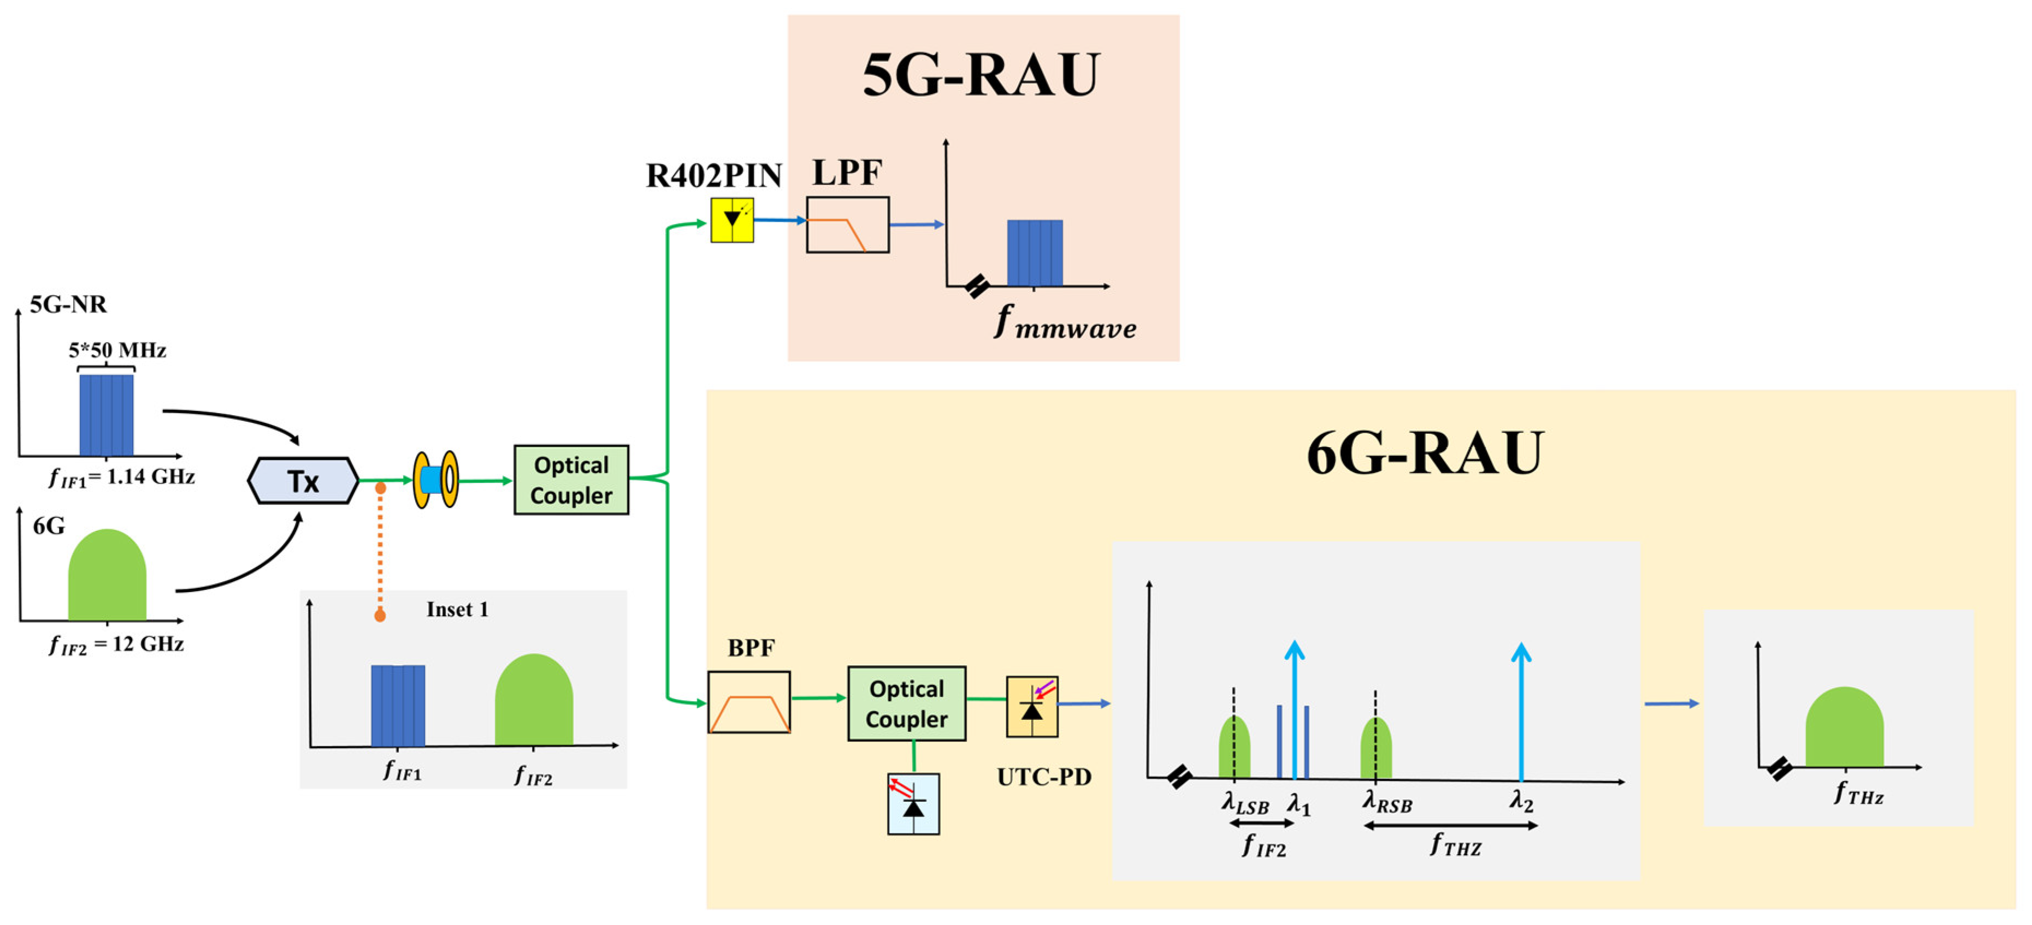
Backup: 5G + Candidate 6G Demo on One Fiber
Source: Hadi & Murtaza, "Fibre Wireless Distributed Antenna Systems for 5G and 6G Services," Electronics 12(1), 64 (2023), CC BY 4.0, Fig. 2.
Notes:
Laboratory demonstration only: a 5G-NR signal (IF1 = 1.14 GHz) and a candidate 6G THz signal (IF2 = 12 GHz) carried on one fiber.

