Slide 1

PRINCE SATTAM BIN ABDULAZIZ UNIVERSITY · COLLEGE OF ENGINEERING · ELECTRICAL ENGINEERING
Future Energy Lab
An Integrated Low-Voltage Testbed for Microgrid, Protection, Digital-Twin.
MG
AF
DT
LX
MicroGrid
Arc-Fault Protection
Digital Twin
One Year Achievements
PV + battery + grid-forming inverter; 60 Hz islanded
Series / parallel arc detection on LV feeders
Live telemetry · 3D model · SCADA alarms · analytics
Papers , results , partnership
Notes:
This platform is deliberately integrated. The microgrid is the energy source and the object under study. Arc-fault protection is applied to that same microgrid and its LV feeders. The digital twin is the common monitoring and visualisation layer and logs events for engineering decisions. The fourth block turns a lab result into something deployable on the Saudi 60-Hz grid. Everything shown today runs, is simulated, or is a defined build step, and each slide labels which.

Slide 2
Lab Vision and Strategic Direction
Saudi LV systems need combined progress in safety, renewable integration, energy visibility and locally engineered 60-Hz equipment — and a scaled lab is the safest place to develop and validate it.
Smart Meter
Smart devices for load disaggregation , electrical theft , smart forecasting.
PV + battery on a 60-Hz LV network needs grid-forming control, islanding logic and protection coordination.
Renewable integration
Energy visibility
Per-circuit metering + digital twin turn a panel into analysable data: power, PF, energy, alarms.
Smart Fault detection
Utilization of deep learning architecture for develop AI detection algorithm.
Future Energy Lab · PSAU College of Engineering · Electrical Engineering
2
Notes:
These four needs are usually pursued in isolation. The strategic point is that they share infrastructure: the same LV board, the same metering breakers, the same data layer. A series arc fault draws less than rated current, so today's protection misses it. Renewable integration on a 60-Hz network is a control and protection problem, not just sizing. Every imported device needs explicit 60-Hz and high-temperature verification before it can be trusted on the Saudi grid.

Slide 3
SMART METER
Data layer validated
Three Goals, One Data Foundation
A smart meter's value is what it can infer from a single measurement point - but every inference model must be trained on per-appliance ground-truth data. The Future Energy Lab built a Data Setup to produce exactly that.
AF
Electricity theft detection
FC
Load forecasting
ND
Load disaggregation (NILM)
Detect tampering, bypass and abnormal consumption directly from the metered signal.
Predict consumption for network planning, time-of-use tariffs and demand response (demand modelling).
Break the aggregate signal into individual appliances from one metering point.
All three need the same thing: a labelled, synchronised, per-appliance active-power dataset with known switching events. -> Build a Data Setup: an open, reproducible edge rig that isolates, switches and continuously logs each appliance's power signature.
IMPLEMENTATION PATH
1
Collect data the Data Setup rig
2
Develop a model train on the dataset
3
Fabricate it embed into a meter
1
Notes:
A smart meter is only as good as what it can infer from one measurement point. The three targets are theft detection, load forecasting, and load disaggregation. All three are supervised-learning problems, and all three need the same input: a labelled, time-synchronised, per-appliance power dataset with known switching events. That data does not exist off the shelf, so the Future Energy Lab built a Data Setup to generate it. The implementation path is three steps: collect the data with the rig, develop the models on that data, and finally fabricate the model into a meter.

Slide 4
SMART METER
Pilot Deployment: SE + CHINT
After a short preparation period, a pilot with Saudi Electricity (SEC) and CHINT will begin - moving the smart-meter models from lab data to field validation on real customer premises.
PARTNERS & ROLES
PILOT OBJECTIVES (one per smart-meter goal)
CHINT - smart metering / breaker hardware and integration (the CHINT NB2LE class already used in the Data Setup).
Saudi Electricity (SE) - host premises, field load data, and grid-code / standards alignment for Saudi 60-Hz networks.
Future Energy Lab - Data Setup replication, model development, and validation protocol.
Theft detection - validate on real tampering / bypass and abnormal-consumption cases.
Forecasting - validate load predictions against SEC field consumption data.
Disaggregation (NILM) - validate appliance-level breakdown on live households.
FROM LAB DATA TO FIELD DEPLOYMENT
1
Lab dataset
2
Field pilot
3
Scale-up
3
Notes:
The next step after the lab dataset is a field pilot with Saudi Electricity and CHINT, starting after a short preparation period. CHINT brings the metering and breaker hardware - the same NB2LE class we already use in the Data Setup - and SEC provides host premises, real field load data, and alignment with Saudi grid codes and standards. The pilot has one objective per smart-meter goal: validate theft detection on real tamper cases, validate the forecasting models against SEC consumption data, and validate NILM disaggregation on live households. The outputs are field-validated models, a fabrication-ready meter specification, and a scale-up recommendation. To be precise: this is the stated plan; the formal agreement and pilot document are not yet in the project folder.

Slide 5
MICROGRID
Phase A Microgrid — Design & Sizing
A scaled-down, low-voltage-side laboratory version of the NEOM City microgrid concept — sized for the Phase A loads only, for a fully islanded 24-hour cycle at 230 V / 60 Hz.
PHASE A LOAD DEMAND “RATINGS”
DESIGN & SIZING PROCESS
Device | Rated W | Hours/day | Wh/day | Type
Air Conditioner | 1,300 | 6.0 | 7,800 | non-crit
Hoover | 1,600 | 1.0 | 1,600 | non-crit
Iron | 1,200 | 0.5 | 600 | non-crit
Water Cooler | 600 | 4.0 | 2,400 | critical
Fan | 53 | 8.0 | 424 | critical
Blender | 330 | 0.08 | 27 | non-crit
TOTAL | 5,083 W | — | 12,851 | PF 0.94
Our design is a scaled-down LV-side version of the NEOM City microgrid concept — Phase A loads only, not the whole residential load set.
Ground truth = the Phase A load CSV: device rating x daily on-hours -> 24-h load profile and daily energy.
Islanded design basis: 24-h off-grid cycle, single-phase 230 V / 60 Hz, critical loads supplied at all times.
Sizing chain: load profile -> PV array -> battery storage -> grid-forming inverter -> DC/AC cables.
Sizing built on 4 operating cases: base, low-PV, high-load, low-PV + high-load (hardware fixed, not re-sized per case).
Daily energy 12.85 kWh · critical 2.82 kWh · connected 5.08 kW / 5.40 kVA
SIZED RESULT PV 4.4 kWp · Battery 10 kWh LiFePO4 (51.2 V, >=5 kW) · Inverter 5 kW / 5.5 kVA grid-forming (>=10 kVA surge) · AC 6 mm2 / DC 50 mm2 Cu
Future Energy Lab · PSAU College of Engineering · Electrical Engineering
1
Notes:
Phase A is a scaled-down, LV-side version of the NEOM City microgrid concept. It covers only the Phase A loads, taken directly from the load CSV: each device's rated power times its daily on-hours gives the 24-hour profile and 12.85 kWh/day, of which 2.82 kWh is critical. The design basis is a full islanded 24-hour cycle at 230 V / 60 Hz with critical loads always supplied. The sizing chain runs load -> PV -> battery -> grid-forming inverter -> cables and protection, and the whole system is checked against four operating cases on fixed hardware.

Slide 6
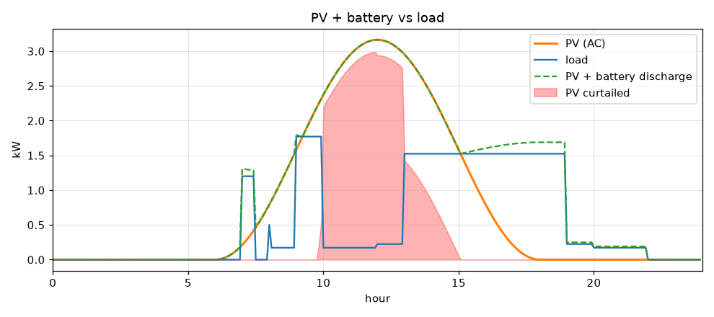
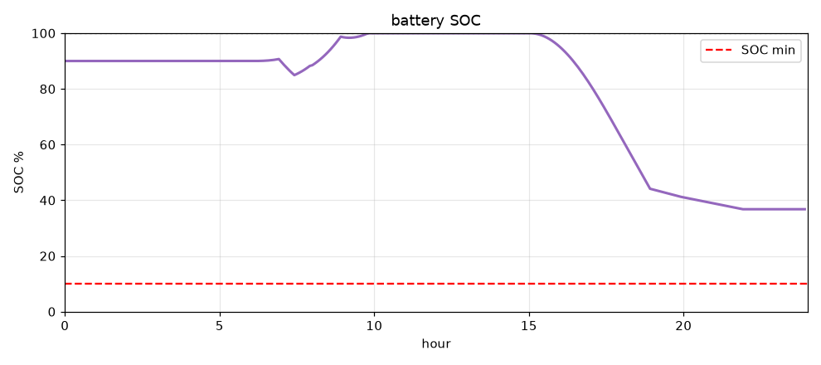
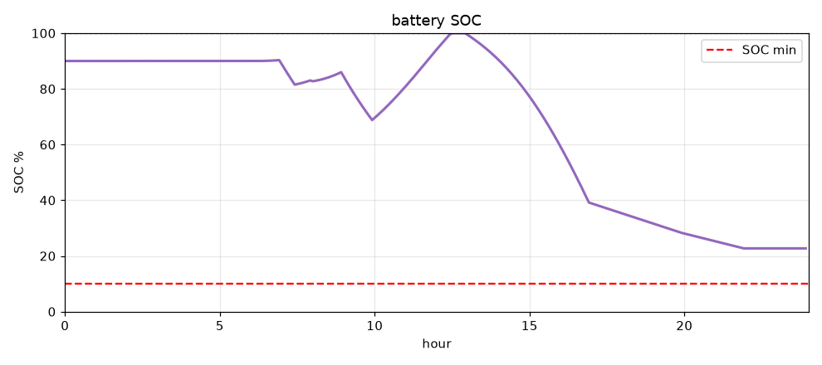
MICROGRID
Phase A Microgrid — Simulation Verification
The sizing was verified with a runnable 24-hour energy/power-balance simulation across the four operating cases — critical load is served 100% in every case.
Operating case | PSH (h) | Load | Served | SOC min | Non-crit shed | Critical unmet | Result
Base | 5.5 | 100% | 100% | 37% | 0.00 kWh | 0.000 kWh | PASS
Low PV | 2.5 | 100% | 90% | 29% | 1.30 kWh | 0.000 kWh | PASS
High load | 5.5 | +25% | 94% | 27% | 0.95 kWh | 0.000 kWh | PASS
Low PV + high load | 2.5 | +25% | 80% | 23% | 3.21 kWh | 0.000 kWh | PASS
Base case — PV + battery vs load
Base case — battery state of charge
Worst case (low PV + high load) — SOC
EMS sheds the non-critical air conditioner at SOC < 40% — the 10 kWh battery is retained and critical supply is guaranteed in all four cases..
Future Energy Lab · PSAU College of Engineering · Electrical Engineering
2
Notes:
The sizing is not just a spreadsheet. A Python model (sizing.py then sim.py) runs a 24-hour energy and power balance for each of the four operating cases on the same fixed hardware. Across all four, critical load is served 100% of the time and the battery stays above its 10% floor. Single stresses are absorbed with minor non-critical shedding; the compound worst case still keeps critical loads fully supplied. The plots show PV plus battery tracking the load, the base-case state of charge, and the worst-case state of charge.

Slide 7
MICROGRID
Microgrid Applications: Lab Validation to Data-Centre Resilience
The same microgrid model can study data-centre energy resilience — continuity, renewable integration, peak-load management, backup-power coordination — with the lab providing a scaled environment to validate scenarios before wider implementation.
1
Concept
2
Simulation
3
Lab validation
4
Deployment
Instructor direction: the data centre can be utilised via the microgrid
Scenario engine models resilience, peak shaving, backup coordination
Scaled hardware testbed validates energy-management scenarios
Field system — not in scope; no partner, approval or deployment
Current position: Simulation -> Lab validation
Future Energy Lab · PSAU College of Engineering · Electrical Engineering
5
Notes:
Data centres are becoming a major LV/MV load with strict continuity requirements. The instructor's direction is to explore the microgrid as an energy-resilience solution for that case. The lab's value is a scaled, instrumented environment where scenarios are simulated then validated on real hardware before committing to a field system. To be precise: we have a concept and a simulation capability; no data-centre partnership, deployment or approval, and no operator is named in our documents.

Slide 8
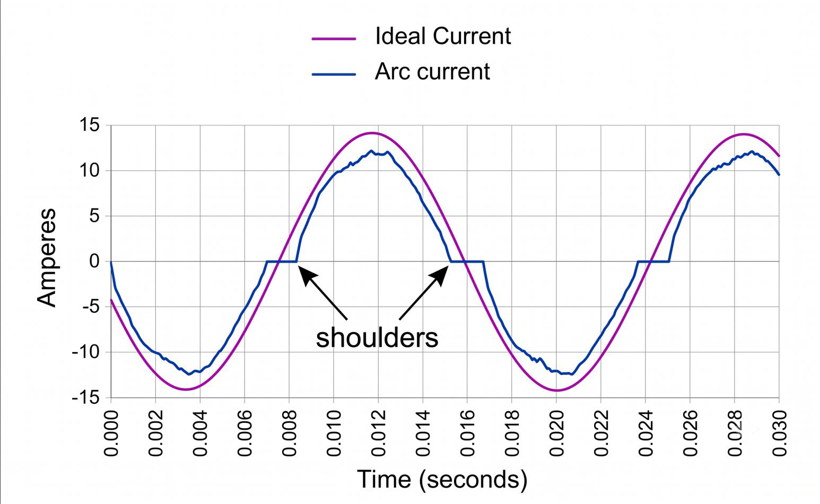
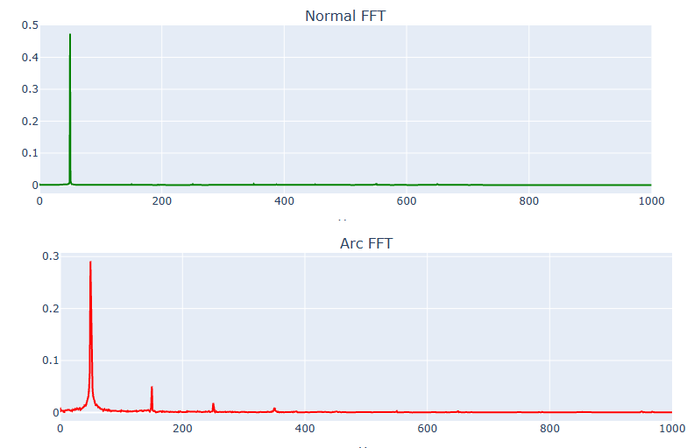
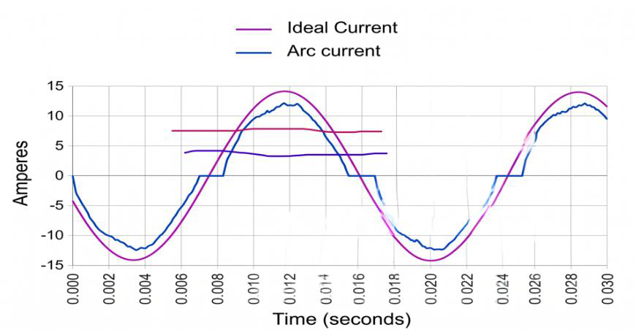
ARC-FAULT
Arc-Fault Dataset & Signal Analysis
A curated experimental arc-fault dataset across 10+ residential load types — each recording split into a no-arc and an arc segment and analysed in the time domain, frequency domain, and time-frequency (spectrogram) representations.
DATASET
SIGNAL ANALYSIS (per load type)
CHINT AFCI dataset: 258 labelled trials · 4 AFDD device models (A-D) · series + parallel arc faults.
Loads: halogen & fluorescent lamps, power tool, vacuum cleaner, SMPS, dimmers (60/90/120 deg), air compressor, resistive baseline, household mixes.
Signal: AC current only, 6.4 kHz, 230 V / 50 Hz; each trial = labelled no-arc segment + arc segment.
Time domain: zero-crossing 'shoulders', conduction collapse, di/dt transients.
Frequency domain: FFT - arc adds broadband + low-order harmonic content vs a clean single-tone spectrum.
Time-frequency: spectrogram / moving-RMS energy envelope tracks the no-arc -> arc transition; features feed a ResNet-1D classifier (~90%+ lab).
Time domain - ideal vs arc current ('shoulders')
Frequency domain - normal FFT vs arc FFT
Moving-RMS / envelope analysis
1
Notes:
Our arc-fault work starts from a real, labelled dataset. It covers more than ten residential load types across four AFDD devices, with both series and parallel arcs, sampled as current only at 6.4 kHz. Every recording has a clean no-arc segment and an arc segment. We analyse each load type in three views: the time domain, where the arc produces zero-crossing shoulders and conduction collapse; the frequency domain, where the FFT shows added broadband and harmonic content; and the time-frequency domain, where a spectrogram or a moving-RMS envelope marks the transition. These features feed a ResNet-1D classifier that reaches about 90% under lab conditions.

Slide 9
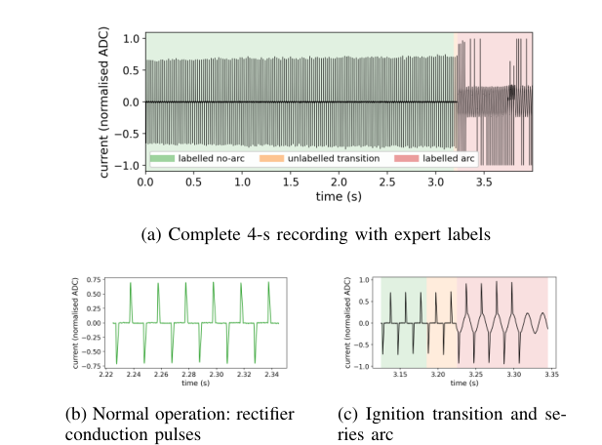
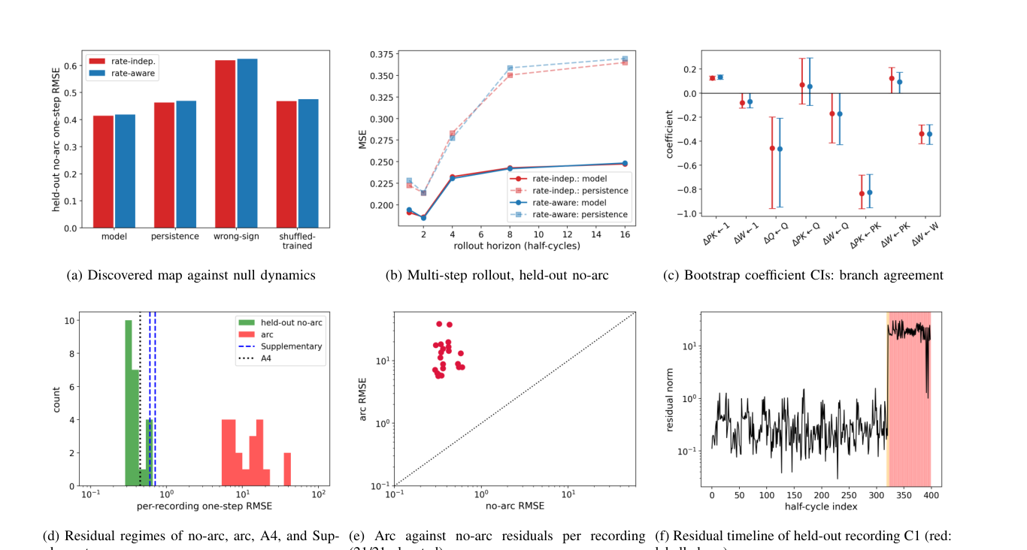
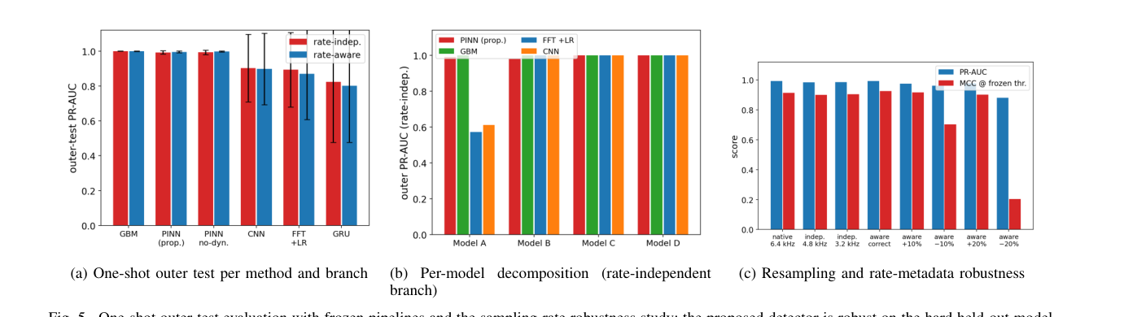
ARC-FAULT
PINN Contribution & Results
A sampling-rate-independent, current-only physics-informed neural network (PINN) for series arc-fault detection in switching power supplies - the device dynamics are discovered from data (SINDy), independently verified, then embedded in the detector.
CONTRIBUTION
RESULTS (one-shot leave-one-SMPS-model-out test)
Current-only, voltage-free detection - no branch-voltage sensor required.
Nominal SMPS dynamics discovered from data with SINDy (a stable linear charge-balance contraction map), independently verified - not an assumed arc equation.
Causal period estimator removes all dependence on the sampling rate.
Mayr / Cassie arc-plasma equations shown unidentifiable from current-only data - documented and rejected.
Average precision 0.9924 with no sampling-rate knowledge (0.9954 with it); 105/105 arc events detected, median delay 0 half-cycles.
0.59 false alarms / 100 cycles - 3-10x better than the accuracy-leading benchmarks (GBM 2.0-5.6, FFT+LR 4.7-5.4).
Rate-robust: AP 0.984-0.985 after resampling to 4.8 / 3.2 kHz with no rate info; a -20% assumed-rate error collapses a rate-aware detector to MCC 0.20.
Physics helps most when the encoder is weak (+0.05 to +0.07 AP); performance-neutral at the accuracy ceiling - reported honestly.
Sample recording - no-arc (green) vs arc (red)
Independent verification of the discovered device dynamics
One-shot outer test + sampling-rate robustness
2
Notes:
The paper's contribution is a current-only, voltage-free arc-fault detector for switching power supplies that does not need to know the sampling rate. Instead of assuming an arc equation, we discover the nominal device dynamics from healthy data using SINDy, verify that discovered map as a genuine dynamic model, and only then embed it in the neural network. We also show, with documented evidence, that the classical Mayr and Cassie arc equations cannot be identified from current alone. On the one-shot outer test the detector reaches 0.9924 average precision with no rate information, catches all 105 arc events with zero median delay, and - most importantly for field acceptance - fires only 0.59 false alarms per 100 cycles, several times better than the strongest benchmarks. It also stays accurate when the data is resampled, a regime where a rate-aware detector collapses.

Slide 10
ARC-FAULT
Implementation Plan: Arc-Fault Data-Acquisition Setup
A locally engineered arc-fault test bench for the Future Energy Lab: a controlled arc generator on a dedicated line, downstream of the CHINT NB2 smart breaker, feeding a load - for safe, repeatable data collection and detection trials on Saudi 60-Hz systems.
1
2
3
4
Main grid / LV supply
CHINT NB2 smart breaker
Arc generator line
Load bank
230 V, 60 Hz
metering V·I·P·PF + trip
series & parallel arc rig,
safety enclosure, supervised
SMPS · motor · resistive · dimmer
Localize the dataset: reproduce and extend the arc-fault dataset on Saudi 60-Hz / 230 V with local loads and ambient conditions.
Controlled arc generator: fixed-gap / carbonised-path series arc and line-to-neutral parallel arc, in a rated safety enclosure, under supervision.
Instrumentation: NB2 built-in metering + high-rate current acquisition (>= 6.4 kHz) on the arc line; every event time-stamped and logged.
Integration: arc events stream into the digital twin as alarms; multi-feature and PINN detectors tested against live rig data.
Safety: controlled test rig only - safety enclosure, PPE, approved procedures, LV-lab compliance. No unsafe live-arc procedure is provided.
Future Energy Lab · PSAU College of Engineering · Electrical Engineering
3
Notes:
The vision is to localize the arc-fault work into our own test bench. The layout is simple and safe: the LV supply feeds the CHINT NB2 smart breaker, which meters voltage, current, power and power factor and can trip; downstream is a dedicated arc-generator line inside a rated safety enclosure; and beyond that a load bank of SMPS, motor, resistive and dimmer loads. The breaker's metering plus a high-rate current acquisition on the arc line feed the DAQ and the digital twin, so every arc event is logged and alarmed. This lets us reproduce and extend the CHINT dataset at Saudi 60 Hz and test both the multi-feature and PINN detectors on live data. All of this is done on a controlled rig with an enclosure, PPE and approved procedures.

Slide 11
DIGITAL TWIN
Digital Twin — Concept and Layers
A digital twin is a dynamic software mirror of a physical asset, continuously synchronized with it through live IoT telemetry - not a static 3D model. It adds real-time monitoring, analytics, simulation and control on top of the physical system.
PHYSICAL / IoT
Physical asset + smart sensor / meter (V · I · P · PF) + automation hub
REAL-TIME CHANNEL
MQTT brokers - primary + failover - sub-second telemetry up, commands down
EDGE / CLOUD
Serverless functions: broker config · control proxy · history · analytics
TWIN / PRESENTATION
Live KPIs & charts · 3D model · SCADA alarms · physics simulation · remote control
Decision loop: physical state -> digital twin -> analytics / alarm -> operator decision or remote command -> physical actuator
Continuous synchronization (telemetry in, commands out) - a live mirror, not a one-off model.
Analytics on history: energy, efficiency, cost, and trends over any date range.
Physics simulation and what-if scenarios run against the twin, never the real asset.
Fault / alarm management with an acknowledge-and-clear workflow.
Future Energy Lab · PSAU College of Engineering · Electrical Engineering
1
Notes:
A digital twin is not a 3D picture. It is a software model that stays continuously synchronized with a physical asset through live telemetry, and lets you monitor, analyse, simulate and control that asset from one place. It is built in layers: the physical layer with the asset and its smart meter; a real-time channel, here MQTT over secure WebSockets with a primary and a failover broker; an edge and cloud layer of serverless functions that keep credentials out of the browser; and the twin layer itself - the KPIs, charts, 3D model, SCADA alarms and physics simulation. The value is the closed loop: the physical state drives the twin, the twin drives a decision, and a command goes back to the asset.

Slide 12
DIGITAL TWIN
Running · live demo
Case Study: LAMPS_PANEL Pilot
The Future Energy Lab pilot: a digital twin of a 40-lamp LV lighting distribution panel behind a CHINT NB2 smart breaker - live metering, 3D visualization, SCADA alarms, historical analytics and remote control.
LIVE DEMO : https://digital-twin-lamps-panel.pages.dev/
PHYSICAL <-> DIGITAL TWIN
TWIN FUNCTIONS (what the demo shows)
Physical: 40 x Philips 11 W E27 4000K LED (8 x 5) · CHINT NB2 smart breaker (V·I·P·PF, WiFi) · Home Assistant hub.
Measured operating point: 402 W · 229.7 V · 2.93 A · PF 0.60 · 1,200 lm at 109 lm/W · L70 12,000 h.
Link: NB2 -> MQTT (HiveMQ + EMQX) -> Cloudflare Pages Functions -> browser, ~1 s telemetry.
Data Overview: live KPIs (Power / Voltage / Current / PF / Energy ), charts, historical analytics with date range, per-circuit breaker status.
3D Model & Control: interactive 3D panel model; remote Unlock / Open / Close via Cloudflare -> Home Assistant.
Simulation & Scenarios: thermal model (Tj = Tamb + P x Rth), TM-21 lumen-maintenance projection, scenario engine (aging, dimming, ambient, partial failures), SCADA alarm panel , CSV export.
Future Energy Lab · PSAU College of Engineering · Electrical Engineering
2
Notes:
This is our working pilot. The physical object is a 40-lamp lighting distribution panel behind a CHINT NB2 smart breaker whose built-in metering we publish over MQTT, with a failover broker, through a serverless edge layer to a browser dashboard. At this point in the talk the presenter should stop and open the website to run the demo: show the live telemetry and KPIs, rotate the 3D panel model, run a simulation scenario such as the datasheet L70 baseline or the beyond-rated summer-ambient case, and demonstrate the remote Open and Close commands. Then return to the slides. To be precise on scope: the stakeholder demonstration is planned, and there is no documented SEC engagement yet.

Slide 13
CHINT + LOCALIZATION
Strategic Technology Pillars
Four CHINT technology tracks the Future Energy Lab will integrate and verify for Saudi nominal 60-Hz systems - each moving from an existing CHINT capability to a defined lab activity.
MV
ES
EV
CX
MV Circuit Breakers
Emerging Energy-Sector Tech
EV Technology
CloudX at PSAU
CHINT NG7 gas-insulated switchgear and intelligent MV MCCB / ACB for industrial, commercial and utility distribution - product families already supplied to SEC.
"One Cloud, Two Networks" direction: smart grids and EIoT, PV grid-connection and islanding protection, DC ACB / MCCB, topology identification and line-loss analysis.
EV charging with sequence / orderly charging for substation peak-load management, plus high-accuracy metering, billing and encrypted data transfer.
Proposed cloud-connected energy-monitoring and AIoT platform at PSAU (CHINT EmpowerX: EMS + Digital Twin + Edge) to advance smart-energy research, local talent and Vision 2030 goals.
Lab: protection-coordination reference; verify 60-Hz ratings, +55 C, 37-SDMS.
Lab: microgrid + data-centre resilience studies on the LV testbed.
Lab: EV peak-load scenario in the microgrid simulation and testbed.
Status: conceptual architecture; engagement with PSAU stated, not yet documented.
Localization is not just purchasing equipment: it includes local integration, 60-Hz verification, commissioning, panel assembly, firmware, testing, calibration, maintenance, training and future manufacturing.

Slide 14
OUTCOMES
Future Energy Lab: Achievements Through 1-year
Stated at their evidence-supported level for a partner audience: what is running today, and what is a target or a direction.
Item | Status by evidence in the folder
Research output | 2 arc faults papers , 1 published paper about PINN for arc fault detection , in progress (paper about sintific comparison between NN models in arc fault detection)
CHINT | Technical engagement via CHINT LV R&D + CHINT AFCI dataset + NB2 hardware in use — no agreement; state as 'collaboration in progress'
Saudi Electricity / SEC | CHINT has an SEC supply history; no SEC engagement with the lab is evidenced — pilot direction proposed (10 -> 100 houses), not initiated
Arc-fault IP | Patent concept / application in preparation (Instructor Notes) — no filing document
STRATEGIC IMPACT
Research output · industry collaboration · student training · local 60-Hz engineering capability · LV safety innovation · smart-house / community pilot scalability · a validated deployment pathway for PSAU, the LV Department and Saudi 60-Hz systems.
Future Energy Lab · PSAU College of Engineering · Electrical Engineering
10
Notes:
We want to be precise because the audience includes potential partners. What exists: a running digital twin on live telemetry, a data-acquisition rig proven over months, a fully simulated lab-scale microgrid, and an arc-fault dataset with a ~90% classifier and a manuscript in preparation. What is a target or direction: four papers in a year, a conference paper, a formal CHINT partnership, SEC involvement, a 10-to-100-house pilot, and an arc-fault patent — goals with partial or verbal support, labelled as such. The strategic impact is a repeatable pipeline: research, trained students, local 60-Hz capability, and a validated path to deployment.

