Slide 1
Café shop in Madinah
Data Analysis

Slide 2
Factors
Location
Customers reviews
We are going to discuss about location effects on business and customer pleasing.
Numbers of customers review correlation with overall rating
Price
Discussion about our data
Is price has an impact on customer satisfaction.

Slide 3

In the last few years there was a huge jump in numbers of café in Saudi Arabia due to increased demand for it. And there will be a huge competition on this sector, and to overcome this from affecting your business you should make a better judgment of the market, and using data is the most powerful technique for making a better chances for success.

Slide 4

PROBLEM
Due to increased competition on café businesses there will be a huge demand for data associated with it and analysis of it which will make a better chance for business success. There are multiple criteria that will make you a better place for customers such as location, price level, etc. and in this project we will determine which factor has the most impact for customer satisfaction and it will be gathered from customers reviews on Google Maps , and determine if it associated with any of the criteria.

Slide 5
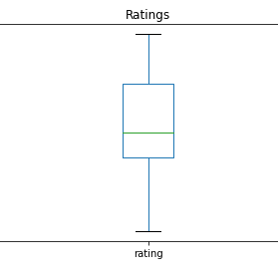
Ratings
Rating of the customer is a very important to determine if your business is going to continue or fail. As we can see in the next box graph our data collection gave us that the most of our rating is between 3.9 and 4.2 and the median is almost 4.0.

Slide 6
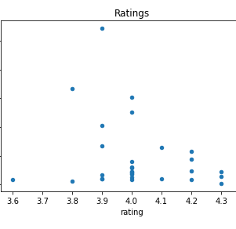
Ratings
Also, there was a normal distribution of our data with the ratings and total user rating and as we can see in scatter graph .

Slide 7
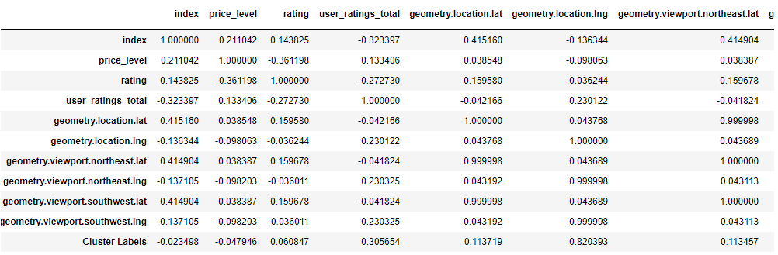
Correlation
As can wee see there almost no correlation between location and customer reviews due to correlation factor was almost to 0.06 between Cluster Labels which was out location clusters and ratings which means that there is no correlation.

Slide 8
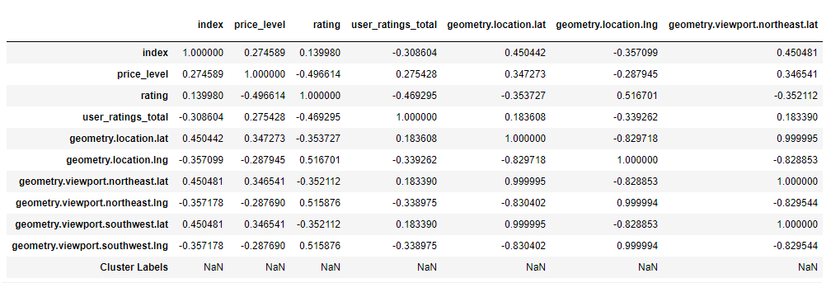
Correlation
As can we see in our data from cluster red there is a moderate correlation between price level and rating of the customers which was a inversely correlation which means that the customer prefer café shops that gave them the best price for there coffee which give us our first hint for our business.

Slide 9

For better chances for a customer pleasing from our data there was a moderate inverse correlation between price level and customer ratings which means that customers are pleased with low prices of coffee , which gave business owners to give the customer what he/she needs.
Results

Slide 10
If business owners want to grow their businesses, they need to get the customer and from our data the best way was to gave them good prices.
Recommendations

Slide 11
Data was gathered and analyzed and gave us a small hint to the price and customer pleasing , but it was not enough data to determine all the factors to gave success of the business, I wish in the future data become more available and gathered more often because it will leads our future to a better life.
Conclusion

