Slide 1
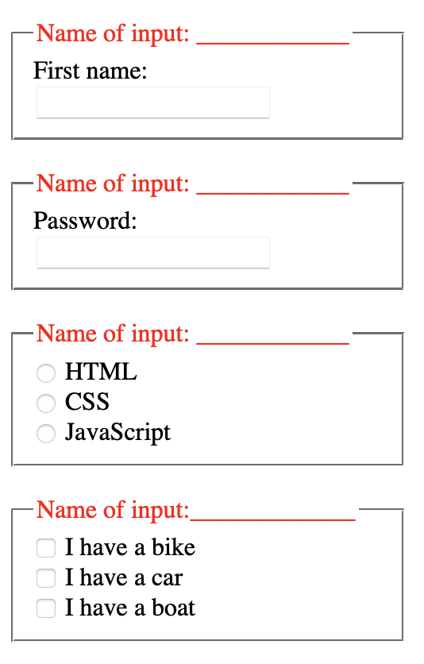
<label for="fname">First name:</label>
<input type="text" id="fname" name="fname">
<label for=“password">Password:</label>
<input type="text" id=“password" name=“password">
<input type=“radio" id=“html" name=“html">
<label for=“html">HTML</label>
<input type=“radio" id=“css" name=“css">
<label for=“css">CSS</label>
<input type=“radio" id=“javascript" name=“javascript">
<label for=“javascript">Javascript</label>
<input type=“checkbox" id=“bike" name=“bike">
<label for=“bike">I have a bike</label>
<input type=“checkbox" id=“vehicle" name=“vehicle">
<label for=“vehicle">I have a car</label>
<input type=“checkbox" id=“boat" name=“boat">
<label for=“boat">I have a boat</label>

Slide 2
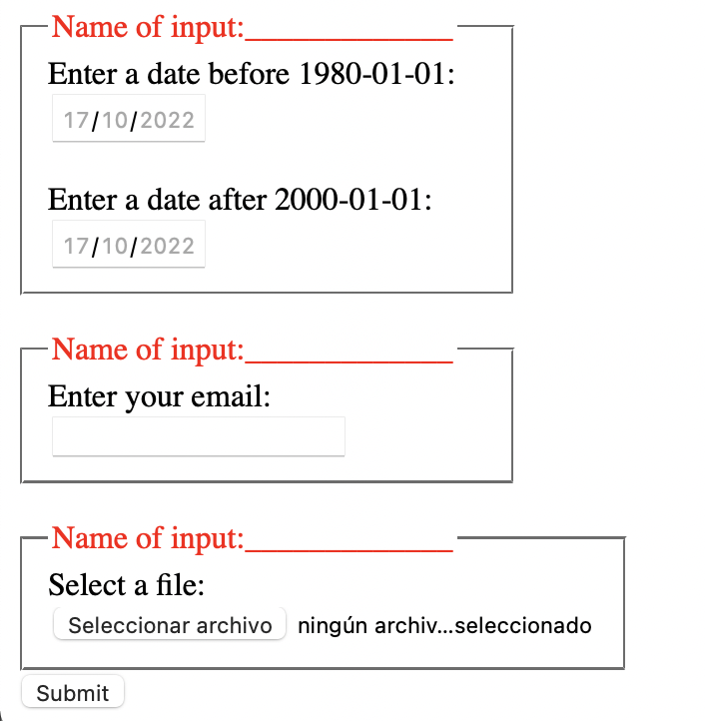
<label for=“birthday">Enter a date before 1980-01-01</label>
<input type=“datemin" id=“birthday" name=“birthday">
<label for=“birthday2">Enter a date before 2000-01-01</label>
<input type=“datemax" id=“birthday2" name=“birthday2">
<label for=“email">Email</label>
<input type=“email" id=“email" name=“email">
<input type="file" id="file" name="file">
<input type="submit" id="submit" name="submit">

