Slide 1
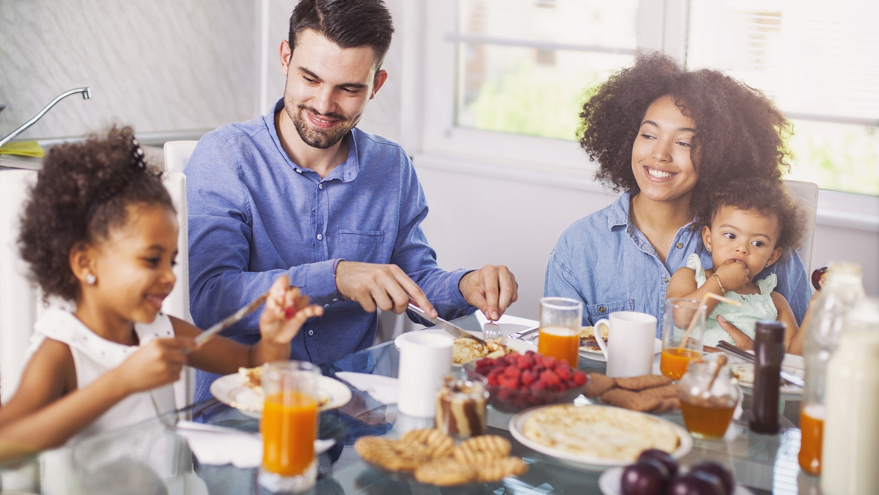
ADVERBS OF FREQUENCY

Slide 2
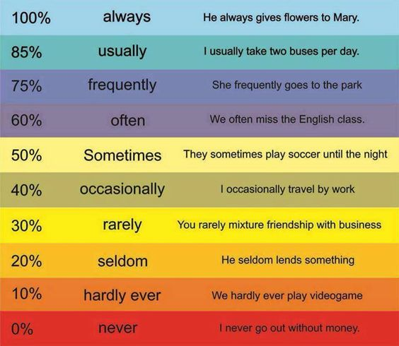
30% Seldom He seldom lends something
20% Rarely You rarely mixture friendship with business

Slide 3

HOW OFTEN DO YOU RIDE A BIKE?

Slide 4
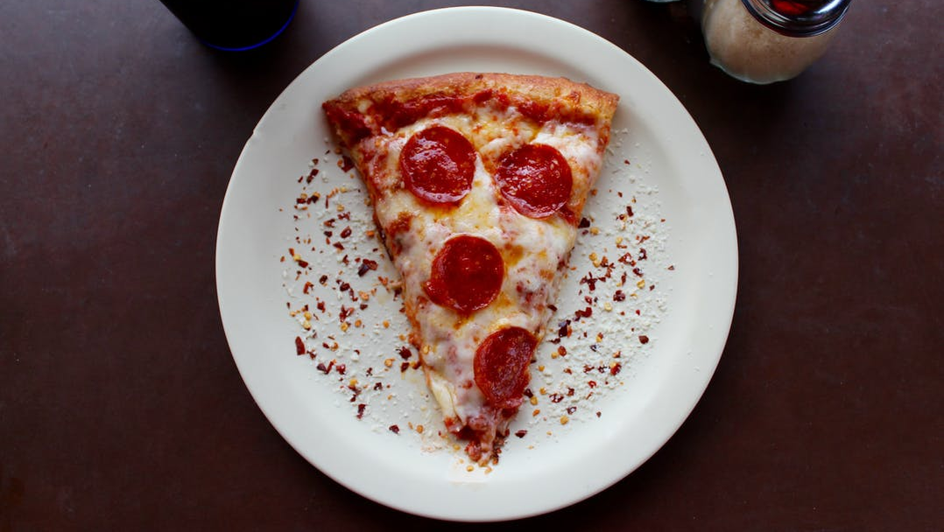
HOW OFTEN DO YOU EAT PIZZA?

Slide 5
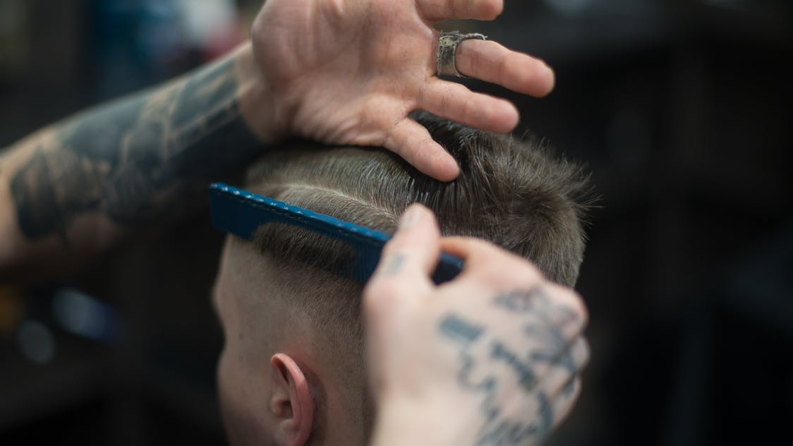
HOW OFTEN DO YOU HAVE A HAIR CUT?

Slide 6

HOW OFTEN DO YOU READ?

Slide 7
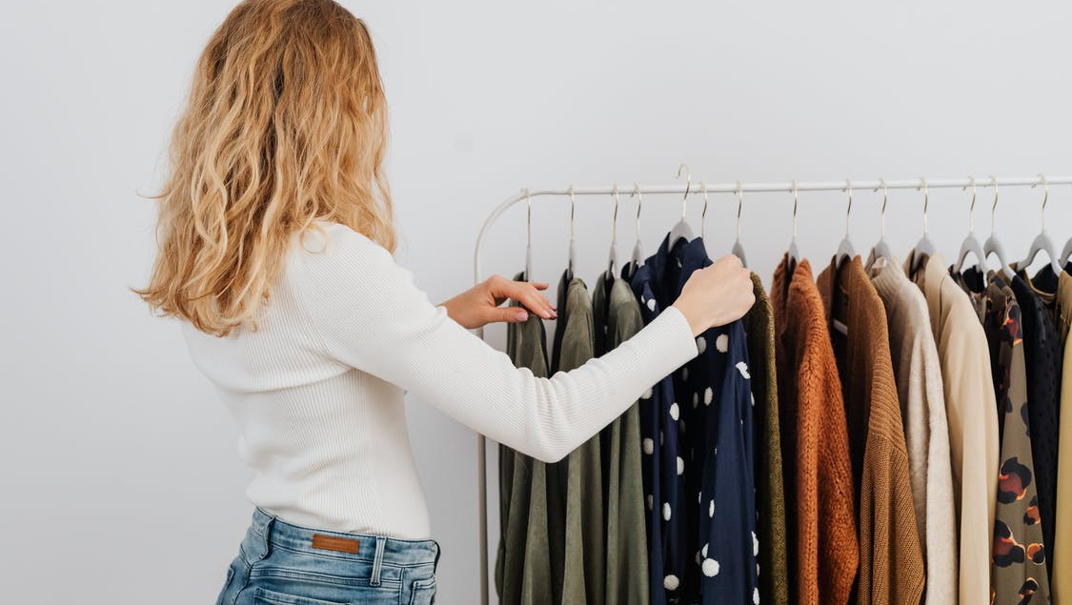
HOW OFTEN DO YOU GO SHOPPING?

Slide 8
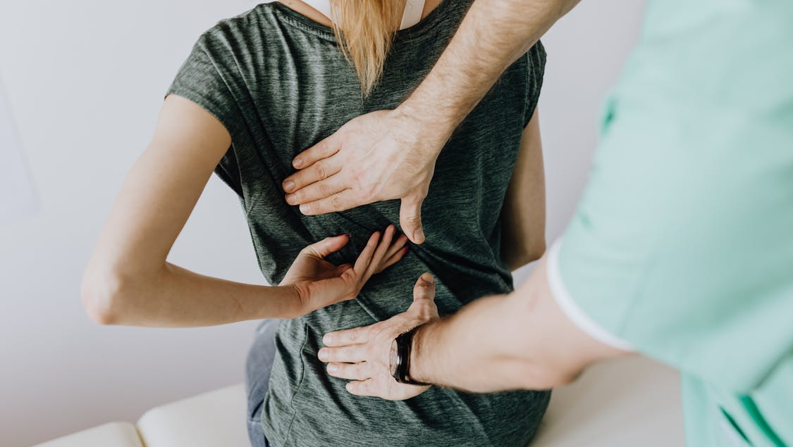
HOW OFTEN DO YOU GO TO THE DOCTOR?

