Slide 1

TYPES OF QUESTIONS
YES OR NO QUESTIONS
WH QUESTIONS
Você gosta de cebola?
Do you like onions?
Yes, I do
Qual o seu nome?
What’s your name?
Who, what, when, where, why and how

Slide 2
YES OR NO QUESTIONS
DO
DOES
Like paçoca?
I
YOU
WE
THEY
SHE
HE
IT

Slide 3
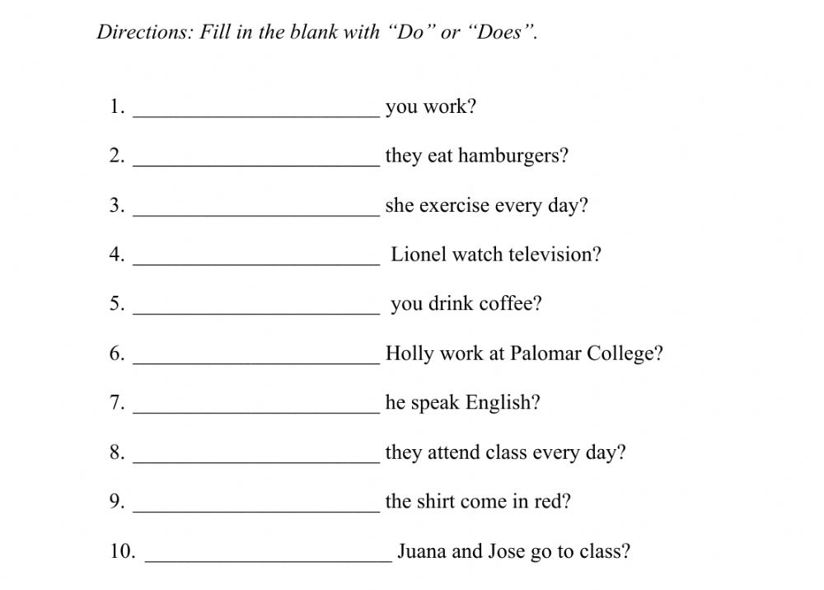
EXERCISE

