Slide 1
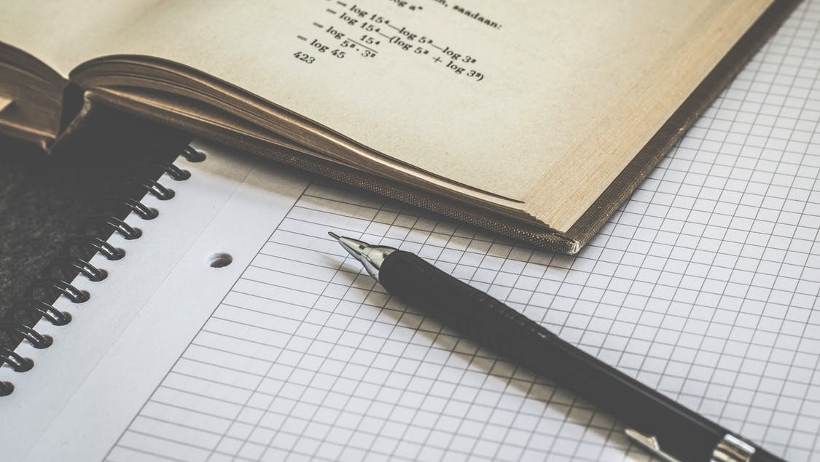
PERSONAL PRONOUN

Slide 2


PERSONAL PRONOUN
Hi, my name is Bob!
3
1
2

Slide 3
1) WHEN I SPEAK OR I SPEAK WITH FRIENDS IT´S CALLED THE 1 PERSON
1) QUANDO EU FALO OU EU FALO COM AMIGOS É CHAMADO PRIMEIRA PESSOA
Hi, my name is Bob!
I (SINGULAR), WE (PLURAL)
3
1
EXAMPLE:
WE LIKE PIZZA
I DRINK WATER EVERY DAY
2

Slide 4
2) WHEN I SPEAK TO YOU OR A GROUP OF PEOPLE IT´S CALLED 2 person
2) QUANDO EU FALO COM VOCÊ OU COM UM GRUPO DE PESSOAS É CHAMADO SEGUNDA PESSOA
YOU (SINGULAR), YOU (PLURAL)
Hi, my name is Bob!
EXAMPLE:
YOU PLAY SOCCER TWICE A WEEK
YOU CAN EAT THE CAKE
3
1
2

Slide 5
3) WHEN I SPEAK ABOUT SOMEONE OR SOMETHING IT’S CALLED 3 PERSON
3) QUANDO EU FALO DE ALGUEM OU DE ALGO É CHAMADO TERCEIRA PESSOA
HE, SHE, IT (SINGULAR), THEY (PLURAL)
Hi, my name is Bob!
EXAMPLE:
HE LOVES CHOCOLATE
THEY LIVE ALONE
3
1
2

Slide 6
Exercise
THIS IS GEORGE, HE WATCHES TV EVERYNIGHT;
LOOK AT MY MOTHER, SHE EXERCISES ONCE A WEEK;
MY COW LOVES GRASS, IT EATS EVERY 2 HOURS;
I DON’T LIKE SUSHI, I’M NOT A FAN OF RAW FOOD.

Slide 7
THIRD PERSON SINGULAR

Slide 8
THIRD PERSON SINGULAR
HE, SHE & IT

Slide 9
THIRD PERSON SINGULAR =
FIRST, SECOND PERSON
(HE, SHE & IT)
(I, YOU, WE)
SIMPLE PRESENT
ROUTINES, HABITS AND DAILY ACTIVITIES
HE, SHE &
IT
EXAMPLES:
AFFIRMATIVE: SHE HAS A BROTHER
NEGATIVE: SHE DOESN’T HAVE A BROTHER
INTERROGATIVE: DOES SHE HAVE A BROTHER?
I, YOU,WE,
EXAMPLES:
AFFIRMATIVE: I HAVE A BROTHER
NEGATIVE: I DON’T HAVE A BROTHER
INTERROGATIVE: DO I HAVE A BROTHER?

Slide 10
THIRD PERSON SINGULAR
VERBOS TERMINADOS EM:
EXEMPLOS:
GO
RELAX
SEARCH
PRESS
VANISH
GOES
RELAXES
O,S,X,SH,CH = + ES
SEARCHES
PRESSES
VANISHES

Slide 11
THIRD PERSON SINGULAR
VERBOS TERMINADOS EM:
EXEMPLOS:
PLAY
SAY
STAY
PRAY
PLAYS
SAYS
VOGAL + Y = + S
STAYS
PRAYS

Slide 12
THIRD PERSON SINGULAR
VERBOS TERMINADOS EM:
EXEMPLOS:
CRY
TRY
FLY
MARRY
CRIES
TRIES
CONSOANTE + Y = - Y + IES
FLIES
MARRIES

Slide 13
THIRD PERSON SINGULAR
VERBOS TERMINADOS EM:
EXEMPLOS:
CRY
TRY
FLY
MARRY
CRIES
TRIES
CONSOANTE + Y = - Y + IES
FLIES
MARRIES
EXCEÇÕES:
EXEMPLOS:
HAVE
HAVE - HAS
I ____ A DOG
SHE ____ A DOG
HAS

Slide 14
Exercise
AFFIRMATIVE:
NEGATIVE:
INTERROGATIVE:
I DON’T PLAY SOCCER
I PLAY SOCCER
DO I PLAY SOCCER?
HE DOESN’T PLAY SOCCER
PLAYS SOCCER
HE _____
DOES HE PLAY SOCCER?
WE DON’T MAKE COFFEE
WE MAKE COFFEE
DO WE MAKE COFFEE?
MAKES COFFEE
SHE DOESN’T MAKE COFFEE
SHE _____
DOES SHE MAKE COFFEE?
YOU DANCE BALLET
YOU DON’T DANCE BALLET
DO YOU DANCE BALLET?
DANCES BALLET
IT DOESN’T DANCE BALLET
IT _____
DOES IT DANCE BALLET?
THEY PASS THE TEST
THEY DON’T PASS THE TEST
DO THEY PASS THE TEST?
PASSES THE TEST
SHE DOESN’T PASS THE TEST
DOES SHE PASS THE TEST?
SHE _____
YOU WASH THE DISHES
YOU DON’T WASH THE DISHES
DO YOU WASH THE DISHES?
WASHES THE DISHES
HE DOESN’T WASH THE DISHES
DOES HE WASH THE DISHES?
HE _____

