Slide 1
🤝 Bayanihan Hub
🏷️ Project Theme: Equalizing an Unbalanced Society
Trisha Dacumos
Jehosue Biscarra
Christopher Buen
Leah Joyce Caoile
Laurice Mae Ancheta

Slide 2
Introduction
A Bayanihan Hub is a community platform where people can donate items, request assistance, and exchange goods with one another. The project aims to address the issue of social inequality by promoting a culture of sharing and mutual support. Through this platform, individuals will have free and equal access to essential resources regardless of their financial status. By encouraging community participation the project helps reduce waste, support those in need, and provide a more inclusive and balanced society.

Slide 3
Methodology
Our Partcipants:
IT Specialist: PAF Bryan C. Amen
Main Client: Brgy. Captain Lauro A. Ancheta
End-user: Larjollene A. Dimaculangan
Why chosen, and how they were recruited?

Slide 4
Methodology
Where they were interviewed?

Slide 5
Methodology
What did you ask?

Slide 6
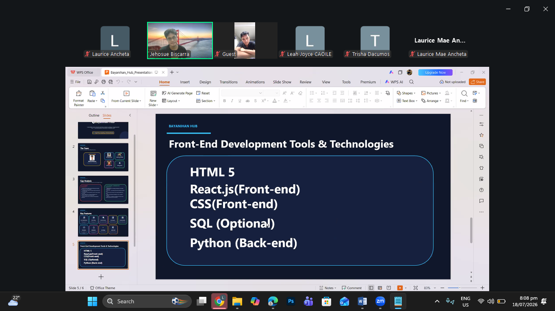
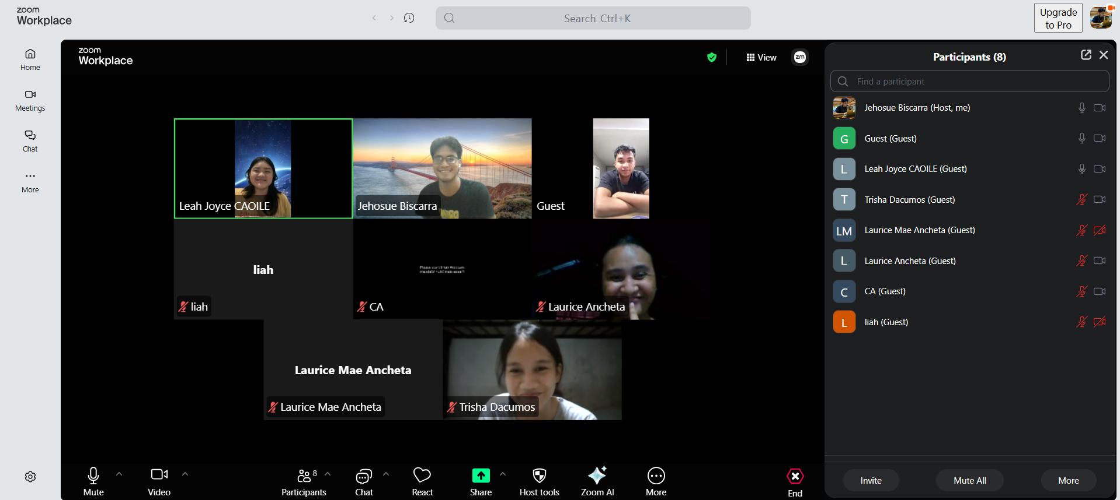
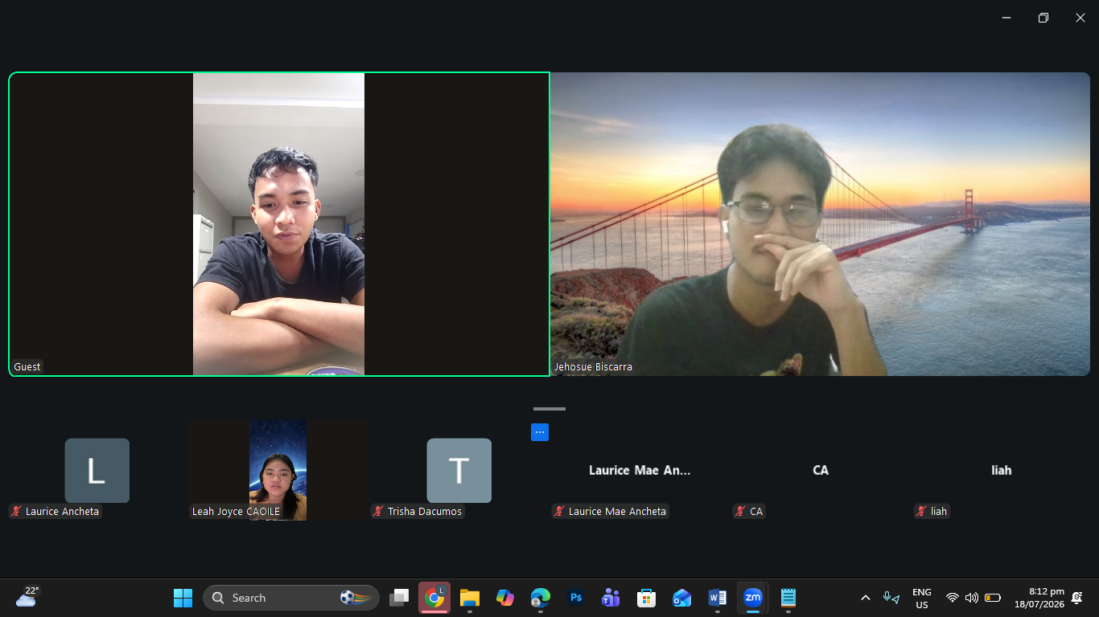
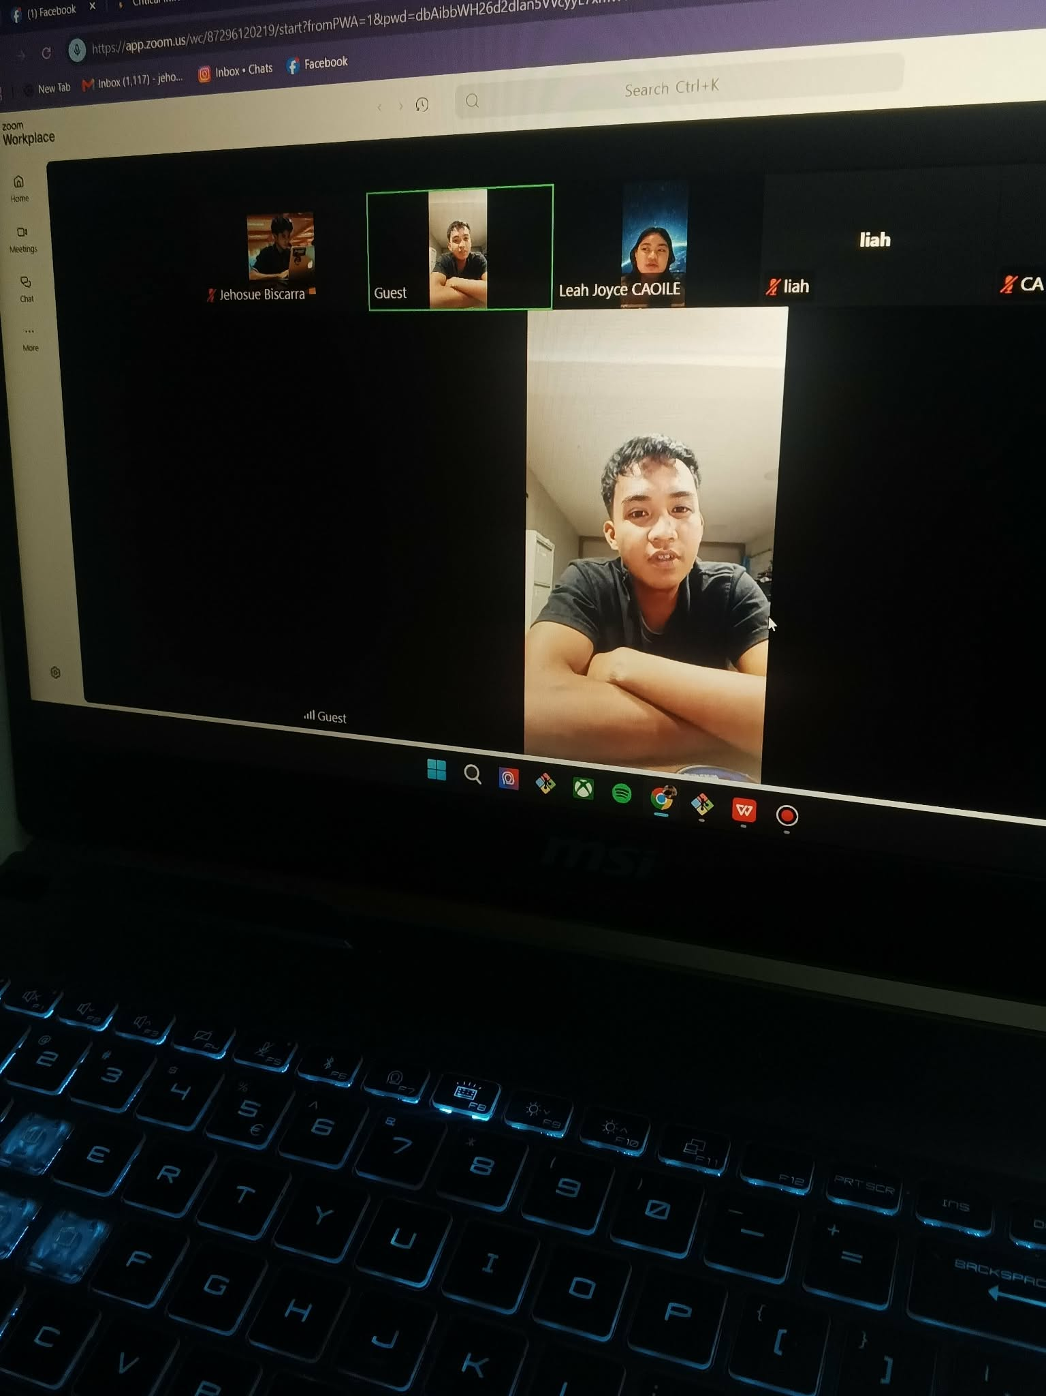
Interview Results

