Slide 1
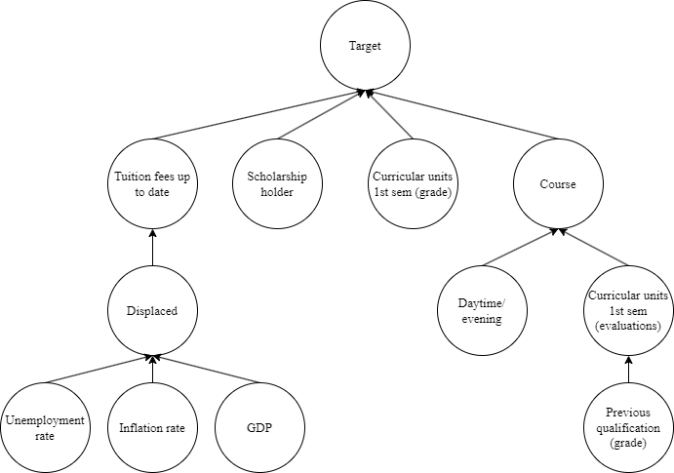
MODELO ORIGINAL

Slide 2
Curricular units 1st sem (evaluations)
Tuition fees up to date
target
scholaship
holder
Curricular units 1st sem (grade)
MODELO K2
Daytime/
evening attendance
previous qualification (grade)
unemployment rate
displaced
Inflation rate
gdp

Slide 3
Inflation rate
Tuition fees up to date
scholaship
holder
MODELO BIC
unemployment rate
gdp
target
Daytime/
evening attendance
Curricular units 1st sem (evaluations)
Curricular units 1st sem (grade)
displaced

