Slide 1


CASE STUDY – 1
Predictive Maintenance in Solar Power Systems

Slide 2
Content
Abstract
Problem Statement
Objective
Data Collection and Preparation
Proposed Solution (Methodology)
Model Performance Evaluation
Screenshots / Demonstration (video)
Future Scope
Conclusion
Notes:
Abstract
Problem Statement (Clearly define the challenge)
Objective (State your project's goal)
Background and Research (Discuss existing solutions, trends, and gaps)
Data Collection and Preparation (Focus on data sources, cleaning, and augmentation)
Proposed Solution (Methodology)
Model Architecture (e.g., CNN, U-Net, YOLOv5)
Key Techniques (e.g., Transfer Learning, Image Augmentation)
Model Performance Evaluation
Metrics (Accuracy, Precision, Recall, IoU, etc.)
Graphs (Confusion Matrix, ROC Curve, etc.)
Screenshots / Demonstration (Visual proof of system functionality)
Future Scope (Improvements, scalability, and integration ideas)
Conclusion (Summarize results and impact)
Q&A Session

Slide 3
Abstract
Solar power is vital for clean energy.
• Traditional maintenance can lead to inefficiencies.
• Predictive maintenance uses AI to optimize performance.
• Reduces costs and increases reliability of solar systems.

Slide 4
Problem Statement
Breakdowns reduce power output and cause financial loss.
• Manual maintenance is often inefficient and reactive.
• Need for intelligent, proactive maintenance system.

Slide 5
Objective
Predict inverter failures using sensor and maintenance data.
• Reduce downtime and increase energy output.
• Enable sustainable operations of solar power systems.

Slide 6
Data Collection and Preparation
Sensor data: temperature, voltage, current, energy.
• Historical maintenance logs.
• Normalization and time-series transformation.
• Labeling based on failure criteria.

Slide 7
Proposed Solution (Methodology)
Use LSTM model for sequence learning.
• Input: sensor data over time.
• Output: failure probability.
• Early stopping to avoid overfitting

Slide 8
Model Performance Evaluation
Train/test split and validation.
• Metrics: Accuracy, Loss, Precision, Recall.
• Achieved ~90% accuracy on test data.
• Visualizations: Accuracy/Loss graphs over epochs.

Slide 9
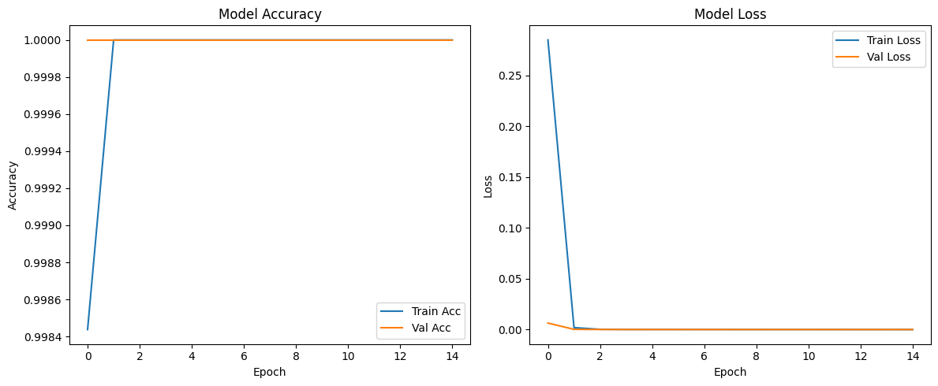
Screenshots / Demonstration (video)
GITHUB LINK : https://github.com/Jeivabala/Ai-and-green-skills_case-study-1

Slide 10
Future Scope
Integrate real-time weather and irradiance data.
• Explore advanced models like Transformers.
• Automate maintenance scheduling and alerts.
• Expand model for multiple components (not just inverters).

Slide 11
1.What features in the dataset are most important for predicting equipment failures?
Answer:
To effectively predict equipment failures, it's crucial to monitor and analyze specific features that often serve as indicators of potential issues. These features include:
Temperature: Elevated temperatures can signal overheating components or insufficient cooling mechanisms.​
Vibration: Unusual vibration patterns may indicate misalignments, imbalances, or wear in moving parts.​
Pressure: Abnormal pressure readings can point to blockages, leaks, or malfunctions in hydraulic or pneumatic systems.​
Usage Patterns: Deviations from standard operating procedures or unexpected usage spikes can stress equipment, leading to premature failures

Slide 12
2.Develop a machine learning model to predict inverter failure
Answer:
Data Collection: Gather historical data from inverters, including sensor readings (e.g., voltage, current, temperature), operational logs, and maintenance records.​
Data Preprocessing: Clean the data to handle missing values, remove outliers, and normalize the dataset for consistency.​
Feature Engineering: Identify and select relevant features that have a significant impact on inverter performance and potential failures.​
Model Selection: Choose appropriate machine learning algorithms such as Random Forest, Support Vector Machines, or Neural Networks, known for their effectiveness in classification tasks.​
Deployment: Implement the trained model into the monitoring system to provide real-time predictions and alerts for potential inverter failures

Slide 13
3.How would you improve the model's accuracy?
Answer:
Feature Selection: Utilize techniques like Recursive Feature Elimination or Principal Component Analysis to identify and retain the most informative features, removing redundant or irrelevant data.​
Data Augmentation: Increase the diversity and volume of training data through simulation or synthetic data generation, helping the model generalize better.​
Hyperparameter Tuning: Optimize model parameters using methods like Grid Search or Random Search to find the best combination for improved performance.​
Cross-Validation: Implement k-fold cross-validation to ensure the model's robustness and prevent overfitting.​
Continuous Learning: Regularly update the model with new data to adapt to evolving patterns and maintain accuracy over time.

Slide 14
4.What actions should be taken if a failure is predicted?
Answer:
Immediate Notification: Alert maintenance teams promptly to ensure they are aware of the potential issue.​
Diagnostic Assessment: Conduct a thorough examination to confirm the prediction and identify the root cause.​
Scheduled Maintenance: Plan and execute maintenance activities during non-peak hours to minimize operational disruption.​
Component Replacement: Replace or repair the faulty components as identified during the diagnostic assessment.​
Post-Maintenance Testing: After maintenance, perform tests to ensure the equipment operates correctly and the issue is resolved.

Slide 15
5.How can predictive maintenance contribute to sustainability and reduce waste?
Answer:
Extending Equipment Lifespan: Timely maintenance prevents excessive wear and tear, prolonging the service life of machinery and reducing the need for frequent replacements.
​
Reducing Resource Consumption: Efficiently operating equipment consumes less energy and materials, leading to lower resource utilization.​
Minimizing Waste Generation: Preventing unexpected breakdowns reduces the disposal of damaged parts and the production of defective products, thereby decreasing waste.​
Lowering Carbon Footprint: Efficient maintenance schedules reduce the need for emergency repairs and associated logistics, contributing to lower greenhouse gas emissions.

Slide 16
Conclusion
Predictive maintenance boosts solar efficiency.
• AI helps prevent unexpected failures.
• Reduces environmental waste and cost.
• Supports a more sustainable energy future.

