Slide 1


Ruby
Aron Ludwinski, Ashly Lovings, Jay Kmetz

Slide 2
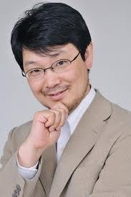


Background
Started developing Ruby in 1993
Yukihiro Matsumoto

Slide 3

About Ruby
Ruby became popular in 2005 to build web applications through Ruby on Rails
It’s an open source object-oriented programming language
Compiled Language
Supports Short Circuit evaluation
If you want to know the current type of a variable you can use the method .kind_of
To instantiate a new object of a class, the format is as follows:
Variable_name = Type.new(optionalParameters)
The main reason it was designed was to be powerful but useful for many different applications
There is no one domain it is meant to be used for

Slide 4





Memory in Ruby
Allocating
Running out
Asking for more
Ruby generally allocates more memory than is needed.
Ruby holds on to memory for as long as it needs because of the expensive system call
When more memory needs to be used than was previously allocated
Ruby generally allocates more memory than is needed

Slide 5






How Ruby is Compiled
Compile to bytes
Interpreting
Iterating
Compile to YARV instructions
First it gets compiled into a set of byte code instructions
The byte code instructions are then interpreted by yet another Ruby virtual-machine (YARV)
Ruby recursively iterates over the nodes in the AST from the top down
Then complies each node into corresponding YARV instructions
Notes:
AST → abstract syntax tree

Slide 6






Ruby types
Boolean Objects
Arrays
Either True or False
Ordered list of values which can have mixed types
Hashes
Strings
Hold a list of key-value pairs similarly to Java’s HashMap class
Can contain characters not in ASCII, specified by single quotes
Notes:
An Example of an array with mixed types → index 0 contain a Boolean and index 1 contain a String
Strings in Ruby
Symbols that are unique to Ruby and are similar to Strings (they are usually used for fixed values, specified by a colon and then characters excluding spaces)

Slide 7


Everything is truthy or Falsey
Falsey values are:
Nil
False
Everything else evaluates as true
Demonstration!
Notes:
Demonstration here!!!!

Slide 8
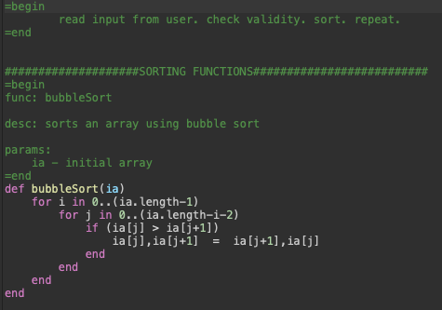

Bubble Sort

Slide 9



Control Statements
They all use the keyword end to specify the end of the control structure
If Statement
Elseif Statement
While Loops
For Loops
if (left < h)
…
end
if inp.match
state =: EXIT
elsif inp.match
State = : RAND_NUMS
end
while (i < n1 && j < n2)
…
end
for i in 0..5
…
end

Slide 10

Methods and Procedures
Methods
Procedures
Can be included in and outside of an object
Can be recursive
When a method is called, it may be associated with a block
If the last parameter in a method definition is prefixed with an ampersand, any associated block is converted to a Proc Object and that object is assigned to the parameter
Can take in any object and return any other object
This makes for functions and methods very versatile
This can also make debugging difficult

Slide 11

Data abstraction is built into Ruby
You can declare private variables!
Use “<“ character to create a subclass
Use @ symbol for an instance variable
Create Classes and Subclasses
Instance Variables
Static Variables
Use $ symbol for variables
The arrow pointing towards the subclass shows that the subclass is derived from the superclass
The @ symbol is front of a variable name is to specify that it is an instance variable
To specify class variables use $ in front of the variable

Slide 12
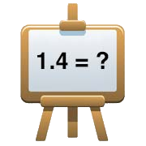
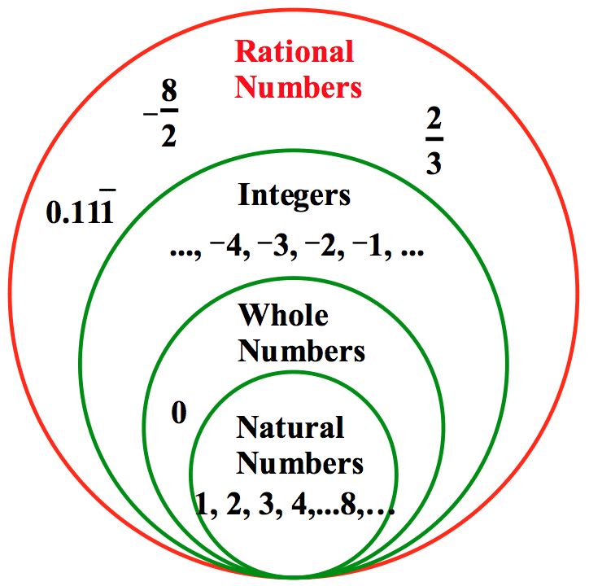



Numbers are type Numeric
Integer
Float
BigDecimal
Complex/Rational
Two Child Classes
Prevents certain logical operations from being performed as expected like comparing two float values to each other
Must be instantiated explicitly using the BigDecimal class and can be used for mathematical operations.
Complex hold complex numbers.
Rational holds rational values which is an integer divided by another integer.
Fixnum: if value is less than 32 bits in size
Bignum: if value is greater than 32 bits in size (Downside for calculations is its far less efficient than using floating-point numbers
Approximation of decimal numbers and is the default type Ruby chooses when assigning a decimal number to a variable.

Slide 13



Pros
Variables are loosely typed
Full support of Regular Expressions
You don’t have to worry about type checking since everything is an object.
Regex comes with its own set of operators and predefined syntax with Ruby.
Everything just works
Implicit variable making
Ruby was made to be as intuitive as possible. If you think a function exists, it probably does!
Variables can be declared at any time and the type is determined for you.

Slide 14

Cons
Functions can return anything
Comparisons of variables of any type
A function returns the last value set. This can be of any type. Sloppy programming can lead to hard debugging.
This is harder to track during debugging since the program allows for it.
Feature Multiplicity
Dynamic Typing
Having more than one way to accomplish a particular operation.
It allows any variable to change types, even when the programmer may not intend to do so.

Slide 15

Summary
Ruby is a great teaching language since everything is an object
Ruby is lenient with the types of objects passed to functions and methods as well with the types of objects returned.
Since Ruby also supports functional and procedural programming, any experience with other languages can also help
Why you should choose Ruby.

Slide 16


Thank You
Aron Ludwinski, Ashly Lovings, Jay Kmetz

Slide 17

Works Cited Page
https://blog.newrelic.com/engineering/python-programming-styles/
https://www.sitepoint.com/history-ruby/
https://ruby-doc.com/docs/ProgrammingRuby/
https://www.techotopia.com/index.php/Understanding_Ruby_Variables
https://ruby-doc.com/docs/ProgrammingRuby/
https://www.sitepoint.com/ruby-uses-memory/
https://ruby-doc.com/docs/ProgrammingRuby/
^{https://www.ruby-lang.org/en/}
https://launchschool.com/books/ruby/read/introduction
https://www.sitepoint.com/history-ruby/
https://www.javatpoint.com/ruby-data-types
https://www.rubyguides.com/2015/08/ruby-recursion-and-memoization/
Images
Dhanvani, Poonam. “Creator of Ruby.” Famous IT Personalities in Computers | Language Founders, 2012, freefeast.info/personality-motivation/famous_it_personalities/famous-it-personalities-in-computers-language-founders/.

