Slide 1

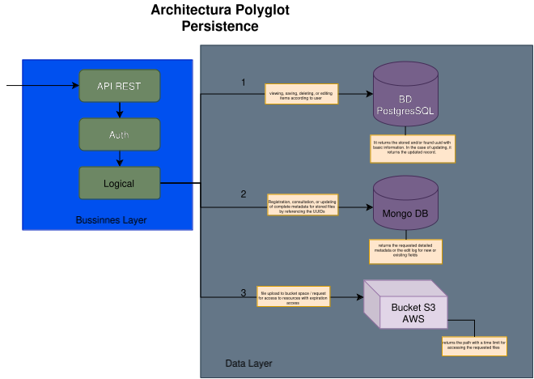
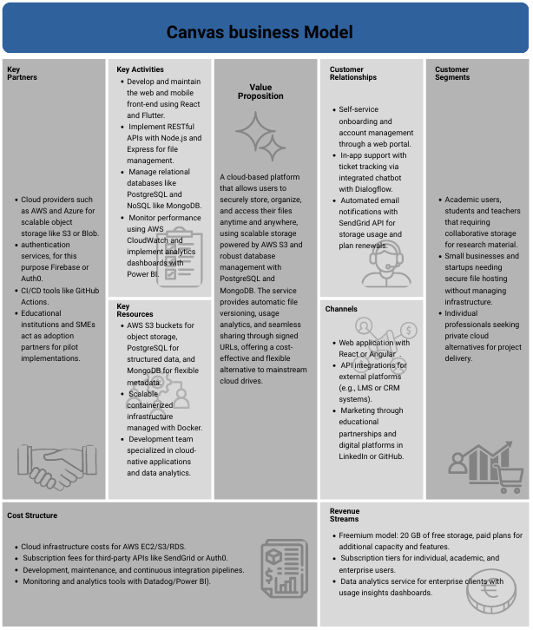
CLOUD UD – CLOUD STORAGE PLATFORM
Santiago Avella Torres; Cristian Camilo Tuso; Juan Esteban Oviedo
University Distrital FJDC
ABSTRACT
GENERAL OBJETIVE
REQUIREMENTS
In today’s cloud computing landscape, organizations
and users increasingly require reliable and secure platforms to
store and manage large volumes of heterogeneous data. This
paper presents the engineering of a cloud-based file storage
system that integrates relational, document-oriented, and object
storage technologies under a distributed polyglot persistence
architecture. The proposed solution provides scalability, security,
and data consistency while maintaining user accessibility and
system reliability, establishing a robust foundation for future
experimentation and deployment.
Design and implement a cloud storage platform that allows secure access through personalized accounts, offering private storage spaces with hierarchical and classified management of folders and files, and complete functionality for uploading, downloading, and organizing items. The solution must meet acceptance criteria geared toward high concurrency, ensuring high availability, usability, performance, security, and scalability to guarantee a reliable and efficient experience for multiple simultaneous users.
Essential functional requirements (RF):
FR1. User Registration and Login
FR2. Storage Management with Folders
FR3. File Upload Management
FR4. Storage Usage Display
FR5. File Viewing and Management
Essential No functional requirements (NRF):
NFR1. Security
NFR2. Scalability
NFR4. Performance
NFR5. Usability
NFR6. Maintainability
BUSINESS MODEL
Figure 2. Architecture High Level Model for the File Storage Platform.
The proposed business model is based on a cloud storage platform that combines security, flexibility, and scalability through the use of services such as AWS S3, PostgreSQL, and MongoDB.
The system offers private storage spaces with file versioning, usage metrics, and sharing via signed links, aimed at academic users, professionals, and small businesses looking for a reliable and cost-effective alternative to traditional services.
The proposal integrates a freemium approach, which allows for limited storage space. Similarly, a paid storage service is offered that increases the capacity available for use.
DISTRIBUTION STRATEGIES
ARCHITECTURE DESING
Hybrid Database Architecture
The implementation of a dual architecture combining PostgreSQL and MongoDB leverages the specific strengths of each system. PostgreSQL manages structured metadata, including user information, permissions, and file references, while MongoDB handles the storage of binary content and flexible metadata.
Hierarchical Indexing with Ltree
PostgreSQL offers the ltree data type to represent hierarchical structures, ideal for modeling folder systems. This extension allows ancestor and descendant queries to be performed in logarithmic time using GiST indexes.
Asynchronous Processing with Non-Blocking I/O
The implementation of asynchronous operations using streams and event loops allows a single process to handle thousands of concurrent connections without multiple threads. While an operation waits for a response from the disk or network, the process can handle other requests, maximizing CPU utilization and enabling high parallelism with lower memory overhead compared to traditional multi-thread models.
The system is based on a polyglot persistence architecture that integrates PostgreSQL, MongoDB, and AWS S3, combining the advantages of each technology to achieve efficient, secure, and scalable data management. It is implemented under a three-layer model (presentation, business, and data), which ensures separation of responsibilities, agile maintenance, and high availability.
Key Components
Logical Orchestrator: Coordinates flows between the three databases, applies business rules (quotas, permitted types), and maintains consistency using the SAGA pattern, which allows operations to be rolled back in case of failures. It also generates correlation identifiers for complete traceability.
PostgreSQL: Acts as a relational source of truth, ensuring referential integrity between users, folders, and files. Controls transactions, states, and relationships using foreign keys and constraints.
MongoDB: Functions as a flexible metadata repository, allowing hierarchical structures and complex queries (searches by text, tags, or specific attributes) to be stored without altering schemas.
AWS S3: Manages binary files using a key-value model. Its design decouples physical storage from logical storage, optimizing performance and scalability. Additionally, it supports pre-signed URLs for secure and direct downloads, and versioning for historical control and data recovery.
0
REFERENCES
Rachoork. (2025, septiembre). Polyglot Persistence: A Strategic Approach to Modern Data Architecture. Medium.
GeeksforGeeks. (2025). Introduction of 3-Tier Architecture in DBMS (Set 2).
Corporate Finance Institute (CFI). (2025). Business Model Canvas Examples: Automobile & Amazon Case Studies.
PostgreSQL Global Development Group. (2025). PostgreSQL 18 Documentation: ltree — hierarchical tree-like data type.
Figure 1. Business Model Canvas for the File Storage Platform..

