Slide 1
APPLICATION COMPONENT

Slide 2
Content Of Application Components
Intent and Intent Filters.
Activities
Services
Content Providers
App Widgets
Processes and Threads

Slide 3
Intent And Intent Filters
→ Messaging Object.
To Start an Activity
startActivity().
startActivityForResult().
onActivityResult() .
To Start a Service
startService().
bindService().
To deliver a broadcast
sendBroadcast(), sendOrderedBroadcast(), or sendStickyBroadcast().
Notes:
You can start a new instance of an Activity by passing an Intent to startActivity().
If you want to receive a result from the activity when it finishes, call startActivityForResult().
You can start a service to perform a one-time operation (such as download a file) by passing an Intent to startService().
If the service is designed with a client-server interface, you can bind to the service from another component by passing an Intent to bindService().
The system delivers various broadcasts for system events, such as when the system boots up or the device starts charging.

Slide 4
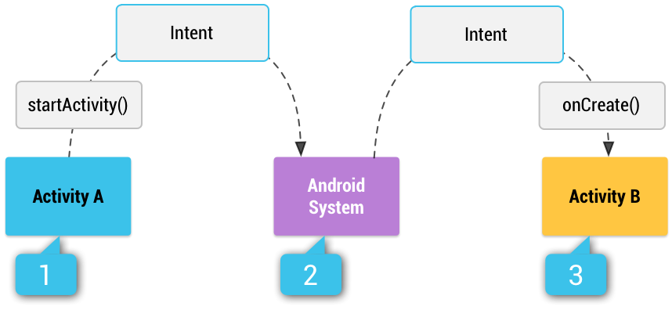
Intent Types
Explicit intents
Implicit intents
Illustration of how an implicit intent is delivered through the system to start another activity: [1] Activity A creates an Intent with an action description
and passes it to startActivity(). [2] The Android System searches all apps for an intent filter that matches the intent.
When a match is found, [3] the system starts the matching activity (Activity B) by invoking its onCreate() method and passing it the Intent.
Notes:
Explicit – Only specific component
For example, start a new activity in response to a user action or start a service to download a file in the background.
Implicit- don’t have specific component…
For example, if you want to show the user a location on a map, you can use an implicit intent to request that another capable app show a specified location on a map.

Slide 5
Intent Filters
App’s Manifest file of Expression
If not declare any intent filters for an activity, started only with an explicit intent.
Caution:
Explicit intent is secure to develop a app.
Do not declare the intent filter when starting a service.
Build an Intent:
→ Determine Which Component to Start.
Component Name.
Action
Data
Category
Extras
Flag
Notes:
It is an expression in an app's manifest file that specifies the type of intents that the component would like to receive.
To ensure your app is secure, always use an explicit intent when starting a Service and do not declare intent filters for your services. Using an implicit intent to start a service is a security hazard because you cannot be certain what service will respond to the intent, and the user cannot see which service starts.
Build an intent:
An Intent object carries information that the Android system uses to determine which component to start (such as the exact component name or component category that should receive the intent), plus information that the recipient component uses in order to properly perform the action (such as the action to take and the data to act upon).

Slide 6
Component Name:
System decides which component should receive the intent based on the other intent information.
setComponent(), setClass(), setClassName(), or with the Intent constructor.
Action:
ACTION_VIEW
ACTION_SEND
For Example:
If you define your own actions, be sure to include your app's package name as a prefix.
static final String ACTION_TIMETRAVEL = "com.example.action.TIMETRAVEL“.
Data:
URI and MIME type of data.
URI - setData(). And MIME - setType().
Do not call separately Uri and Mime types in an Activity because they each nullify the value of the other. Explicitly with setDataAndType().
Notes:
ACTION_VIEW: Activity to show to the user.
ACTION_SEND: User can share through another app.
Category: A string containing additional information about the kind of component that should handle the intent

Slide 7
Category:
Some Categories:
CATEGORY_BROWSABLE.
CATEGORY_LAUNCHER.
You can specify the category with addCategory().
Extras:
Key-value pairs carry additional information to the requested the action.
putExtra() to add extra data and each accepting two parameters : key name and value.
Insert the Bundle of data by inserting Intent with putExtra().
For Example:
The Intent class specifies many EXTRA_* constants for standardized data types
static final String EXTRA_GIGAWATTS = "com.example.EXTRA_GIGAWATTS“.
Flag:
In the intent class that a function of metadata for the intent.
It is used to instruct how to launch an activity.
Notes:
Extras:
For example, when creating an intent to send an email with ACTION_SEND, you can specify the "to" recipient with the EXTRA_EMAIL key, and specify the "subject" with the EXTRA_SUBJECT key.

Slide 8
Example explicit intent
For example, if you built a service in your app, named DownloadService, designed to download a file from the web, you can start it with the following code:
// Executed in an Activity, so 'this' is the Context // The fileUrl is a string URL, such as "http://www.example.com/image.png" Intent downloadIntent = new Intent(this, DownloadService.class); downloadIntent.setData(Uri.parse(fileUrl)); startService(downloadIntent);
The Intent(Context, Class) constructor supplies the app Context and the component a Class object. As such, this intent explicitly starts the DownloadService class in the app.

Slide 9
Example of Implicit Intent.
// Create the text message with a string Intent sendIntent = new Intent(); sendIntent.setAction(Intent.ACTION_SEND); sendIntent.putExtra(Intent.EXTRA_TEXT, textMessage); sendIntent.setType(HTTP.PLAIN_TEXT_TYPE); // "text/plain" MIME type // Verify that the intent will resolve to an activity if (sendIntent.resolveActivity(getPackageManager()) != null) { startActivity(sendIntent); }

Slide 10
Forcing An app chooser
Intent intent = new Intent(Intent.ACTION_SEND);
// Always use string resources for UI text. // This says something like "Share this photo with“
String title = getResources().getString(R.string.chooser_title);
// Create intent to show chooser Intent chooser = Intent.createChooser(intent, title); // Verify the intent will resolve to at least one activity
if (sendIntent.resolveActivity(getPackageManager()) != null) { startActivity(sendIntent); }
Notes:
Intent.createChooser(intent, title) is used to choose the app

Slide 11
Receiving an implicit intent
<action>
Declares the intent action accepted, in the name attribute. The value must be the
literal string value of an action, not the class constant.
<data>
Declares the type of data accepted, using one or more attributes that specify various
aspects of the data URI (scheme, host, port, path, etc.) and MIME type.
<category>
Declares the intent category accepted, in the name attribute. The value must be
the literal string value of an action, not the class constant.
Notes:
An app component should declare separate filters for each unique job it can do. For example, one activity in an image gallery app may have two filters: one filter to view an image, and another filter to edit an image. When the activity starts, it inspects the Intent and decides how to behave based on the information in the Intent (such as to show the editor controls or not).
Note: In order to receive implicit intents, you must include the CATEGORY_DEFAULT category in the intent filter. The methods startActivity() and startActivityForResult() treat all intents as if they declared the CATEGORY_DEFAULT category. If you do not declare this category in your intent filter, no implicit intents will resolve to your activity.

Slide 12
Example of Filter
<activity android:name="MainActivity"> <!-- This activity is the main entry, should appear in app launcher --> <intent-filter> <action android:name="android.intent.action.MAIN" /> <category android:name="android.intent.category.LAUNCHER" /> </intent-filter> </activity> <activity android:name="ShareActivity"> <!-- This activity handles "SEND" actions with text data --> <intent-filter> <action android:name="android.intent.action.SEND"/> <category android:name="android.intent.category.DEFAULT"/> <data android:mimeType="text/plain"/> </intent-filter> <!-- This activity also handles "SEND" and "SEND_MULTIPLE" with media data --> <intent-filter> <action android:name="android.intent.action.SEND"/> <action android:name="android.intent.action.SEND_MULTIPLE"/> <category android:name="android.intent.category.DEFAULT"/> <data android:mimeType="application/vnd.google.panorama360+jpg"/> <data android:mimeType="image/*"/> <data android:mimeType="video/*"/> </intent-filter> </activity>

Slide 13
Using an Pending Intent
User performs an action.
It is used to grant permission to a foreign application to contained Intent from your own process.
When using a pending intent, your app will not execute the intent with a call such as startActivity(). You must instead declare the intended component type when you create the PendingIntent by calling the respective creator method:
PendingIntent.getActivity() for an Intent that starts an Activity.
PendingIntent.getService() for an Intent that starts a Service.
PendingIntent.getBroadcast() for a Intent that starts an BroadcastReceiver.

Slide 14
Activity
Multiple activities that are loosely bound to each other.
Each activity can then start another activity in order to perform different actions.
BACK STACK AND TASKS USER FOCUS
Back stack → "last in, first out" stack mechanism.
Creating an Activity
Two Most Important Callback Methods
onCreate()→Calls when creating an activity.
onPause()→ persisted beyond the current user session.
Notes:
When a new activity starts, it is pushed onto the BACK STACK AND TASKS USER FOCUS.
The back stack abides to the basic "last in, first out" stack mechanism, so, when the user is done with the current activity and presses the Back button, it is popped from the stack (and destroyed) and the previous activity resumes.

Slide 15
Managing the Activity Lifecycle
An activity can exist in essentially three states:
Resumed → foreground of the screen and has user focus.
Paused →foreground and has focus, but this one is still visible.
Stopped→ obscured by another activity, still alive.
Notes:
Paused→That is, another activity is visible on top of this one and that activity is partially transparent or doesn't cover the entire screen. A paused activity is completely alive (the Activity object is retained in memory, it maintains all state and member information, and remains attached to the window manager), but can be killed by the system in extremely low memory situations.

Slide 16
Implementing of the lifecycle callback
public class ExampleActivity extends Activity { @Override public void onCreate(Bundle savedInstanceState) { super.onCreate(savedInstanceState); // The activity is being created. } @Override protected void onStart() { super.onStart(); // The activity is about to become visible. } @Override protected void onResume() { super.onResume(); // The activity has become visible (it is now "resumed"). } @Override protected void onPause() { super.onPause(); // Another activity is taking focus (this activity is about to be "paused"). } @Override protected void onStop() { super.onStop(); // The activity is no longer visible (it is now "stopped") } @Override protected void onDestroy() { super.onDestroy(); // The activity is about to be destroyed. } }

Slide 17
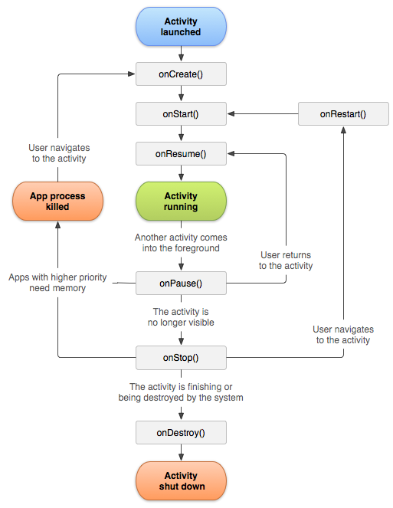
Lifecycle Activities

Slide 18
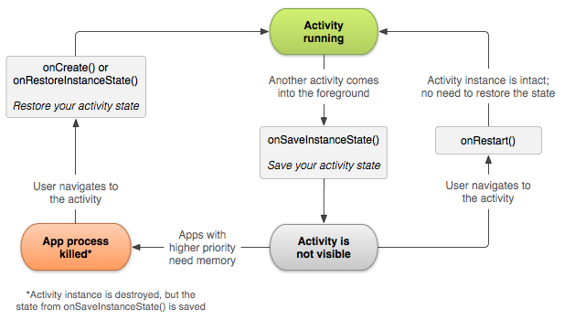
Saving activity state

Slide 19
Handling configuration changes
The best way to handle such a restart is to save and restore the state of your activity using onSaveInstanceState() and onRestoreInstanceState() (or onCreate()).

Slide 20
Fragment Life Cycle
Phase I: When a fragment gets created, it goes through the following states:
onAttach()
onCreate()
onCreateView()
onActivityCreated()
Phase II: When the fragment becomes visible, it goes through these states:
onStart()
onResume()
Phase III: When the fragment goes into the background mode, it goes through these states:
onPaused()
onStop()
Phase IV: When the fragment is destroyed, it goes through the following states:
onPaused()
onStop()
onDestroyView()
onDestroy()
onDetach()

Slide 21
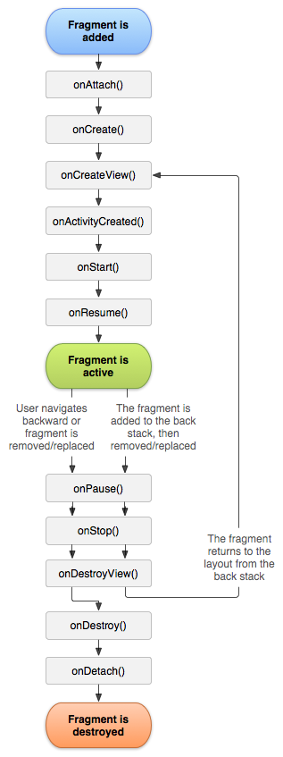

Slide 22
Loader
Characteristic:
→available in every activity and fragment.
→provide asynchronous loading of data.
→Monitor the source and deliver the new result when content changes.
→automatically connect the last loader cursor when the content changes.
Loader API:
LoaderManager →abstract class associated with an activity and fragment
LoaderManager.LoaderCallbacks → Callback interfaces for the loader manager.
Loader → base class for a loader.
AsyncTaskLoader →Abstract loader that provides an AsyncTask to do the work.
CursorLoader → Sub Class of AsyncTaskLoader that queries the ContentResolver and returns a Cursor.
Notes:
LoaderCallbacks: A callback interface for a client to interact with the LoaderManager. For example, you use the onCreateLoader() callback method to create a new loader.
Loader: An abstract class that performs asynchronous loading of data. This is the base class for a loader. You would typically use CursorLoader, but you can implement your own subclass. While loaders are active they should monitor the source of their data and deliver new results when the contents change.

Slide 23
Using Loader in an application
Starting a Loader:
getLoaderManager().initLoader(0, null, this);
Restarting a Loader:
getLoaderManager().restartLoader(0, null, this);
Using the LoaderManager Callbacks
onCreateLoader() — Instantiate and return a new Loader for the given ID.
onLoadFinished() — Called when a previously created loader has finished its load.
onLoaderReset() — Called when a previously created loader is being reset, thus making its data unavailable.

Slide 24
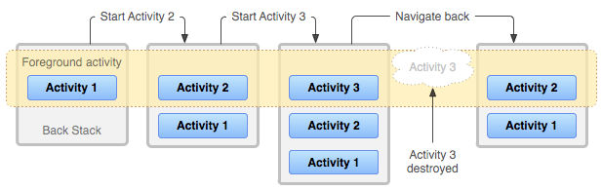
Tasks and Back Stack
Multiple Activities.
Specific Kind Of Action the user perform and start other activities.
Tasks is user interact with performing certain jobs.
Activities arranged in a stack i.e. back stack

Slide 25
Managing a Tasks:
by placing all activities started in succession in the same task and in a "last in, first out" stack.
The principal <activity> attributes you can use are:
taskAffinity
launchMode
allowTaskReparenting
clearTaskOnLaunch
alwaysRetainTaskState
finishOnTaskLaunch
And the principal intent flags you can use are:
FLAG_ACTIVITY_NEW_TASK
FLAG_ACTIVITY_CLEAR_TOP
FLAG_ACTIVITY_SINGLE_TOP

Slide 26
Services
A Service is an application component that can perform long-running operations in the background and does not provide a user interface.
A service runs in the main thread of its hosting process—the service does not create its own thread and does not run in a separate process (unless you specify otherwise). This means that, if your service is going to do any CPU intensive work or blocking operations (such as MP3 playback or networking), you should create a new thread within the service to do that work.

Slide 27
Different Forms of Services
Started
Performs a single operation and does not return a result to the caller.
For example, it might download or upload a file over the network.
Bound
Offers a client-server interface that allows components to interact with the service, send requests, get results, and even do so across processes with interprocess communication (IPC).

Slide 28
Different Forms of Services...
 | Started Service | Bound Service
When to use | If the application doesn’t need to communicate with the service after starting it. | If the application or other applications need to communicate with the service after starting it.
Method called to start the service | startService() | bindService()
Lifetime | Once started, a service can run in the background indefinitely, even if the component that started it is destroyed. When the operation is done, the service should stop itself. | Runs only as long as another application component is bound to it. Multiple components can bind to the service at once, but when all of them unbind, the service is destroyed.

Slide 29
Started Service
2 Types based on whether you need to concurrently handle multiple start requests:
Concurrency not needed
Extend the IntentService class.
Multiple requests will be automatically queued and handled one after another.
Concurrency needed
Extend the Service class.
You need to handle multiple requests concurrently.

Slide 30
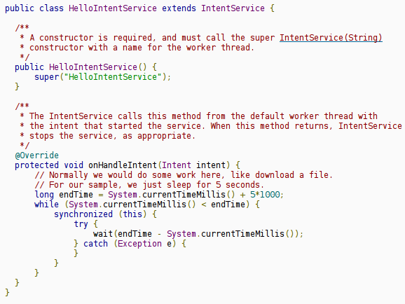
Started Service...
Example of IntentService:

Slide 31
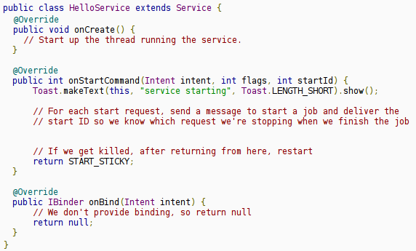
Started Service...
Example of Service:

Slide 32
Bound Service
2 Types based on whether the service is accessed from different processes:
Service is private to your process
Create your interface by extending the Binder class and returning an instance of it from onBind().
The client receives the Binder and can use it to directly access public methods available in either the Binder implementation or even the Service.
Service can be accessed from different processes
Yet again 2 types based on whether multiple requests need to be handled concurrently or not.
Concurrency not needed: Use a Messenger.
Concurrency needed: Use AIDL (Android Interface Definition Language).

Slide 33
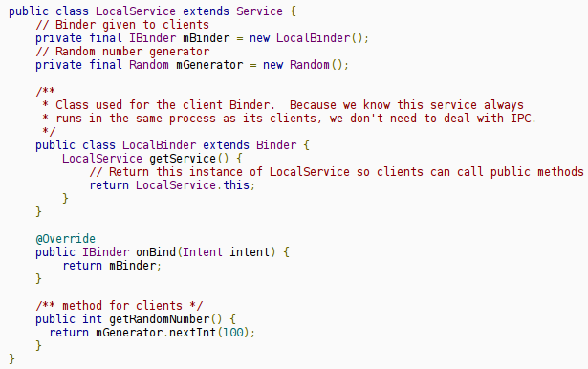
Bound Service...
Example of Extending the Binder class:

Slide 34
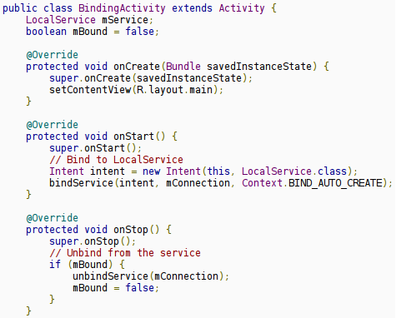
Bound Service...
An activity that binds to LocalService and calls getRandomNumber() when a button is clicked:

Slide 35
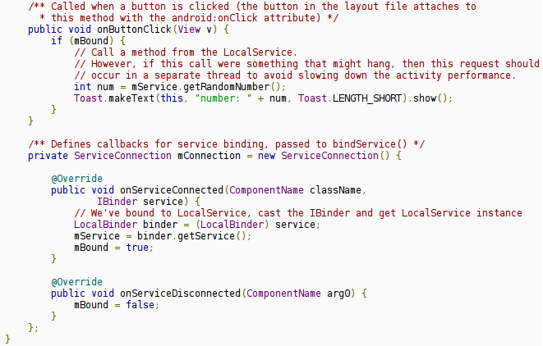
Bound Service...
An activity that binds to LocalService and calls getRandomNumber() when a button is clicked (cont.):

Slide 36
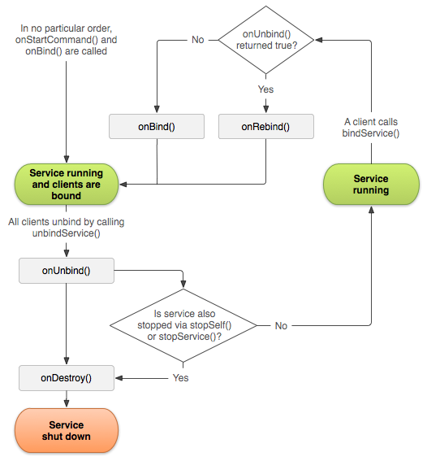
Managing the Lifecycle of a Bound Service

Slide 37
Running a Service in Foreground
A foreground service is a service that's considered to be something the user is actively aware of and thus not a candidate for the system to kill when low on memory.
A foreground service must provide a notification for the status bar, which is placed under the "Ongoing" heading, which means that the notification cannot be dismissed unless the service is either stopped or removed from the foreground.
For example, a music player that plays music from a service should be set to run in the foreground, because the user is explicitly aware of its operation. The notification in the status bar might indicate the current song and allow the user to launch an activity to interact with the music player.
To request that your service run in the foreground, call startForeground().
To remove the service from the foreground, call stopForeground()
Notes:
Note: The methods startForeground() and stopForeground() were introduced in Android 2.0 (API Level 5). In order to run your service in the foreground on older versions of the platform, you must use the previous setForeground() method—see the startForeground() documentation for information about how to provide backward compatibility

Slide 38
Android Interface Definition Language
It allows you to define the programming interface that both the client and service agree upon in order to communicate with each other using interprocess communication (IPC).
Defining an AIDL Interface
To create a bounded service using AIDL, follow these steps:
Create the .aidl file This file defines the programming interface with method signatures.
Implement the interface The Android SDK tools generate an interface in the Java programming language, based on your .aidl file. This interface has an inner abstract class named Stub that extends Binder and implements methods from your AIDL interface. You must extend the Stub class and implement the methods.
Expose the interface to clients Implement a Service and override onBind() to return your implementation of the Stub class.

Slide 39
Content Provider
A content provider manages access to a central repository of data..
The provider is part of an Android application, which often provides its own UI for working with the data.
However, content providers are primarily intended to be used by other applications, which access the provider using a provider client object.
Together, providers and provider clients offer a consistent, standard interface to data that also handles inter-process communication and secure data access.

Slide 40
Accessing a Content Provider
A content provider offers methods which correspond to the basic CRUD functions of persistent storage.
An application accesses the data from a content provider with a ContentResolver client object. This object has methods that call identically-named methods in the provider object.
A content provider is identified by a content URI.

Slide 41
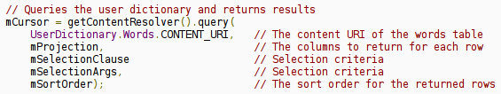
Accessing a Content Provider...
Example of getting a list of words from the User Dictionary provider:
The content URI of the words table is: content://user_dictionary/words
Read permission for accessing the content provider is also needed in the manifest file:

Slide 42
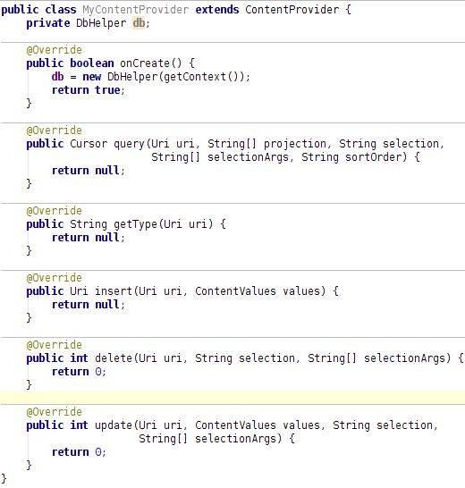
Developing a Custom Content Provider
Extend the ContentProvider class.
In the onCreate() method, create a new instance of the database helper class.

Slide 43
Developing a Custom Content Provider...
Suppose, we need to provide access to 2 tables through this single content provider. As we have only one method per CRUD operation, we need a way to differentiate between accesses to these two tables.
We need to define content URI paths to each table. These are defined in a public final class which can be used by both provider and user as a contract: (see next slide)

Slide 44
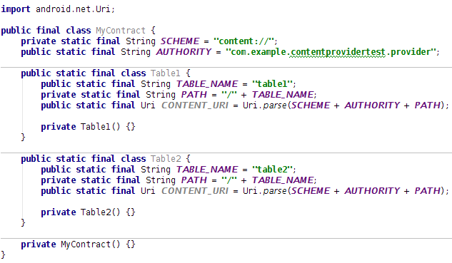
Developing a Custom Content Provider...

Slide 45
Developing a Custom Content Provider...
Now comes the issue of differentiating between paths. The idea is to match a URI and then taking appropriate actions for the corresponding table path.
Add a UriMatcher to the provider and add expected URI patterns to it.
In the query() method, get the appropriate table name from the URI.

Slide 46
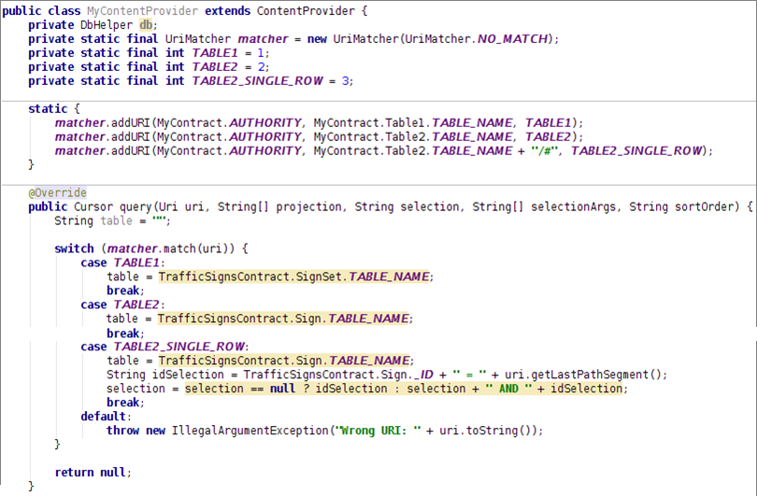
Developing a Custom Content Provider...

Slide 47
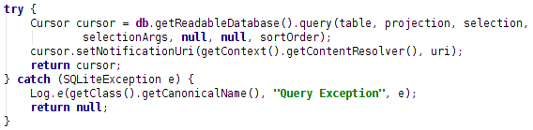
Developing a Custom Content Provider...
Now write the actual query method:
You should add this URI to notification observables by calling setNotificationUri() so that if this cursor is directly used in a ListView, updating or inserting or deleting data in the table represented by this URI would notify the ListView of this data change.

Slide 48
Developing a Custom Content Provider...
insert, update and delete methods are similar.
insert() returns the Uri with the newly inserted ID appended.
update() and delete() returns the number of rows affected.
You should call notifyChangeToContentObservers(uri); before returning from these methods.

Slide 49
Developing a Custom Content Provider...
We need to provide MIME type of the data returned by a URI.
The overridden method getType(Uri uri) needs to be filled-in.
For common types of data such as as text, HTML, or JPEG, getType() should return the standard MIME type for that data.
For content URIs that point to a row or rows of table data, getType() should return a MIME type in Android's vendor-specific MIME format:
Type part: vnd
Subtype part:
If the URI pattern is for a single row: android.cursor.item/
If the URI pattern is for more than one row: android.cursor.dir/
Provider-specific part: vnd.<name>.<type>
You supply the <name> and <type>.
The <name> value should be globally unique, and the <type> value should be unique to the corresponding URI pattern.
A good choice for <name> is your company's name or some part of your application's Android package name.
A good choice for the <type> is a string that identifies the table associated with the URI.

Slide 50
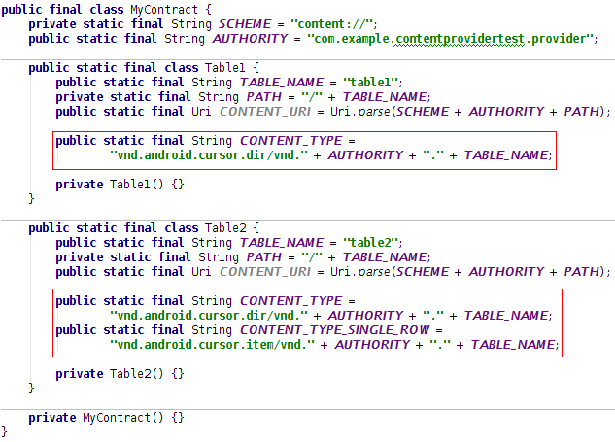
Developing a Custom Content Provider...
Content type defined in the contract class:

Slide 51
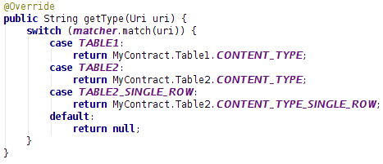
Developing a Custom Content Provider...
getType() method in the provider class:

Slide 52
Developing a Custom Content Provider...
We need to declare the provider in the manifest.xml file:

Slide 53
Developing a Custom Content Provider...
Finally, we need to define permissions for applications who wish to access the provider.
Different forms of permissions:
Single read-write provider-level permission
One permission that controls both read and write access to the entire provider, specified with the android:permission attribute of the <provider> element in manifest.xml.
Separate read and write provider-level permission
A read permission and a write permission for the entire provider.
Specified with the android:readPermission and android:writePermission attributes of the <provider> element.
They take precedence over the permission required by android:permission.

Slide 54
Path-level permission
Read, write, or read/write permission for a content URI in your provider.
You specify each URI you want to control with a <path-permission> child element of the <provider> element.
Temporary permission
A permission level that grants temporary access to an application, even if the application doesn't have the permissions that are normally required.

Slide 55
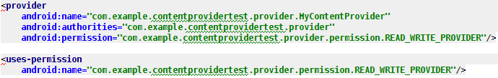
Developing a Custom Content Provider...
Permission defined in manifest.xml of the provider:
Permission defined in manifest.xml of the user:

Slide 56
Processes and Threads
If an application component starts and there already exists a process for that application (because another component from the application exists), then the component is started within that process and uses the same thread of execution.

Slide 57
Processes
The following list presents the different types of processes in order of importance (the first process is most important and is killed last):
Foreground process → onResume().
Visible process → onPause().
Service process → startService().
Background process → onStop().
Empty process →doesn't hold any active application components.

Slide 58
Threading in Android
Threads in the same VM interact and synchronize by the use of shared objects and monitors associated with these objects.
There are basically two main ways of having a Thread execute application code.
One is providing a new class that extends Thread and overriding its run() method.
The other is providing a new Thread instance with a Runnable object during its creation.
In both cases, the start() method must be called to actually execute the new Thread

Slide 59
Threads share the process' resources but are able to execute independently.
Applications responsibilities can be separated
main thread runs UI, and
slow tasks are sent to background threads.
Particularly useful in the case of a single process that spawns multiple threads on top of a multiprocessor system. In this case real parallelism is achieved.
Consequently, a multithreaded program operates faster on computer systems that have multiple CPUs.

Slide 60
Multithreading Via AsycTask
Using the AsyncTaskClass
AsyncTaskenables proper and easy use of the UI thread.
This class allows to perform background operations and publish results on the UI thread without having to manipulate threads and/or handlers.
An asynchronous task is defined by a computation that runs on a background thread and whose result is published on the UI thread.
An asynchronous task is defined

Slide 61
Using the AsyncTaskClass

Slide 62
Multithreading Via Handler
Handler allows you to send and process Messageand Runnableobjects associated with a thread's MessageQueue
Each Handler instance is associated with a single thread and that thread's message queue
(1) to schedule messages and runnablesto be executed as some point in the future; and
(2) to enqueuean action to be performed on a different thread than your own.
Post(Runnable) & sendMessage(Message)

