Slide 1
Vezbe08

Slide 2
z1
Draw a use case diagram for a ticket distributor for a train system. The system includes two actors: a traveler,
who purchases different types of tickets, and a central computer system, which maintains a reference database
for the tariff.
Use cases should include:
BuyWeeklyCard, BuyOneWayTicket, BuyMonthlyCard, UpdateTariff
Also include the following exceptional cases:
TransactionAborted DistributorOutOfChange Time-Out DistributorOutOfPaper

Slide 3
z2
Given the following assertions for a relational database that represents the current term enrollment at a
large university, draw an UML diagram for this schema that takes into account all the assertions given.
There are 2000 instructors, 4000 courses, and 30,000 students. Use as many UML constructs as you can
to represent the true semantics of the problem.
Assertions:
An instructor may teach none, one, or more courses (average is 2.0 courses)
An instructor must advise the research of at least one student (average = 2.5 students)
A course may have none, one, or two prerequisites (average = 1.5 prerequisites)
A course may exist even if no students are currently enrolled
All courses are taught by only one instructor.
The average enrollment in a course is 30 students.
A student must select at least one course per term (average = 4.0 course selections).

Slide 4
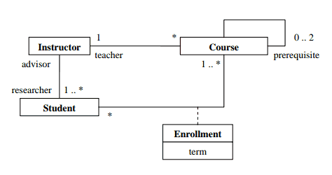

Slide 5
z3
Draw UML class diagrams for a car rental agency database (e.g. Hertz), keeping track of current rental location of each car, its current condition and history of repairs, and customer information for a local office, expected return date, return location, car status (ready, being-repaired, currently rented, being-cleaned). Select attributes from your intuition about the situation.
Draw one diagram showing the relationships of the classes without the attributes listed. Then show each class individually with the attributes listed.

Slide 6
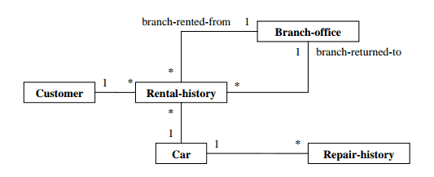

Slide 7
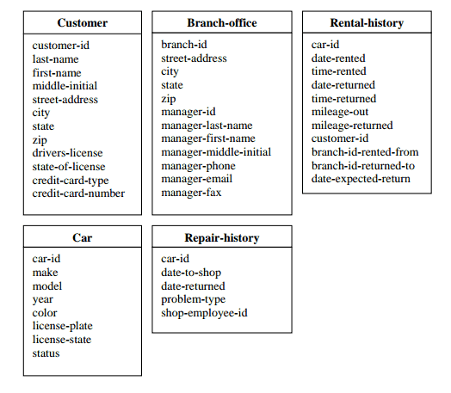

Slide 8
z4
Draw a class diagram for bibliographic references.
• An abstract class Publication
• A many to many relationship between Author and publication
• At least three or more concrete classes reﬁning Publication
• At least one aggregation relationship

Slide 9
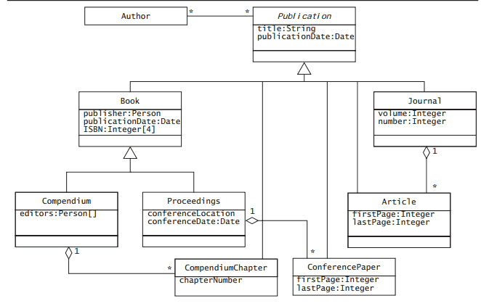

Slide 10
z5
Draw a detailed ER diagram for an car rental agency database (e.g. Hertz), keeping track of current rental location of each car, its current condition and history of repairs, and customer information for a local office, expected return date, return location, car status (ready, being-repaired, currently-rented, being-cleaned). Select attributes from your intuition about the situation, and list themseparately from the diagram, but associated with a particular entity or relationship in the ER model.

Slide 11
Game Design patterns
Sequencing Patterns
Double Buffer
Game Loop
Update Method
…

