Slide 1
Nefunkcionalni zahtevi
i vi

Slide 2
Zahtevi na nivou koda
Testabilnost
Performanse
Skalabilnost
Izdržljivost

Slide 3
Odabir baze
SQL baze
Standardizacija
Jednostavan relacioni model
Snažan SQL
ACID
NoSQL, document-based
Manja stabilnost, 0 standarda
Lakoća podešavanja i korišćenja

Slide 4
JSON over HTTP
Json standard http://www.json.org/
HTTP requests (GET, PUT, DELETE…)
primer:
https://ajax.googleapis.com/ajax/services/search/images?v=1.0&q=belgrade

Slide 5
CouchDB
DL:
https://couchdb.apache.org/#download
Bazirana na JSON dokumentima preko HTTP Rest servisa

Slide 6
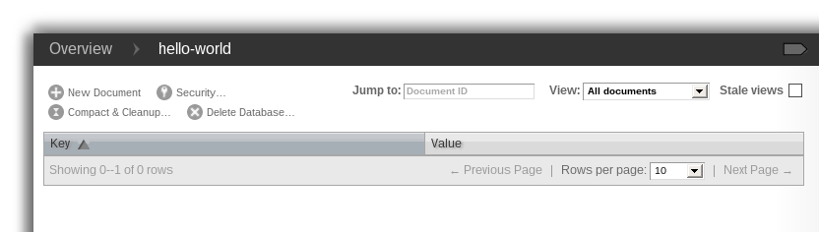
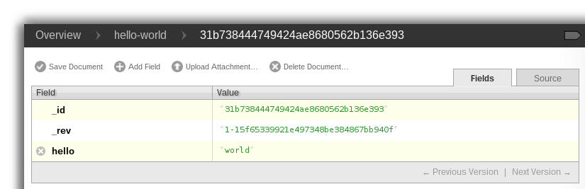
CouchDB
Grafički interfejs:
http://127.0.0.1:5984/_utils/

Slide 7
CouchDB
GET http://127.0.0.1:5984/{imeBaze}/{id}
GET http://127.0.0.1:5984/hello-world/00a271787f89c0ef2e10e88a0c0001f4
{
"_id": "00a271787f89c0ef2e10e88a0c0001f4",
"_rev": "1-2628a75ac8c3abfffc8f6e30c9949fd6",
"hello":"world”
}

Slide 8
MySQL
“Considering MySQL? Use something else. Already on MySQL? Migrate. For every successful project built on MySQL, you could uncover a history of time wasted mitigating MySQL's inadequacies, masked by a hard-won, but meaningless, sense of accomplishment over the effort spent making MySQL behave.”
http://grimoire.ca/mysql/choose-something-else

Slide 9
Usability zahtevi
Learnability
Efficiency
Memorability
Errors
Satisfaction

Slide 10
Zadatak1: Redizajn Twittera
Zahtevi:
Pristupačnost
Devices, native clients, crawlers
Brzina
Search, response time

Slide 11
Pristupačnost
Redizajn APIja, twitter.com je sada samo jedan klijent twitter APIja.
Back-end rendering umesto JS
Mustache http://mustache.github.io/

Slide 12
Mustache
Template:
<h1>{{header}}</h1>
{{#bug}}
{{/bug}}
{{#items}}
{{#first}}
<li><strong>{{name}}</strong></li>
{{/first}}
{{#link}}
<li><a href="{{url}}">{{name}}</a></li>
{{/link}}
{{/items}}
{{#empty}}
<p>The list is empty.</p>
{{/empty}}
Data:
{ "header": "Colors",
"items": [ {"name": "red", "first": true, "url": "#Red"},
{"name": "green", "link": true, "url": "#Green"},
{"name": "blue", "link": true, "url": "#Blue”}],
"empty": false }
Output:
<h1>Colors</h1>
<li><strong>red</strong></li>
<li><a href="#Green">green</a></li>
<li><a href="#Blue">blue</a></li>

Slide 13
Brzina
Prelazak sa MySQLa na Lucene search tehnologije
http://lucene.apache.org/
Prelazak sa Ruby-On-Rails monolitne web aplikacije na distribuiranu Javu
http://netty.io/ Netty server framework
Threadovi threadovi threadovi

