Slide 1
FOSS4GIS 2026
Spatial Risk Assessment
of Heavy Metal Pollution
in Serbian Surface Waters
GIS · Multi-Criteria Decision Analysis · Spatial Statistics · QGIS
Jelena Lukić
Environmental Scientist | Independent GIS Analyst · City Institute of Public Health, Belgrade
Notes:
Good morning everyone. My name is Jelena Lukić. I am an Environmental Scientist at the City Institute of Public Health in Belgrade and an independent GIS Analyst. Today, I will show you how GIS, multi-criteria analysis, and spatial statistics can help transform routine surface water monitoring data into actionable environmental intelligence.

Slide 2



Why This Matters
More data, not more answers
Where exactly is the problem?
Pass/fail is not enough
Serbia collects water quality data from dozens of stations every year. But having numbers and understanding what they mean spatially are two very different things.
Standard monitoring tells us if a station crossed a limit. It does not tell us where risk is concentrated, how it spreads, or whether it is getting worse.
A simple yes/no answer misses gradients between stations, changes over time, and how pollution moves from one part of a river system to another.
Notes:
Water quality monitoring generates a huge amount of data every year. In Serbia, we have dozens of monitoring stations, and similar programs exist across Europe. The problem is that traditional monitoring mainly checks compliance. To be precise, did a station exceed a limit or not? But environmental risk is not that simple. Pollution doesn't happen in isolation. It varies across space, changes over time, and is influenced by different factors. So we end up with a lot of data, but not a clear picture of where risk is actually concentrated. Environmental monitoring tells us what is happening. GIS helps us understand where and why.

Slide 3
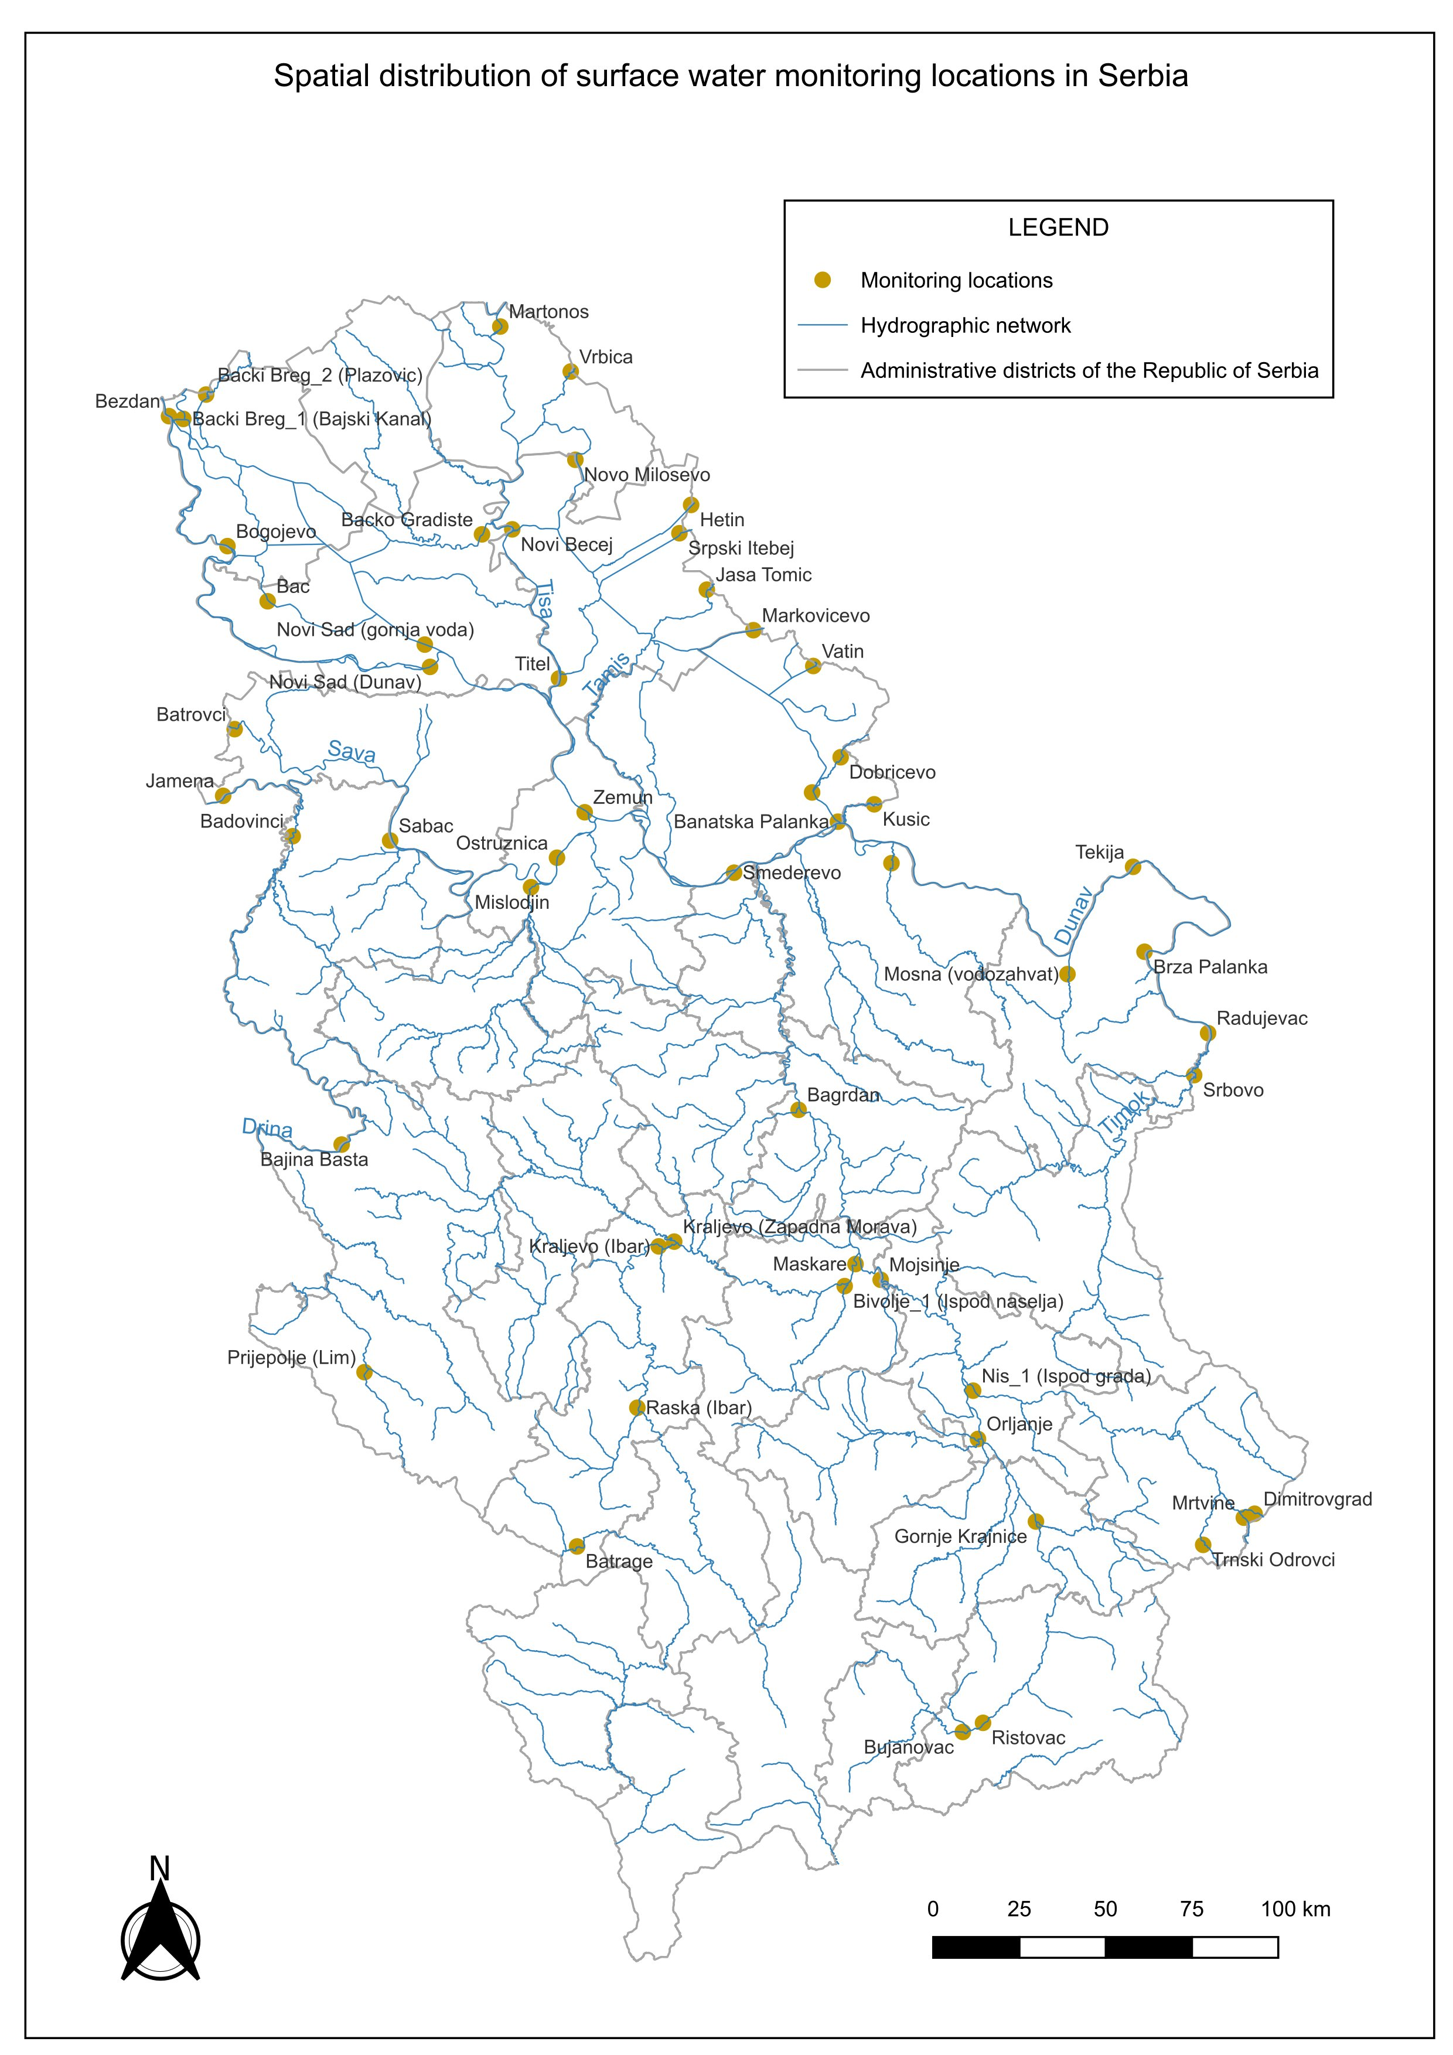
Study Area & Data
54
Monitoring Stations
3
Heavy Metals
5
Years (2019–2023)
Cd
Cadmium
Highly toxic, accumulates in kidneys over time. One of the most tightly regulated metals under the EU Water Framework Directive.
Pb
Lead
A potent neurotoxin that binds to river sediments and persists for decades. Closely linked to legacy mining and industrial activity.
Ni
Nickel
Harmful at relatively low concentrations. Enters rivers mainly through mining runoff, industrial effluents, and urban stormwater.
River systems: Danube · Sava · Drina · Velika Morava · Južna Morava · Tisa · Tamiš · Timok
Notes:
For this study, data from 54 monitoring stations across Serbia was used, covering the period from 2019 to 2023. The stations cover eight major river systems. Three heavy metals were analyzed: cadmium, lead, and nickel. These metals were selected because they are priority pollutants under both Serbian and European legislation. They are routinely monitored across the national network and represent different types of environmental pressures. Despite these differences, they share several important characteristics: they are persistent, toxic, and can accumulate in aquatic ecosystems. Because of these properties, they represent an important environmental concern. However, knowing the concentration of a pollutant is only part of the story.

Slide 4


How the Method Works
1
2
3
4
5
Monitoring
Data
Calculate
Indexes
Weight &
Combine
Risk
Surface
Find
Clusters
▶
▶
▶
▶
54 stations · 5 yrs
4 different views
AHP method
One combined map
Getis-Ord Gi*
From individual measurements → a spatial picture of where risk is high, why, and how it clusters
Notes:
The method has five steps. Starting from raw monitoring data, four risk indexes were calculated, AHP weighting was applied, everything was combined into one risk map, and finally spatial clustering analysis was performed. Each step builds on the previous one, moving from raw numbers to a structured understanding of risk. The result is not just a list of polluted stations. It is a framework for understanding environmental risk as a spatial phenomenon.

Slide 5




Four Ways to Look at Pollution Risk
Total Pollution Load
Bioavailability
How much pollution is there?
How dangerous is it to living things?
The total amount of cadmium, lead, and nickel at each station, combined into one score. A simple but essential starting point — how heavy is the overall burden at this location?
Not all pollution in the water is equally harmful. Some metals are locked in forms that fish and insects cannot absorb. This index measures only the fraction that can actually enter the food chain.
Trend Over Time
Regulatory Risk
Is it getting better or worse?
How often are legal limits broken? · Weight: 49%
How did metal levels change from 2019 to 2023? A location with moderate pollution that is steadily getting worse needs attention sooner than one with higher levels that are stable or improving.
How frequently and how severely does each station exceed the limits set by Serbian and EU law? This carries the highest weight — because breaking legal limits is what triggers management action.
Notes:
No single indicator can capture environmental risk. That is why I combined four complementary dimensions.
The first is Total Pollution Load -it answers the question: how much pollution is there overall?
The second is Bioavailability how dangerous is it actually to living things?
The third is Trend Over Time — is it getting better or worse?
And the fourth is Regulatory Risk — how often are legal limits broken?
Each one answers a different question. Together, they give a complete picture that no single measurement could provide.

Slide 6
How I Weighted the Four Indexes (AHP)
Regulatory risk carries the most weight — breaking legal limits triggers real-world action.
Consistency Ratio = 0.022
(well below the 0.10 threshold)
Weights are logical and valid.
IIR = 0.239×TPI + 0.086×BI
+ 0.153×IT + 0.522×RRI
Final risk score per station.
Notes:
AHP was used to assign weights to the four indexes based on their relative importance. Regulatory risk carries the most weight at 49%, because breaking legal limits is what triggers real-world action. AHP also includes a built-in consistency check. The Consistency Ratio was 0.022, well below the 0.10 threshold. This confirms the weights are logical and valid. The final Integrated Risk Index is calculated as a weighted sum of all four indexes, combining pollution load, bioavailability, trend, and regulatory risk into one score for each station. But before showing the final map, let's look at each index individually.

Slide 7
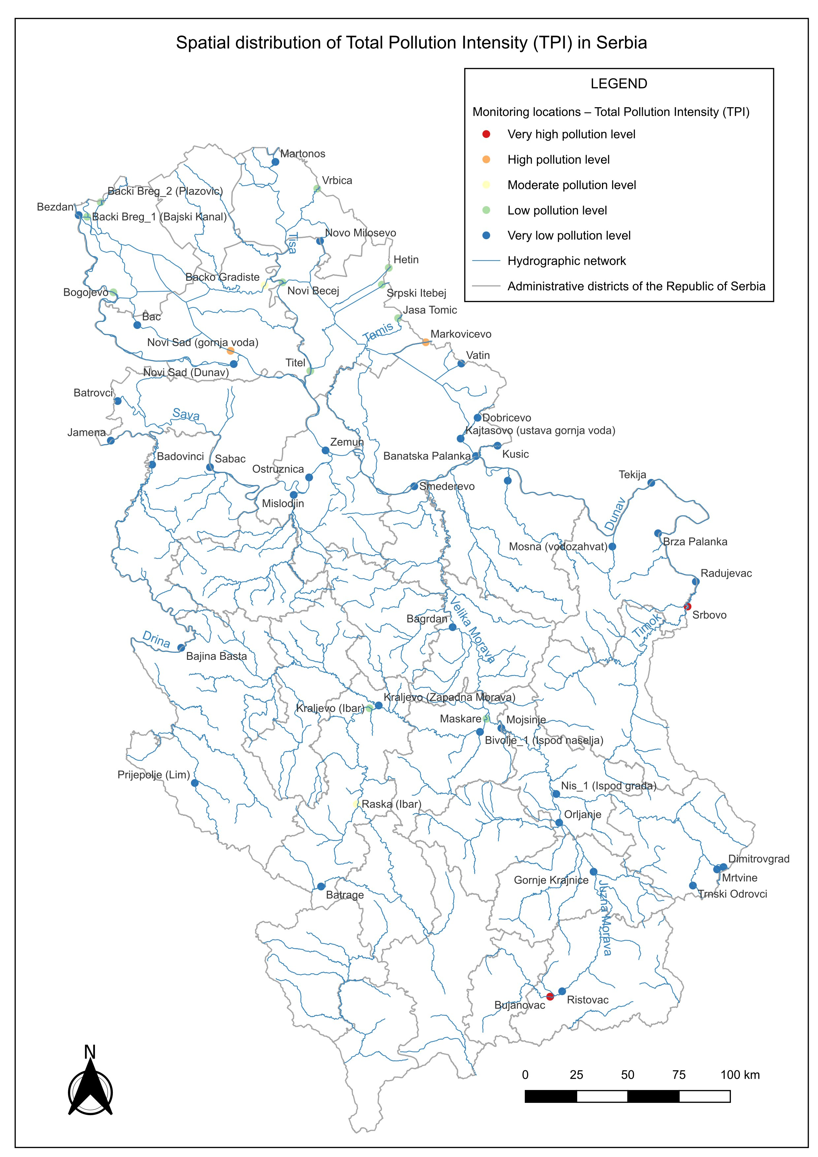
Total Pollution Load
How much pollution is there?
Five stations carry most of the burden
Srbovo, Bujanovac, Novi Sad (gornja voda), Markovićevo, and Bačko Gradište lead the ranking. The gap between these five and the rest of the network is striking.
Most stations are actually in good shape
Most monitoring locations fall in the Very Low class. Heavy pollution is concentrated in just a few places, not spread evenly across the country.
North and south tell very different stories
High pollution levels in Vojvodina reflect diffuse agricultural loading. In the south, the highest values are linked to old mining areas.
Notes:
Pollution is not spread evenly across Serbia. It is concentrated in a small number of locations — Srbovo, Bujanovac, Novi Sad (gornja voda), Markovićevo, Bačko Gradište — while most of the network is actually in good condition. Most stations are clean. Just a few carry almost all the pollution.

Slide 8
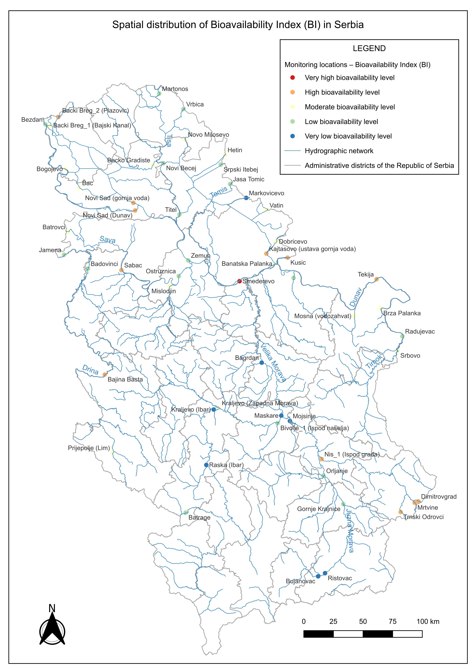
Bioavailability
How dangerous is it to living things?
Smederevo stands far above the rest
Top five: Smederevo, Mrtvine, Tekija, Trnski Odrovci, Bački Breg 2. Smederevo's score is in a league of its own — dissolved metal fractions released near the steel plant.
High load does not always mean high danger
Several stations with moderate total pollution scores turn out to have high bioavailability. The total load alone would have missed this.
The Ibar catchment: contaminated but less ecologically active
Despite elevated metal concentrations, most metals along the Ibar are locked in stable sediment-bound forms that organisms cannot easily take up.
Notes:
Ecological risk does not always follow total concentration.
Smederevo has the least favorable class — not because of high total metal concentrations, but because the metals there are present in dissolved forms that living organisms can actually absorb.
A station can look moderate on the previous map and be the most ecologically relevant one on this map. That is exactly why this index matters.

Slide 9
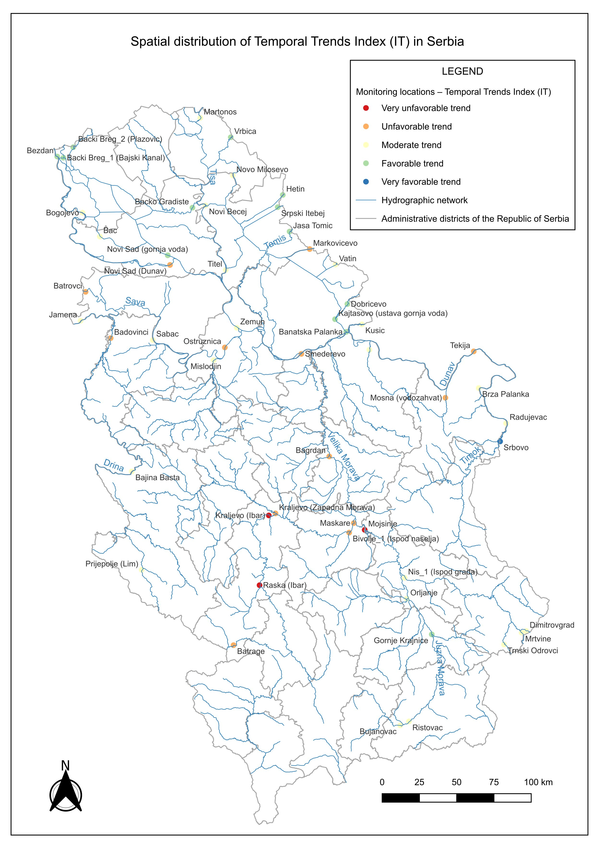
Trend Over Time
Is pollution getting better or worse?
The Ibar valley shows the strongest negative trend
Kraljevo (Ibar), Mojsinje, and Raska (Ibar) show the strongest negative trends, followed by Bagrdan and Maskare. All five showed acceptable levels in 2019. By 2023, the situation had changed significantly.
Srbovo is the one clear success story
Despite the highest total pollution load in the network, Srbovo is the only station with a Very Favorable trend. Concentrations are coming down.
Most of the network is holding steady
More than half of all stations show moderate or favorable trends. The problem is not country-wide — it is concentrated in specific locations.
Notes:
Some of the most important locations are not the most polluted ones. They are the ones getting worse. Kraljevo (Ibar), Mojsinje, and Raska (Ibar) show the strongest worsening between 2019 and 2023. And the most surprising finding: Srbovo, the most polluted station in the network, is the only one showing a clearly improving trend. Risk and trend can move in completely opposite directions.

Slide 10
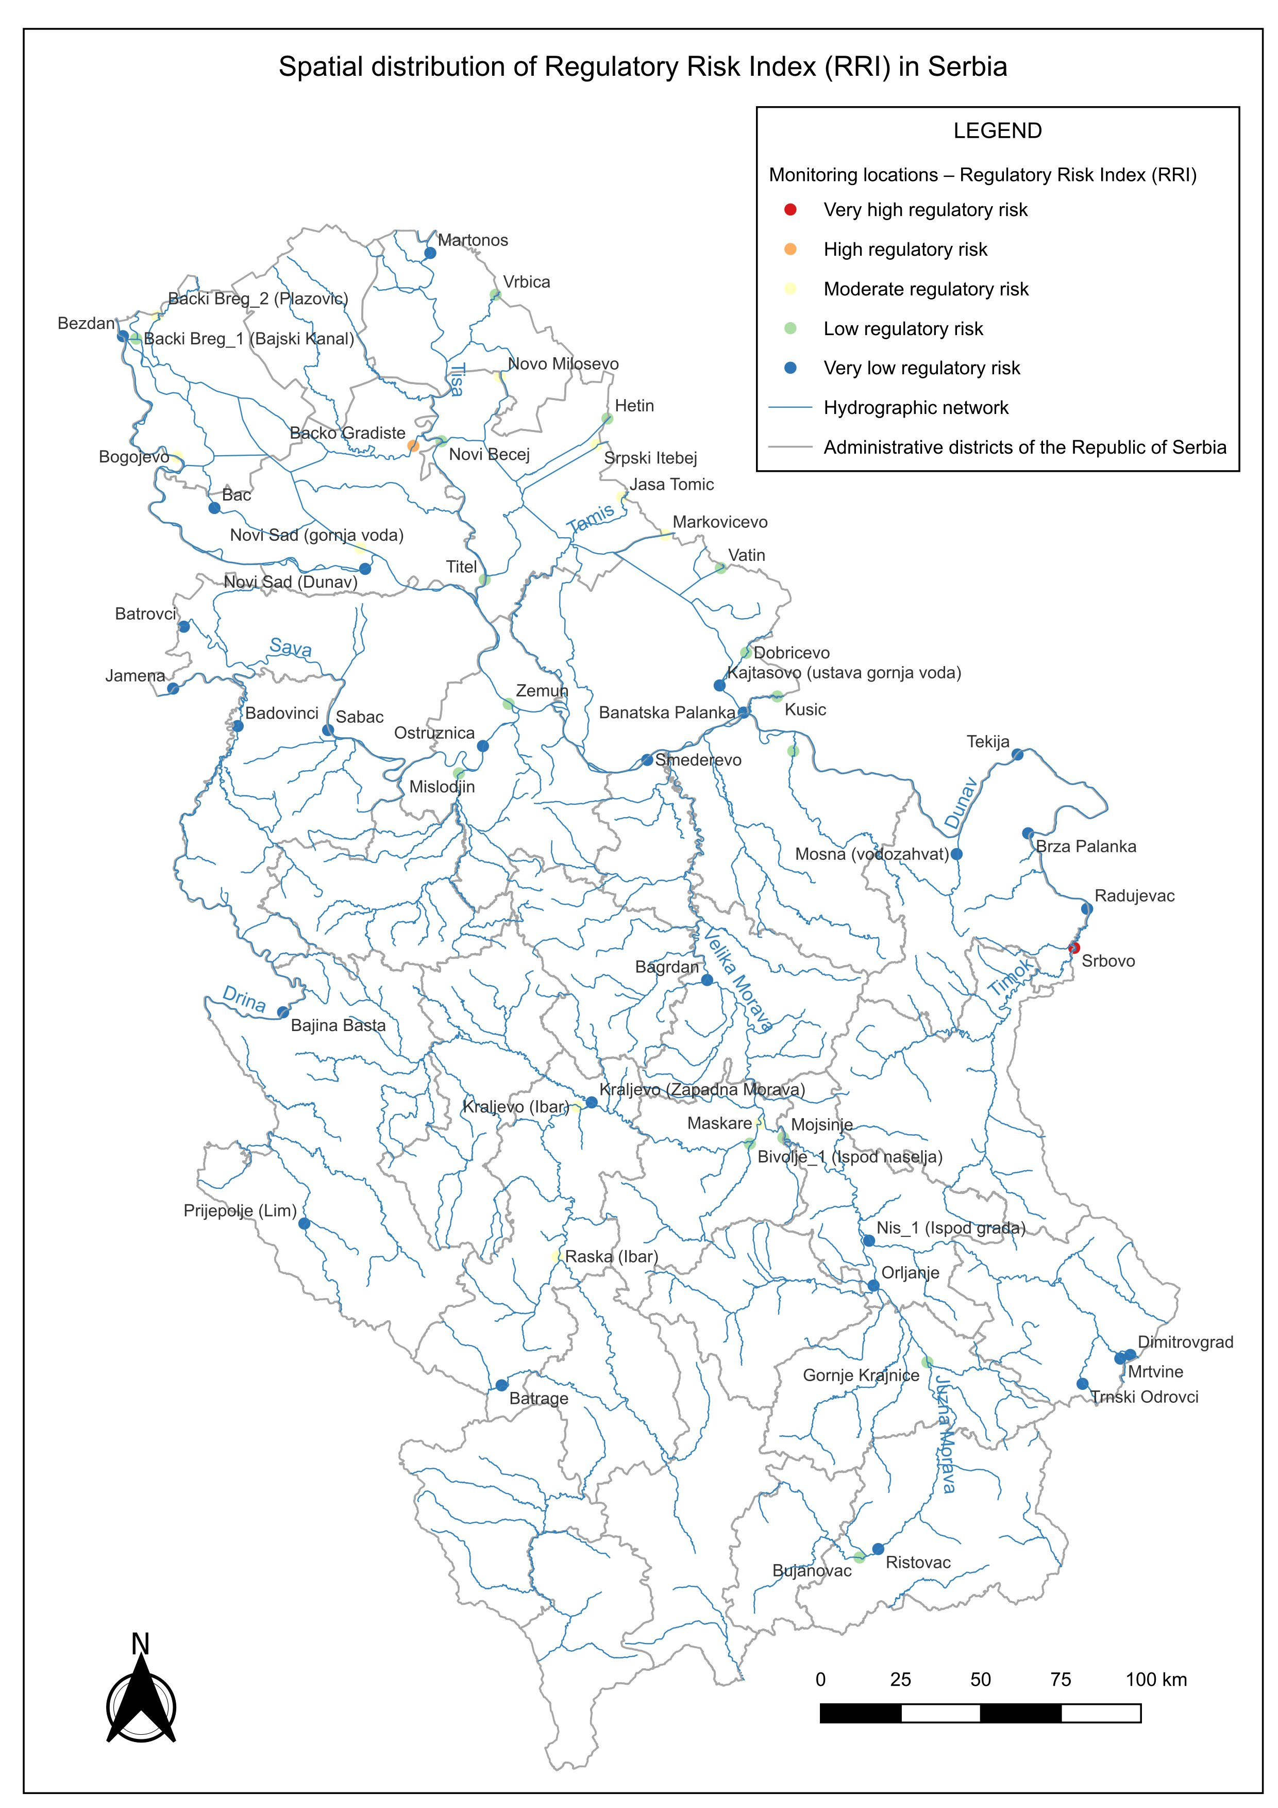
Regulatory Risk
How often are legal limits broken? · Weight: 49%
Srbovo has broken legal limits in almost every cycle
With a score of 1.0 — the maximum — Srbovo exceeded water quality standards in nearly every measurement over five years. Top five: Srbovo, Bačko Gradište, Raska (Ibar), Markovićevo, Jaša Tomić.
Two very different problems at the top
Srbovo's exceedances come from mining on the Timok. Bačko Gradište has persistent nickel problems from the canal network in Vojvodina. Same score, very different problem.
This index shapes the final risk map most strongly
Because regulatory risk carries 49% of the AHP weight, where it is high, the combined risk score follows.
Notes:
Compliance pressure is the dominant driver of overall risk, and this map shows why. Srbovo scores 1.0, the maximum. Legal limits were broken in almost every measurement cycle over five years. Srbovo and Bačko Gradište are both at the top of this ranking, but through completely different mechanisms. Mining on the Timok in one case. Nickel from the canal network in Vojvodina in the other. Same score, very different problem.

Slide 11
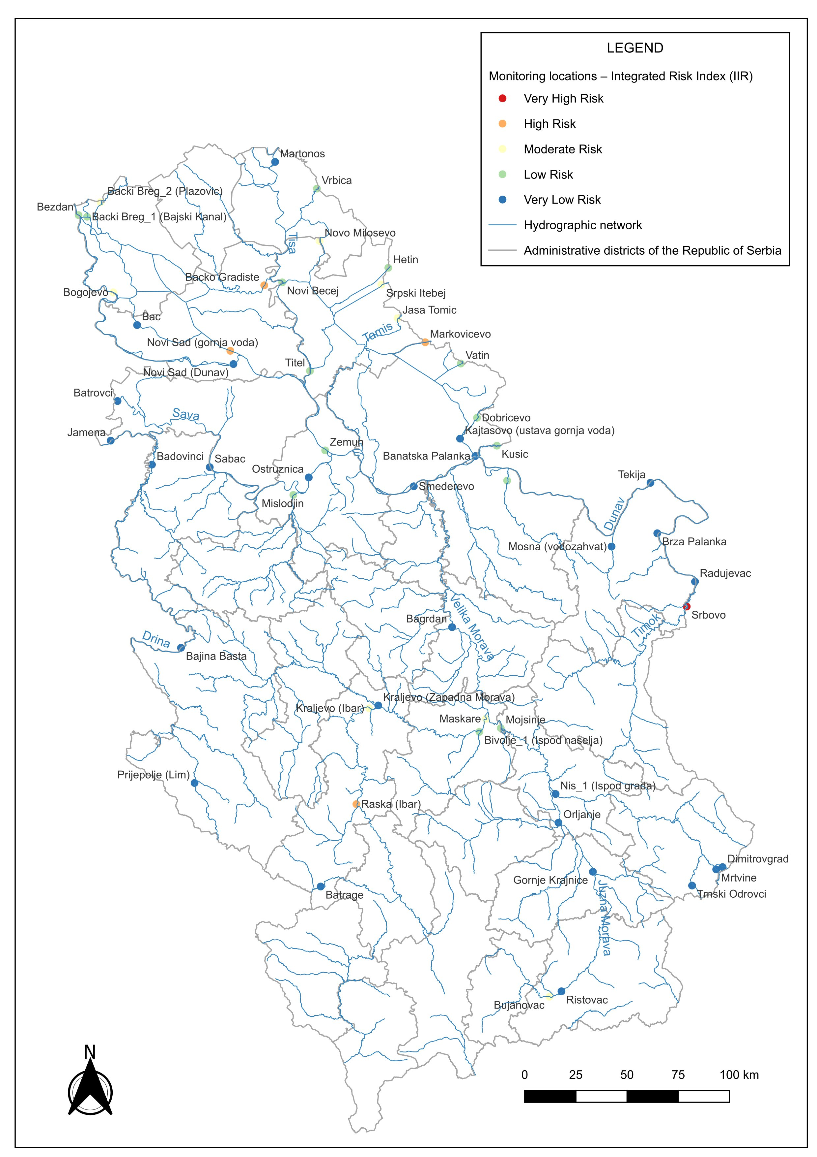
Combined Risk Index (IIR)
All four factors together
This is the central result of the whole analysis
The final combined risk map — a single map that combines pollution load, ecological relevance, temporal behavior, and regulatory pressure.
Most of Serbia appears low-risk
A small number of locations clearly emerge as priority areas — and each one got there for a different reason.
Each high-risk station got there a different way
Srbovo through mining and regulatory exceedances. Raska through a worsening trend. Smederevo through bioavailability.
Something no single index could have shown
This pattern only emerges when all four indexes are combined into one synthesized surface.
Notes:
This is the central result of the whole analysis. The final combined risk map. A single map that combines pollution load, ecological relevance, temporal behavior, and regulatory pressure. Most of Serbia appears low-risk. But a small number of locations clearly emerge as priority areas, and each one got there for a different reason. That is something no single index could have shown.

Slide 12
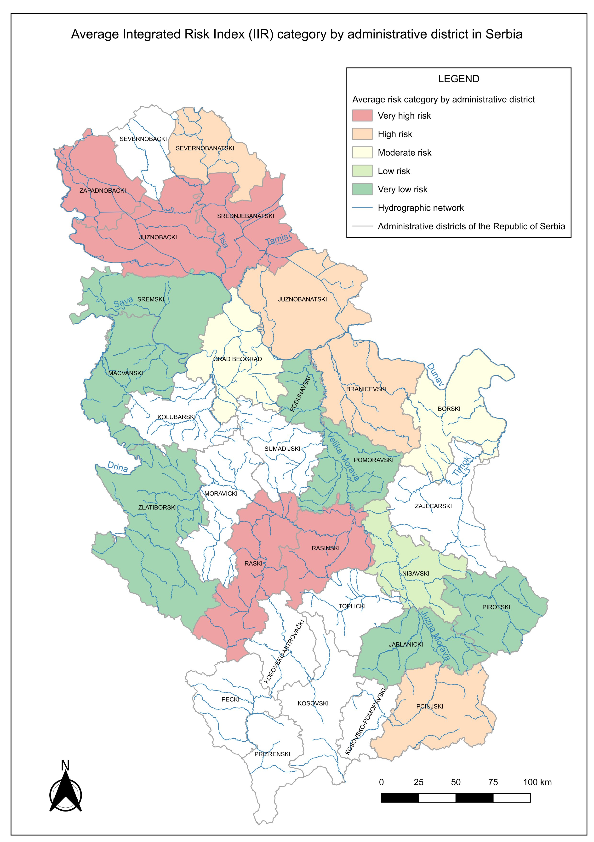
When Averages Hide the Problem
District averages can hide extreme local values.
The average has completely erased the worst station in the network.
Borski district — a clear example
The district average falls in the low risk category. Yet Srbovo, inside that district, has the highest Integrated Risk Index in the whole country.
Raška & Rasinski districts
Mining-related point sources dominate at the station level, but the district average smooths them into something that looks merely moderate.
Vojvodina (north)
Agricultural loading raises the district average — while cleaner stations within the same area disappear into that same number.
The policy consequence
Environmental funding built on district averages will systematically miss the places that need help most.
Notes:
This map shows what happens when we look at districts instead of individual stations.
Most districts look moderate or low risk, which is manageable.
But look at Borski district. The district average falls in the moderated risk category. And yet Srbovo, which sits inside that district, has the highest Integrated Risk Index in the whole country.
The average has completely erased the station with the highest integrated risk in the network.
This is why we must be very careful when interpreting results based on average values.

Slide 13
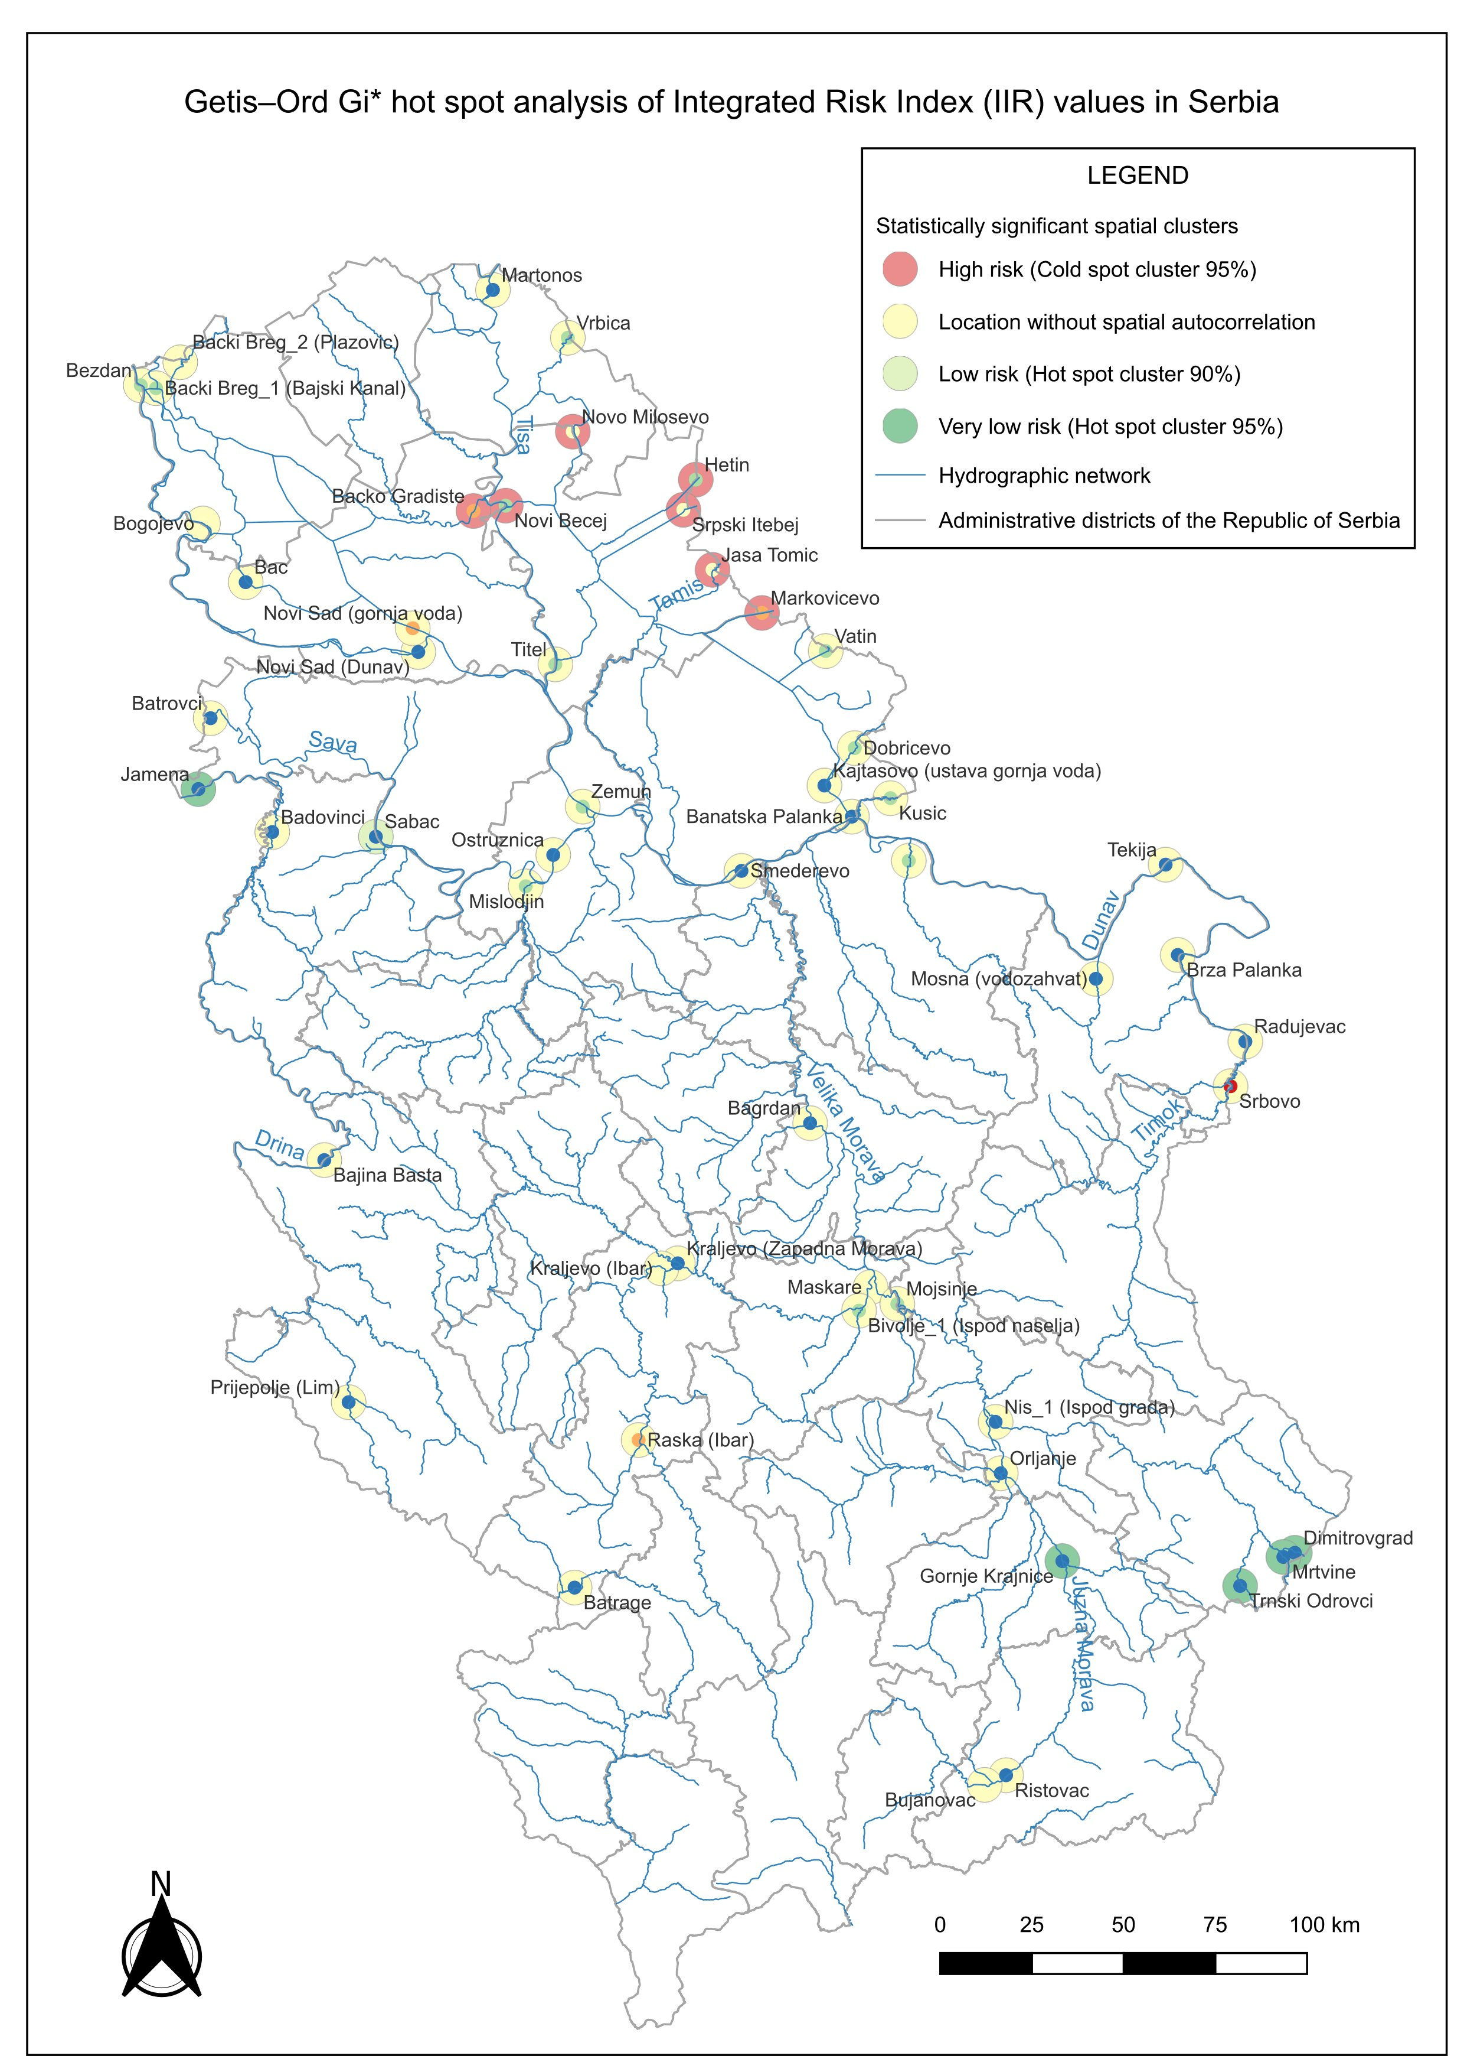
Are High-Risk Stations Clustered in Space?
Cold Spots = High Risk Clusters
7 stations · Banat region · 95% confidence
Seven stations in the Banat share elevated risk AND their neighbors are also elevated. A regional problem driven by agriculture and industry — needs a regional response.
Hot Spots = Low Risk Clusters
5 stations · Southeast Serbia · 95% confidence
Five stations near Dimitrovgrad form the cleanest cluster in the network. Stable, uncontaminated conditions — valuable reference points for the whole monitoring system.
Spatial Outlier — Isolated Extreme
Srbovo · Very High risk · no high-risk neighbors
The most polluted station in Serbia — but surrounded by clean water. A local mining point source on the Timok. Needs a completely different response than the Banat cluster.
77.8% of stations show no significant spatial clustering — each one needs to be understood on its own terms
Notes:
This map shows whether monitoring stations with similar risk levels tend to group together or are spread out randomly.
Quick note, a Cold Spot means high-risk monitoring locations grouped together. A Hot Spot means low risk grouped together.
Seven stations form a Cold Spot — a high-risk cluster driven by shared agricultural and industrial pressure. A regional problem that needs a regional response.
Five stations form a Hot Spot — the cleanest cluster in the network. Important reference points.
And then there is Srbovo again. The highest integrated risk in the country, but completely isolated. No cluster around it. A local problem that needs a completely different response than the Cold spot cluster.
Not all high-risk locations require the same response. Some are regional problems. Others are local problems. Getis-Ord Gi* is what tells us the difference.
77.8% of stations show no significant spatial clustering at all. Each one needs to be understood on its own terms.

Slide 14


Why AHP + Getis-Ord Gi*?
AHP
Getis-Ord Gi*
“How risky is this location?”
“Does that risk form a pattern?”
Gives each station an absolute risk score — Class 1 to 5 — based on pollution load, bioavailability, trend, and regulatory risk.
Tells us whether a high-risk location is part of a wider cluster, or stands alone as an isolated case.
Answers: WHERE is risk high?
Answers: WHAT KIND of problem is it?
Together: not just WHERE risk is high, but WHAT KIND of problem it is — and what response it needs.
Notes:
AHP and Getis-Ord Gi* answer two different questions. AHP tells us how risky a location is, on its own. Getis-Ord Gi* tells us whether that risk forms a spatial pattern. Whether a location is part of a wider cluster, or stands alone. Together, they tell us not just where risk is high, but what kind of problem it is and what kind of response it needs.

Slide 15
Assumptions, Constraints & Future Directions
Current Constraints
Future Directions
Network covers urban/industrial zones more than rural areas
Expand spatial coverage
Only 5 years — not enough for long-term patterns
Extend time series
Only 3 metals — other pollutants outside scope
Include more pollutant groups
AHP weights — expert-based, not statistically derived
Test weights & add ML prediction
These constraints do not invalidate the framework — they define its scope and give a clear roadmap for what comes next.
Notes:
Before concluding, a few words about the scope of this work. The monitoring network covers urban and industrial zones more than rural areas. Five years is not enough for long-term patterns. Only three metals were included, and the AHP weights are expert-based. But these constraints do not invalidate the framework. They define its scope and give a clear roadmap for the future. Future directions include expanding spatial coverage, extending the time series, including more pollutant groups, and exploring machine learning for prediction at unmonitored locations.

Slide 16

Open Source Perspective
Transparent
Reproducible
Every step is visible. There are no hidden calculations inside a proprietary black box.
Anyone can take this workflow and run it themselves, and verify the results.
Adaptable
Open science
The same framework can be applied to other regions, other pollutants, other time periods.
QGIS
Open-source GIS is not just a practical choice. It is a commitment to open, verifiable, and accessible science.
Notes:
One more thing. Everything you have seen today was done with open-source tools, entirely in QGIS. This means the workflow is transparent. Every step is visible. It is reproducible. Anyone can take this workflow and run it themselves. And it is adaptable. The same framework can be applied to other regions and other pollutants. Open-source GIS is not just a practical choice. It is a commitment to open, verifiable, and accessible science.

Slide 17

Conclusions
Environmental monitoring tells us what is happening.
Spatial analysis tells us where it matters.
And when we combine the two, we move beyond reporting environmental problems and begin to understand their spatial structure.
That understanding is essential for effective environmental management. And that, ultimately, is the value of GIS.
Thank you — Questions welcome
Notes:
Environmental monitoring tells us what is happening. Spatial analysis tells us where it matters. And when we combine the two, we move beyond reporting environmental problems and begin to understand their spatial structure. That understanding is essential for effective environmental management. And that, ultimately, is the value of GIS. Thank you very much. I am happy to take any questions.

