Slide 1

Online Grading System - Group Project – Jelena Budakovic, Bianca Stancu, Davide Matteri

Slide 2

Description
Online grading system for universities
Students anonymously submit a form with how they want to grade their team members (for group works)
The professor submits a grade for the group work
Individual grades are computed base on the average between professor’s feedback and group member’s feedback.

Slide 3
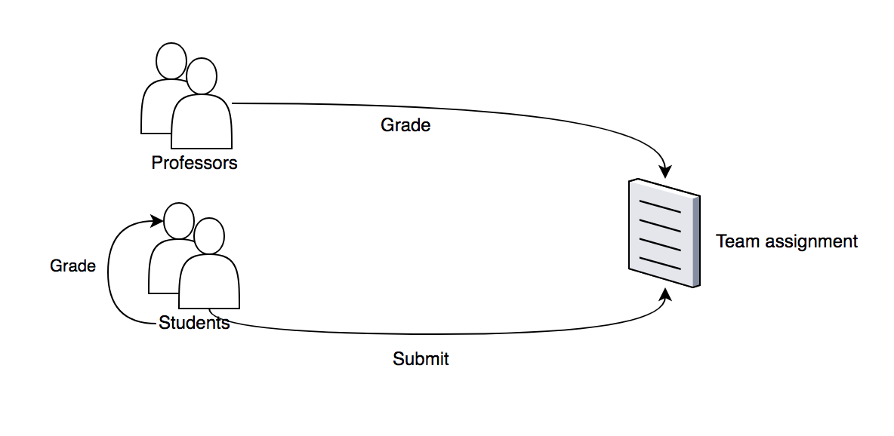
USE CASE

Slide 4
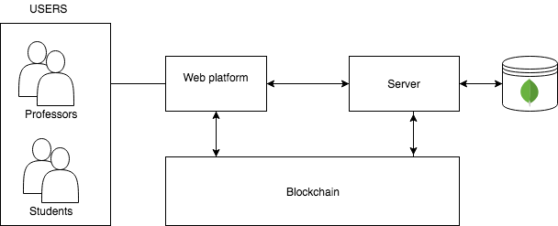
Proposed architecture

