Slide 1
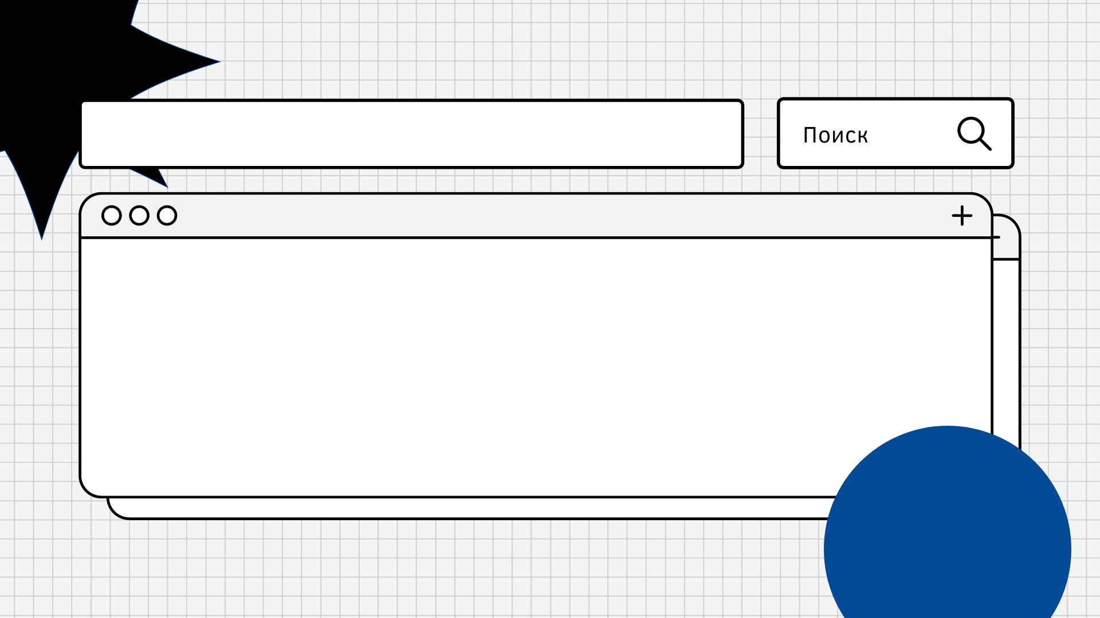
Cyberstalking

Slide 2

Being a victim of stalking in the outside world is frightening, but we often feel a sense of safety once we get home and are able to lock the door behind us. Cyberstalking allows an abuser to circumvent physical barriers and invade a victim’s life from a distance. Cyberstalkers are well versed in hiding on the internet as well as covering their tracks, making reporting and prosecuting cyberharassment challenging.

Slide 3
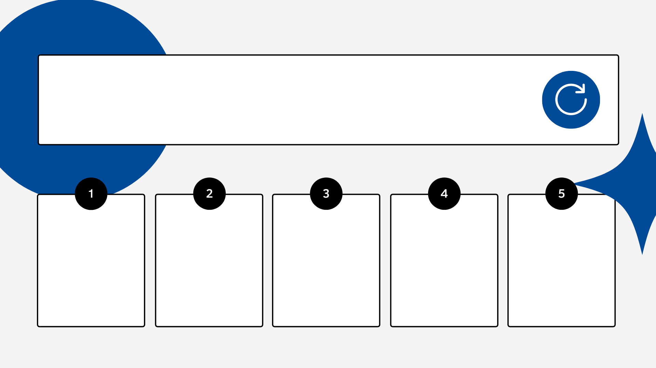
Types
Gender-based stalking
Of celebrities and public persons
By anonymous online mobs
Stalking by strangers
Of intimate partners

Slide 4
Signs you have a cyberstalker:
Receiving a lot of unwanted messages from the same person online.
You get inappropriate messages you didn’t ask for.
They try to disconnect you from family and friends.
You notice someone is posting rumors about you online.
Personal bank or social media accounts are hacked.
Pay attention to your account activity online and note when something or someone is acting odd. It might be a cyberstalker. If you receive repeated, unwanted communications, threats, or fear for yourself in any way, it’s time to take action.

Slide 5
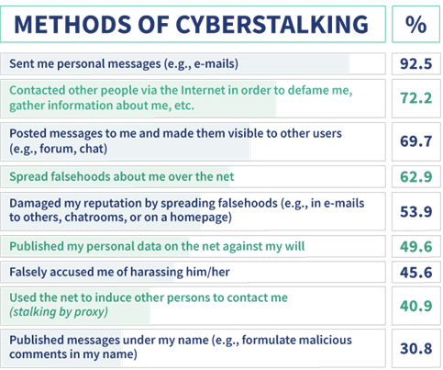
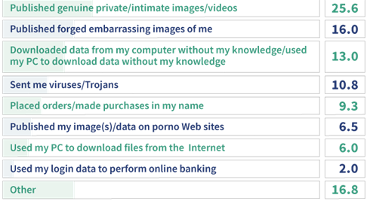

Slide 6
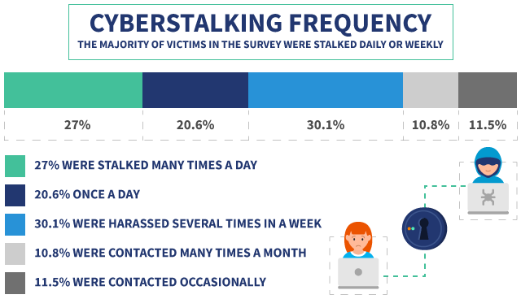

Slide 7
The Intent of Cyberstalkers
Those who choose to stalk or harass a victim online may be doing so for one or more of the following reasons:
To demean, embarrass or scare someone.
To track someone’s whereabouts without them knowing.
To try and “win back” an ex-partner through coercive efforts or threats. This is often seen with abusive ex-partners after a survivor has separated from them.
To damage a person’s reputation.
To get someone fired from a job or kicked out of school, sometimes as a form of financial control.
To make unwanted sexual advances.
To steal someone’s identity or impersonate them online.

Slide 8
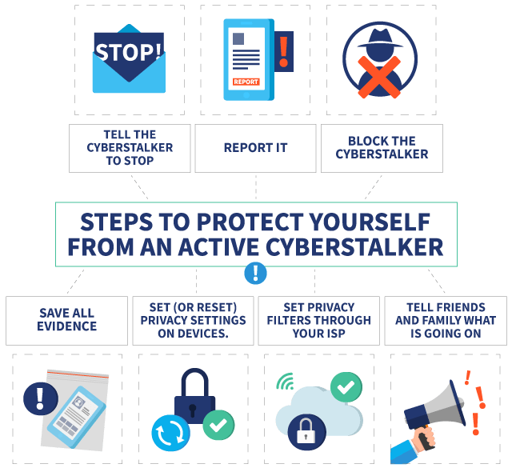

Slide 9
my friend's story
As a teenager, I often liked boys, with whom I could never have anything. That's why I very often arranged for myself a "detective game" About their lives, learning everything about them (like Marinette their Ladybug and super cat)
Fortunately, now my life is quite interesting and I understand that it’s not good to do this, but I don’t think that my “victims” actually suspected something. Back then there were no such terms.

