Slide 1
Leetcode 1
By Jeffrey Li

Slide 2
Some intro to Leetcode
Lots of programming problems
Some questions may involve unseen data structures and algorithms
Problem analysis and solving skills
https://leetcode.com/problemset/all/

Slide 3
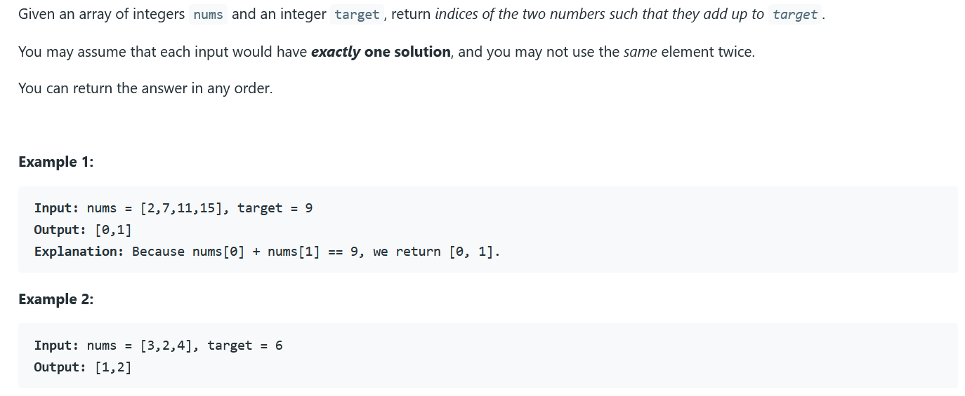

Slide 4
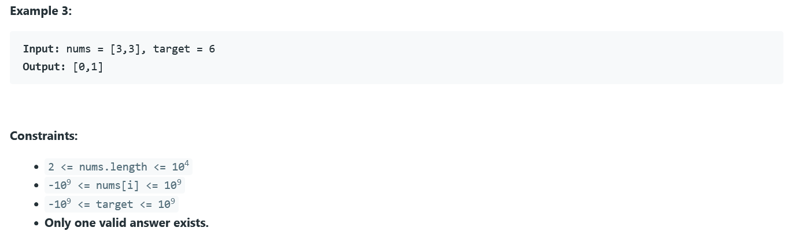

Slide 5
Brainstorm Time

Slide 6
The Easy Solution

Slide 7
Can we do better?

Slide 8
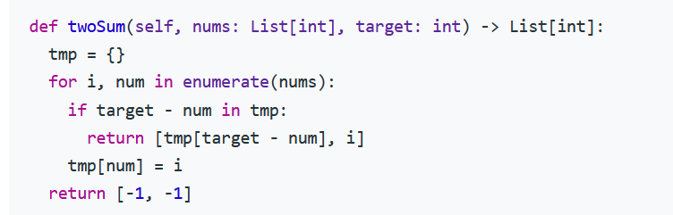
More involved solution
https://leetcode.com/problems/two-sum/

