Slide 1
reference slides

Slide 2
i. INTRODUCTION TO NAÏVE BAYES
Introduction to Problem
Multinomial Naïve Bayes Classifier
General Approach

Slide 3



Multinomial Naïve Bayes
ASSUMPTIONS: BAG OF WORDS MODEL
Conditional Independence
Positional Independence
Multinomial Distribution

Slide 4
ii. CHALLENGES AND METHODS USED
Pre-processing Data
Feature Selection
Building and Training Model
Validating Model

Slide 5
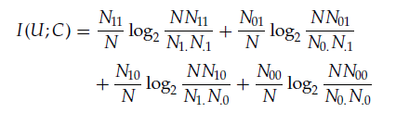

2. FEATURE SELECTION
MUTUAL INFORMATION SCORE
N_11 is the number of documents containing term (t) and is of class (c) .
N_01 is the number of documents not containing term (t) and is of class (c).
N_1. is the number of documents with term (t) irrespective of the class.

Slide 6
iII. Comparison OF PARAMETERS
Obtaining Metrics
Stemming vs Lemmatization
Feature Selection: With vs Without
Keeping Ties: With vs Without
Features vs Accuracy

Slide 7
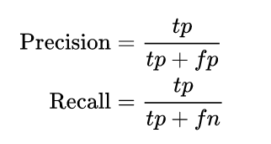
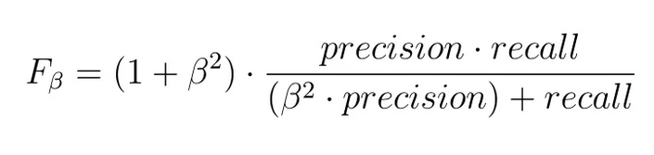

1. OBTAINING METRICS
Precision
Recall
F_Beta Score
Accuracy

Slide 8
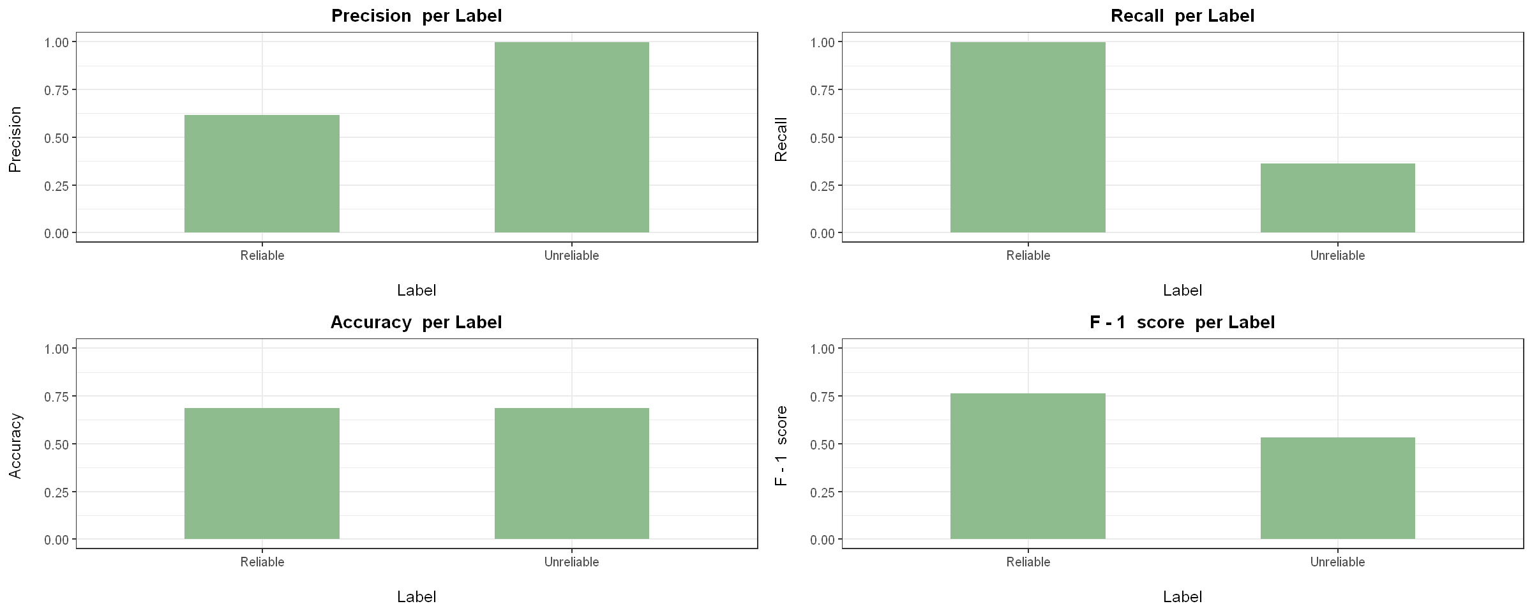
3. FEATURE SELECTION: WITH VS WITHOUT
STEM: 1, LEM: 0, FEAT: 0

Slide 9
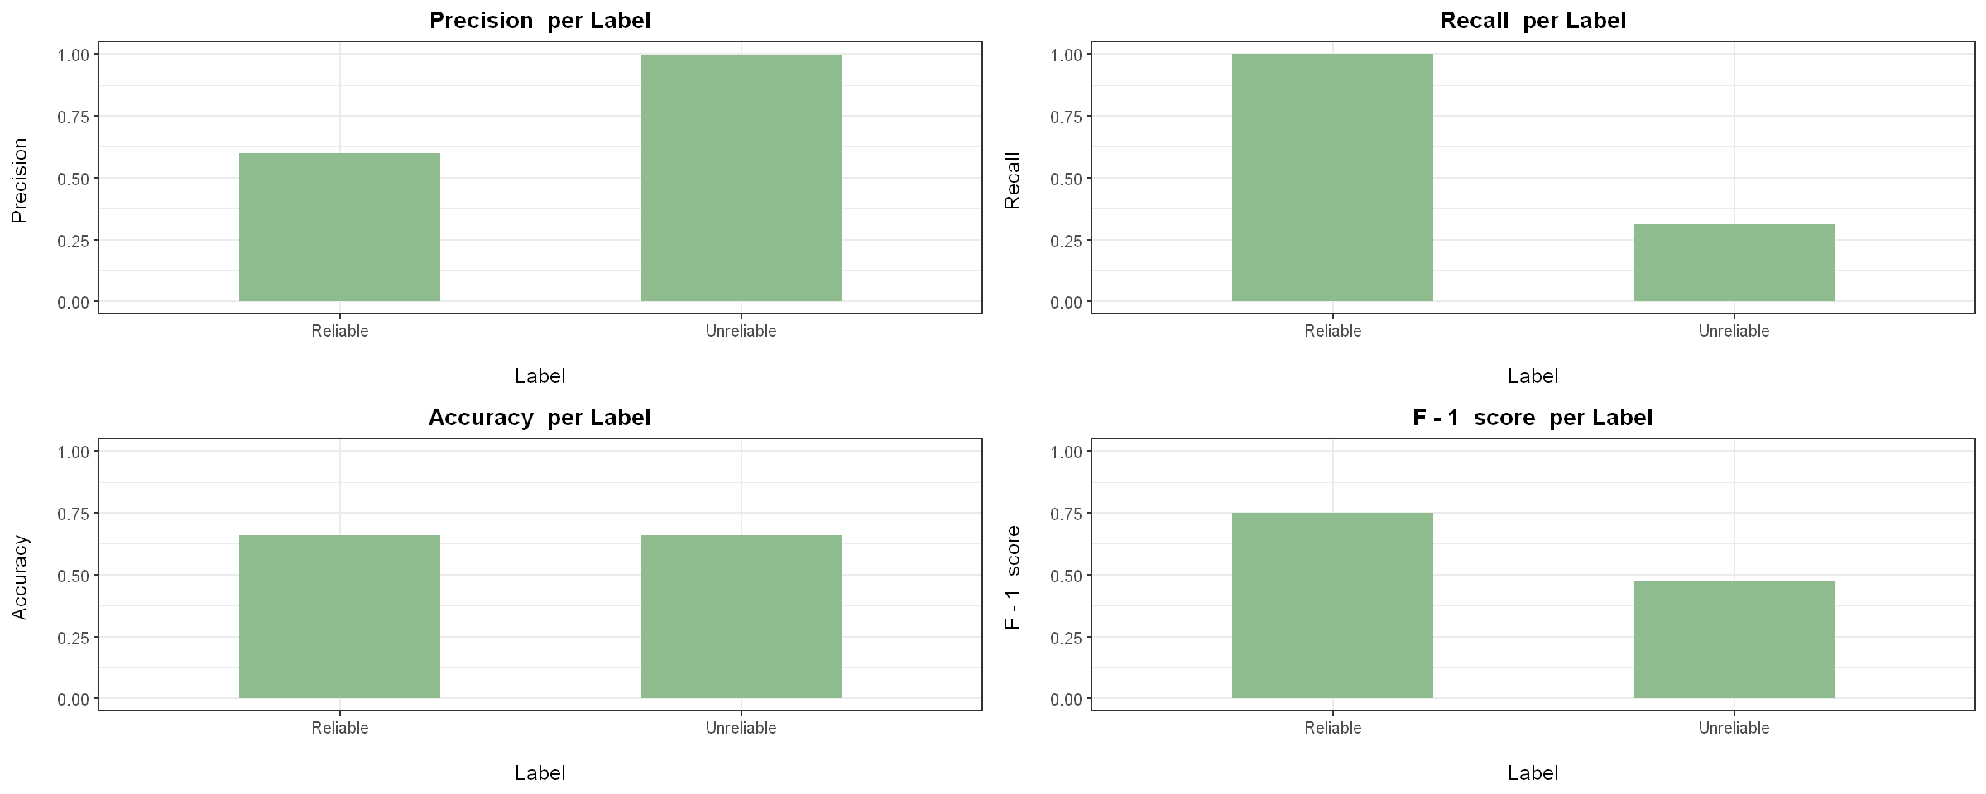
3. FEATURE SELECTION: WITH VS WITHOUT
STEM: 1, LEM: 0, FEAT: 1

Slide 10
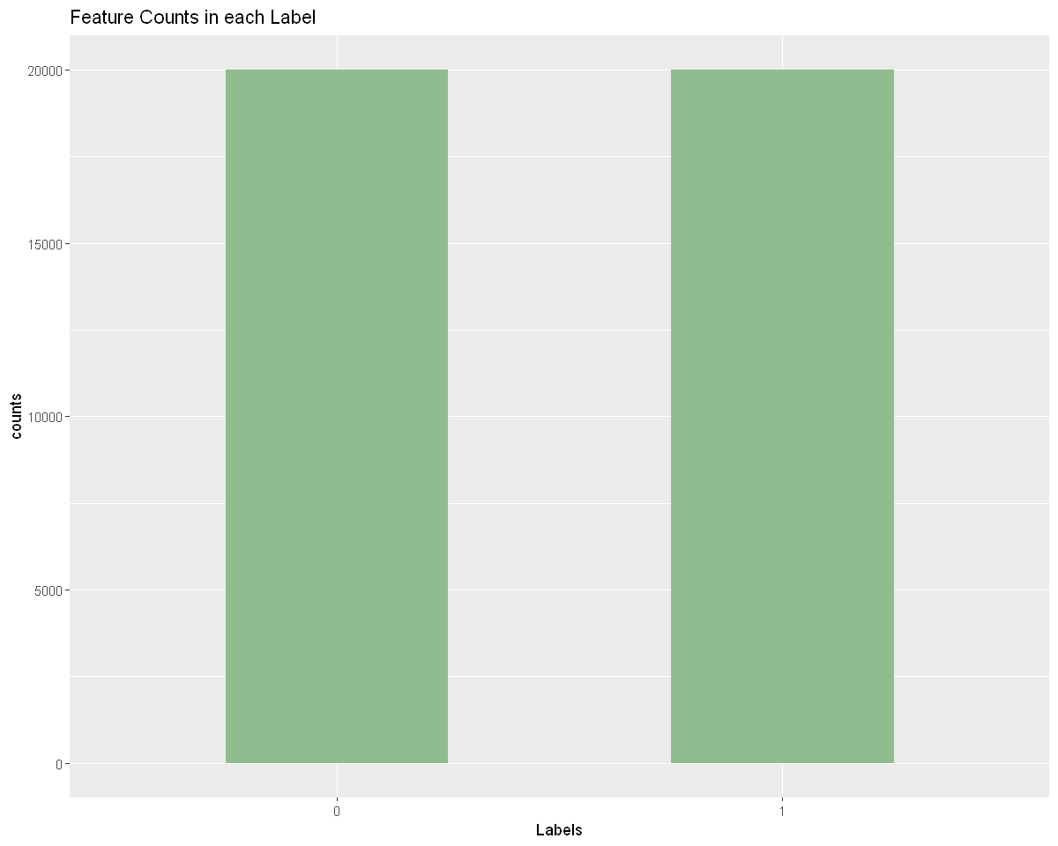
4. Keeping ties: WITH VS WITHOUT
TIMING
STEM: 1, LEM: 0, FEAT: 1, TIES: 0, TOP_K: 500
1.8 seconds

Slide 11
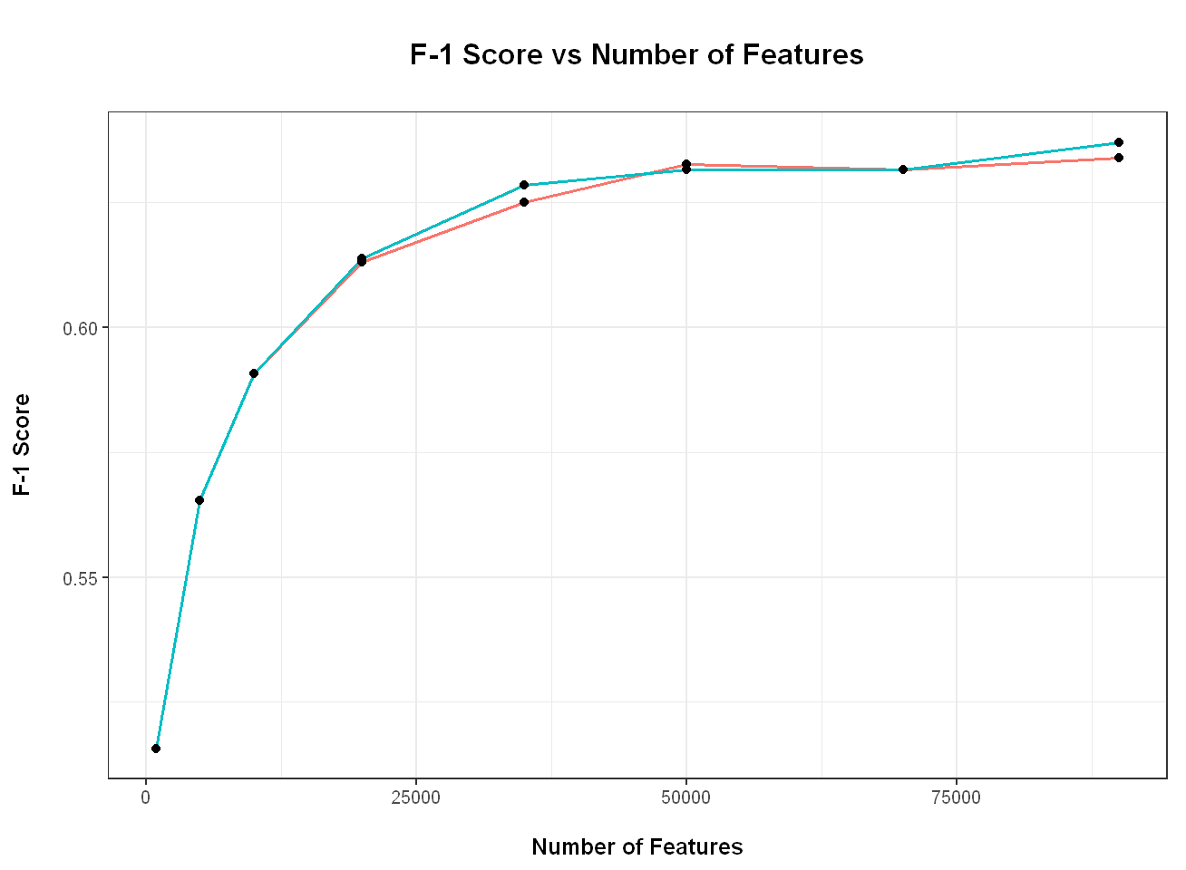
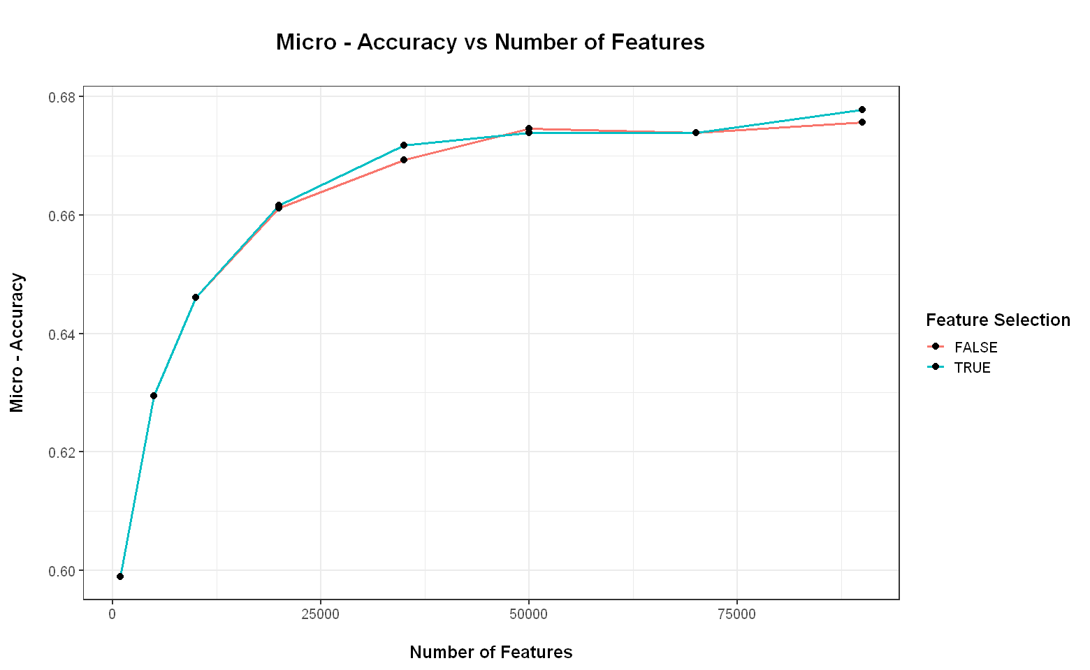
4. Keeping ties: WITH VS WITHOUT
STEM: 1, LEM: 0, FEAT: 1, TIES: 0
Keep Ties

Slide 12
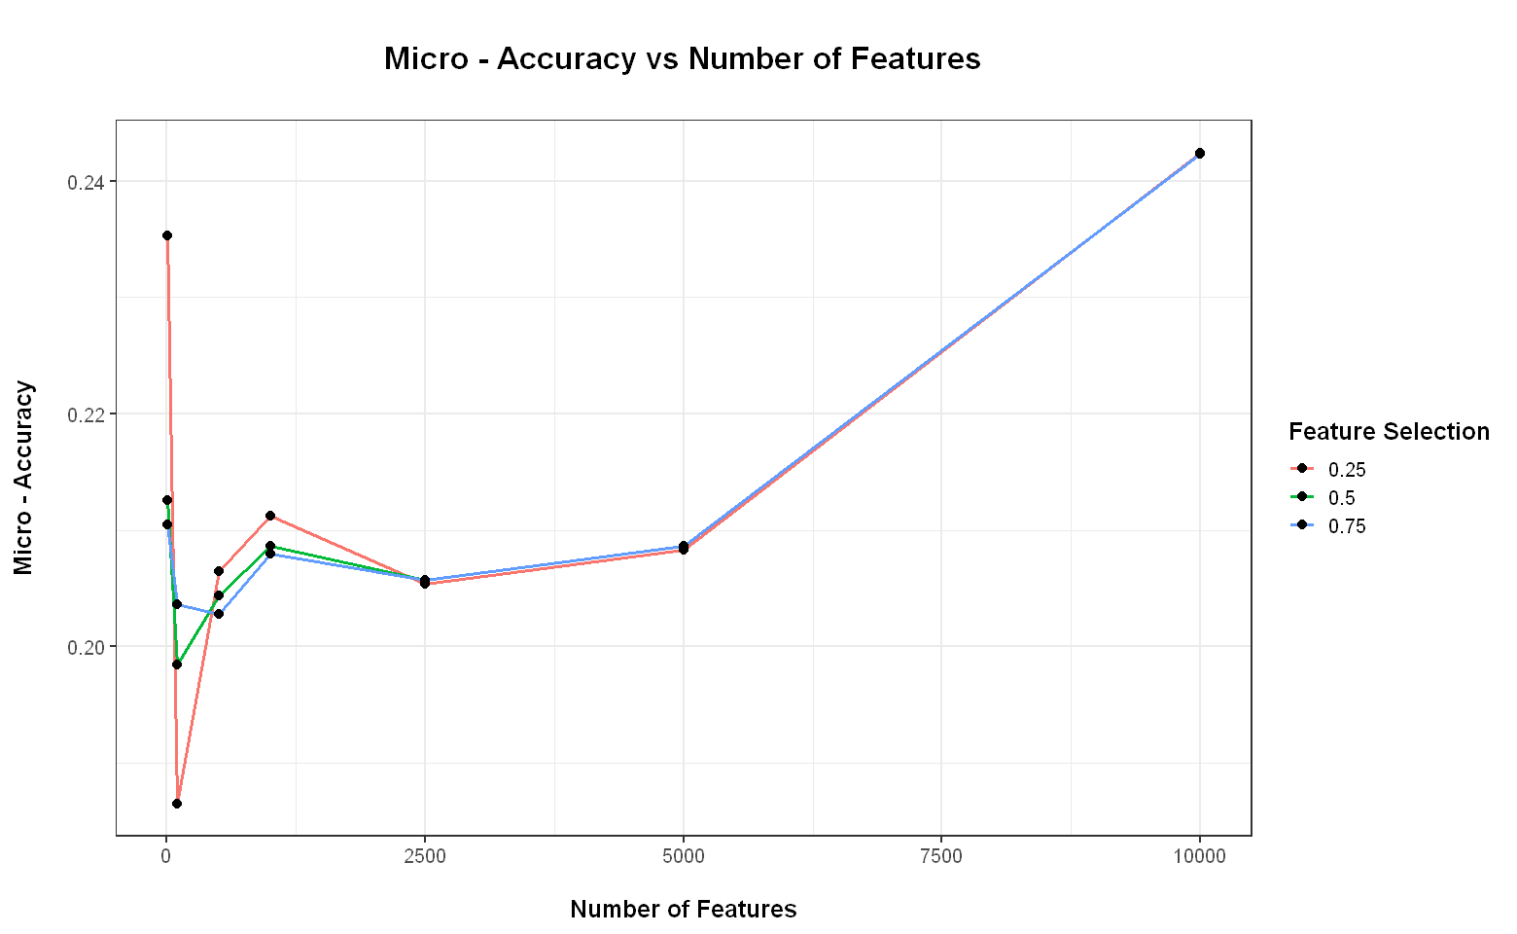
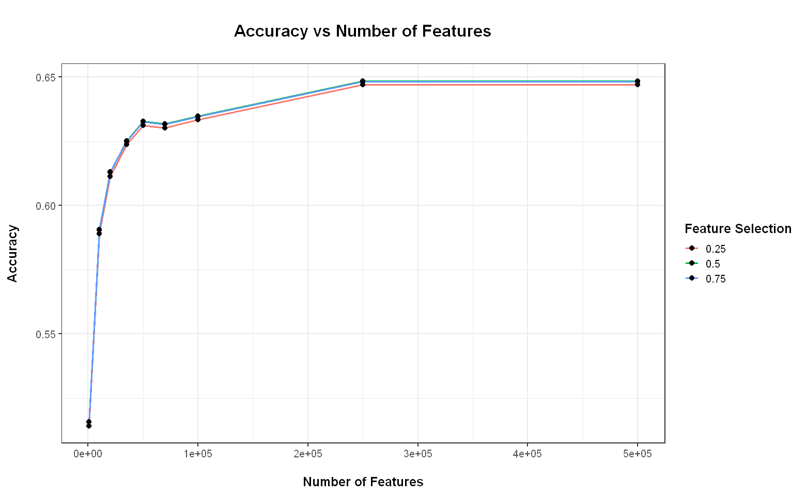
REMOVE PERCENTAGES
Dataset 1
Dataset 2

Slide 13
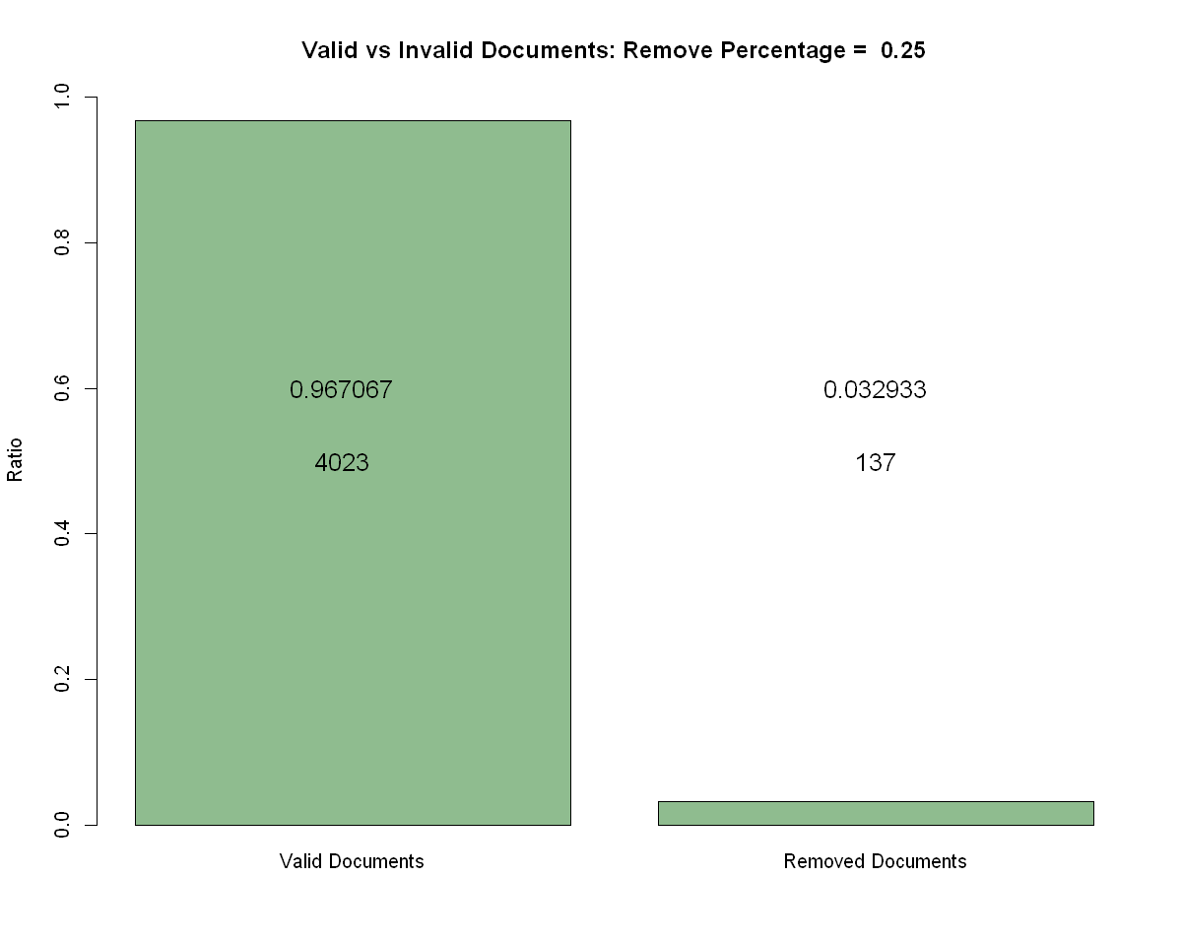
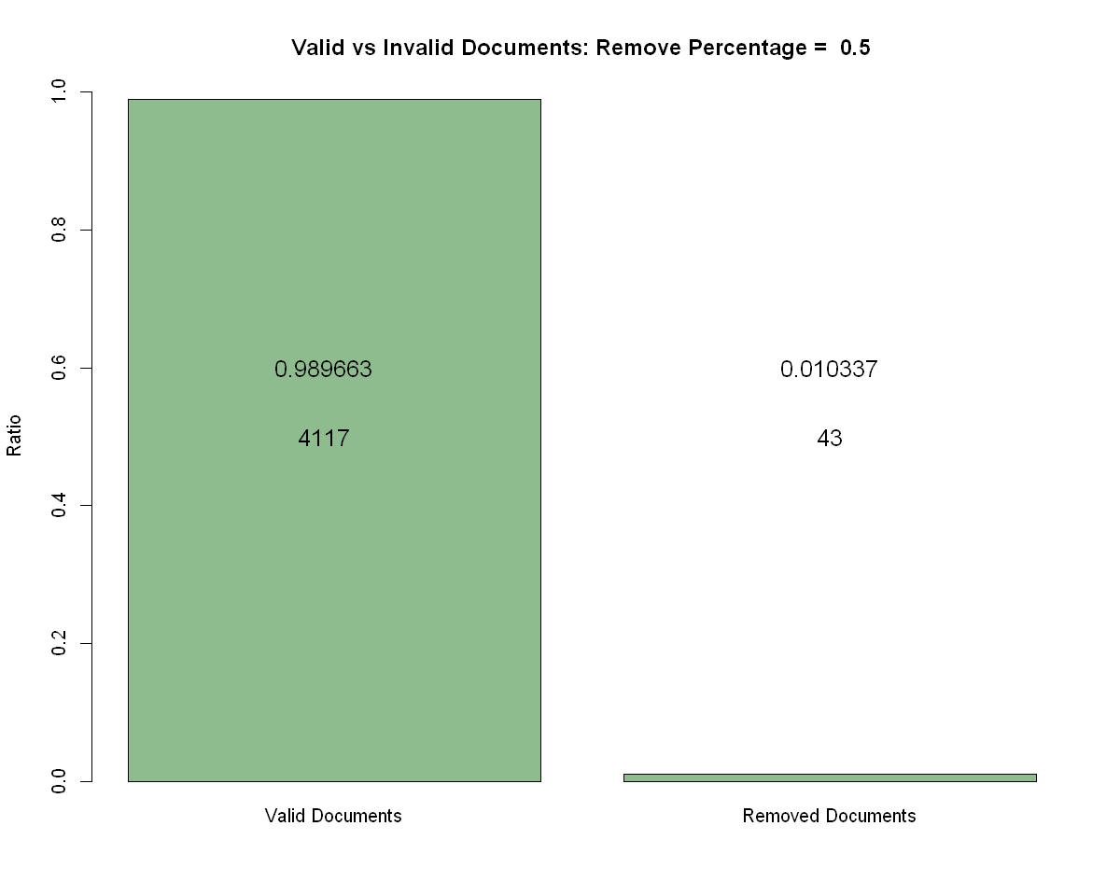

DOCS REMOVED (DATASET 2)

Slide 14
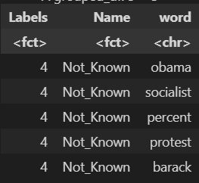
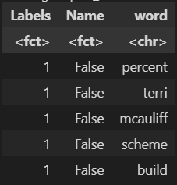
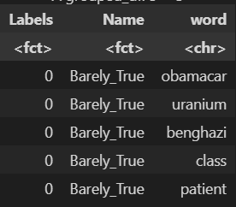
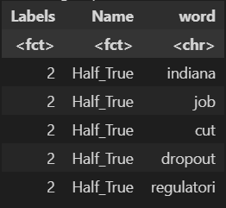
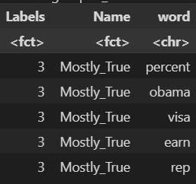
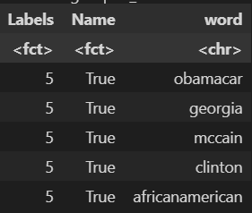
Most occurring words per label
STEM: 1, LEM: 0, FEAT: 1, TIES: 0

