Slide 1
reference slides

Slide 2
i. PROBLEM AND APPROACH OVERVIEW
Introduction to Problem
Transformers
General Approach
Challenges Faced
Methods Used

Slide 3
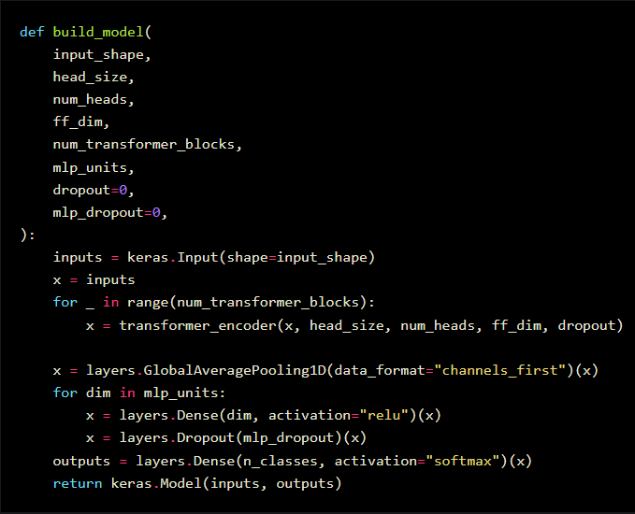
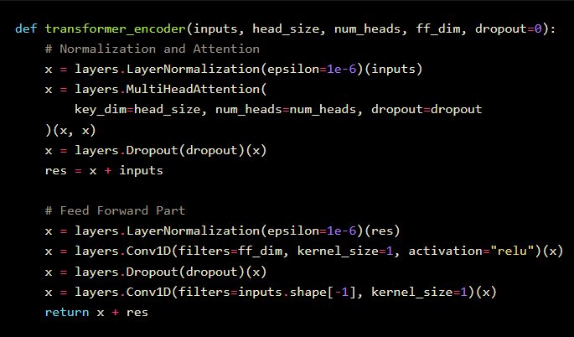
1. TRANSFORMERS, TIMESERIES
Ref: https://keras.io/examples/timeseries/timeseries_transformer_classification/

Slide 4
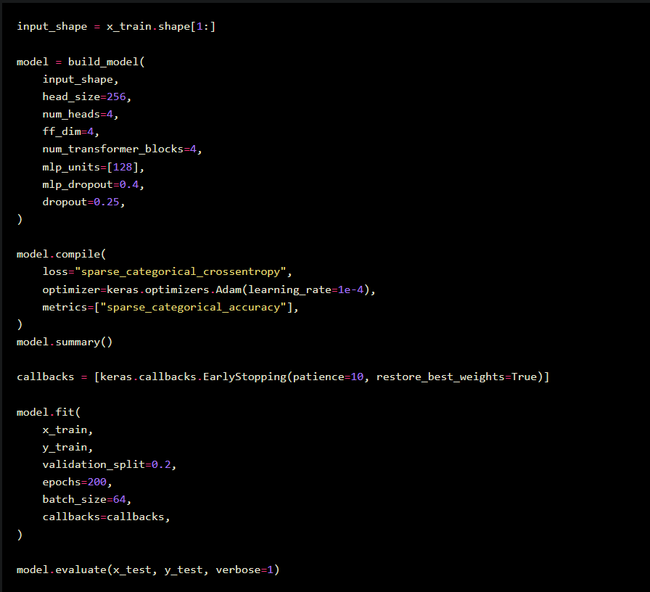
Training and evaluating model

Slide 5
ii. DATA PREPARATION
Structure of Data
MP vs MP-Less Analysis
Preparing Data

Slide 6
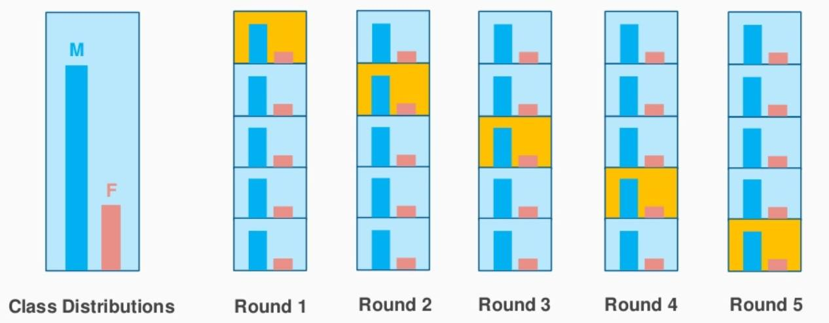
Stratification while validation
Stratification while validation

Slide 7
Mp vs mp-less datasets
Training window length: 320 T (alfven)
Prediction window length: 100 t (alfven)
Prediction window length: 20 t (alfven)
Head_size: 256
Num_heads: 1
Ff_dim: 16
Kernel_size: 3
Num_transformer_blocks: 1
Dropout: 0.1
Activation: relu
No dense layers
Epochs: 50
Repetitions: 10

Slide 8
iii. Validation among model architectures
Schemes of Architectures
Grid Search on Models
Why Transformers
Plots and Results

Slide 9
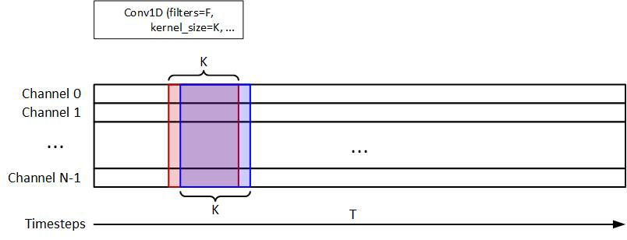
Convolution 1D model

Slide 10
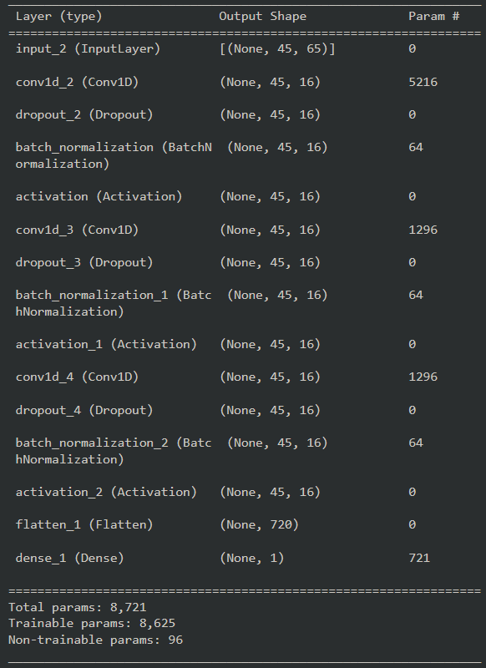
CNN architecture

Slide 11
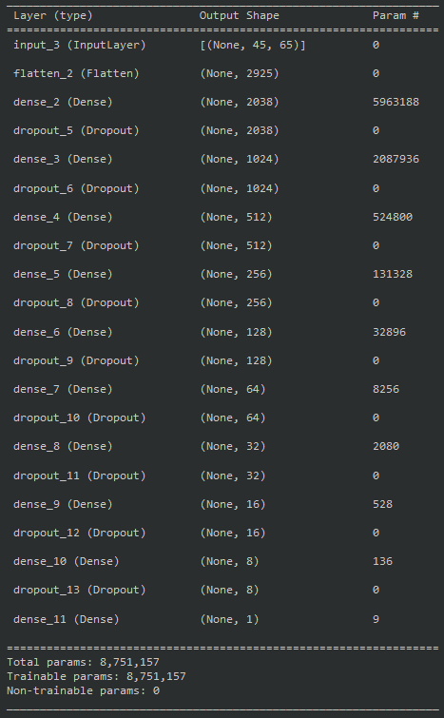
DNN architecture

Slide 12
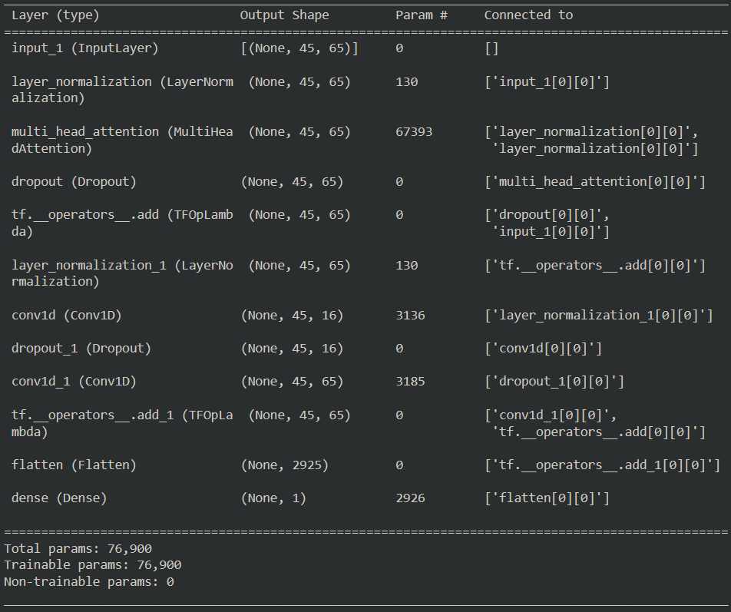
transformer architecture

