Slide 1
Anomaly detection and predictive maintenance for industrial devices
Members:
Davide Checchia - 2078232
Jelin Raphael Akkara - 2072064
Kiamehr Javid - 2084294
GROUP-18

Slide 2
OUTLINE
SETTING UP THE VIRTUAL MACHINES
INTRODUCTION TO THE PROBLEM
TIME NORMALIZATION
TASK 1: ANOMALY DETECTION
TASK 2: CORRELATIONS WITH TEMPERATURE
TASK 3: ALARM CORRELATIONS AND PREDICTION
BENCHMARKING

Slide 3
i. SETTING UP THE VIRTUAL MACHINES
INSTALLING LIBRARIES, ESTABLISHING CONNECTION
PREPARING DASK CLUSTERS
PREPARING CONNECTION TO BUCKETS

Slide 4
INSTALLING LIBRARIES, ESTABLISHING CONNECTION
Installing the Dask library is required, from github repository and pip install command
SSH Tunneling to connect ports 8888 from local machines to 8888 in VM
Connection to VSCode and/or browser based on the forwarding

Slide 5
PREPARING DASK CLUSTERS
Prepare cluster with dask-ssh command for single use, SSHCluster in jupyter for bulk analysis
Forward port 8787 for Dashboard monitoring and data collection

Slide 6
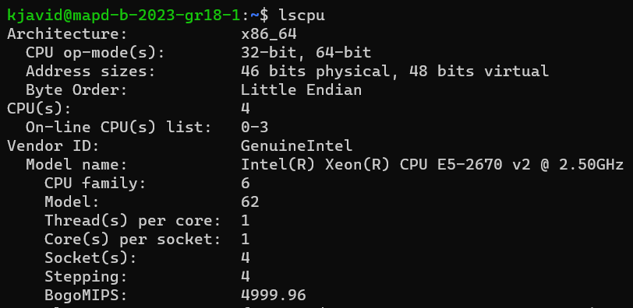
PREPARING DASK CLUSTERS

Slide 7
PREPARING CONNECTION TO BUCKETS
Install boto3 library, set up connection with credentials
Create bucket, put parquet files in a folder, CSV outside of the folder
Code snippet for data downloading

Slide 8
iI. INTRODUCTION TO THE PROBLEM
OVERVIEW OF TASKS
THE DATASET

Slide 9
OVERVIEW OF TASKS
Main Objective: Implement Distributed Analysis with Large Dataset (~5GB)
Preparing Data: Normalizing Time
Task 1: Anomaly Detection, Correlations
Task 2: Correlations
Task 3: Correlations, Prediction

Slide 10
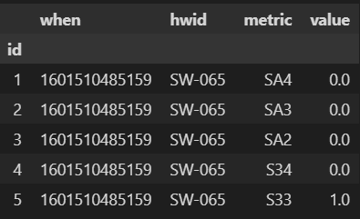
THE DATASET
The data is collected for four devices (refrigerators), each recorded for around 4-6 months, spanning a period from 1 October, 2020 to 31 March, 2021.
Each device is measured with 132 metrics, some measured more frequently than others. The data types of the metrics vary: Integers, decimals and alarms.
Alarms are recorded as 16 bit integers – the 16 bits corresponding to 16 different sensors.

Slide 11
III. Time normalization
OBTAINING TIME INTERVAL
IMPLEMENTING MAP-REDUCE
GROUPING AND AGGREGATION

Slide 12
OBTAINING TIME INTERVAL
Main Objective: Find optimal time interval and group dataframe in equally spaced intervals.
Approach: For a given time interval, we check the percentage of occurrence of each metric per bin. If most metrics occur with a desired average occurrence (say 97%), we accept the time interval size.
Implementation: In order to parallelize the code, we use the map-reduce framework.
Mapping Phase: For each partition, we define a pandas dataframe that records the presence of each metric in each bin.
Reduce Phase: Going through pairs of partition results, we combine the two dataframes into one by applying the logical OR function. At the end of this phase, we obtain a final dataframe with updated occurrence values for each bin.
Optimal Value(s): 200 seconds for 97% occurrence, 600 seconds for 98% occurrence

Slide 13
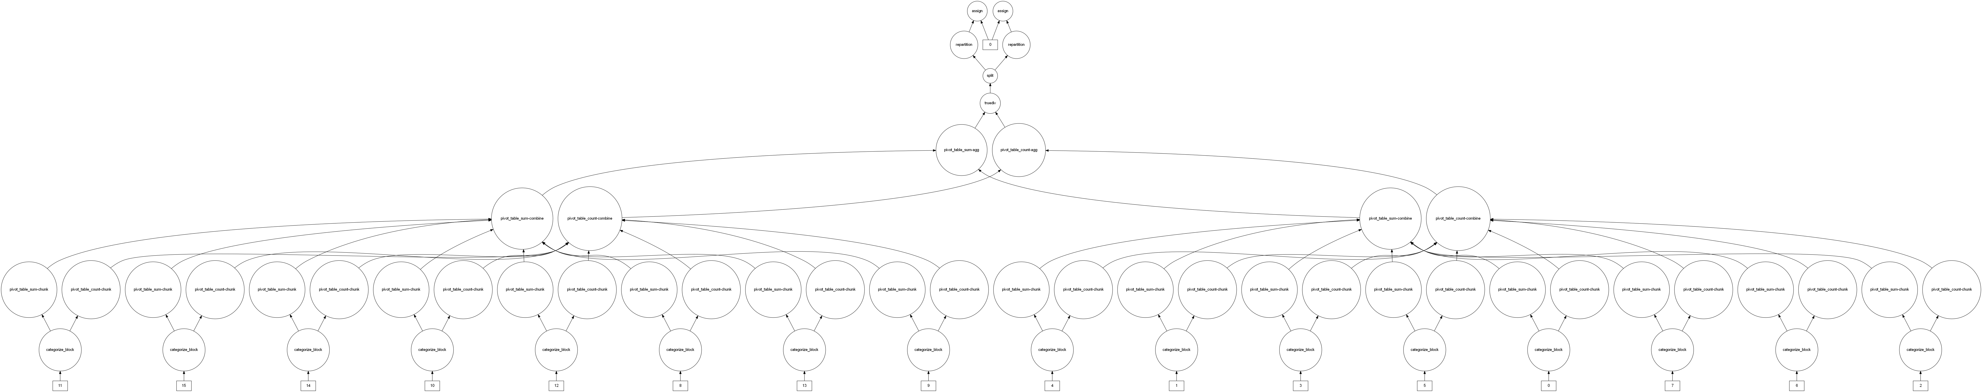
IMPLEMENTING MAP-REDUCE
DASK DATAFRAME
DELAYED OBJECTS
DASK BAG WITH DELAYED OBJECTS
FOLD

Slide 14
IMPLEMENTING MAP-REDUCE
DASK DATAFRAME
DELAYED OBJECTS
DASK BAG WITH DELAYED OBJECTS
FOLD

Slide 15
GROUPING AND AGGREGATION
Once we have the optimal time interval size, we move on to group the metrics so that the dataframe has equally spaced readings.
We define custom aggregation functions for different datatypes:
For integers: We take the maximum
For decimals: We take the mean
For alarms: We convert the integer value to its corresponding binary bits, and consider the logical OR of its 6th, 7th, 8th bits.

Slide 16
III. TASK 1: ANOMALY DETECTION
APPROACH USED
IMPLEMENTATION
RESULTS

Slide 17
APPROACH USED
Main Objective: Detect anomalies occurring in either of four engines, and find correlations to other metrics
Approach: An anomaly is a period of high frequency fluctuations / flips in the binary states of either of the four engines in a device (S117, S118, S169, S170).
Detecting a flip:
All four engines are considered as one system.
Assign an integer value to the combined binary states of the engines.
A change in the integer value signifies a flip in either of the engines’ states.
Detecting an anomaly:
Dynamic Window: Use a dynamic window to capture closely occurring flips.
Anomaly Threshold: Define a threshold to classify n number of flips as an anomaly event.

Slide 18
IMPLEMENTATION
This was implemented using a map-reduce framework:
Mapping Phase: For each partition, using the dynamic window and anomaly threshold parameters, anomalies are classified and the time periods noted.
Reduce Phase: Combines a pair of dataframes and returns a cleaned version. Cleaning includes removing duplicate time ranges, time ranges that may fall inside others and removing overlaps.
For correlations, we compute the resulting dataframe to pandas and calculate the linear and non-linear correlations (Pearson, Spearman, Kendall correlations).
It is possible to find correlations in Dask, but it is only possible to find the linear correlations. Also, pivoting is costly in here.

Slide 19
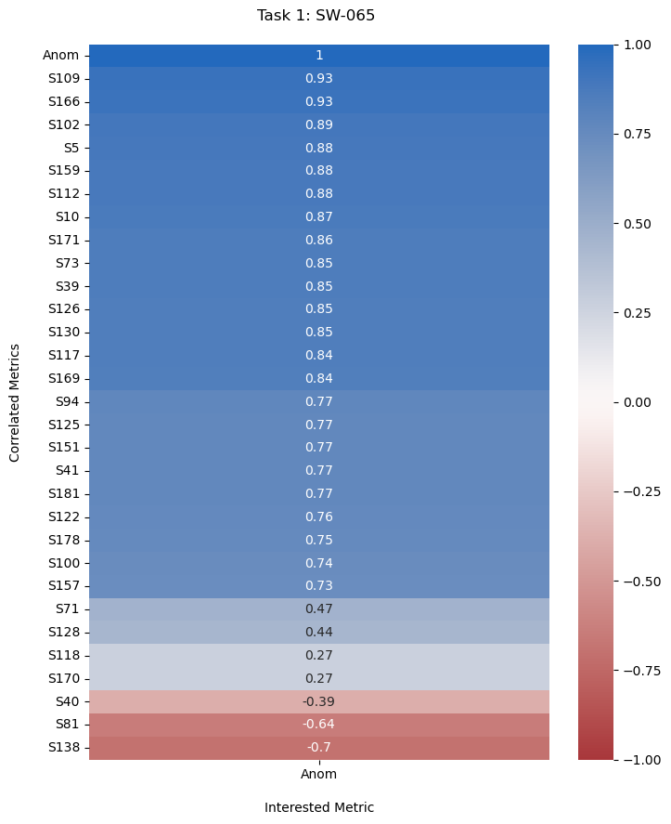
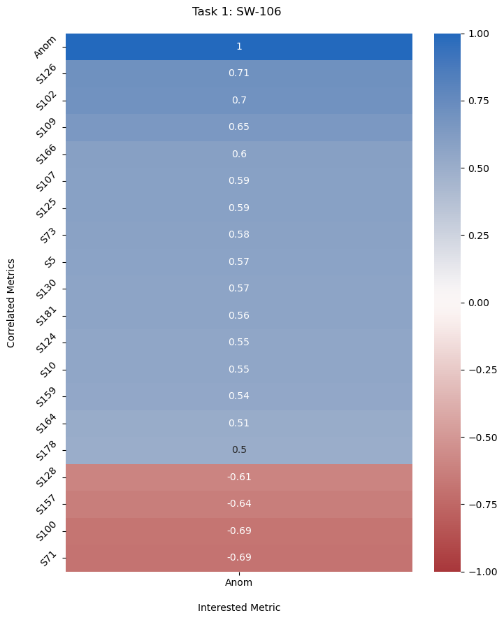
RESULTS
Correlation: Pearson, Threshold: 20, Window Size: 1000 minutes
S109: Discharge Temperature, C1,1
S166: Discharge Temperature, C1,2
S102: Discharge Pressure Circ 1
S126: Pressure Ratio Circ 1

Slide 20
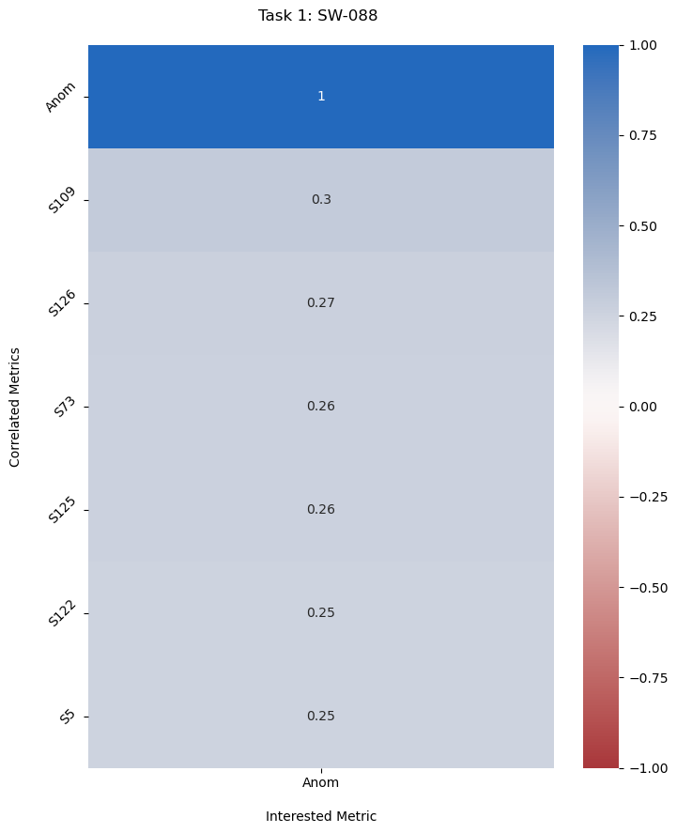
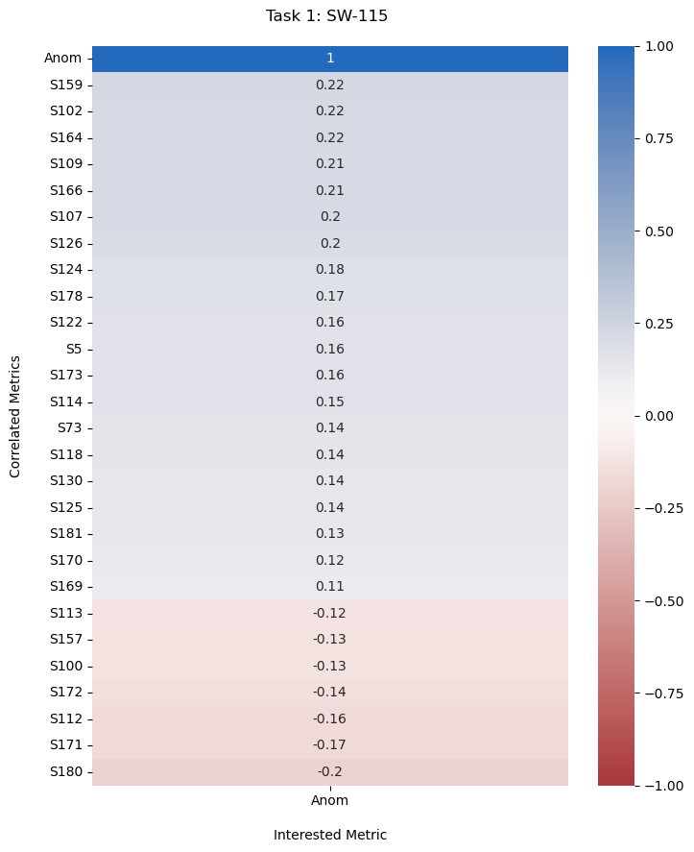
RESULTS
Correlation: Pearson, Threshold: 20, Window Size: 1000 minutes
S109: Discharge Temperature, C1,1
S159: Discharge Pressure Circ 2
S102: Discharge Pressure Circ 1
S126: Pressure Ratio Circ 1

Slide 21
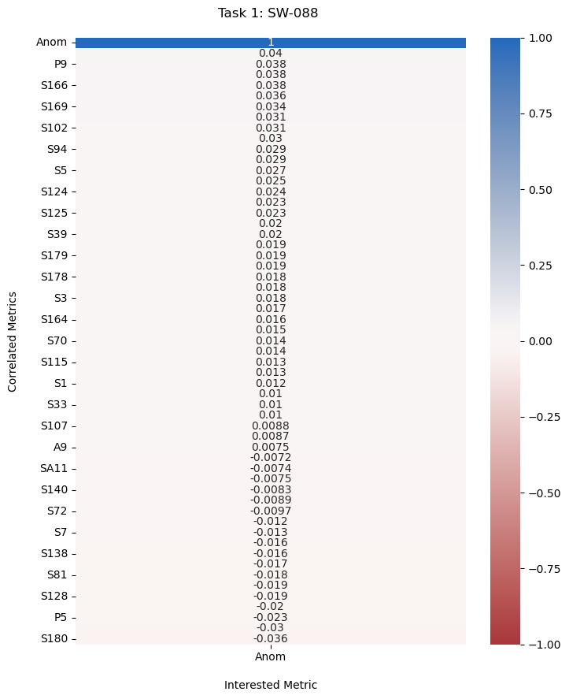
RESULTS: Whole
Correlation: Pearson, Threshold: 20, Window Size: 1000 minutes

Slide 22
iv. Task 2: Correlations with temperature
OBJECTIVE AND APPROACH
RESULTS

Slide 23
OBJECTIVE AND APPROACH
Main Objective: Calculate correlations of two metrics (S125, S118) , referring to percentage of device loading, against external temperature (S41)
Approach: Using the grouped dataframe (Time Normalized), we filter to the metrics and calculate the correlations.

Slide 24
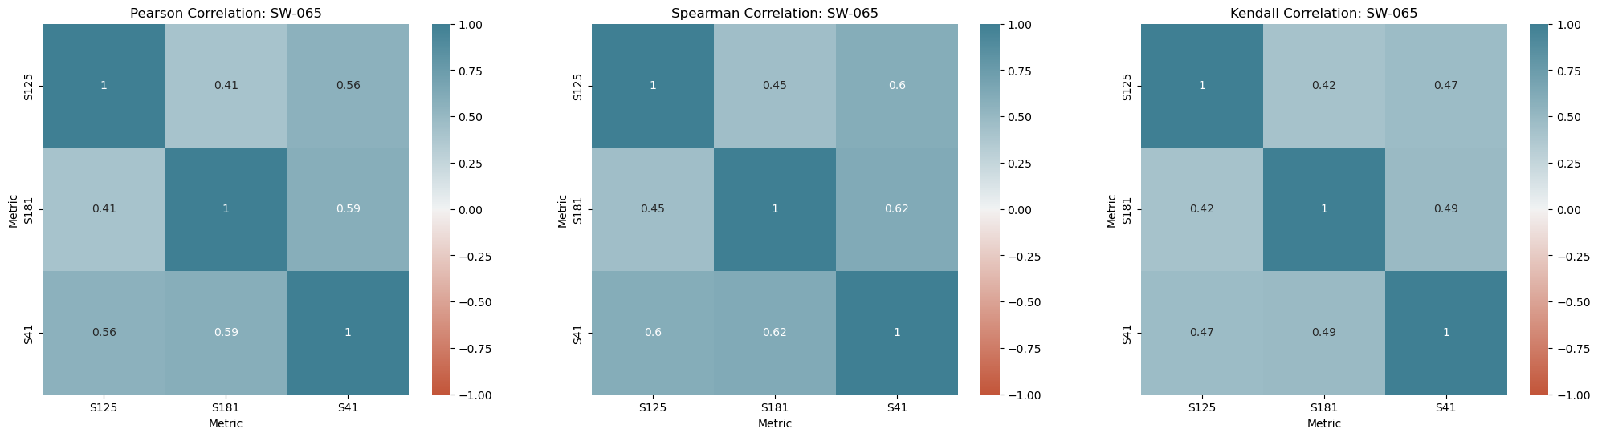
RESULTS: SW-065

Slide 25
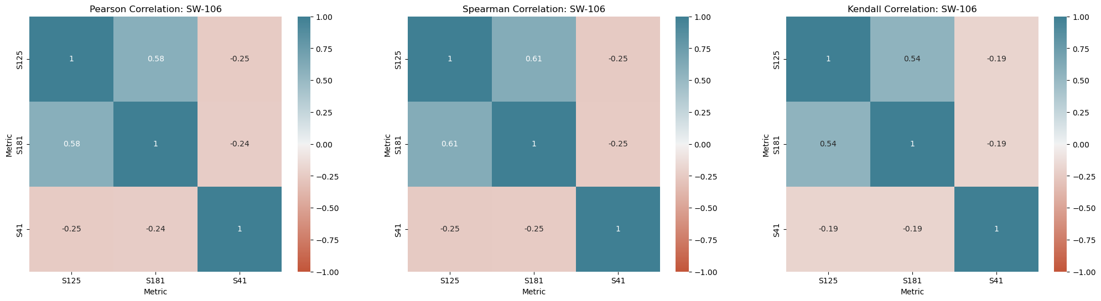
RESULTS: SW-106

Slide 26
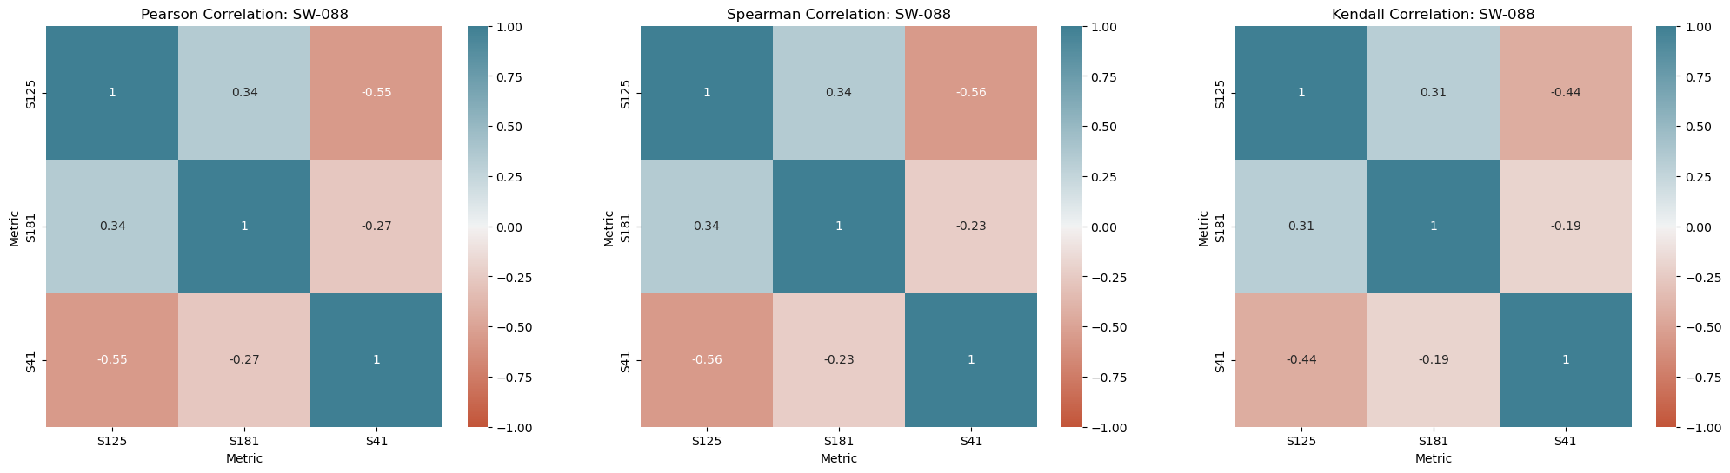
RESULTS: SW-088

Slide 27
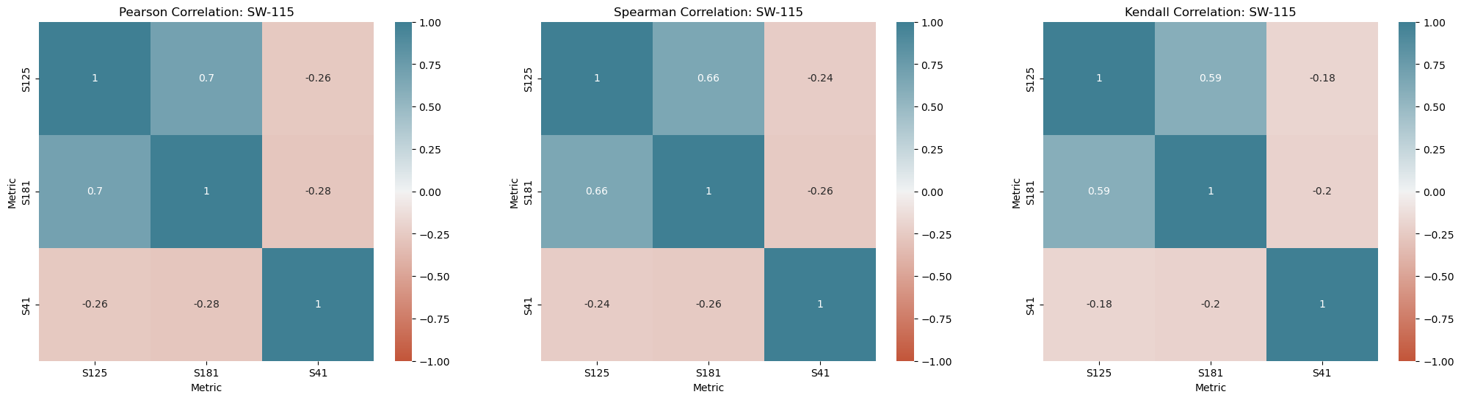
RESULTS: SW-115

Slide 28
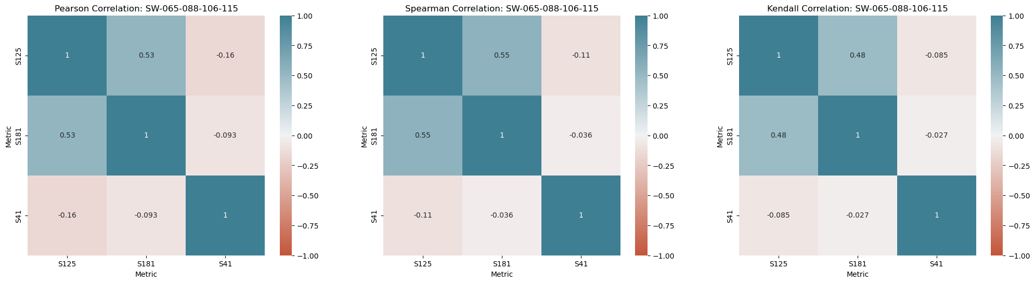
RESULTS: Whole Data

Slide 29
iv. Task 3: aLarm correlations and prediction
OBJECTIVE AND APPROACH
RESULTS

Slide 30
OBJECTIVE AND APPROACH
Main Objective: Find correlations for alarms and develop an algorithm for predicting an alarm state based on previous values of metrics.
Approach:
Correlations: Define a new column, which is the logical OR of the two alarm columns (A5, A9), and get the correlations with respect to the new column.
Prediction: We get the most correlated metrics, and assign weights and thresholds to each of them. The weight is a normalized value that is proportional to the corresponding correlation value. The threshold is obtained by taking the mean of the average values when the alarm is one and zero. This gives a sense of each metric’s position depending on the alarm’s value.

Slide 31
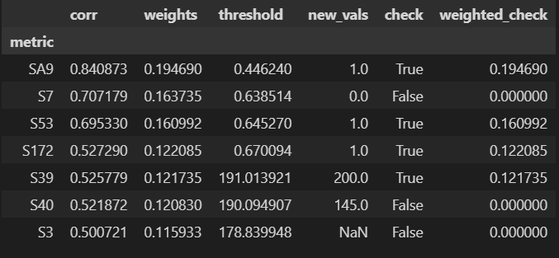

OBJECTIVE AND APPROACH
Prediction Example:
Corr(param_1) = 0.7
Corr(param_2) = 0.68
Corr(param_3) = 0.62
Corr(param_4) = 0.6
Sum(Corr(param)) = 2.6
Probability = $\sum_{i}{{Corr(param}_{i}) ∗{( param}_{i}>{Threshold}_{i}) / 2.6}$

Slide 32
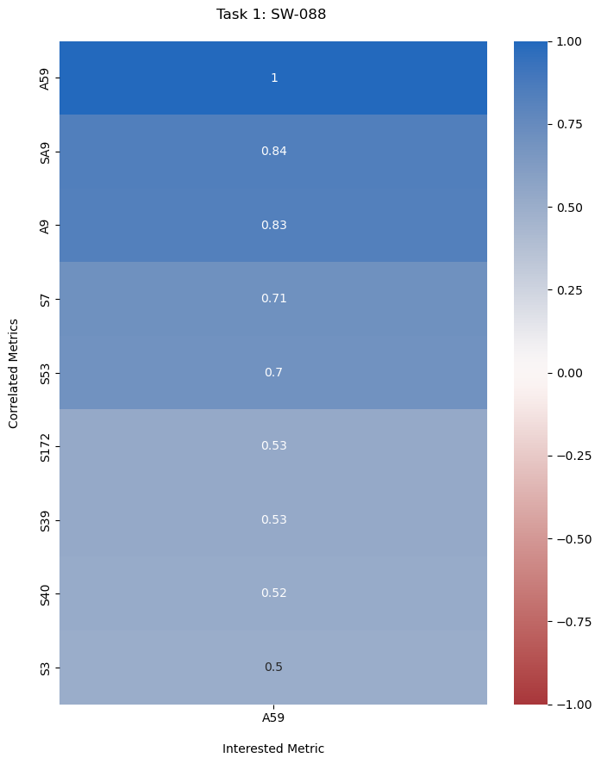
RESULTS: SW-088
The alarms are activated in only one device (SW-088). Out of a total of 1332 alarm measurements (in the whole data), there are only 161 instances where either of the alarms are active, all of which occur in a single device.
All the highly correlated metrics correspond to other alarm metrics. However, there are weak correlations with metrics involving the water flow.
Correlated Metrics:
SA9, S7, S53: Circuit 2 Alarm 1 (status), Blocked Alarm, Comulative Alarm
S172: Chiller Valve Circ 2
S39, S40: Utility Water IN, OUT

Slide 33
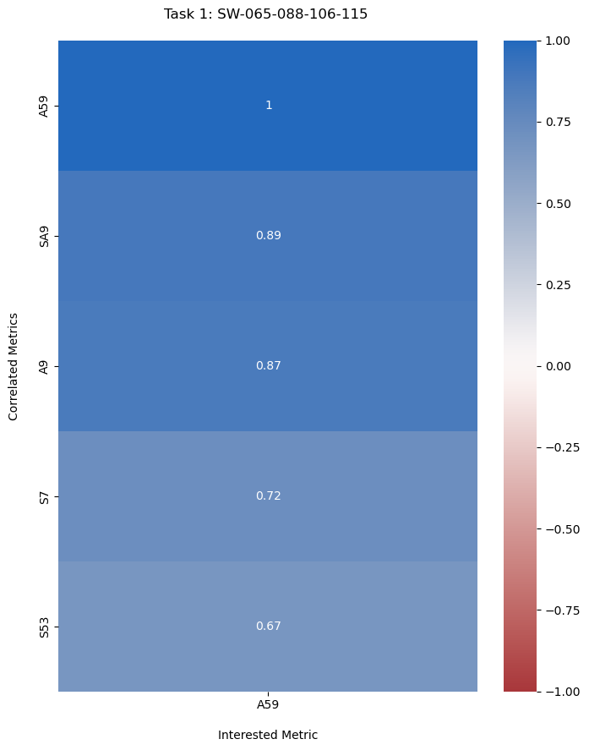
RESULTS: Whole Data
In this case, there are no metrics, other than alarms, with greater than 0.5 correlations.
The lack of correlations from relevant metrics proves, again, that the devices behave separately.
Correlated Metrics:
SA9: Circuit 2 Alarm 1 (status)
S7: Blocked Alarm
S53: Comulative Alarm

Slide 34
v. benchmarking
WORKERS VS PARTITIONS
WORKERS VARYING
PARTITIONS VARYING
TASK STREAMS
WORKER BANDWIDTHS
CSV VS PARQUET

Slide 35
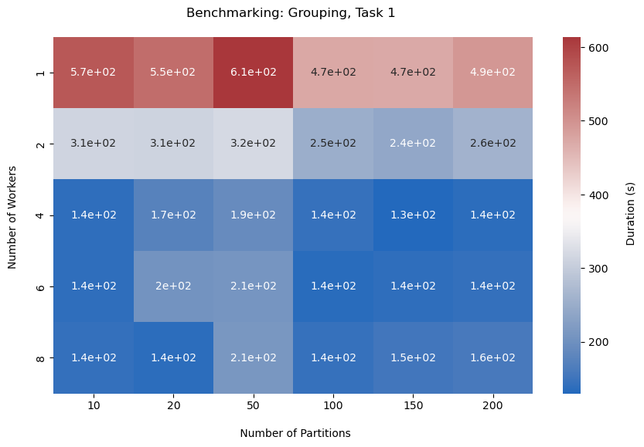
WORKERS VS PARTITIONS

Slide 36
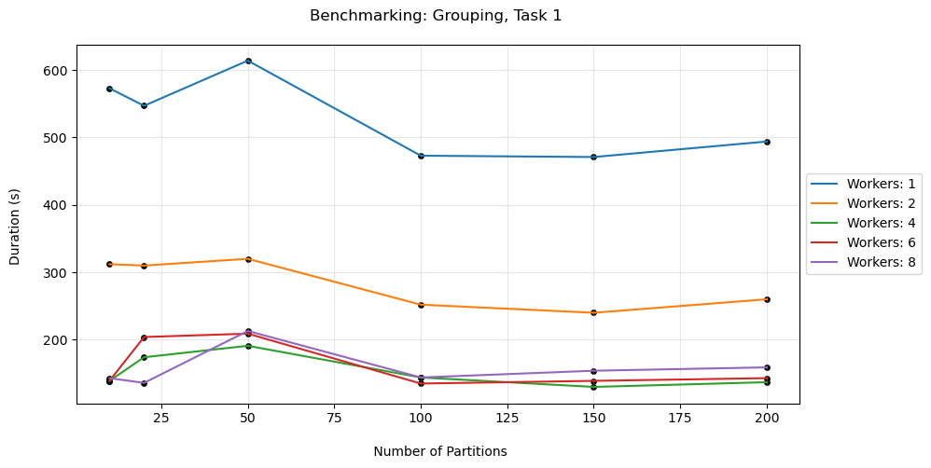
WORKERS VS PARTITIONS

Slide 37
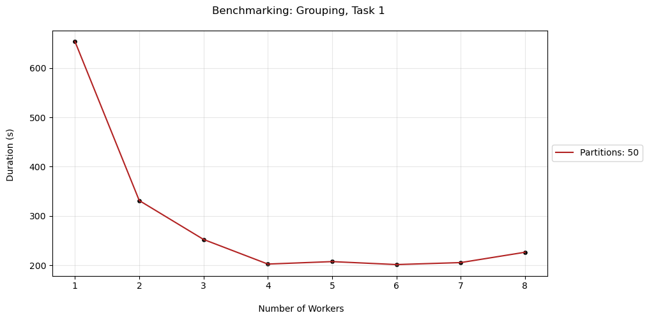
WORKERS VARYING

Slide 38
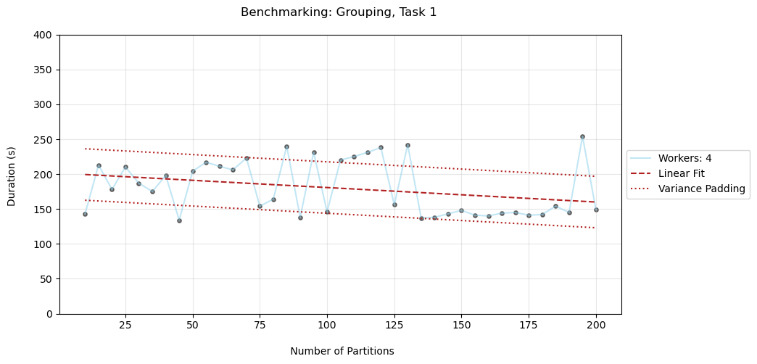
PARTITIONS VARYING

Slide 39
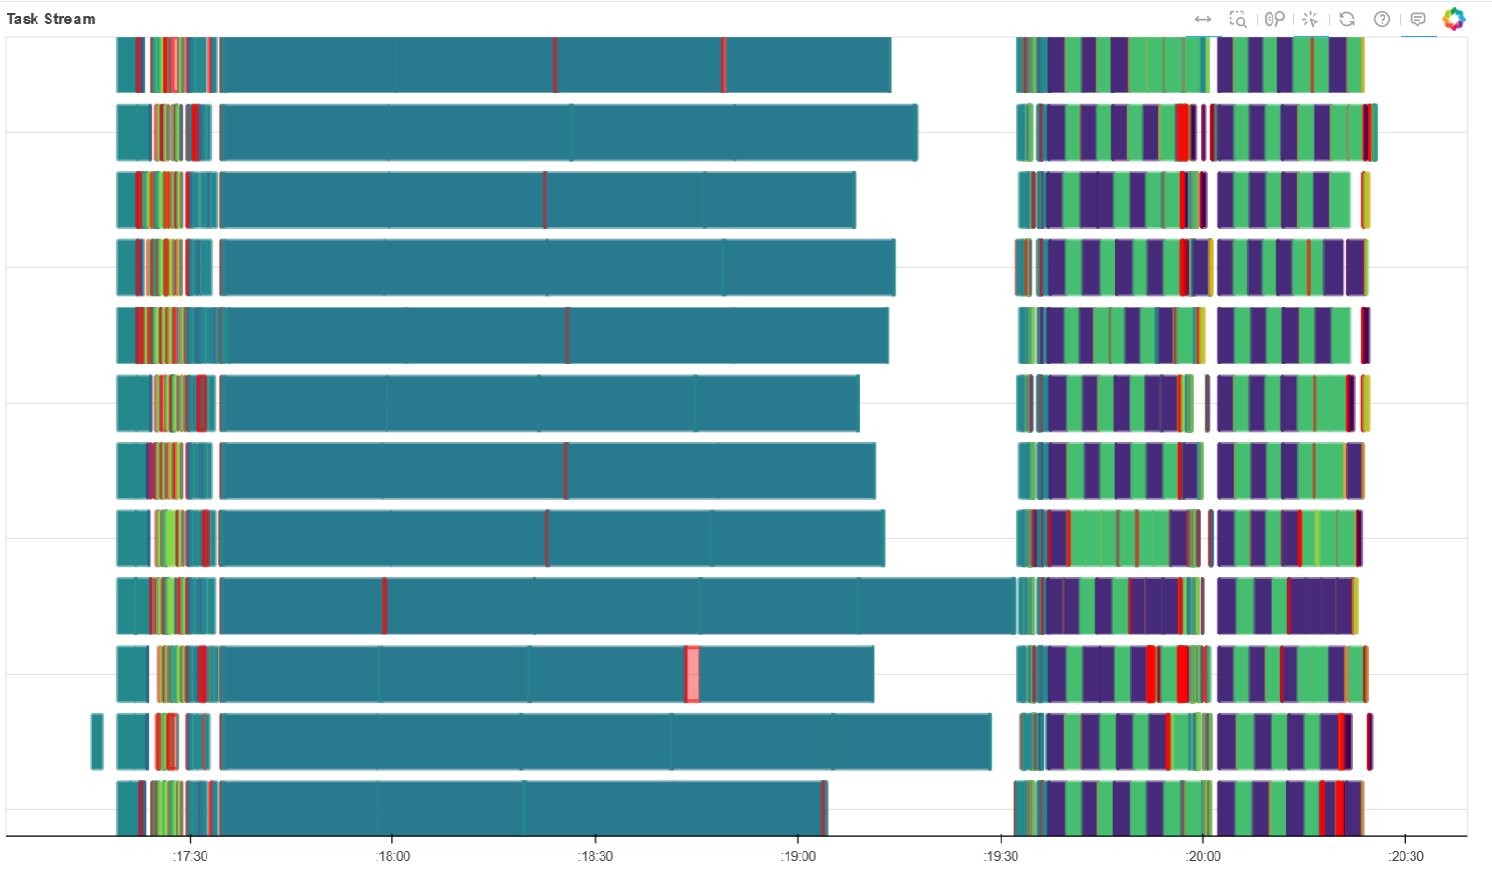
TASK STREAM: NW = 4, NP = 50, Grouping+Task_1

Slide 40
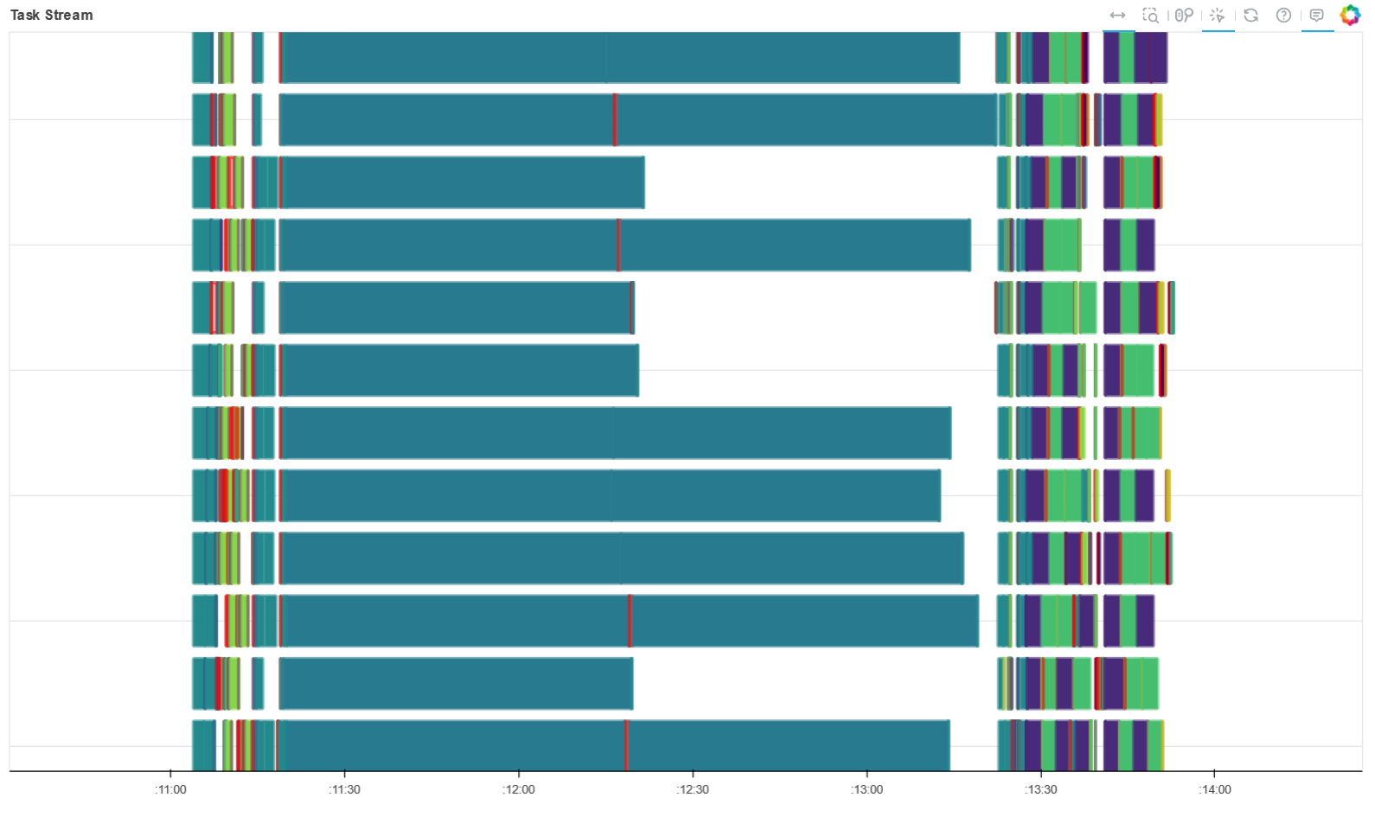
TASK STREAM: NW = 4, NP = 20, Grouping+Task_1

Slide 41
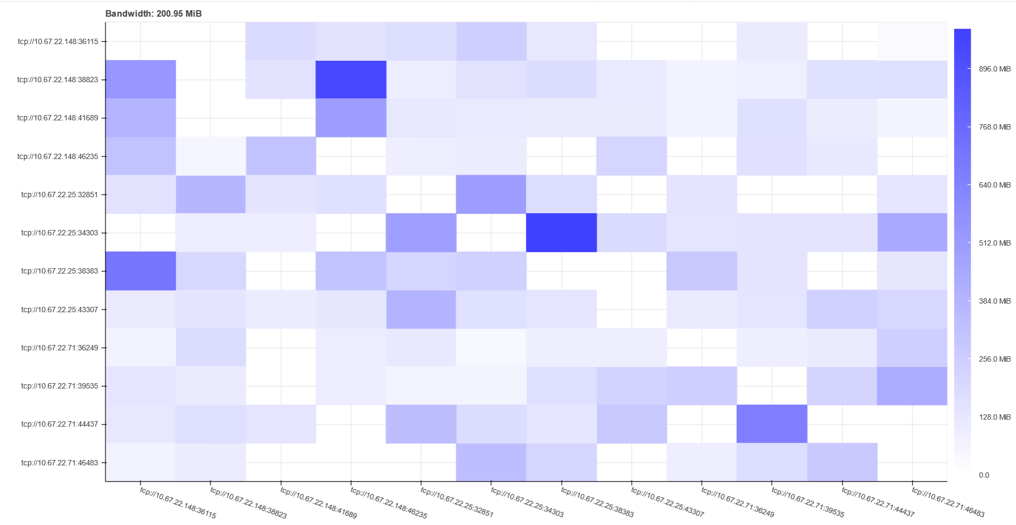
WORKER BANDWIDTHS: NW = 4, NP = 50, Grouping+Task_1

Slide 42
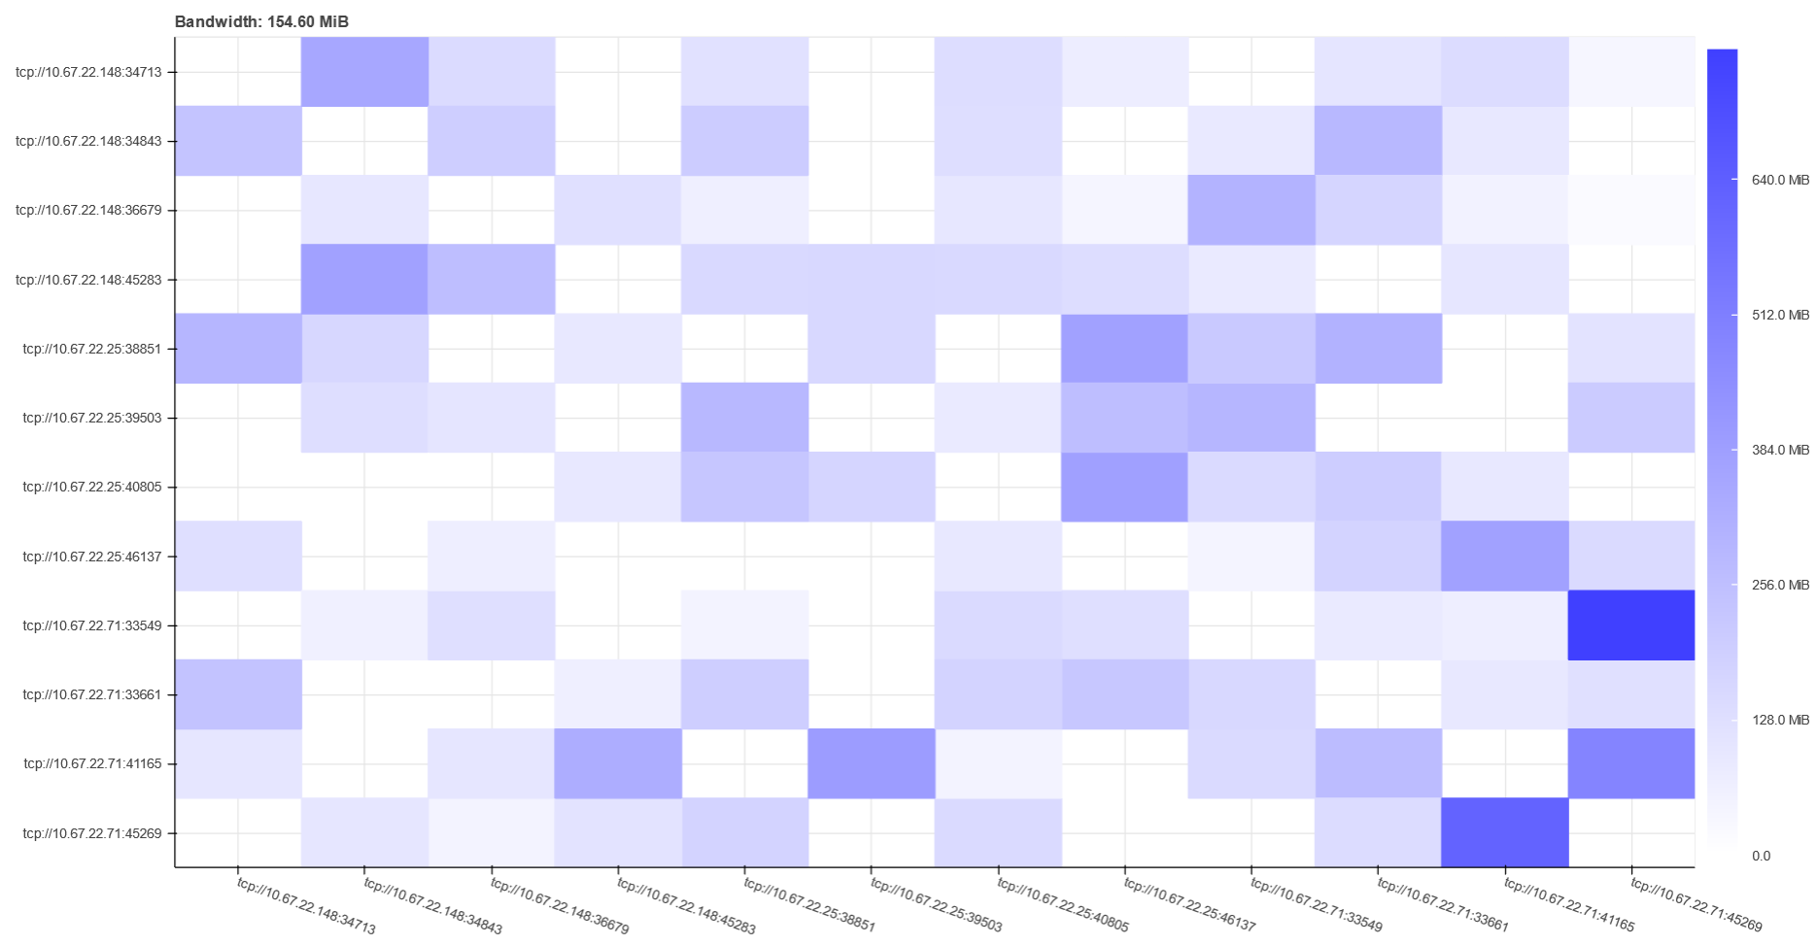
WORKER BANDWIDTHS: NW = 4, NP = 20, Grouping+Task_1

Slide 43
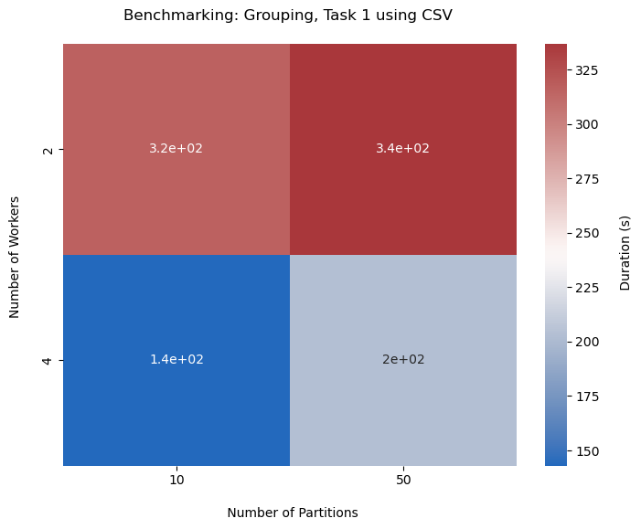
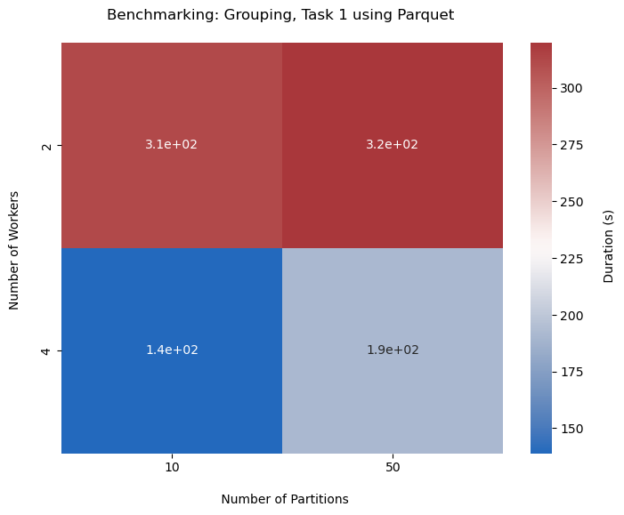
CSV VS PARQUET

Slide 44
THANK YOU
GROUP 18

