Slide 1
Soldering station
Jelle Claes 1 PBA: EA-ICT

Slide 2
Tabel of contents
Libraries
Schematic design
PCB design
Solutions
Case design
Improvements
2

Slide 3
Libraries
Connecting footprints with symbol
Wrong footprint MOSFET
3

Slide 4
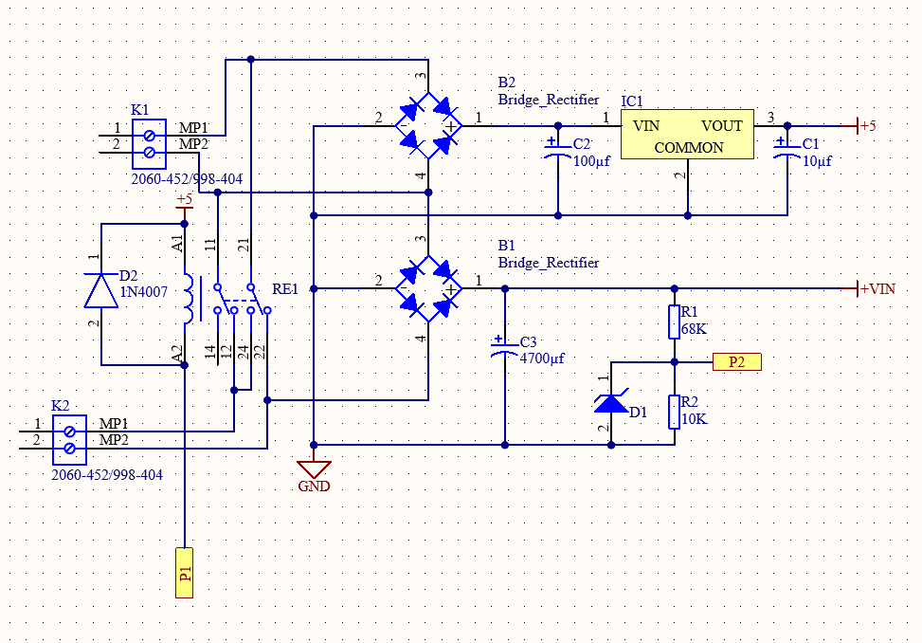
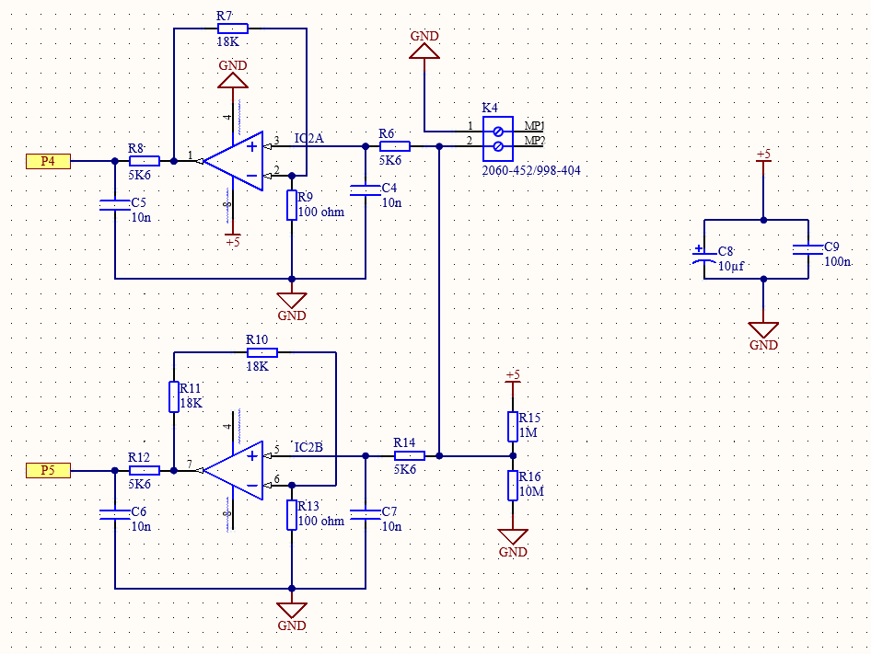
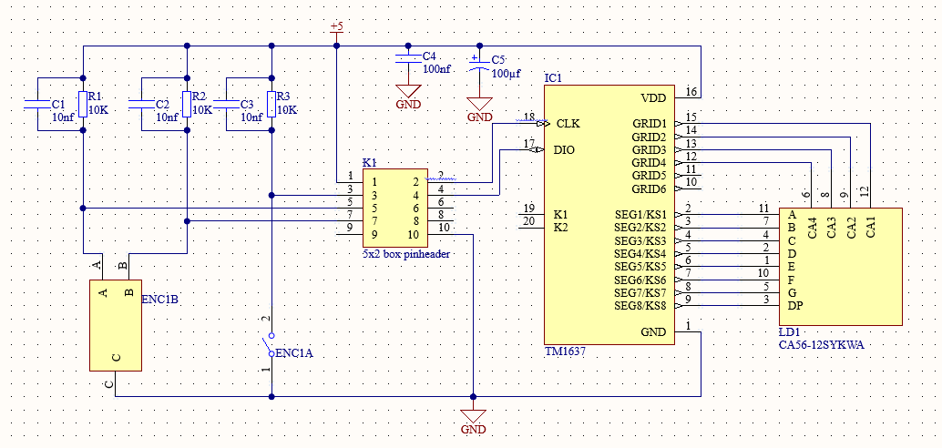
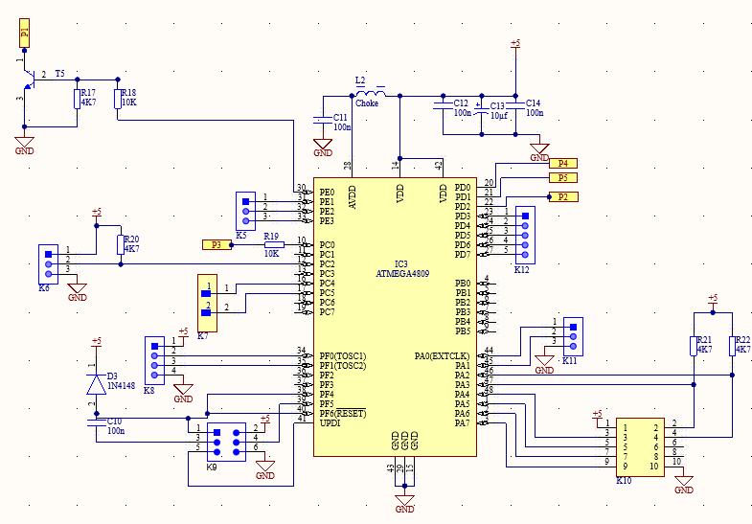
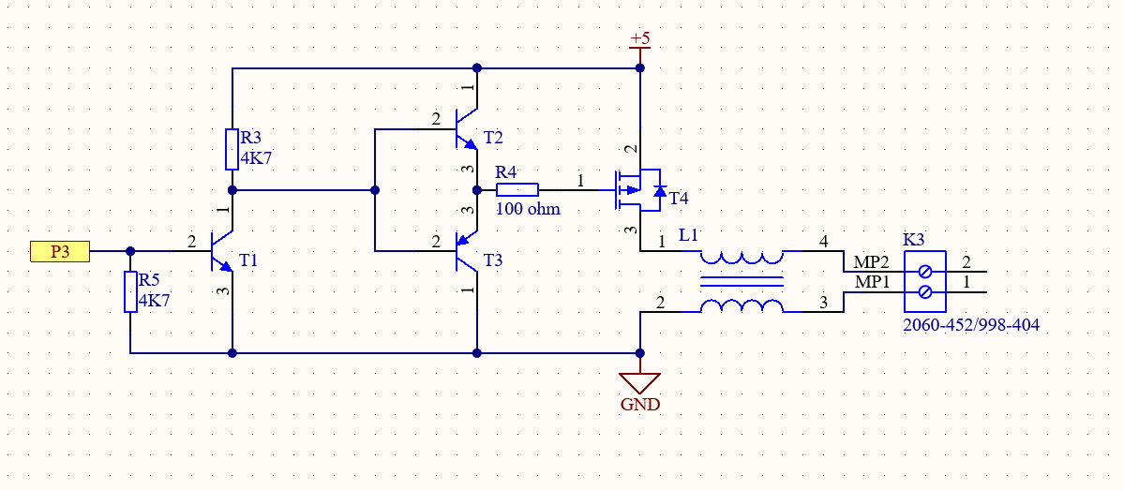
Schematic design
5 different parts:
1. Power Supply
2. PWM (+5V → Vin)
3. Thermocouple
4. CPU
5. Display
4

Slide 5
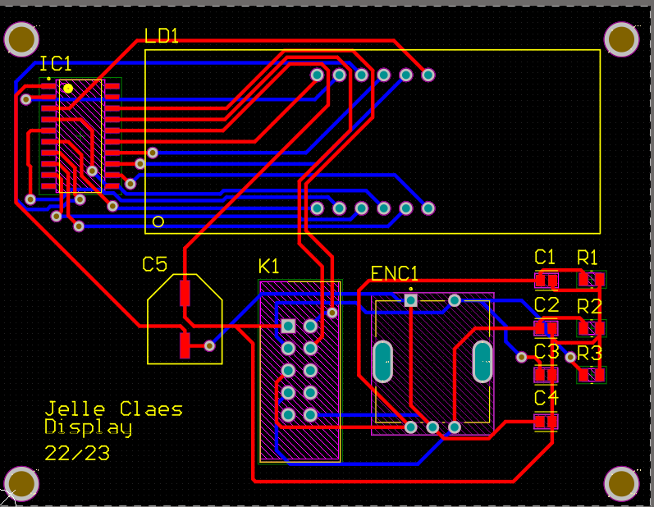
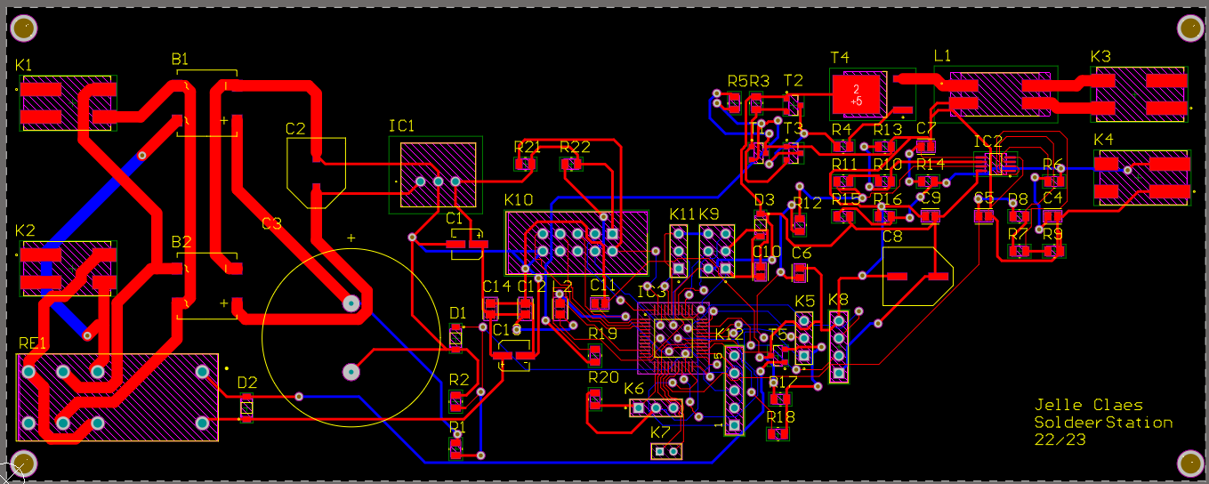
PCB design
2 PCBs
1. Main PCB (wrong footprints)
2. Display
5

Slide 6
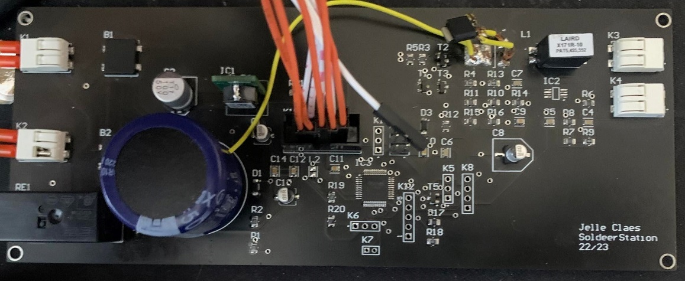
Solutions
Capacitor → Bended leads
MOSFET → Wires
5V to Vin → Scratch and wire
C8 → fitted on wrong footprint
6

Slide 7
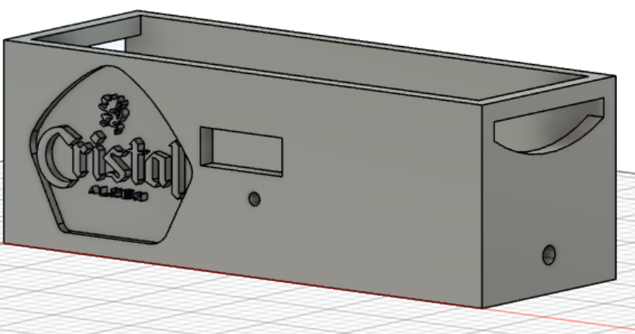
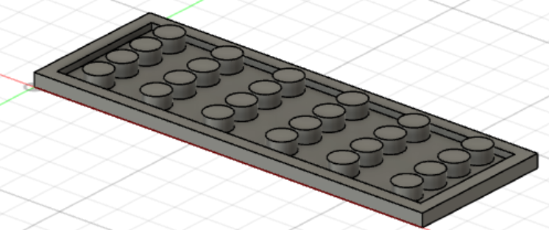
Case design
7

Slide 8
Improvements
Use 2 sides of PCB
Start earlier with case
Careful with size
8

Slide 9
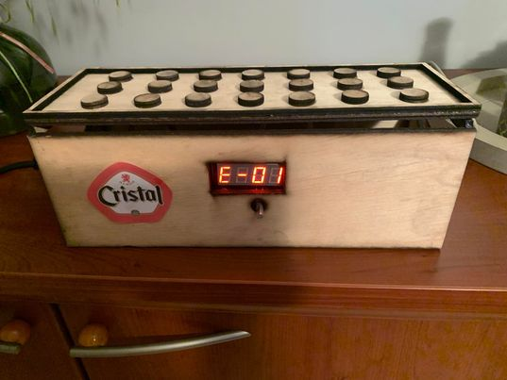
9

